Slide 1
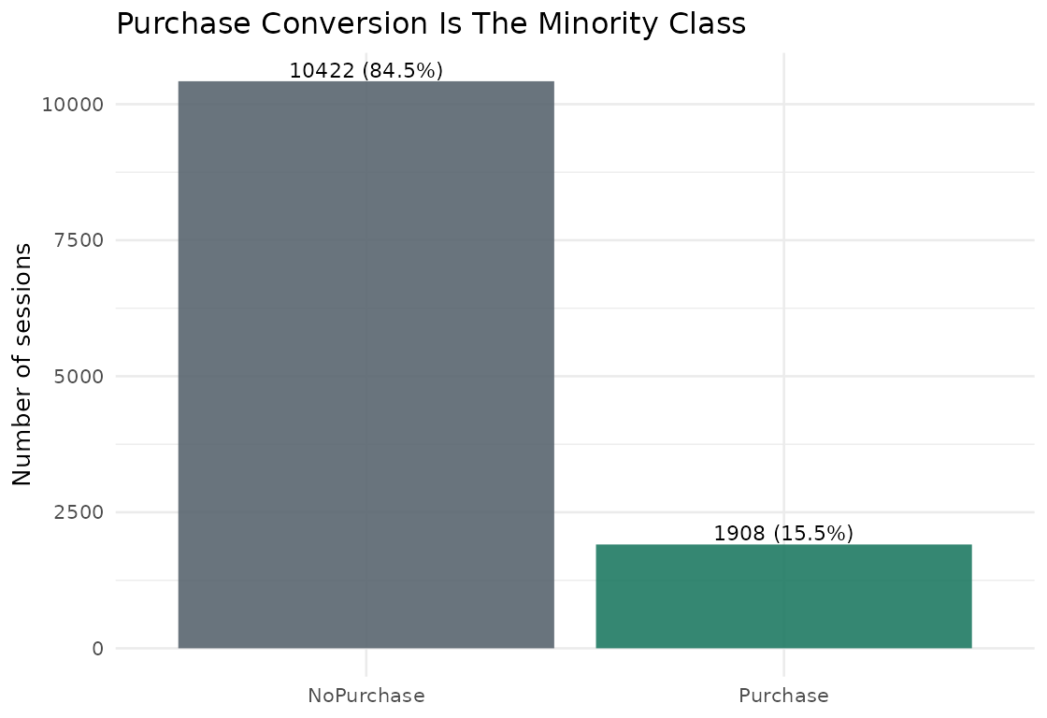
Problem Statement
Predicting Online Purchase Conversion From Session Behavior
Predict whether an online shopping session will generate revenue.
Frame Revenue as Purchase versus NoPurchase.
Use session behavior to support targeted marketing decisions.
Model is decision support, not automatic customer treatment.

Slide 2
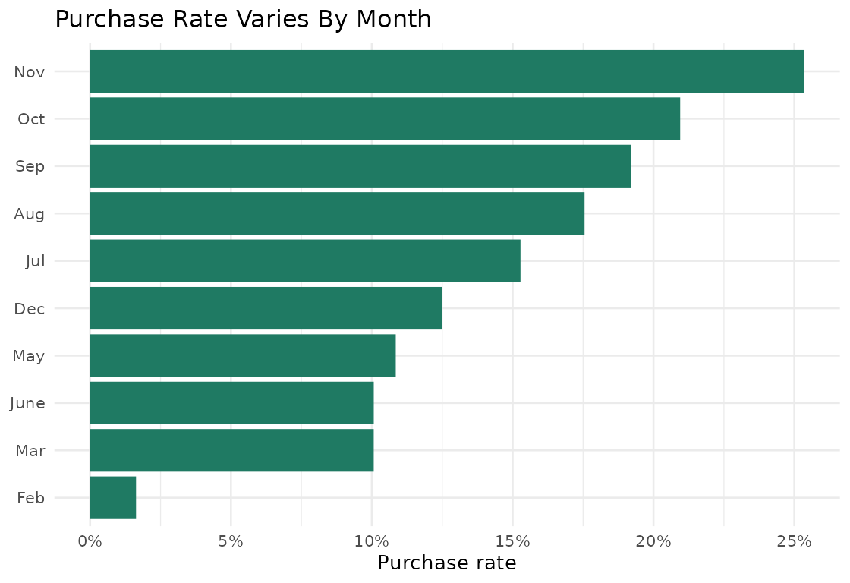
Business Motivation
Predicting Online Purchase Conversion From Session Behavior
Most shopping sessions do not purchase.
Marketing and support interventions have limited capacity.
A model can rank sessions by purchase intent.
Goal is prioritization and experiment design.

Slide 3
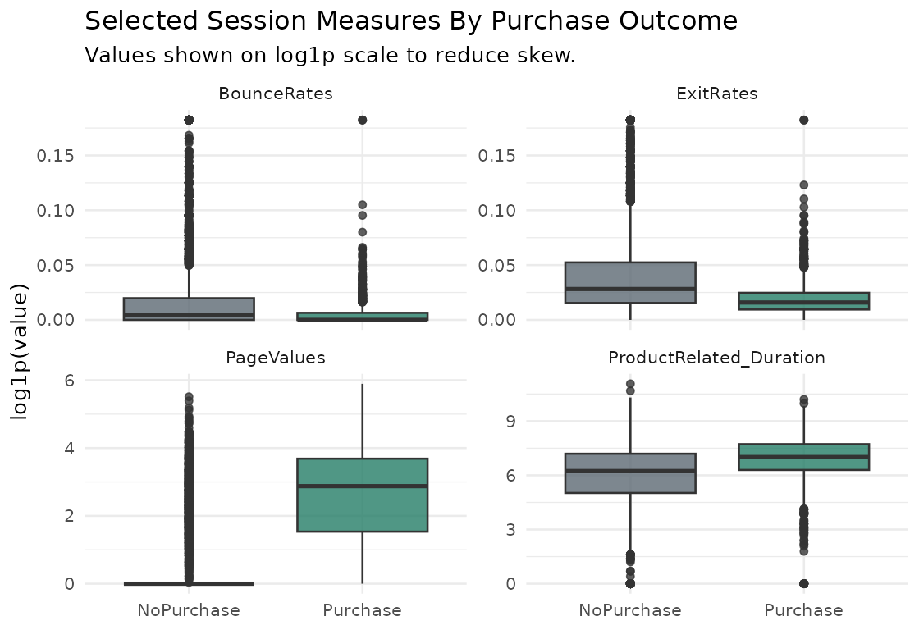
Dataset
Predicting Online Purchase Conversion From Session Behavior
UCI online shoppers dataset with 12,330 sessions.
Each row is one website visit session.
Predictors include page counts, durations, bounce and exit rates, month, visitor type, and traffic source.
Original response is whether the session generated revenue.

Slide 4
Target And Class Balance
Predicting Online Purchase Conversion From Session Behavior
Binary target: Purchase versus NoPurchase.
Purchase class is 15.5% of rows.
Accuracy alone can be misleading.
Evaluation must include sensitivity, precision, F1, and AUC.

Slide 5
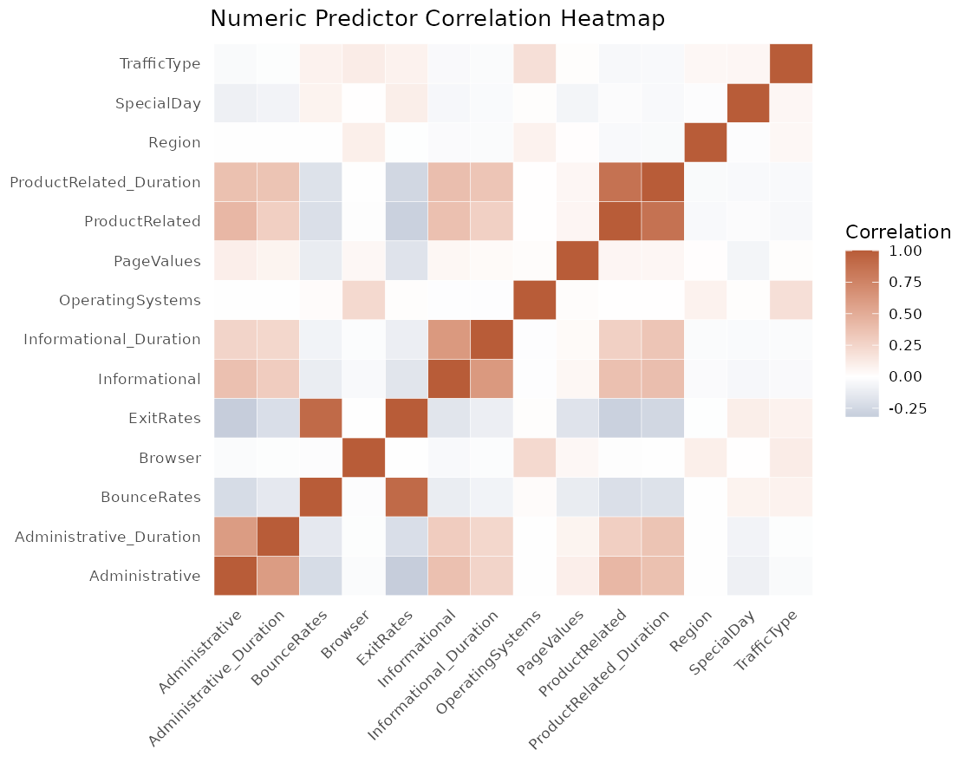
EDA Findings
Predicting Online Purchase Conversion From Session Behavior
Purchase sessions show higher page value and product engagement.
No-purchase sessions show higher bounce and exit rates.
Predictor overlap means perfect classification is unrealistic.
Correlated predictors support comparing several model types.

Slide 6
Preprocessing
Predicting Online Purchase Conversion From Session Behavior
Converted Revenue into a binary purchase target.
Removed original Revenue field from model inputs to avoid leakage.
Checked missing values: none in the downloaded file.
Collapsed rare technical categories and standardized numeric predictors for logistic regression.

Slide 7
Data Splitting
Predicting Online Purchase Conversion From Session Behavior
Used stratified 80/20 train-test split.
Training set used for fitting and tuning.
Test set held out until final evaluation.
Stratification preserved minority-class share.

Slide 8
Validation Design
Predicting Online Purchase Conversion From Session Behavior
Used stratified cross-validation.
Tuned decision tree complexity.
Tuned random forest mtry.
Selected probability thresholds from validation predictions.

Slide 9
Model Strategy
Predicting Online Purchase Conversion From Session Behavior
Logistic regression created a transparent baseline.
Decision tree tested simple non-linear rules.
Random forest tested stronger non-linear performance.
Final choice balances ranking quality and purchase-class detection.

Slide 10
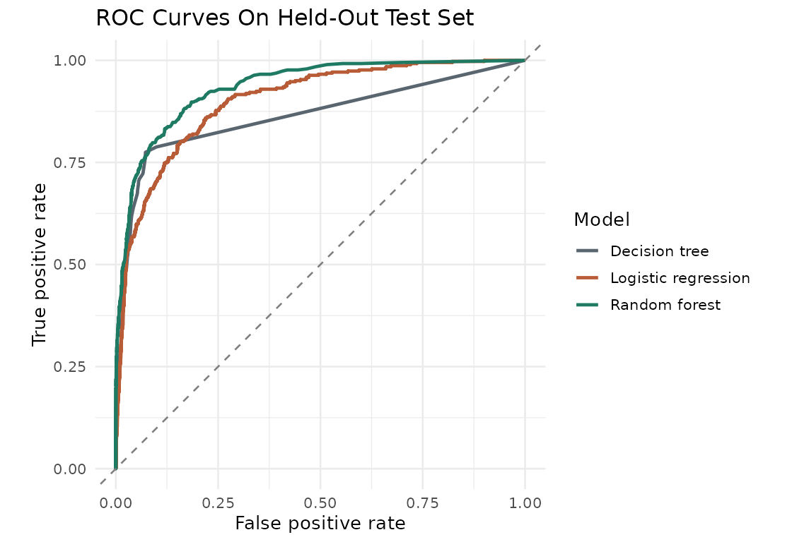
Metrics
Predicting Online Purchase Conversion From Session Behavior
ROC AUC measures ranking quality across thresholds.
Sensitivity measures how many purchase sessions are found.
Precision measures how many predicted purchases are true purchases.
F1 balances sensitivity and precision.

Slide 11
Final Test Results
Predicting Online Purchase Conversion From Session Behavior
Selected model: Random forest.
ROC AUC: 0.935.
F1 score: 0.716.
Accuracy: 0.909.
Sensitivity: 0.738; specificity: 0.941.
AUC 0.935
F1 0.716
Accuracy 0.909

Slide 12
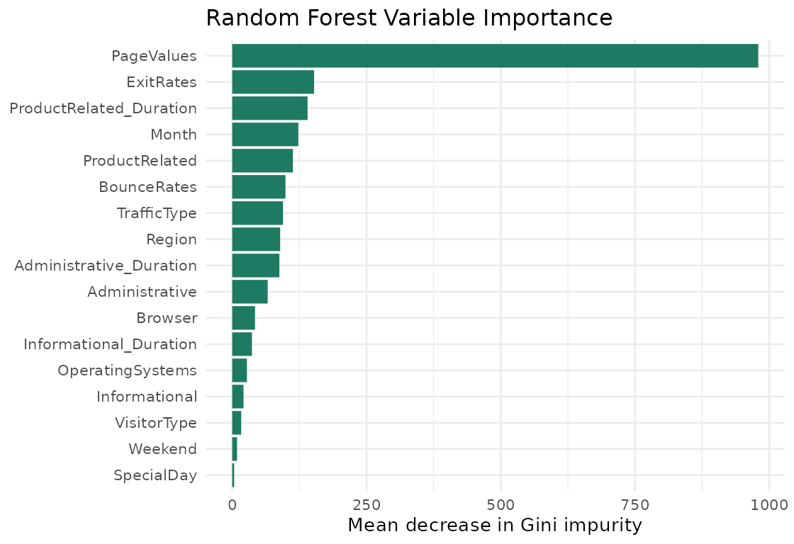
Interpretation
Predicting Online Purchase Conversion From Session Behavior
Top predictors in random forest:
PageValues, ExitRates, ProductRelated_Duration, Month, ProductRelated.
These variables help rank sessions by purchase probability.
Variable importance is predictive, not causal.

Slide 13
Limitations And Next Steps
Predicting Online Purchase Conversion From Session Behavior
Dataset comes from one e-commerce context.
Missing business variables: product, price, customer history, margin, and campaign cost.
Verify PageValues availability before real-time deployment.
Next step: calibrate probabilities and A/B test interventions.

Slide 14
Conclusion
Predicting Online Purchase Conversion From Session Behavior
Session behavior can identify useful conversion-intent signal.
Use output as ranked shortlist, not final customer-treatment rule.
Best use is prioritizing controlled marketing experiments.
AI assistance is disclosed in the report and repository.

