Slide 1
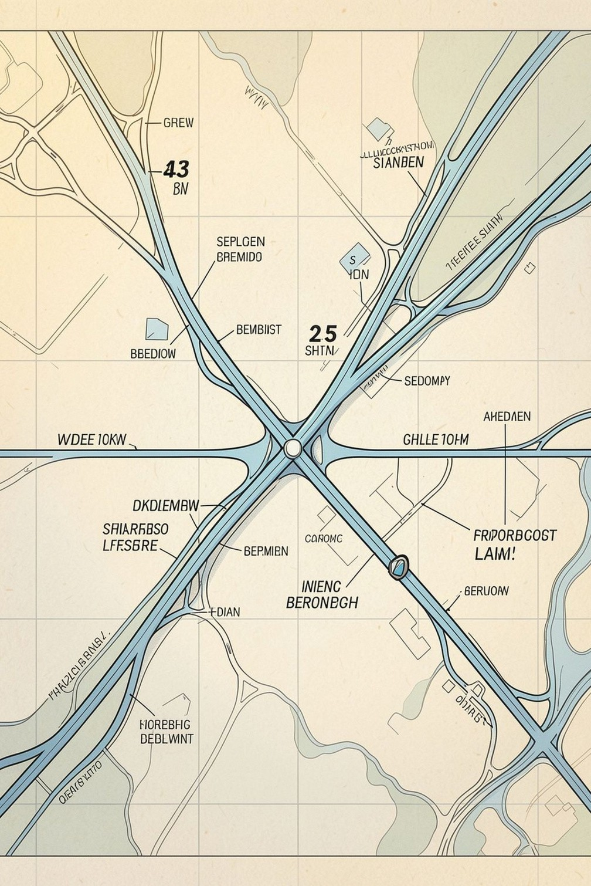
SMART NAVIGATION SYSTEM —
USing DijkStra'S Algorithm
Data Structures & Algorithms mini-project
Dhruva Gupta [V022] Nikita Sadani [V044]
Core concepts: Graphs, adjacency matrix, shortest-path algorithms

Slide 2
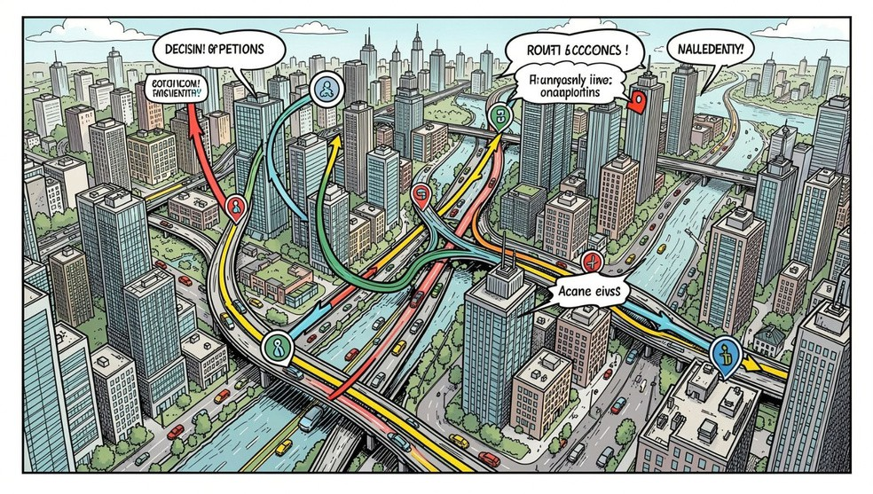
Problem Statement & Objective
Problem Statement
Road networks contain many possible routes between two locations. As the network grows, finding the true shortest route manually is infeasible. The system must:
accept source and destination, represent the network, compute the shortest route and total distance, display the route clearly, and handle invalid inputs and edge cases.
Objective: Build a simple, menu-driven navigation system that computes shortest paths using Dijkstra's Algorithm and presents route + distance to the user.

Slide 3
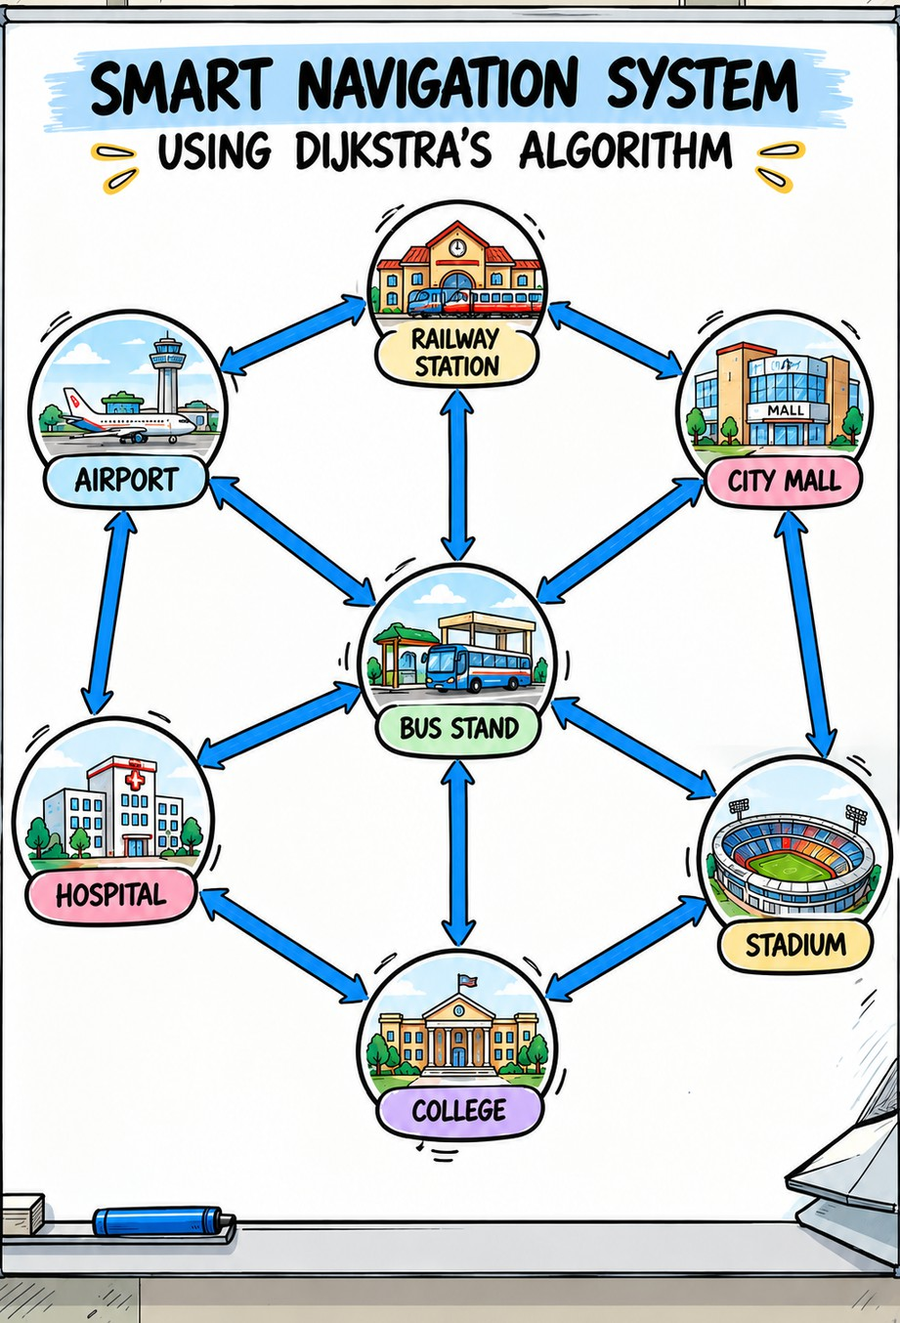

Proposed Solution — High Level
Model
Weighted graph: vertices = locations, edges = roads, weights = distance (km)
Storage
Adjacency matrix (int g[N][N]) to store inter-node distances and absence of edges
Algorithm
Dijkstra's
Algorithm finds minimum distances; parent array used to reconstruct the route
Flow
Input (source/destination) → build weighted graph → run Dijkstra →
reconstruct route → display route & distance

Slide 4
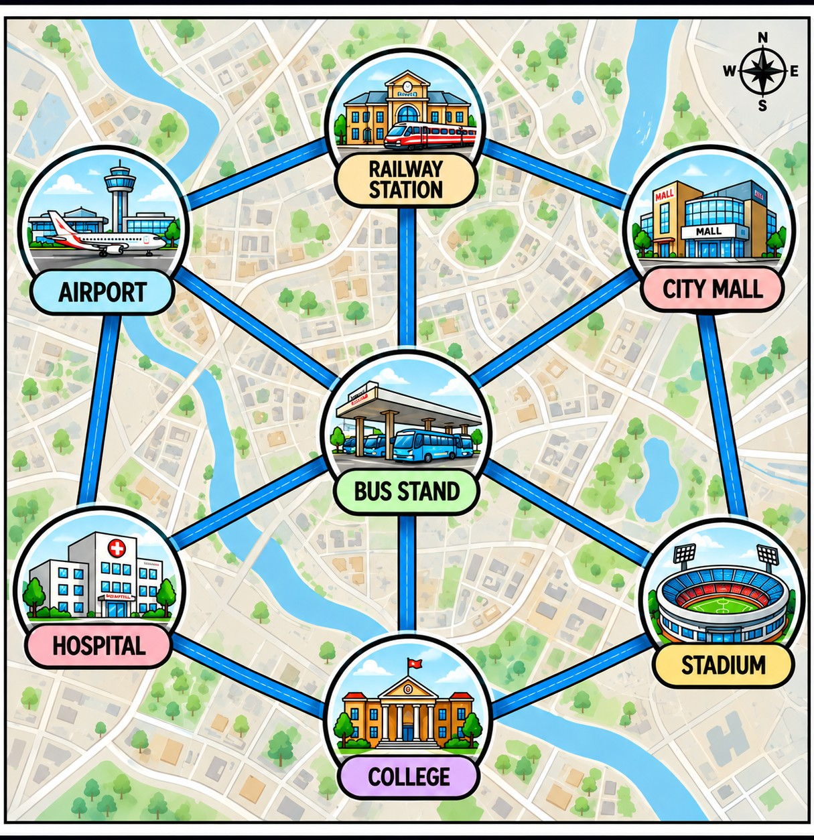
Graph & Data Structures
Project Graph Details
Vertices (7): Airport, Railway Station, City Mall, Bus Stand, Hospital, College, Stadium.
Representation: adjacency matrix int g[N][N]; example: g[0][2] = 4 means Airport → City Mall = 4 km.
d[] — distance estimates (int) v[] — visited flags (bool/int)
p[] — parent pointers to reconstruct path path[] — final route extracted from parents

Slide 5

What iS DijkStra'S Algorithm?
Key Characteristics
Greedy algorithm for non-negative weighted graphs Maintains provisional distances and visited set
Core operation: relaxation — update distance if a shorter path is found
Algorithm Steps
Set source distance = 0; others = ∞
Select unvisited vertex with minimum distance
Relax all adjacent neighbours; update parent when improved
Mark vertex visited; repeat until target or all visited
Source
Choose Min
Relax Neigh
Update Dist
Repeat to Target

Slide 6
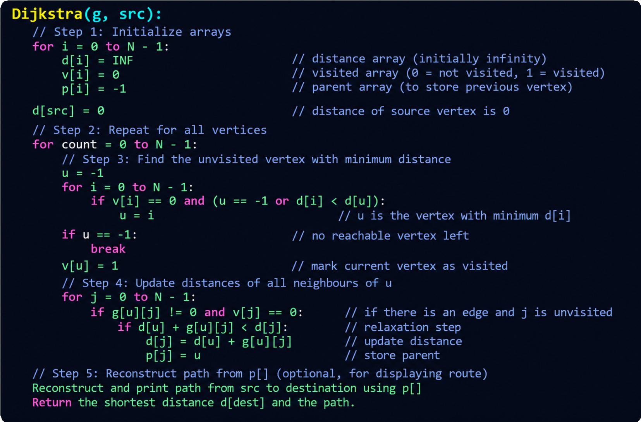
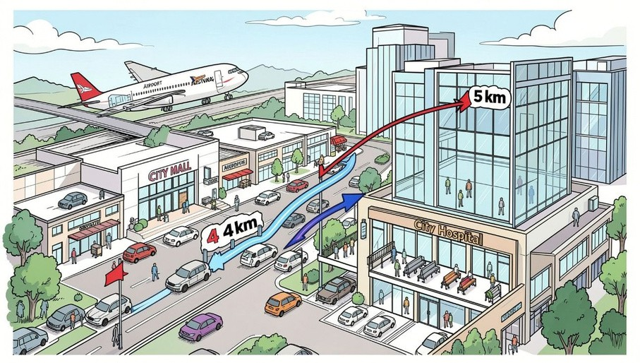
P S e u d o c o d e & W o r k e d E x a m p l e
Working Example
Airport → City Mall (4 km) + City Mall →
Hospital (5 km) = 9 km (shortest)

Slide 7
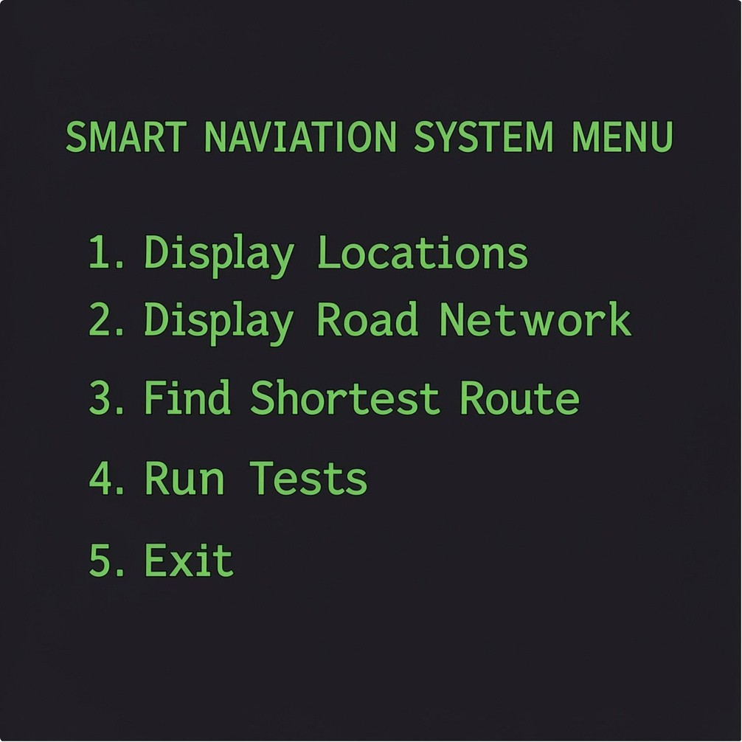
Implementation & Menu
Main Menu (program)
Display Locations
Display Road Network
Find Shortest Route
Run Tests
Exit
Core Functions
locations() — prints indexed list of nodes roads() — prints adjacency matrix / edge list dijkstra() — computes distances and parents tests() — automated test cases and result summary
main() — input loop and menu control

Slide 8
Time & Space Complexity
Time Complexity
Using an adjacency matrix and linear scan to select the minimum unvisited vertex yields O(V²) time. For V = 7 (this project): runtime is small, but scales quadratically with V.
Summary
Time = O(V²) • Space = O(V²) (with V = 7)
Space Complexity
Adjacency matrix requires O(V²) space to store V
× V distances. Additional arrays (d[], p[], visited[]) are O(V).

Slide 9
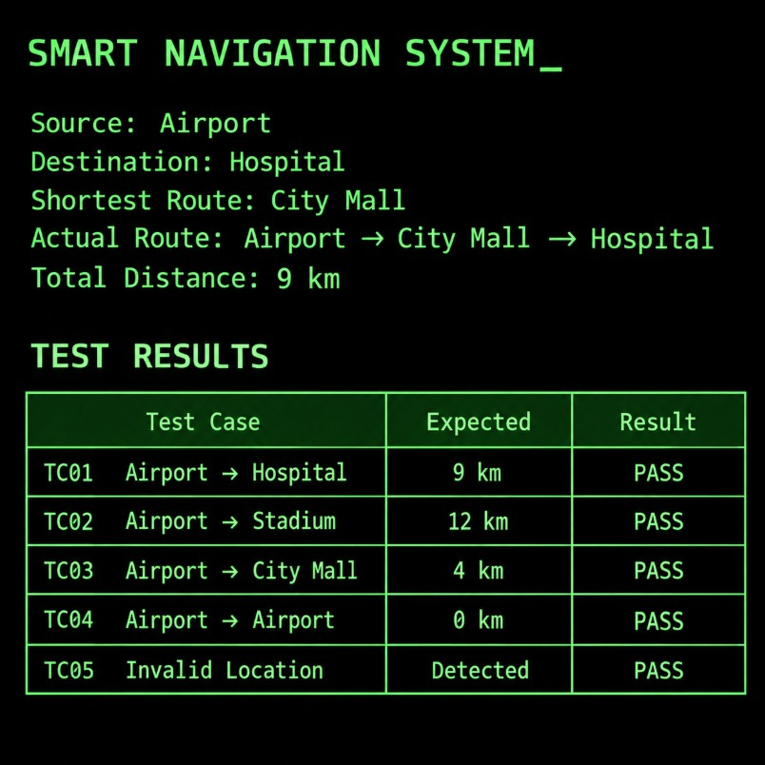
Re Sult S & Te Sting
Sample Run
Source: Airport Destination: Hospital
Shortest route: Airport → City Mall → Hospital Total distance: 9 km
Test Cases (summary)
Test case
Result
Airport → Hospital
9 km — PASS
Airport → Stadium
12 km — PASS
Airport → City Mall
4 km — PASS
Airport → Airport
0 km — PASS
Invalid location
Detected — PASS
Overall: 5/5 test cases passed.

Slide 10
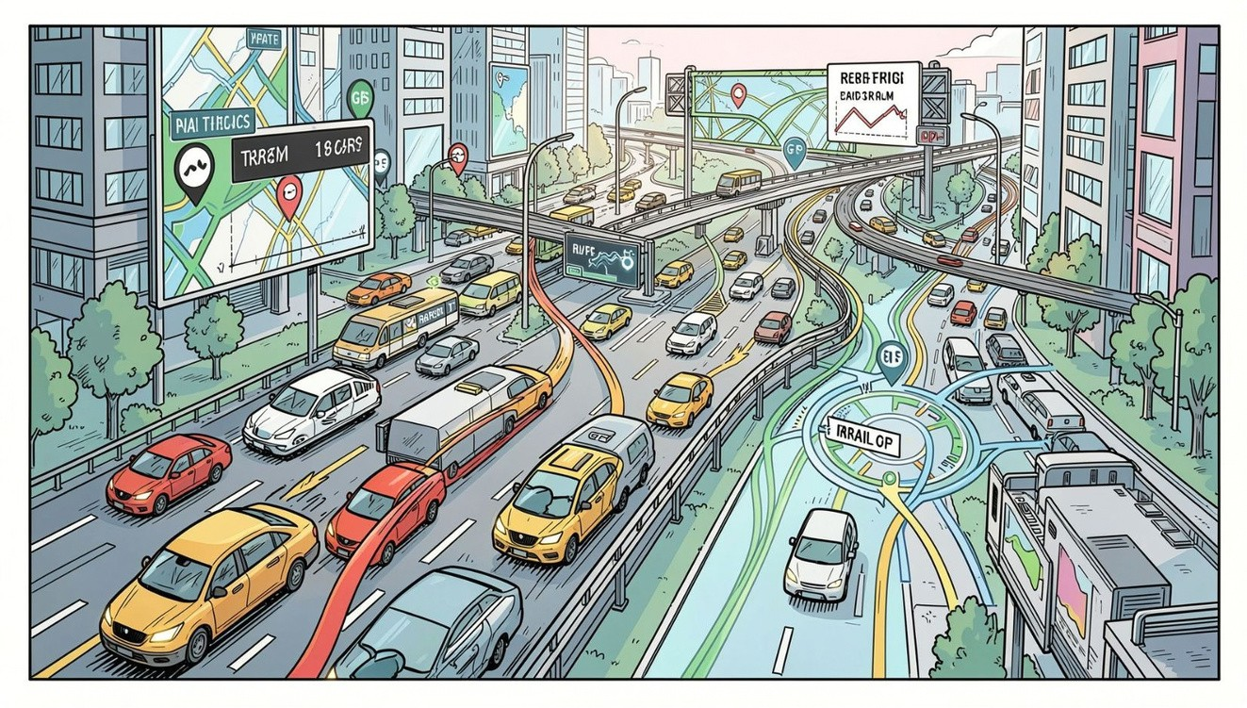
C o n c l u si o n & F u t u r e S c o p e
Conclusion
Implemented a menu-driven navigation system
in C using an adjacency matrix.
Applied Dijkstra's Algorithm to compute shortest paths and used a parent array for route reconstruction.
All test cases passed and edge conditions handled (invalid input, unreachable nodes).
Future Scope
Integrate GPS data and map APIs for real-world
coordinates
Incorporate real-time traffic and dynamic edge weights (time-dependent Dijkstra/variants) Offer multiple route suggestions and visual map UI
THANK YOU — Questions?

