Slide 1

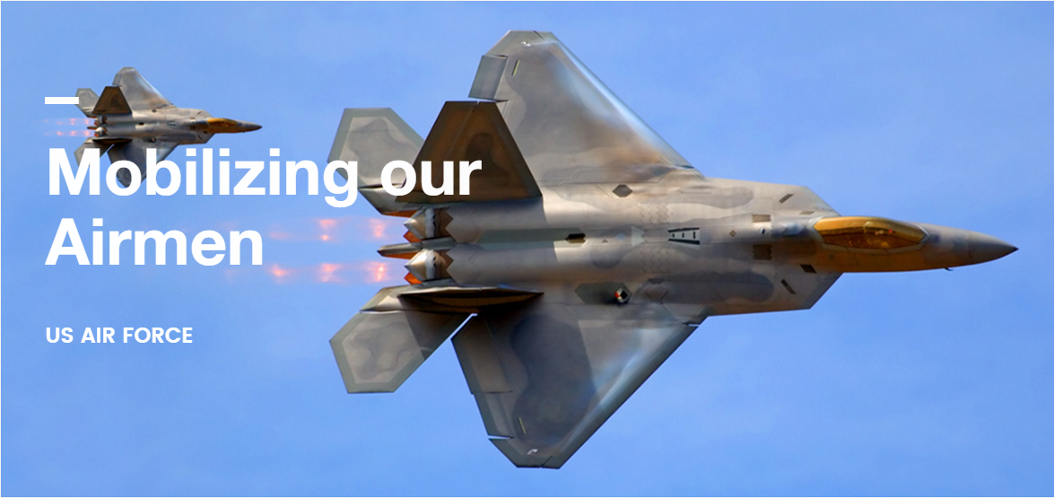
PROJECT PRESENTATION ISOBAR Mobilizing our Airmen Instructor: Prof. Kambiz Heydari Student: Nikita Saple NUID: 001686003
College of Engineering

Slide 2
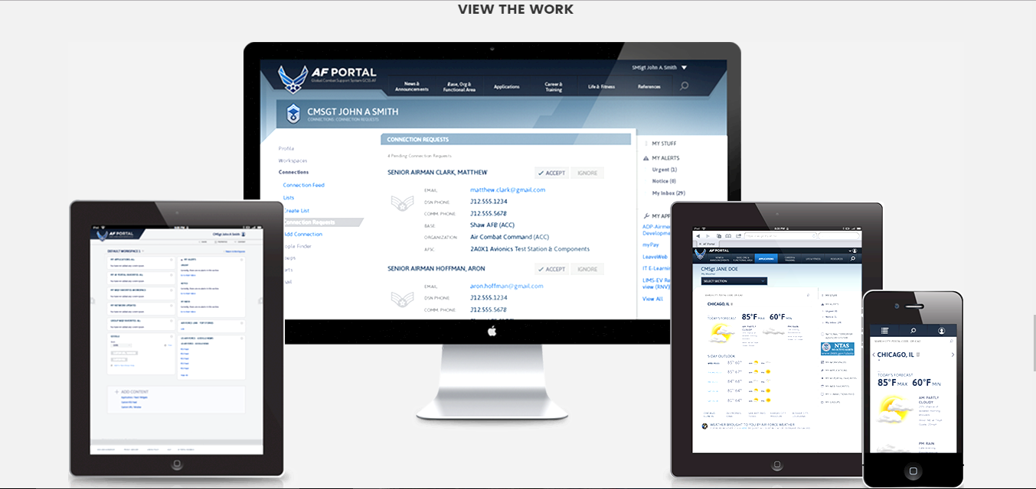
Mobilizing our Airmen
College of Engineering

Slide 3
Company Approach - Isobar
College of Engineering
Vision Statement
Develop a predictive readiness model called the five levers of readiness.
the flying hour program
weapons system sustainment
critical skills availability
training resource availability
deploy to dwell/ops tempo.

Slide 4
Problem Statement
College of Engineering
Significant amount of information uncaptured in digital form
25% effort - searching for data and then transferring to another (sometimes virtual) location
Need to collect more accurate and detailed performance information
Narrow segmentation of customers
Improve decision-making, minimize risks
Unearth valuable insights

Slide 5
Strategy and Roadmap
College of Engineering
Scope and Major deliverables
Support Airmen with easier, more secure access to information
Using Big Data achieve information transparency.
Creation and storage of data in digital form
Narrower segmentation of customers for more precise tailored services.
The old system had become cluttered.
Difficult to navigate and didn’t support mobile access.
Joining Data from multiple RDMS sources and combining
Enable faster and easier data processing

Slide 6
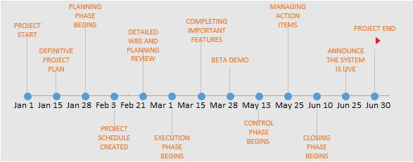
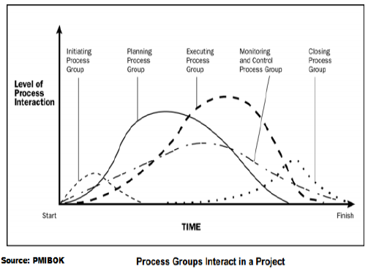
RoadMap and Objectives
College of Engineering
Social Media Analytics to Find the Enemy
Knowledge Management to Improve the Organization
A Solution for 800.000 Air Force Users (Cloud)
Reducing Energy Consumption at Air Forces Bases (Big data + IOT using sensors, Splunk)
Improved Battlefield Analytics to Reduce Collateral Damage (video data + sensor + trend detection algorithms)

Slide 7
Requirements
College of Engineering
Functional Requirements
Historical Data
Authentication and Authorization
Audit Tracking or Audit Logs
Upgraded UI
Reports
Alerts and Warnings
Alerts and Warnings Report
Archive Data
Non Functional Requirements
No data loss in streams
Handle streaming data while it is flowing in
Handle heterogeneous data sources
Availability of past data
Updating the models, data sources and visualization layouts
Scalability of the system
Ensure data privacy and security
Disaster recovery

Slide 8
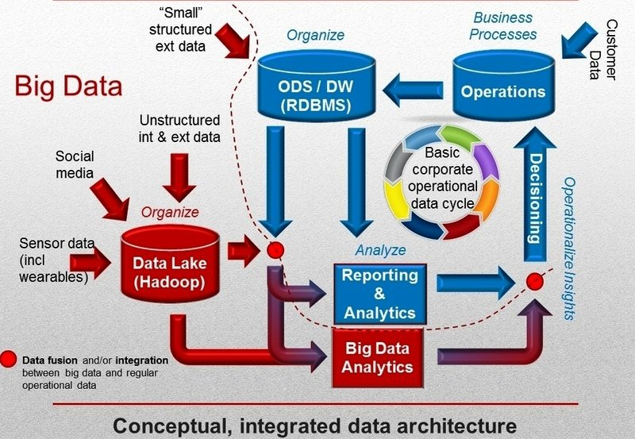
Proposed Architecture
College of Engineering
SANDBOX APPROACH
Isolated computing environment
Obtaining huge volumes of data in one go is replaced by acquiring data from a single source.
Data scientists manipulate the data, build models using the data, and understand the results being produced.
Ensures that robust requirements are developed
Evolves the requirements in an incremental manner. This approach will also help refine requirements.

Slide 9
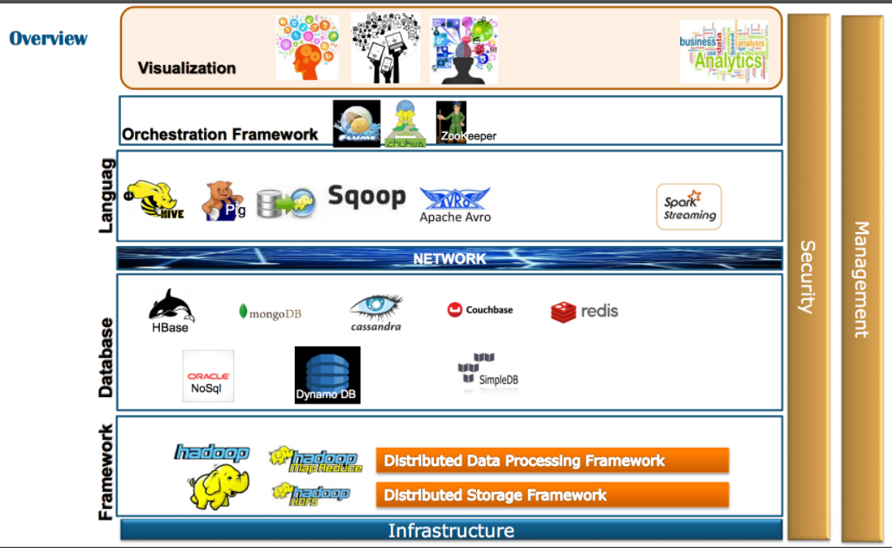
Visualization
College of Engineering
Tableau
Business Intelligence tool for visually analyzing the data.
Create and distribute interactive and shareable dashboards which depict the trends, variations and density of the data in form of graphs and charts.
Connect to files, relational and Big data sources to acquire and process data.
Data blending and real time collaboration of huge data sets.
Visually representing satellite data which was analyzed and will give a fast and easy to use intuitive interface.

Slide 10
Orchestration
College of Engineering
Apache Flume
Distributed, reliable for efficiently collecting, aggregating, and moving large amounts of log data.
Robust, fault tolerant with tunable reliability mechanisms and recovery mechanisms.
Due to huge amounts of Satellite data generated per second, Flume can prevent data loss and is highly reliable.
Data flow from Data centers -> to HDFS.
Compatible with other Hadoop based tools used and will enable smooth working.
Apache Zookeeper will prove to be useful for distributed configuration service and synchronization service.
Due to parallel complex systems it will provide a centralized infrastructure and services that enable synchronization across a cluster.

Slide 11
Language
College of Engineering
Go Language
Go language developed by Google is suitable for the project.
Go language enhances processing on large datasets.
Quick compilation and language level concurrency. Built-in strings and map.
Go can be combined with Hive language called Beeline. HiveServer2 and a JDBC client (such as Beeline) as the primary way to access Hive.
Hive data can also be accessed from other applications, such as Pig. For these use cases, use the Hive CLI and storage-based authorization.

Slide 12
Database
College of Engineering
Apache Hive
Data warehouse software project built on top of Apache Hadoop for providing data summarization, query, and analysis.
SQL-like interface to query data stored in various databases and file systems that integrate with Hadoop.
HBase
Open source, non-relational, distributed database modeled after Google's Bigtable and is written in Java.
Runs on top of HDFS (Hadoop Distributed File System), providing Bigtable-like capabilities for Hadoop.

Slide 13
Framework
College of Engineering
Hadoop
Scalable
Store and distribute very large data sets across hundreds of inexpensive servers that operate in parallel.
Cost effective
Scale-out architecture that can affordably store all of a company's data for later use.
Flexible
Access new data sources and tap into different types of data (both structured and unstructured) to generate value from that data. social media, email conversations or clickstream data.
Fast
Storage method is based on a distributed file system that basically 'maps' data wherever it is located on a cluster.
Resilient to failure
Fault tolerance - Data is sent to an individual node, that data is also replicated to other nodes in the cluster, which means that in the event of failure, there is another copy available for use.

Slide 14
Security
College of Engineering
Identify and Protect Sensitive Data
Know Who’s Accessing It, And How
Log Everything
Shutdown Threats Quickly
Don’t Underestimate the Cultural Hurdles
Authentication and Authorization
Each stage provides their own form of security like,
Talend: LDAP Authentication
Tableau: SAML and OAuth Authentication, Roles and permissions, Data and Network Security
Hive: Kerberos authorization support, SASL Integration
HBase: Kerberos authorization support, Server-side/Client-side Configuration for Secure Operation with Thrift and REST gateway
Apache Flume: Kerberos Security

Slide 15
Manageability
College of Engineering
Flume
Ability to control data flows, monitor nodes, modify settings, and control outputs of a large system.
HBase and Hive
Data backup and Recovery
Performance Tuning
Data Modeling and Schema Evolution
Data Pruning
Online Expansion and Upgrade
HBase proves to fit really well in the Hadoop environment. It increases efficiency of hard disk access, lowers latency and high throughput by enabling fast, random reads and writes to data.

Slide 16
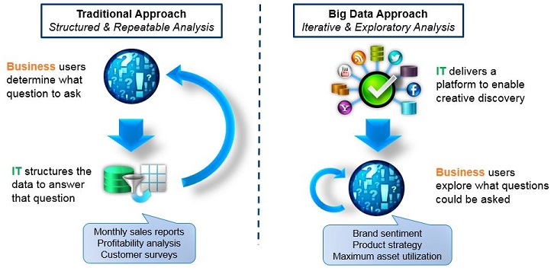
Big data governance
College of Engineering
People
Organized structure of highly skilled people
Stakeholders
Process:
Effective measurement of data governance program
Strict policies for the data access of
Regular backups, in case of data disaster
Framework and Practice
Data will be combined from multiple data.
Balanced, Lean Governance
Data Access
Data Literacy.
Analytic Prioritization.

Slide 17
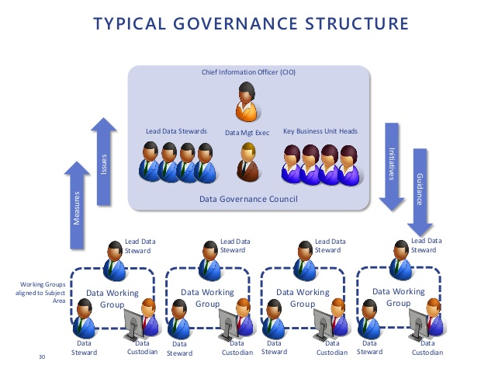
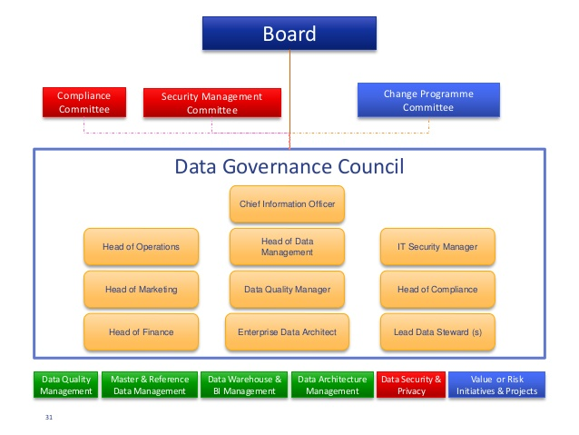
Governance Structure
College of Engineering

Slide 18
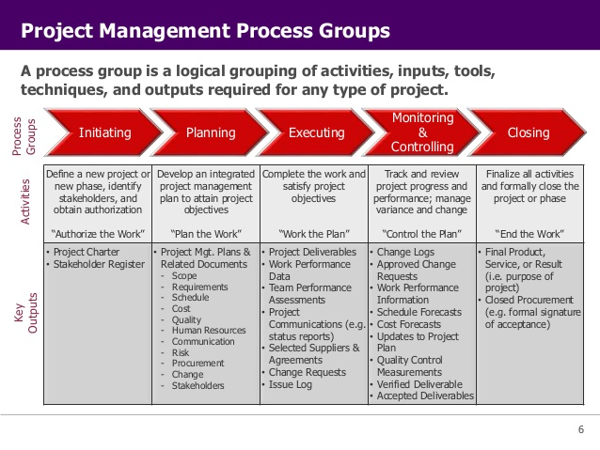
Organization Structure
College of Engineering
Process Groups | Resources
Initiation | Business Analyst, Data Architect, Senior Developers, Project Managers, Project Engagement Team, Sponsors
Planning | Data Architects, Database Developers, Project Managers, Senior Developer, Business Analyst, Project Manager
Execution | Developers, Data Scientists, BI Developer, Project Manager
Monitoring and Control | Performance Engineers, Developer, QA Team and Information Security Analysts
Closure | Support Team and Project Manager

Slide 19
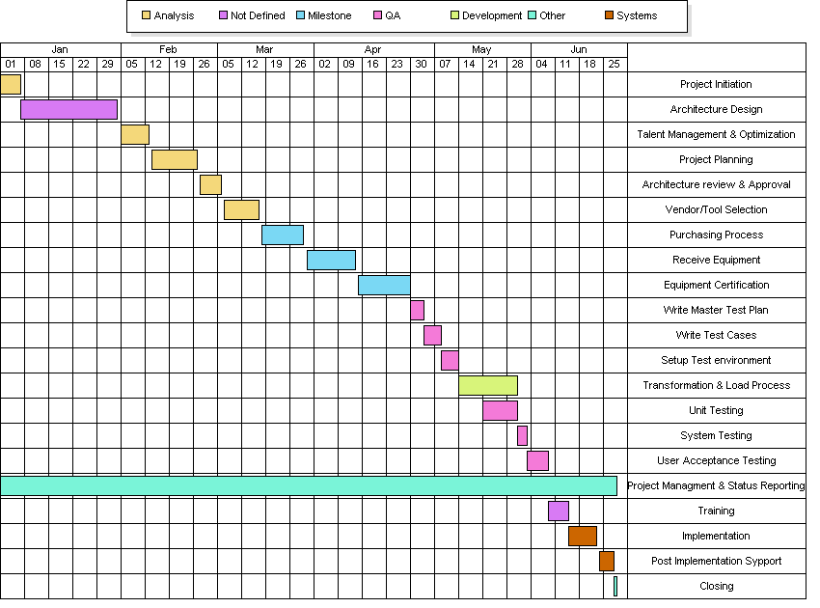
Gantt Chart
College of Engineering

Slide 20
References
College of Engineering
http://www.isobar.com/us/en/
http://neu11.myvelero.com/VPPMMenu.cfm?Menu=2&winH=672&winW=1577
http://www.isobar.com/se/en/privacy/
https://isobar-idev.github.io/code-standards/
https://www.mja.com.au/journal/2009/190/11/isobar-concept-and-handoverchecklist-
national-clinical-handover-initiative
http://nightwatchjs.org/
http://bobchesley.net/front-end-code-standards-best-practices-roundarch-isobar/
http://www.slideshare.net/yoav-netcraft/roundarch-isobar-java-script-codingstandards
http://www.dentsuaegisnetwork.com/m/enuk/
responsibility/code%20of%20conduct/dentsu%20aegis%20network%20code%
20of%20conduct.pdf
http://www.isobar.com/us/en/terms/
https://en.wikipedia.org/wiki/Roundarch_Isobar
http://www.businesswire.com/news/home/20110228005609/en/Isobar-Expands-
Creative-Leadership-Addition-Max-Fresen
http://www.isobar.com/us/en/services/platforms/
http://www.isobar.com/us/en/services/
http://www.isobar.com/us/en/services/strategy/
https://isobarmarketingintelligence.com/aboutus/
http://www.dentsuisobar.com/en/about_us/

Slide 21

Thank you!
College of Engineering

