Slide 1

PROJECT OVERVIEW ISOBAR Mobilizing our Airmen Instructor: Prof. Kambiz Heydari Student: Nikita Saple NUID: 001686003
College of Engineering

Slide 2
Company Approach - Isobar
College of Engineering
Mission statement
Isobar brings into existence applications and digitally centered marketing campaigns for mobiles devices, web and social media.
Vision Statement
By creating, conceiving and optimizing “Ideas without Limits”, Isobar intends to resolve complex client challenges and render incontrovertible business results to become the preferred choice in digital media.

Slide 3
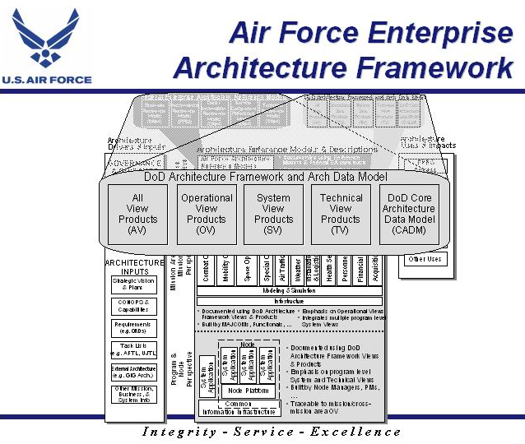
College of Engineering

Slide 4
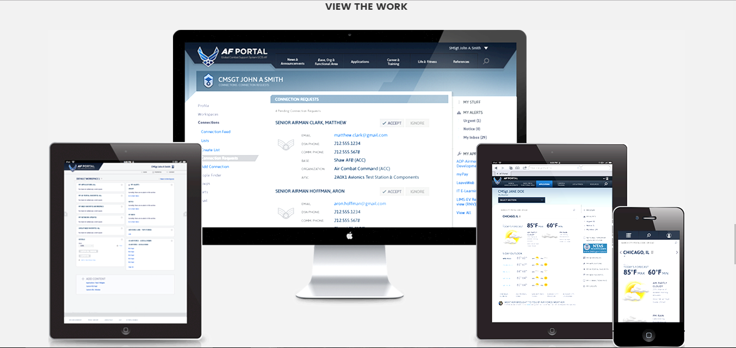
Mobilizing our Airmen
College of Engineering

Slide 5
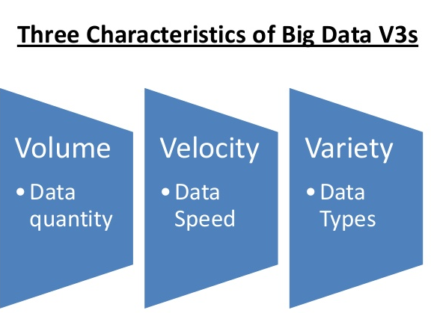
Mobilizing our Airmen
College of Engineering
Support Airmen with easier, more secure access to information
Exiting issues:
The old system had become cluttered.
Difficult to navigate and didn’t support mobile access.
Joining Data from multiple RDMS sources and
combining
Multiple factors from several records is not feasible.
For faster and easier processing, and to achieve in depth
analytics for the airmen, big data solution would be appropriate

Slide 6
Proposed Architecture
College of Engineering
Strategy – Build
Created over ten years ago, the Air Force Portal is the single site for Airmen to securely receive communications, access information, and connect and collaborate with other Airmen.
Portal refashion: mobile-ready, responsive web design optimized for low-bandwidth network connections.
Productivity: implement features that enabled user personalization and group workspaces.
Streamline content and a more intuitive navigation boost usability.
Updated design reflects current Air Force branding.

Slide 7
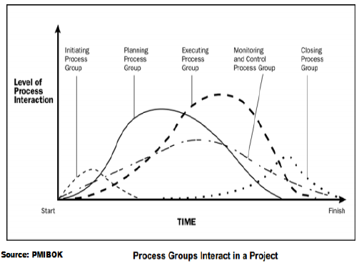
Project Planning
College of Engineering
Project Life Cycle

Slide 8
Project Planning
College of Engineering
Impact
Current Process Improvement
Service Improvement
Cost Saving
Regulatory
Strategic Initiative
Saving Years – 3 years

Slide 9
Mandates
College of Engineering
Scope
Upgrading the portal to meet airmen’s needs.
Find out what you need in terms of recruiting and training.
Business discovery – Consider the broader use cases for Big Data.
Information discovery and architecture - Discovering the data sources (Cargo transports, weather reconnaissance) needed to support target use cases and then develop an architecture that supports it.
Design - Design the Big Data part — including hardware, software, analytics and application stacks.
Procurement - Design a Programmatic engine that can be used to handle the air traffic and weather conditions
Ingestion - Incorporating the data sets into Big Data platform of choice.
Analytical application to the data sets.
Quality assurance/ Test - Test all of it.

Slide 10
Mandates
College of Engineering
Constraints
Storage constraints are addressed by minimizing free space, eliminating database reorgs, and reducing or eliminating backups
Extended run times for bulk loads are reduced by intelligent data partitioning
Query elapsed time constraints due to reduced data availability are reduced by using an active/inactive table technique.
Scope Constraint: If the scope is not defined then it may result in delivery of product which is not as per the requirements hence affecting the quality of product.

Slide 11
Mandates
College of Engineering
Quality Expectations
Integrating and cleansing data
Business implications
Money/ resources needed
Time span of the system to remain in existence
Impact on other departments
Estimate costs
Training
Software maintenance
Internal manpower

Slide 12
Mandates
College of Engineering
Budget and Resource
3-year Total Cost of Ownership
Scaling up Scaling Out Non – Production environments Staff training Operation Systems Purge/ Archive Disaster Recovery | Project Sponsor Project Managers Vendor Selection Lead Core Team Application Engineer Database Admin Network Architect System Architect Extended Team

Slide 13
Project Execution
College of Engineering
Risks and Issues
RISKS
Data Quality
Security
Cost Management
ISSUES
Talent Shortage
Scalability Challenge

Slide 14
References
College of Engineering
http://www.isobar.com/us/en/
http://neu11.myvelero.com/VPPMMenu.cfm?Menu=2&winH=672&winW=1577
http://www.isobar.com/se/en/privacy/
https://isobar-idev.github.io/code-standards/
https://www.mja.com.au/journal/2009/190/11/isobar-concept-and-handoverchecklist-
national-clinical-handover-initiative
http://nightwatchjs.org/
http://bobchesley.net/front-end-code-standards-best-practices-roundarch-isobar/
http://www.slideshare.net/yoav-netcraft/roundarch-isobar-java-script-codingstandards
http://www.dentsuaegisnetwork.com/m/enuk/
responsibility/code%20of%20conduct/dentsu%20aegis%20network%20code%
20of%20conduct.pdf
http://www.isobar.com/us/en/terms/
https://en.wikipedia.org/wiki/Roundarch_Isobar
http://www.businesswire.com/news/home/20110228005609/en/Isobar-Expands-
Creative-Leadership-Addition-Max-Fresen
http://www.isobar.com/us/en/services/platforms/
http://www.isobar.com/us/en/services/
http://www.isobar.com/us/en/services/strategy/
https://isobarmarketingintelligence.com/aboutus/
http://www.dentsuisobar.com/en/about_us/

Slide 15

Thank you!
College of Engineering

