Slide 1
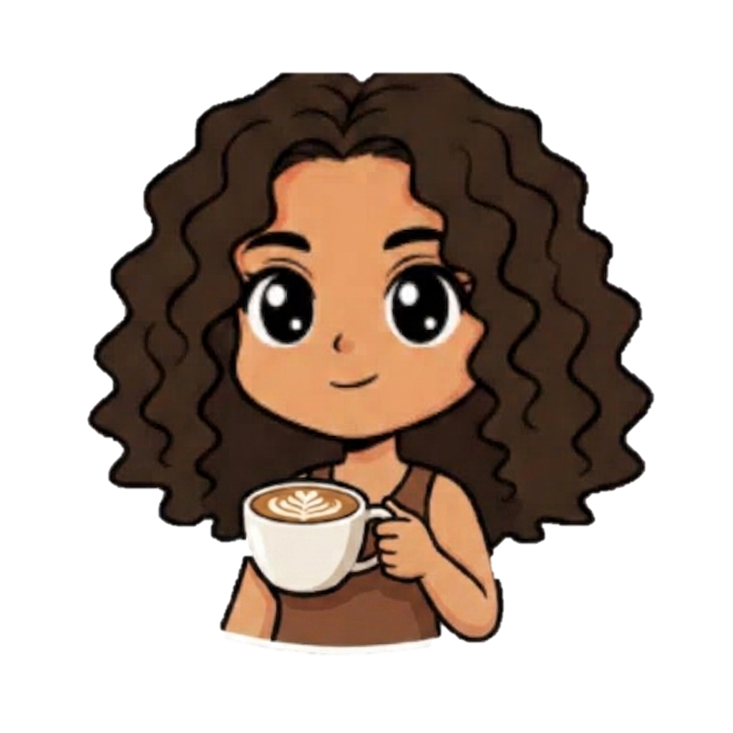
THE NUDGE CAFÉ
FOCUS
GATHER
DATE
CALM
A café that asks how you feel — then builds the room around it.
Two minutes of questions. A seat, a color, a pattern — matched to your mood.
Coffee, engineered around the psychology of the room.
PITCH DECK
Nikita Sharma — Founder

Slide 2

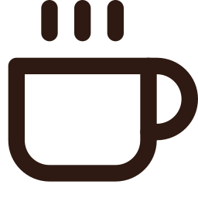

THE PROBLEM
Every table looks the same — but no two visits are
One layout, every mood
Caffeine without context
Seating is a coin flip
The person cramming for finals and the couple on a first date get the exact same hard chair, same lighting, same noise.
Menus push the same drinks regardless of whether you need to focus, unwind, or stay up late — no link between intake and intent.
Customers self-seat by whatever’s free, not what actually helps them — wrong seat, shorter visit, lower spend.
320-student caffeine survey (MSU Baroda, 2024): higher intake tracked with less sleep and sharper exam-day focus — mood and beverage are already linked. Cafés just aren’t designed around it.
02

Slide 3

THE INSIGHT
Mood, environment, and consumption
are already linked — the data says so
320
students studied,
lab-verified data
Environmental psychology has long shown that seating shape, color, and pattern shift arousal and behavior — round forms invite gathering, saturated color sharpens alertness, soft curves lower it. What's been missing is pairing that with a direct, honest read of the person sitting down.
4
validated behavior
links confirmed
That pairing isn't a guess for us — it's the founder's own published research.
0
From “The ABC Insights” — a 320-student consumption study co-authored by the founder
Exam-day intake was significantly higher than regular days (Wilcoxon rank test) · shorter sleep tracked with higher intake (Kruskal-Wallis + Jonckheere-Terpstra trend) · self-reported focus rose with intake during exams — the exact mood/motive states this café is designed to read.
cafés today that
read mood on entry
THE NUDGE CAFÉ
03

Slide 4




THE SOLUTION
Ask first. Seat second.
A 45-second check-in at entry drives everything that happens next.
1
2
3
4
Check-in
Score
Match
Deliver
→
→
→
Quick Likert-scale survey on a QR/tablet: mood, energy, motive, social goal.
Lightweight rules engine (built to graduate into ML) scores each axis.
Customer is matched to one of four zones — no queue, no menu confusion.
Seating, lighting, and menu are already tuned before they sit down.
THE NUDGE CAFÉ
04

Slide 5
Five questions. Sixty-degree seating decision.
Kiosk / QR check-in — sample question set
What’s your mood right now?
YOUR MATCH
Low
Neutral
High
FOCUS ZONE
Why are you here today?
Focus / work
Catch up with people
A date
Wind down
How much energy do you have?
Long communal tabletop · bold indigo palette · low ambient noise · espresso-forward menu
Running on empty
Steady
Wired
How long are you staying?
< 30 min
30–90 min
90 min+
Table 12 is being prepared for you
Noise preference right now?
Quiet
Lively
05

Slide 6




Four zones, four moods, four moods worth of design
FOCUS
SOCIAL
DATE
REST
SEATING
SEATING
SEATING
SEATING
Long shared tabletop
Bubbly, rounded cluster chairs
Intimate two-seaters
Soft lounge seating, deep curves
LOOK
LOOK
LOOK
LOOK
Bold, saturated block color
Warm brights, playful pattern mix
Dusty rose, low warm light
Swirl motifs, sage & lavender
MENU CUE
MENU CUE
MENU CUE
MENU CUE
High-caffeine, minimal-font espresso menu
Shareable pours, group-size servings
Slower-paced menu, low-caffeine options
Decaf, herbal, wind-down blends
06

Slide 7
The menu is designed, not decorated
Each zone hands you a different card — same kitchen, different framing, portioning, and caffeine curve.
ESPRESSO / FOCUS
FOCUS
Arial · tight · caffeine-forward
Double Espresso
90 mg caffeine · focused, fast
SOCIAL
Long Black, No Sugar
Rounded sans · shareable formats
75 mg · clean, sustained
Cortado
DATE
65 mg · balanced lift
Serif · soft · slow-pour language
Iced Americano
80 mg · cold, high alertness
REST
Typography: single minimal sans (Arial), tight tracking, no ornamentation — reads fast for a mind that’s already working.
Light serif · decaf & herbal first
07

Slide 8



BUSINESS MODEL
Four ways this earns beyond the cup
Zone reservations
Campus & corporate plans
Small premium for guaranteed Focus-desk or Date-corner booking at peak hours.
Bulk subscriptions for universities and offices wanting a real quiet-focus space, not just wifi.
Playbook licensing
Aggregate trend reports
License the zone design system and check-in software to independent café owners.
Opt-in, anonymized mood-and-consumption trend reports sold to beverage brands — never individual data.
THE NUDGE CAFÉ
08

Slide 9
MARKET
A large, fast-premiumizing café market
with no personalization play
Who else is in the room
Chains (CCD, Starbucks)
Consistent, everywhere — zero personalization.
Specialty roasters (Blue Tokai, Third Wave)
Excellent coffee — still one room for everyone.
Co-working cafés
Flexible zones — but assigned by the customer, not by evidence.
The Nudge Café
Mood check-in + designed zones + a feedback loop that keeps tuning itself.
Sources: Mordor Intelligence (cafés & bars, 2026), Research and Markets (specialty coffee, 2025-31)
THE NUDGE CAFÉ
09

Slide 10



ROADMAP
From one campus café to a design franchise
Phase 1 — Pilot
Phase 2 — Scale
Phase 3 — License
One café near a campus (Gandhinagar). QR check-in, manually built zones, direct customer feedback.
→
Companion app, loyalty history across visits, 2–3 city expansion, rules engine upgraded with real usage data.
→
Zone Design Playbook licensed to independent cafés; corporate & campus wellness partnerships nationwide.
THE NUDGE CAFÉ
10

Slide 11
MARKET OPPORTUNITY
Riding two lines that are already going up
Third-wave & experiential cafés
Behavioral design & wellness spend
Café culture has shifted from "a coffee" to "an experience worth queueing for." Customers already pay a premium for curated space — we make the curation personal instead of aesthetic-only.
Nudge-based products — apps, workplaces, retail layouts — are a growing line item for anyone trying to shape behavior without mandates. A café is the lowest-friction place to prove the model works, publicly, every day.
TARGET FIRST SEGMENT
University towns & tech campuses — dense, mood-varied daily footfall (deadlines, group projects, dates, downtime) in walking distance of one site.
WHY IT COMPOUNDS
Every visit is a labeled data point — mood in, seat chosen, drink ordered, dwell time out — sharpening the model for the next customer and the next licensee.
10

Slide 12
COMPETITIVE LANDSCAPE
Everyone designs a room. No one designs it around you.
AMBIENCE-DESIGNED
PERSONALIZED
Chain coffee shops
The Nudge Café
The gap: design-forward cafés compete on aesthetics; personalization tools live in apps, not physical space. We’re the only one putting the two on the same floor plan.
Coworking cafés
Third-wave design cafés
GENERIC LAYOUT
11

Slide 13
TEAM
A founder who already ran this experiment
NS
M.Sc. Data Science, DA-IICT (Dhirubhai Ambani University) — B.Sc. Statistics, MS University of Baroda.
Co-authored a 320-student mixed-methods study on caffeine consumption — survey design, iodometric chemical assays, and non-parametric statistics (Wilcoxon, Kruskal-Wallis, Jonckheere-Terpstra).
Nikita Sharma
Independently extended it into a full machine-learning pipeline: regression, classification, PCA, clustering, and a deployed Streamlit intake calculator.
Founder
Currently researching digital consumption and student wellbeing under Prof. Bhaskar Chaudhury — the same behavioral-data instincts this café is built on.
THE NUDGE CAFÉ
11

Slide 14
THE ASK
Let’s design the room around the person, not the other way around.
FOCUS
Raising a seed round to fund the pilot café build-out, the check-in software, and one year of runway to prove the zone system on real foot traffic before licensing it further.
GATHER
DATE
Pilot café build-out
CALM
Seating, lighting, signage for all four zones
Check-in software
Survey kiosk, scoring engine, feedback loop
Runway & team
12 months to validate before scaling
THE NUDGE CAFÉ
12

