Slide 1

Hr analytics
Project Group 5

Slide 2



Group Members
1. Bhakti Ravindra Prabhu
2. Charan Somanna P S
3. Dipali Mane
4. Kasina Sasi Naga Sai
5. Nikita Chetan Surve
6. Ritesh Sarjerao Walke
7. Shubham Bansi Sable

Slide 3
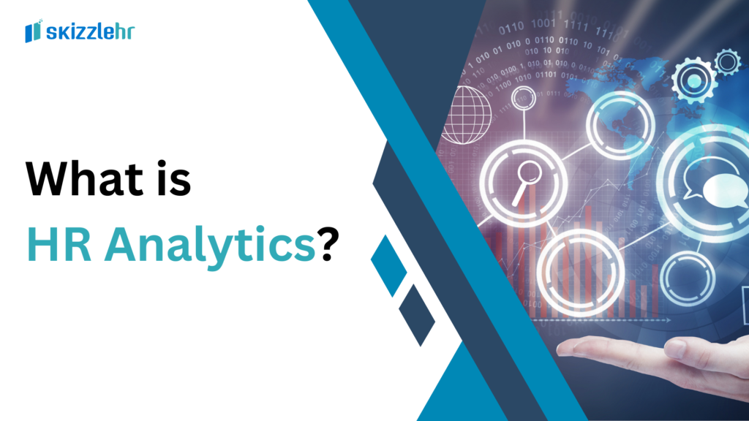
HR ANALYTICS (also known as People Analytics or Workforce Analytics) is the process of collecting, analyzing, and reporting HR data to improve an organization’s performance. Instead of relying on "gut feelings" or traditional intuition, HR professionals use data to make evidence-based decisions regarding their workforce.
At its core, it bridges the gap between Human Resources and Data Science, turning raw employee data into actionable insights that can predict future trends.

Slide 4
The Four Levels of Analytics
Level Type Question Answered Example
1. Descriptive What happened? What was our turnover rate last year?
2. Diagnostic Why did it happen? Why are employees leaving the sales department?
3. Predictive What will happen? Which high-performing employees are at risk of leaving?
4. Prescriptive How can we make it happen? What specific bonus structure will increase retention by 20%?

Slide 5
Key Components & Tools
To effectively run an HR analytics project, a specific technical stack is usually required:
Data Sources: Information pulled from Human Research Information Systems (HRIS), Payroll, Performance Reviews, and Exit Interviews.
Data Cleaning & Manipulation: Using languages like SQL to query databases and Python or R for advanced statistical modeling.
Visualization: Creating dashboards in tools like Tableau or Power BI to make data easy for stakeholders to understand at a glance.

Slide 6
Common Use Cases
Retention & Churn: Identifying patterns among employees who resign to prevent future turnover.
​Recruitment: Analyzing which sourcing channels (LinkedIn, Referrals, Job Boards) produce the highest-quality long-term hires.
​Diversity & Inclusion: Measuring pay gaps or promotion rates across different demographic groups to ensure equity.
​Performance Mapping: Correlating training programs with actual increases in employee productivity.

Slide 7
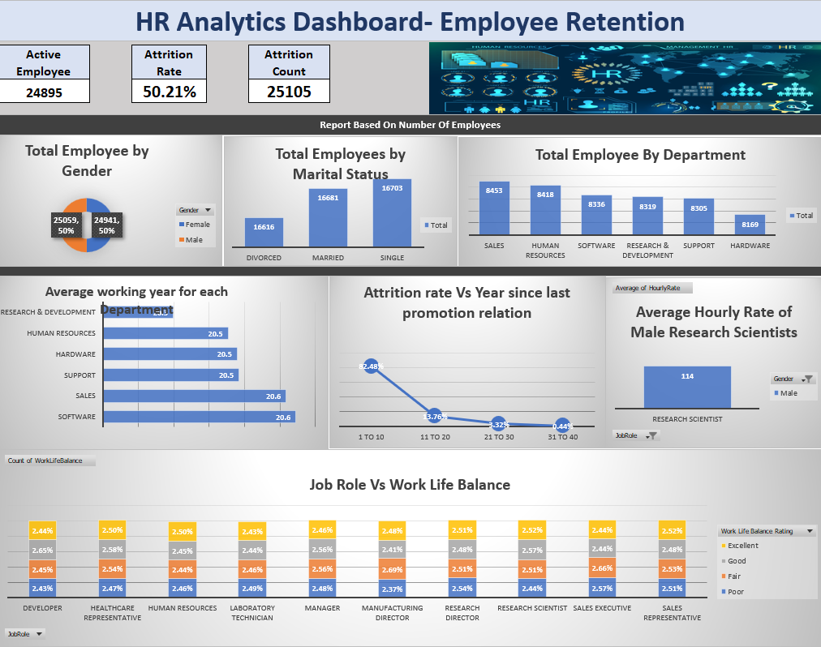
Dashboard in excel

Slide 8
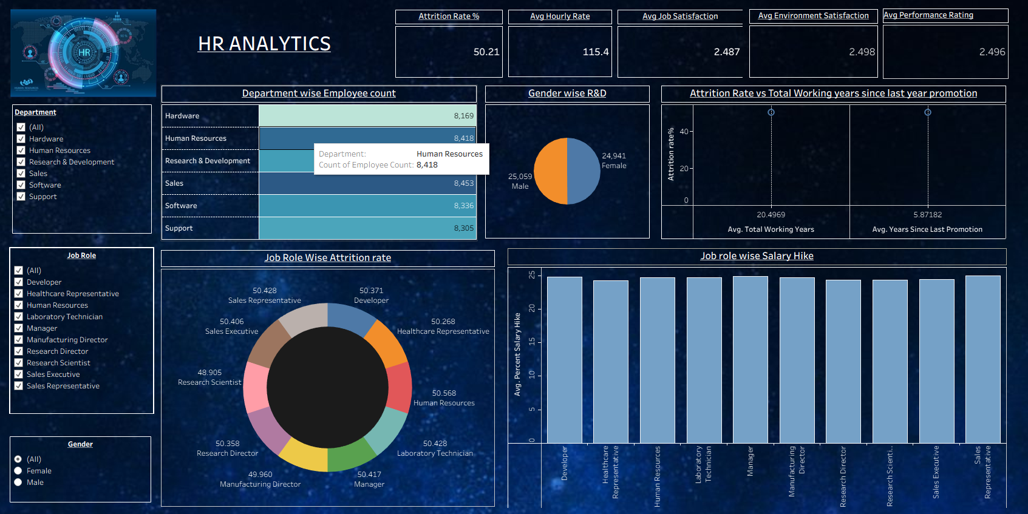
Dashboard in Tableau

Slide 9
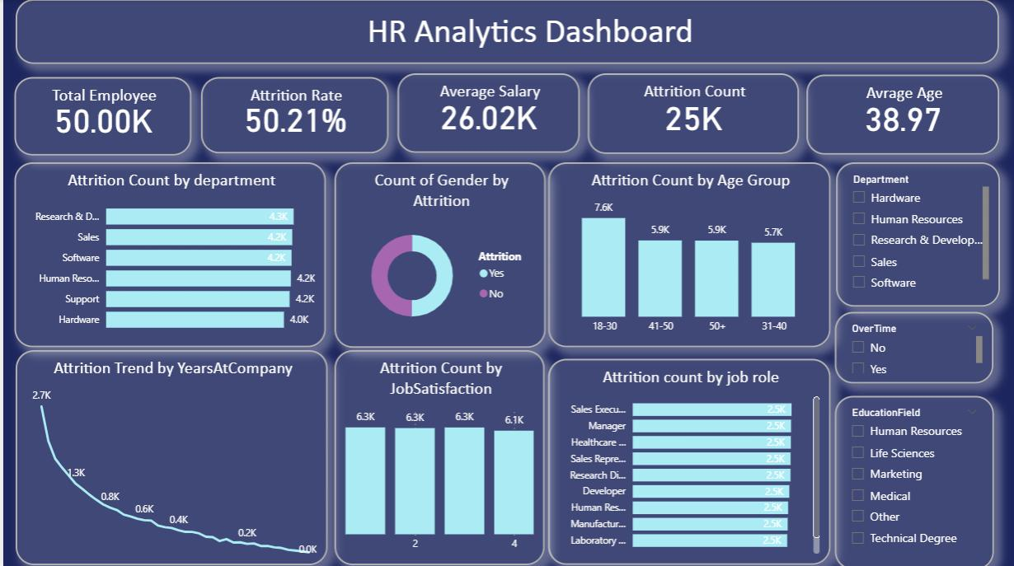
Dashboard in POWER BI

Slide 10
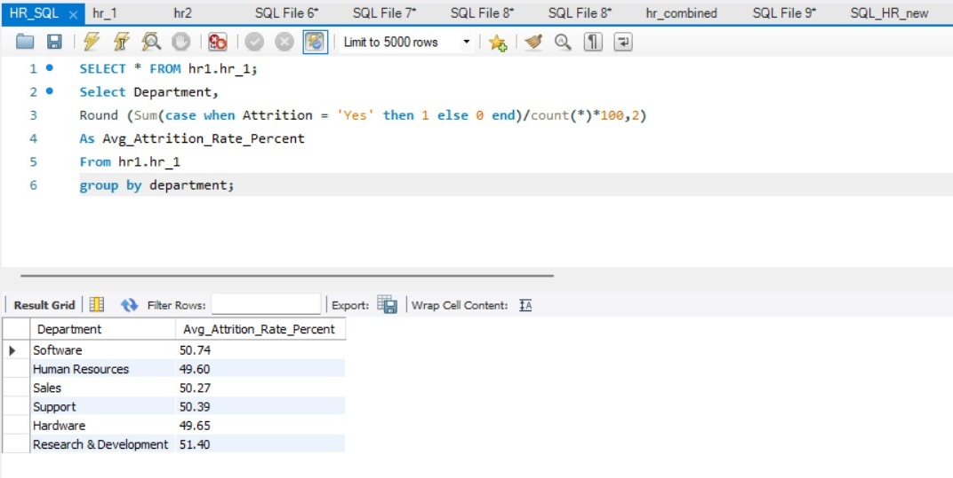
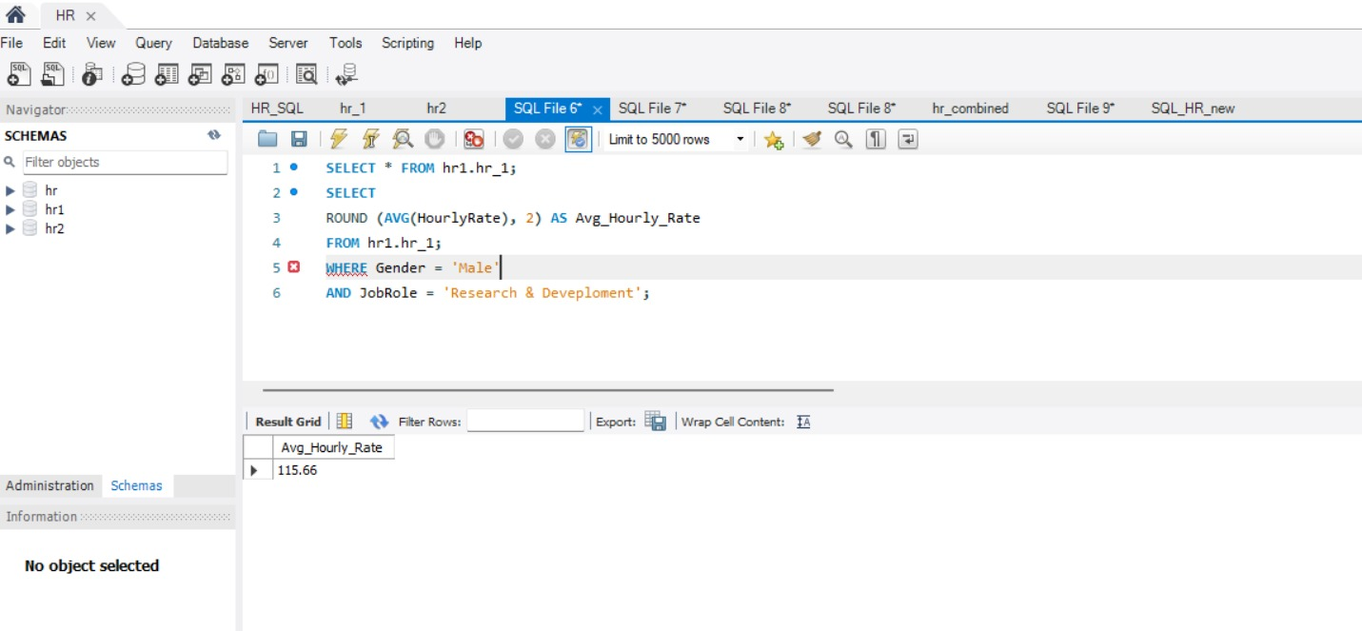
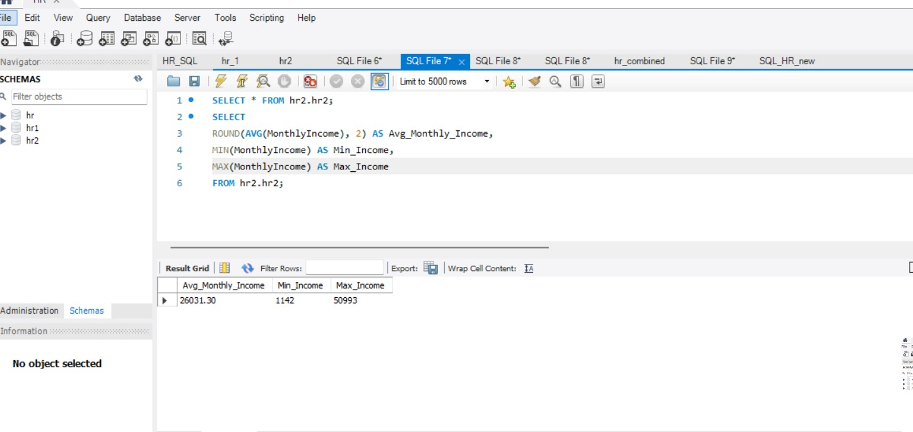
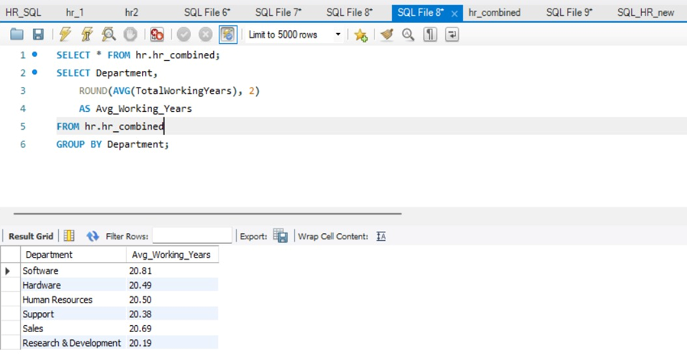
SQL QUERIES

Slide 11
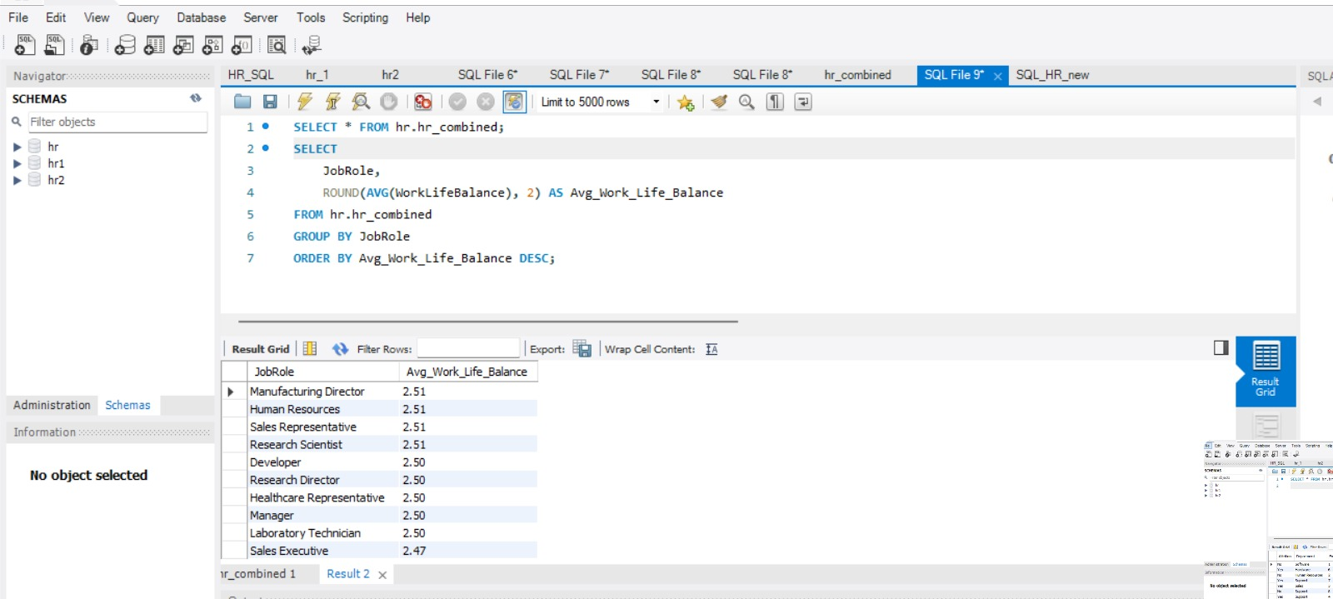
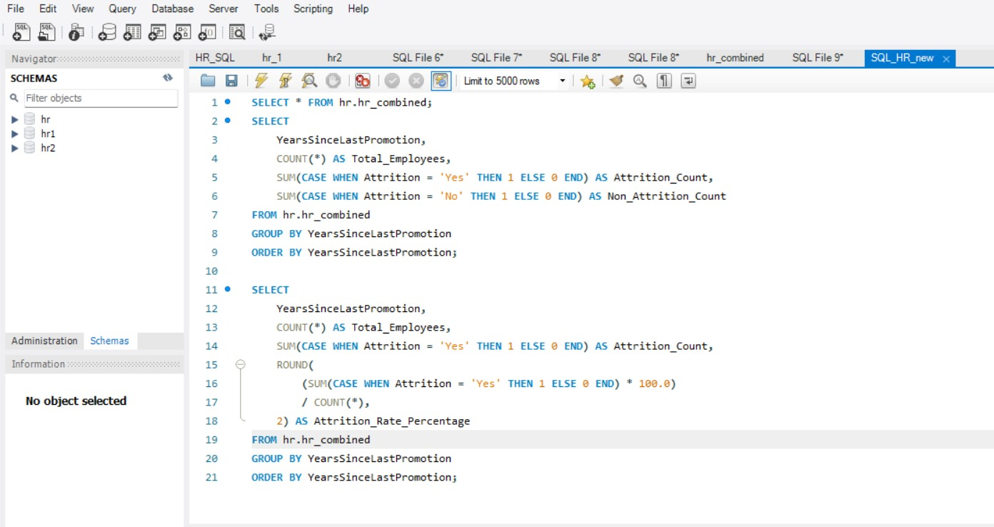
SQL QUERIES

Slide 12
CONCLUSION
HR Analytics project demonstrates that data-driven decision-making is no longer optional for modern organizations. By synthesizing disparate data points—from recruitment efficiency to employee turnover—we have moved beyond simple reporting toward predictive workforce strategy.
The insights gathered highlight a direct correlation between employee engagement initiatives and long-term retention rates. Moving forward, these findings provide a clear roadmap for leadership to address attrition risks before they impact the bottom line. By implementing the recommended interventions, the organization can expect a measurable increase in productivity and a significant reduction in hiring costs.
Ultimately, HR Analytics transforms the human resources function from a traditional cost center into a primary driver of organizational growth. This shift ensures that every people-related decision is backed by evidence, aligning talent management with the company’s broader financial and operational goals.

Slide 13
Key Learnings
Evidence-Based Decisions: Moves HR from "gut feeling" to data-backed strategies.
Predictive Insight: Shifts from analyzing past turnover to preventing future attrition.
Financial Impact: Quantifies how employee engagement directly boosts the bottom line.
Bias Reduction: Uses objective metrics to ensure fairness in hiring and promotions.
Strategic Partnership: Elevates HR from a support function to a core business driver.

Slide 14
Thank you

