Slide 1
Working of Soil Moisture Sensor
The project is about sensing the moisture in the soil in percentage.Here in this project we used soil moisture sensor,ESP8266 board,soil sample.
The wifi connection is given to esp8266 and result observed on the serial monitor that values are given to UBIDOTS dashboard by using API key and graph of result is observed.

Slide 2
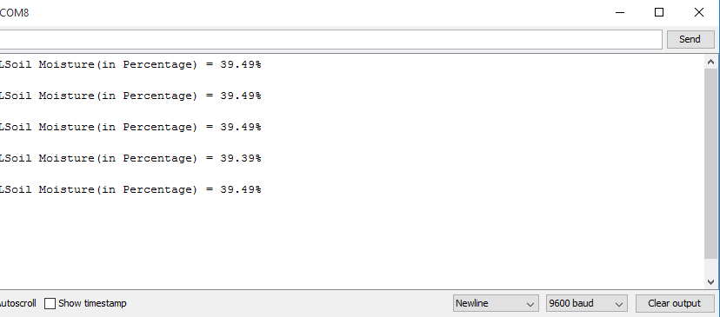
Result

Slide 3
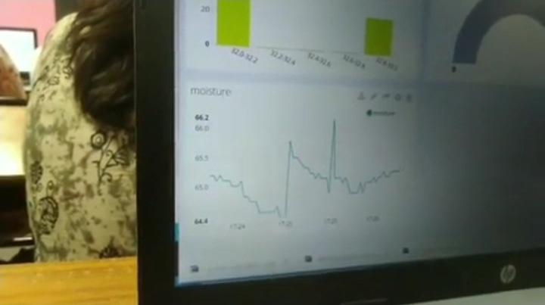
Dashboard Graph

