Slide 1


INSTITUT TEKNOLOGI DEL
Sidang Akhir
HYBRID STACKING ENSEMBLE INTEGRATED WITH RULE-BASED FILTERING FOR PHISHING WEBSITE DETECTION: A PERFORMANCE AND EXPLAINABILITY STUDY
TASI-2526-115
Supervisor : Sarah Rosdiana Tambunan, S.Kom.,M.Cs.
Exeminer I : Junita Amalia, S.Pd., M.Si
Exeminer II : Chandro Pardede, S.Kom., M.Sc.

Slide 2





INSTITUT TEKNOLOGI DEL
TASI-2526-115
12S22005
Nikita Simanjuntak
12S22022
Grace Arintya Siahaan
12S22026
Ruben Sianipar

Slide 3
INSTITUT TEKNOLOGI DEL
Outline
  Background
  Research Question
  Research Purpose
  Scope
  Research methodology
  Research analysis
  Design
  Implementation
  Result & Discussion

Slide 4
INSTITUT TEKNOLOGI DEL
Background
Phishing attacks continue to rise and pose a significant cybersecurity threat. Although Random Forest and XGBoost have demonstrated strong performance in phishing detection, existing approaches often rely on single models and provide limited explanation of their decisions. To overcome these limitations, this study proposes a hybrid framework that combines Rule-Based Filtering, Random Forest, XGBoost, and Stacking Ensemble. In addition, SHAP (SHapley Additive exPlanations) and Large Language Models (LLMs) are integrated to provide transparent and human-readable explanations for phishing detection results.

Slide 5
INSTITUT TEKNOLOGI DEL
Research Question
How do the Random Forest and XGBoost algorithms perform as single models, as well as a combined Stacking model using Logistic Regression as a meta-learner, in detecting phishing websites based on model performance evaluation?
1
How does the implementation of rule-based filtering as an initial layer affect the processing efficiency and consistency of the prediction performance of a phishing detection system based on the combined Random Forest and XGBoost model?
2

Slide 6
INSTITUT TEKNOLOGI DEL
Research Propose
Evaluate and compare the performance of the Random Forest and XGBoost algorithms as single models and as a combined model (ensemble) in detecting new, more complex phishing websites based on accuracy, precision, recall, F1-score, and AUC metrics.
Analyze and evaluate the effect of implementing rule-based filtering as an initial layer on the processing efficiency and consistency of the predictive performance of a phishing detection system based on the combined Random Forest and XGBoost models.

Slide 7
INSTITUT TEKNOLOGI DEL
SCOPE
IMPLEMENTATION SYSTEM :
  Web-based dashboard
  Manual URL input
  Phishing / benign classification output
  Classification probability results
  Top influential features
  AI-generated reasoning and recommendations
Evaluation metric :
  AccurACY
  PRECISION
  RECALL
  F1-SCORE
  AREA UNDER CURVE (AUC)
DATASET :
  Phishing and benign website dataset obtained from the public Kaggle repository.
  Contains URLs and relevant features used for phishing classification.
Algorithm :
  RANDOM FOREST (BASE LEARNER)
  XGBOOST (BASE LEARNER)
  Stacking (Logistic Regression as a meta-learner)
  RULE-BASED FILTERING (PRE-FILTER)
  SHAP (Model Explanation)
  LLM Reasoning

Slide 8
INSTITUT TEKNOLOGI DEL
RESEARCH
METHODOLOGY

Slide 9
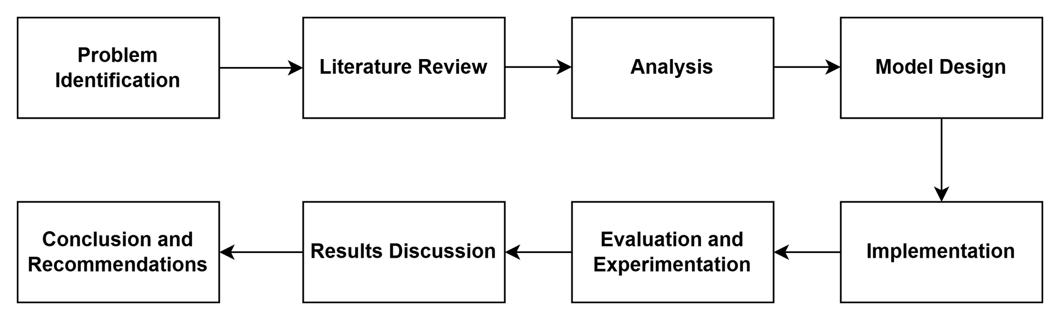
INSTITUT TEKNOLOGI DEL
Research Stages

Slide 10
INSTITUT TEKNOLOGI DEL
RESEARCH
ANALYSIS

Slide 11
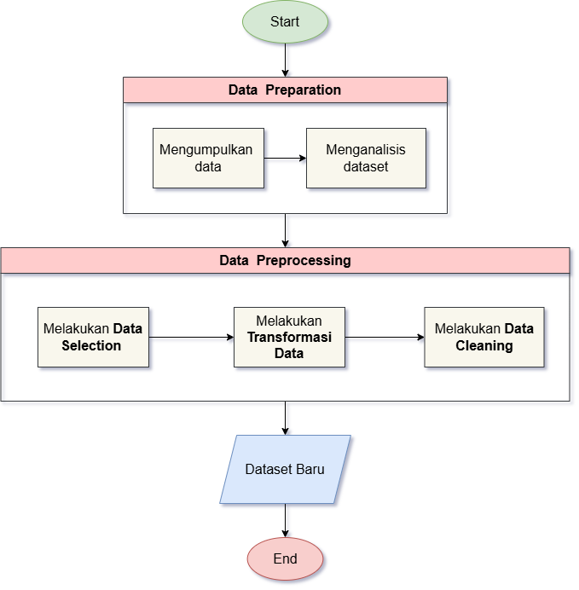
INSTITUT TEKNOLOGI DEL
Data Analysis
DATA PREPARATION:
COLLECTED PHISHING AND BENIGN URL Datasets from public sources and analyzed their characteristics to ensure data quality and relevance.
DATA PREPROCESSING:
PERFORMED FEature selection, data transformation, and data cleaning to prepare the dataset for machine learning modeling.
NEW DATASET:
PRODUCED A CLEAN AND STRUCTURED DATASET CONTAINING 81 phishing detection features for training and evaluation.

Slide 12
INSTITUT TEKNOLOGI DEL
DESIGN

Slide 13
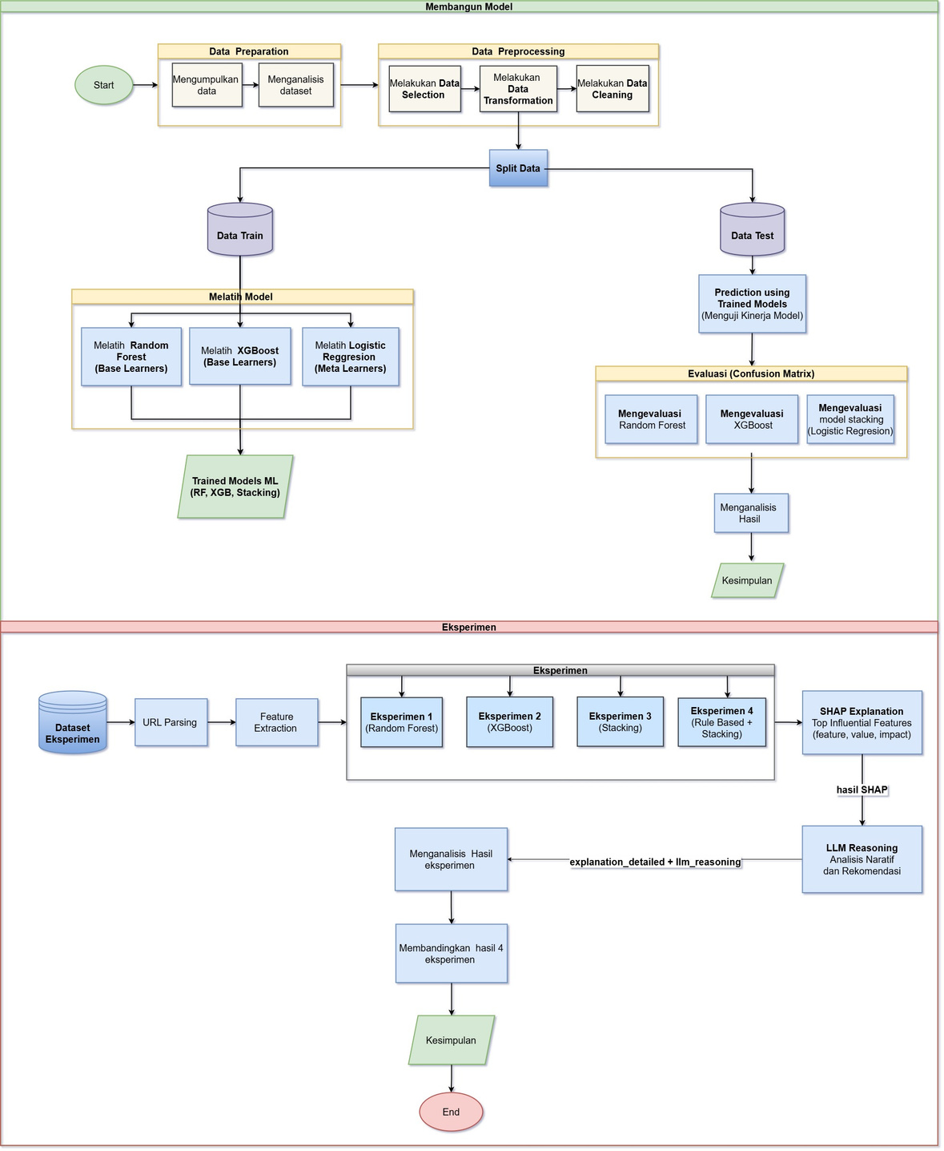
INSTITUT TEKNOLOGI DEL
General System Design

Slide 14
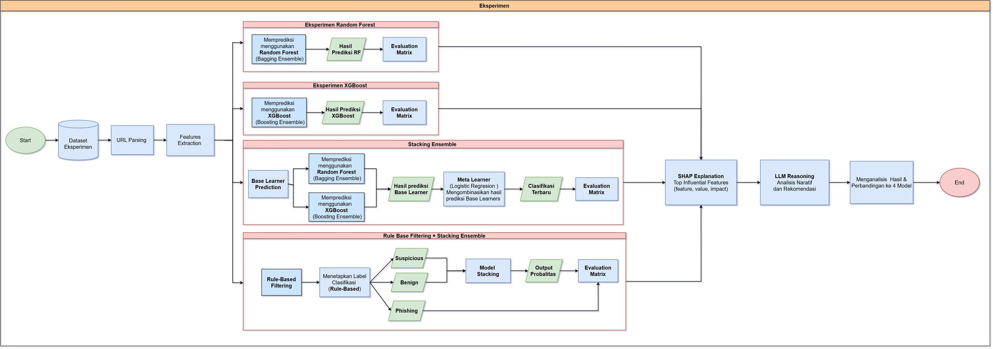
INSTITUT TEKNOLOGI DEL
Experiment Design

Slide 15
INSTITUT TEKNOLOGI DEL
IMPLEMENTATION

Slide 16
INSTITUT TEKNOLOGI DEL
Data Preprocessing
This project is about detecting phishing websites using machine learning. We use data preprocessing, model training, and deployment to build the system. Data Preprocessing is the first step in this project. It prepares the data before training the model.
DATA COLLECTION & ANALYSIS
  Load the phishing dataset
  Analyze data type, rows, and columns
  Check label distribution
  Check missing values and duplicate URLs
DATA SELECTION
  Remove unnecessary columns
  Keep only important features
  Save the selected dataset
DATA CLEANING
  Remove duplicate data based on URL
  Ensure data is clean and consistent
  Save the final dataset
DATA TRANSFORMATION
  Convert labels into numbers
(phishing = 1, legitimate = 0)
  Replace 'status' column with 'label'
  Save the transformed dataset

Slide 17
INSTITUT TEKNOLOGI DEL
Model Development
Model Dvelopment is the process of building and learning the model from data. This step helps the system detect phishing websites.
DATA SPLIT
  SPLIT DATa into training data and testing data (80:20)
  Use 37 URL features
  Or use 81 combined features (URL + web content)
Hyperparameter Optimization
  USe Genetic Algorithm (GA) for tuning
  Optimize Random Forest and XGBoost parameters
  Find the best parameters based on F1-score
MODEL TRAINING
  TRAin Random Forest model
  Train XGBoost model
  Use best parameters from tuning
STACKING MODEL
  Combine multiple models
  Use Random Forest and XGBoost as base models
  Use Logistic Regression as meta-classifier
  Improve prediction performance

Slide 18
INSTITUT TEKNOLOGI DEL
Model Development
CONFUSION MATRIX
  REPRESENT FOUR CLASIFICATION outcomes:
    True Positive
    True Negative
    False Positive
    False Negative
  Basis for Calculating evaluation metric.
MODEL EVALUATION
  EVALUATE model using:
    Accuracy
    Precision
    Recall
    F1-score
    AUC
  Measure model performance
MODEL SAVING
  SAVE BEST PARAMETERS in JSON file
  Save model in pickle file
  Save metadata (features, median, etc.)

Slide 19
INSTITUT TEKNOLOGI DEL
Deployment
Deployment is the process of using the trained model in a real application. Users can check if a website is phishing or not.
PREDICTION PROCESS
  EXTRACT features from the URL
  Apply rule-based filtering
  Use machine learning model if needed
  Return prediction and probability in JSON
Flask API
  USe Flask API for prediction
  Provide endpoint for URL input
  Return prediction result
MODEL LOADING
  LOAD model and metadata once
  Done when the application starts
  Make prediction faster
Feature Extraction
  EXTRACT URL features automatically
  Extract web content features if needed
  Use features for prediction

Slide 20
INSTITUT TEKNOLOGI DEL
SHAP
SHAP is used to explain how each feature contributes to the model's prediction. It identifies the most influential features affecting phishing or benign classifications, making the decision-making process more transparent.
Implementation:
  TREEEXPLAINER → RANDOM Forest & XGBoost
  KernelExplainer → Stacking Ensemble (Logistic Regression)
  Displays Top Influential Features
  Shows positive and negative feature contributions

Slide 21
INSTITUT TEKNOLOGI DEL
LLM Reasoning
Large Language Model (LLM) Reasoning is used to transform technical prediction results and SHAP outputs into human-readable explanations.
Implementation:
  PREDICTION result
  Probability score
  Top SHAP features
  Feature contributions

Slide 22
INSTITUT TEKNOLOGI DEL
RESULTS &
DISCUSSION

Slide 23
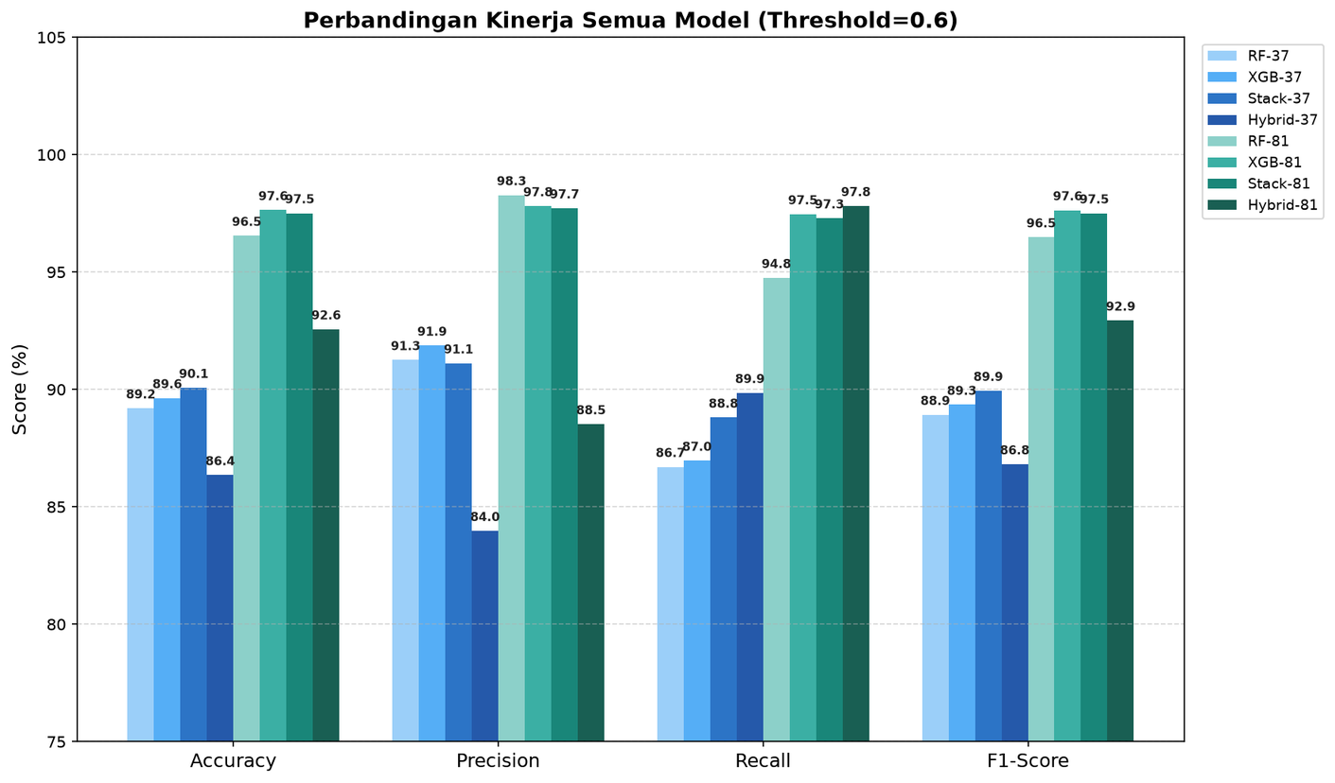
INSTITUT TEKNOLOGI DEL
Comparison Results of The Performance of All Models on The Test Data

Slide 24
INSTITUT TEKNOLOGI DEL
SHAP (SHapley Additive exPlanations) Interpretation
Rank | Random Forest | XGBoost | Stacking
0 | Google_index 0.0888 | page_rank 1.5294 | page_rank 0.1095
1 | page_rank 0.0749 | google_index 1.1084 | google_index 0.0920
2 | nb_hyperlinks 0.0418 | nb_www 0.9198 | nb_hyperlinks 0.0468
3 | web_traffic 0.0391 | nb_hyperlinks 0.7248 | nb_www 0.0443
4 | nb_www 0.0358 | phish_hints 0.5188 | web_traffic 0.0299

Slide 25
INSTITUT TEKNOLOGI DEL
Hasil SHAP dalam Eksperimen
URLPhishing: http://nmhokdypni.sum4iit.club/vnafvra97w/q=3717065149&id=100
URL Benign : https://www.ietf.org/
Rank | Random Forest 0.3597 | XGBoost 0.0264 | Stacking 0.072 | Hybrid 0.072
0 | google_index +0.1450 | nb_hyperlinks -1.4353 | google_index +0.1450 | google_index+0.1450
1 | page_rank -0.0773 | google_index +1.4181 | page_rank -0.0773 | page_rank-0.0773
2 | nb_hyperlinks -0.0766 | nb_www -1.4036 | nb_hyperlinks -0.0766 | nb_hyperlinks-0.0766
3 | web_traffic +0.0640 | page_rank -1.2708 | web_traffic +0.0640 | web_traffic+0.0640
4 | nb_www -0.0588 | shortest_word_path -0.4203 | nb_www -0.0588 | nb_www-0.0588
Rank | Random Forest 0.7405 | XGBoost 0.8191 | Stacking 1.8775
1 | nb_www +0.0974 | nb_and -0.6216 | nb_and -0.6216
0 | ratio_digits_url +0.2324 | ratio_digits_url +1.7030 | ratio_digits_url +1.7030
2 | length_url -0.0784 | nb_www +0.5340 | nb_www +0.5340
3 | nb_eq -0.0258 | nb_eq -0.4515 | nb_eq -0.4515
4 | nb_www 0.0358 | length_url -0.4400 | length_url -0.4400
This phishing URL was immediately classified as Hard Risk by the rule-based filtering layer because it detected the critical rule suspicious_tld (.club) with a score of 0.95 (>0.60). | This phishing URL was immediately classified as Hard Risk by the rule-based filtering layer because it detected the critical rule suspicious_tld (.club) with a score of 0.95 (>0.60). | This phishing URL was immediately classified as Hard Risk by the rule-based filtering layer because it detected the critical rule suspicious_tld (.club) with a score of 0.95 (>0.60). | This phishing URL was immediately classified as Hard Risk by the rule-based filtering layer because it detected the critical rule suspicious_tld (.club) with a score of 0.95 (>0.60).

Slide 26
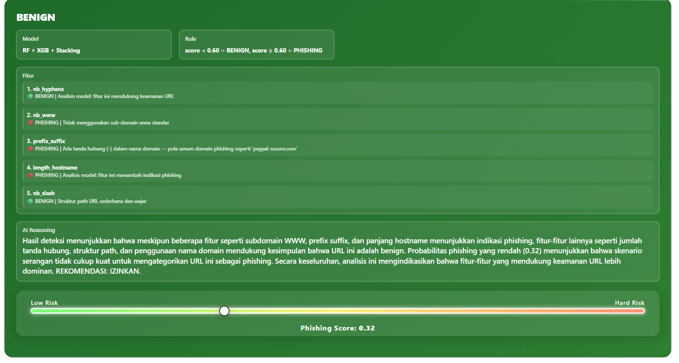
INSTITUT TEKNOLOGI DEL
Large Language Model

Slide 27
INSTITUT TEKNOLOGI DEL
Confusion Matrix Evaluation and Single Model Evaluation Metrics
Parameter | Keterangan | Random Forest | XGBoost
True Positive (TP) | Phishing diprediksi Phishing | 1.111 | 1.114
True Negative (TN) | Benign diprediksi Benign | 1.111 | 1.115
False Positive (FP) | Benign diprediksi Phishing | 32 | 28
False Negative (FN) | Phishing diprediksi Benign | 32 | 29
Metrik Evaluasi | Random Forest | XGBoost
Accuracy | 97.2% | 97.5%
Precision | 97.2% | 97.5%
Recall | 97.2% | 97.4%
F1-Score | 97.2% | 97.5%
AUC | 99.5% | 99.7%
Based on the evaluation metrics, XGBoost outperforms Random Forest as the gradient boosting approach significantly reduces classification errors (FP and FN). This model proves to be more adaptive and effective in distinguishing complex patterns between phishing URLs and benign sites.

Slide 28
INSTITUT TEKNOLOGI DEL
Model PerforEvaluation of Stacking Ensemble and Rule-Based Filtering in Phishing Detectionmance
The Hybrid system is implemented with a defense-in-depth architecture. In the initial stage, each URL is evaluated by Rule-Based Filtering using a risk score calculation. If a URL has a risk score of ≥ 5, the system will immediately block it and classify it as phishing. Conversely, URLs that pass this stage will be forwarded to the Stacking model for further evaluation. This implementation approach is very efficient because it has been proven to reduce the machine learning processing load by up to 24.5% and speed up computation time, although there is a slight increase in False Positives due to the strict filtering in the initial stage.
The Stacking Ensemble model combines Random Forest and XGBoost using Meta-Learners Logistic Regression. The evaluation results show that the Stacking Ensemble model achieves an accuracy of 97.5%, confirming a performance improvement compared to the single Random Forest model. Although this combination successfully corrected some of the classification errors of the base model, its overall performance was not able to surpass the achievement of a single XGBoost (97.6%).

Slide 29
INSTITUT TEKNOLOGI DEL
Evaluation of Stacking and Hybrid Models Using Confusion Matrix and Performance Metrics
Parameter | Keterangan | Stacking Ensemble | Hybrid
True Positive (TP) | Phishing diprediksi Phishing | 1.112 | 1.118
True Negative (TN) | Benign diprediksi Benign | 1.117 | 998
False Positive (FP) | Benign diprediksi Phishing | 26 | 145
False Negative (FN) | Phishing diprediksi Benign | 31 | 25
Metrik Evaluasi | Stacking Ensemble | Hybrid
Accuracy | 97.5% | 92.5%
Precision | 97.7% | 88.5%
Recall | 97.2% | 97.8%
F1-Score | 97.5% | 92.9%
AUC | 99.6% | 98.7%
Based on the evaluation results, the Stacking Ensemble model provided the best overall performance with higher accuracy, precision, F1-score, and AUC values ​​and a lower number of false positives. Meanwhile, the Hybrid model had slightly higher recall, indicating better ability in detecting phishing, but with the trade-off of increased false positives. Therefore, Stacking is more optimal for balanced performance, while Hybrid is more suitable for security-oriented approaches.

Slide 30
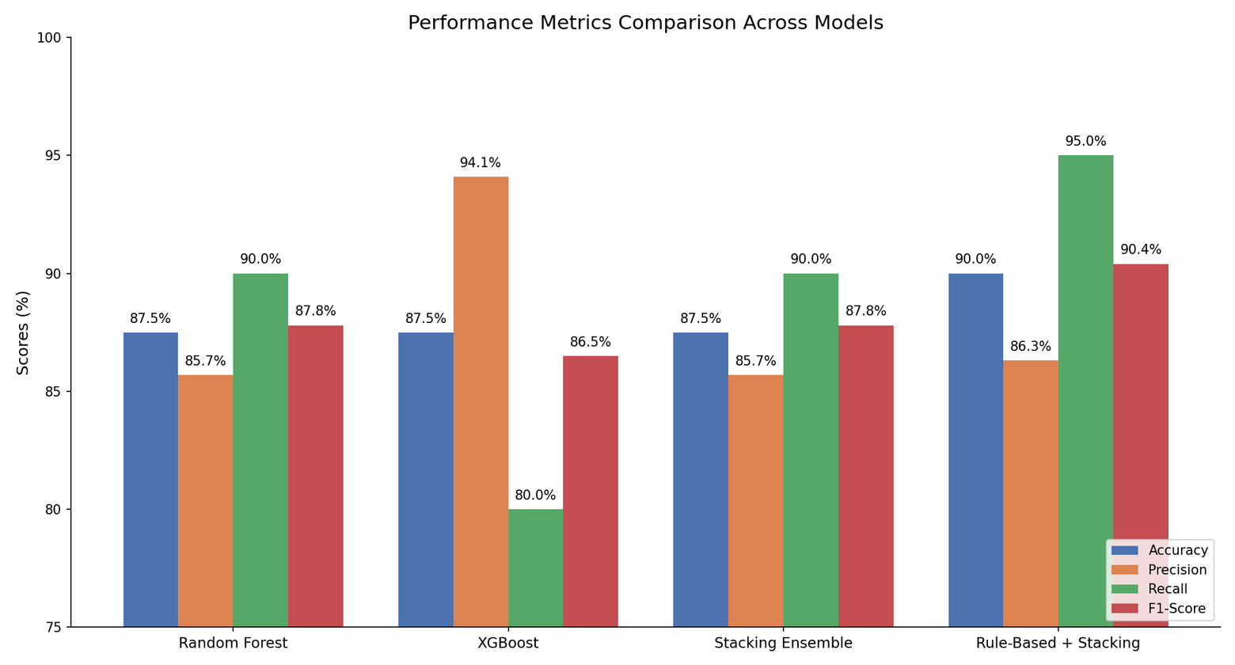
INSTITUT TEKNOLOGI DEL
COMPARATIVE EXPERIMENTS ACROSS MODELS
On the 40-URL real-world test, Random Forest, XGBoost, and Stacking Ensemble achieved equal accuracy (87.5%). After integrating Rule-Based Filtering, accuracy increased to 90.0% and recall rose to 95.0%, demonstrating its role in reducing missed phishing detections.

Slide 31
INSTITUT TEKNOLOGI DEL
DISCUSSION
Hybrid models accelerate the machine learning process by applying rule-based filtering early on. High-risk URLs are classified directly without going through the ML model, reducing the amount of data processed by the stacking model. This reduces computational overhead and speeds up inference time. However, this approach has the trade-off of increasing false positives due to stricter rules in the early stages.
Aspect | Hybrid (Rule-Based + Stacking) | Analysis | Stacking
Total URLs | 2286 | Same | 2286
URLs Processed by Rule-Based | 560 URL 24.5% | Hybrid reduces ML workload | 0 (0%)
URLs Processed by ML | 1.726(75.5%) | Reduced computational load | 2,286 (100%)
Batch Time (seconds) | 0.1736 | 12.0% faster | 0.1972
Time Reduction | 0.0236 seconds | Small but measurable efficiency gain | –
Throughput (URLs/s) | 13.164,7 | Slightly higher in Hybrid | 11.593,1

Slide 32
INSTITUT TEKNOLOGI DEL
The implementation of the hybrid approach offers advantages in terms of computational efficiency. By implementing Rule-Based Filtering at the initial stage, 24.5% of URLs were successfully filtered without going through the machine learning process, reducing the computational burden and speeding up inference time by up to 12.0%, as well as increasing system throughput. This demonstrates the effectiveness of the hybrid approach in optimizing the use of computing resources.
Furthermore, in terms of system intelligence and resilience, the Stacking model is able to capture complex and non-linear phishing manipulation patterns, which cannot be detected by static rules in rule-based filtering. Thus, the combination of these two approaches results in a system that is not only efficient but also adaptive to the development of increasingly complex phishing attack patterns.

Slide 33
INSTITUT TEKNOLOGI DEL
TERIMA KASIH
Presentation By: TASI-2526-115

