Slide 1

CURRENT STATUS: READY TO PUBLISH
Updated – 6 October 2026
October 2026
FY26 | VERSION 1

Slide 2

Terraform Core/CLI – GitHub Releases
From Terraform Releases
July
August
September
v1.17.0-alpha20260729
Pre-release, bug fixes
v1.16.0-beta1 (2026-07-23)
Terraform adds improved state handling, import flexibility, enhanced provider and action trigger capabilities.
v1.16.0 - alpha (2026-07-15)
Pre-release
v1.15.8 (2026-07-08)
  Bug fixes
v1.16.0 - alpha (2026-07-08) & v1.16.0 - alpha (2026-07-06)
v1.17.0 - alpha (2026-08-27)
Pre-release
v1.16.0 (2026-08-26)
New features + enhancements + bug fixes
v1.16.0 – rc2 (2026-08-19)
Pre-release
v1.15.9 (2026-08-19)
  Bug fixes
v1.17.0 - alpha (2026-08-12)
Pre-release
v1.16.0-rc1 (2026-08-12)
Pre-release
v1.16.0 – beta2 (2026-08-05)
Pre-release
v1.16.5 (2026-09-30)
Bug Fixes
v1.17.0-beta2 (2026-09-23)
Pre-release
v1.16.4 (2026-09-23)
Bug Fixes
v1.16.3 (2026-09-16)
Bug Fixes
v1.17.0-beta1 (2026-09-09)
Pre-release
v1.16.2(2026-09-09)
Bug Fixes
v1.16.1 (2026-09-02)
Bug Fixes

Slide 3

Terraform Enterprise Upgrades
From Terraform Releases
July
August
September
Terraform Enterprise v1.2.4 (2026-07-06)
  Focuses on security hardening, addressing vulnerabilities and strengthening content boundary enforcement for VCS-based module ingestion, including remediation for CVE-2026-14468
Terraform Enterprise v2.0.5 (2026-08-06)
  Delivers targeted reliability, identity and integration improvements, addressing SCIM synchronization with Microsoft Entra ID, GitHub Enterprise Cloud workflows, private registry processing, and security vulnerabilities.
Terraform Enterprise v2.0.8 (2026-09-23)
  Improves deployment reliability by fixing Sidekiq startup failures when using a separate Redis instance with mTLS and password authentication.
Terraform Enterprise v2.0.7 (2026-09-18)
  Strengthens VCS integrations and Terraform 1.15 compatibility while improving drift detection, connectivity, and overall platform security.
Terraform Enterprise v2.0.6 (2026-09-01)
  Focused maintenance release that improves operational flexibility and platform reliability, while strengthening security and addressing issues across VCS operations, Terraform Stacks, Explorer, and multi-architecture deployments.

Slide 4

HCP Terraform Upgrades
From Terraform Releases
August
September
October
2026-08-28
Manage team tokens with bulk deletion and filters for active, expired, expiring in 7 or 30 days, and no expiration.
2026-08-25
An Actions dropdown is now available, providing options for Select All, Reset Selection, and Bulk Delete. A warning message and delete confirmation modal have been added to prevent accidental deletions.
2026-08-20
The add_team and remove_team project audit events now include team_id, team_name, permissions, and project_name, ensuring historical records remain reliable even if team names change.
2026-08-13
Fixed the display of workspace and project counts in policy set summaries and indexes when the policy set is not a Terraform Policy VCS policy set.
2026-08-06
HCP Terraform now sends notification emails when API tokens are nearing expiration (30 days and 7 days.
2026-09-17
Enhanced team management and auditability with team descriptions and richer, persistent audit metadata across organizations, memberships, permissions, teams, projects, and variable sets..
2026-09-16
The Teams page now includes an "ID" copy link, allowing you to easily copy the team ID for use in other workflows. This addition enhances the usability of the Teams page by providing a quick and convenient way to access the team ID.
2026-09-10
Terraform policy can now evaluate policies against Stacks. Evaluations are triggered during a deployment run, and occur post-plan.
2026-09-05
Tags are now a valid scope for a policy set. Use matching logic of 'And'/'Or' to specify whether all or just one of the specified tags should be present on a workspace for it to be targeted by a policy set.
2026-10-02
HCP Terraform now supports Azure DevOps Org scoped Personal Access Tokens, allowing users to connect using tokens scoped to a specific organization, rather than globally. This change enables users to migrate their VCS connections before Microsoft retires global PATs on December 1, 2026.
2026-10-01
HCP Terraform expands identity lifecycle management and auditability with SCIM provisioning and richer audit metadata for authentication tokens and SAML configuration changes.

Slide 5

Terraform Recent Blogs
From Blogs
September 28 – See here
Terraform 1.16 completes Actions lifecycles and brings imports into child modules
Explore Topics!
Speed & agility
Risk & Compliance
Optimize operations
Infra Automation
September 22 – See here
Terraform provider for Google Cloud 8.0 now generally available
Secrets & identity management
Platform Engineering
Culture & Collaboration
AI
September 17 – See here
Simplify compliance with the native pre-written policy experience in HCP TF
August 5 – See here
HCP Terraform is the control plane for AI-driven infrastructure
September 15 – See here
Simplify Terraform for IBM Z with intent-driven workflows
July 28 – See here
Terraform AzureRM provider 5.0 now generally available
September 3 – See here
Introducing HCP Terraform Metrics: operational visibility at scale
July 23 – See here
Terraform Stacks, explained

Slide 6


Terraform Upcoming Webinars
All global events here​
NOV 4, 2026 | WEBINAR | See here
Build, deploy, and manage everything as code
Automation has grown from simple scripts on servers to the deployment and management of entire environments including everything from applications, networking, infrastructure, security, and even people. In this webinar learn how both HashiCorp Terraform and the HashiCorp Cloud Platform can be used to create and administer all areas of a modern public cloud environment as code.
DEC 8, 2026| WORKSHOP | See here
Executive roundtable: Agentic Runtime Security
Join fellow security, identity, and technology leaders for an executive discussion on the emerging risks associated with agentic AI and the practical strategies organizations can adopt to securely enable AI-driven innovation.
DEC 9, 2026 | WORKSHOP | See here
Hands-on workshop: Cloud Foundations
Join us for an immersive 2-hour hands-on session demonstrating the gold standard for provisioning and managing enterprise cloud infrastructure.

Slide 7

Vault Enterprise Release Updates
From Vault Releases
June
August + September
September
v2.0.3 (2026-06-17)
Introduces native support for AI agents (public beta), extending Vault's machine identity and secrets management capabilities to emerging AI-driven workloads.
Operational and user experience improvements include enhanced Cloud Foundry authentication efficiency, refreshed usage dashboards, and UI stability enhancements.
v1.21.8 / v.1.20.13 / v.1.19.19 (2026-06-17)
Bug fixes and improvements
v2.0.2 (2026-06-05)
Breaking changes
Containers: Remove cap_ipc_lock capability on vault at build time Runtime operators are advised to disable swapping to guarantee data safety.
secrets/ssh: RSA key sizes are now limited to a maximum size of 8192 bits addressing CVE-2026-39829
v1.21.11 / v.1.20.16 / v.1.19.22 (2026-09-16)
Added a "Submit feedback" button to the sidebar navigation and the Help and Support dropdown, linking to an external feedback survey.
Bug fixes and improvements
v1.21.10 / v.1.20.15 / v.1.19.21 (2026-09-01)
Bug fixes and improvements
v1.21.9 / v.1.20.14 / v.1.19.20 (2026-08-05)
Bug fixes and improvements
v2.0.4 (2026-08-04)
Expands Vault’s machine identity capabilities with native AI-agent support, while delivering targeted reliability, operational and UX improvements and continuing to strengthen the platform’s security posture
v2.1.1 /v.1.21.11 /v1.20.16 /v1.19.22 (2026-09-16)
Strengthens secrets import and identity integrations with trusted private endpoint controls for AWS/Azure imports and enhanced Okta group retrieval for JWT/OIDC authentication.
The release also expands PKI flexibility by supporting additional CSR subject attributes, while delivering security patches and fixes across Secrets Sync, Agent Registry, leases, and the Vault UI.
v2.1.0 (2026-09-01)
Agentic IAM reaches General Availability, extending Vault’s machine identity and security capabilities to AI agents and emerging agentic workloads.
Expanded OAuth support, policy flexibility, and platform improvements enhance the security, reliability, and operational experience of Vault

Slide 8

HCP Vault Release Updates
From Vault Releases
July
August
September
2026-07-07
Vault 2.0.3 is now available for HCP Vault Dedicated clusters on AWS and Azure. Refer to the Vault 2.0.3 release notes to learn more about the new features, enhancements, and fixes included in Vault 2.0.3
2026-08-24
Connectivity Tester: HCP Vault Dedicated clusters on AWS and Azure now support a connectivity tester that validates network connectivity between the cluster and external endpoints.
2026-09-23
Data plane account details: HCP Vault Dedicated clusters on AWS and Azure now expose the data plane account details directly..
2026-09-11
Vault 2.0.4: Vault 2.0.4 is now available for HCP Vault Dedicated clusters on AWS and Azure. Refer to the Vault 2.0.4 release notes to learn more about the new features, enhancements, and fixes included in Vault 2.0.4.

Slide 9
Vault Recent Blogs
From Blogs
September 3 – See here
The common security controls behind India's regulatory wave
Explore Topics!
Speed & agility
Risk & Compliance
Optimize operations
Infra Automation
September 1 – See here
HashiCorp Vault agentic IAM is now generally available
Secrets & identity management
Platform Engineering
Culture & Collaboration
AI
August 27 – See here
Stream HCP Vault Dedicated audit logs to Microsoft Sentinel
July 13 – See here
Preparing for the post-quantum era: Discover and prioritize now
July 21 – See here
AI speeds software development. Is your secret security keeping up?
July 10 – See here
Announcing the public beta of Vault Kubernetes key management
July 16 – See here
Understanding Vault performance: Benchmarks from real-world workloads
June 24 – See here
HCP Vault Dedicated introduces cluster disaster recovery (public preview)

Slide 10
Vault Upcoming Webinars
All global events here
OCT 13, 2026| WEBINAR | See here
Get Certified at TechXchange
Get ready for Atlanta! Learn how to maximize your TechXchange experience with onsite certification exams. Get the first look of our new certifications launching in October (or at the conference), including an exciting new AI credential. We'll also explore IBM and HashiCorp certifications that tailors to your career path/growth.
DEC 8, 2026| WORKSHOP | See here
Executive roundtable: Agentic Runtime Security
Join fellow security, identity, and technology leaders for an executive discussion on the emerging risks associated with agentic AI and the practical strategies organizations can adopt to securely enable AI-driven innovation.
DEC 10, 2026| WEBINAR | See here
Hands-on workshop: Vault Quickstart
Join us at the Vault Quickstart workshop, an immersive learning experience designed to demonstrate how to get started with Vault to secure applications, identities and protect sensitive data.

Slide 11
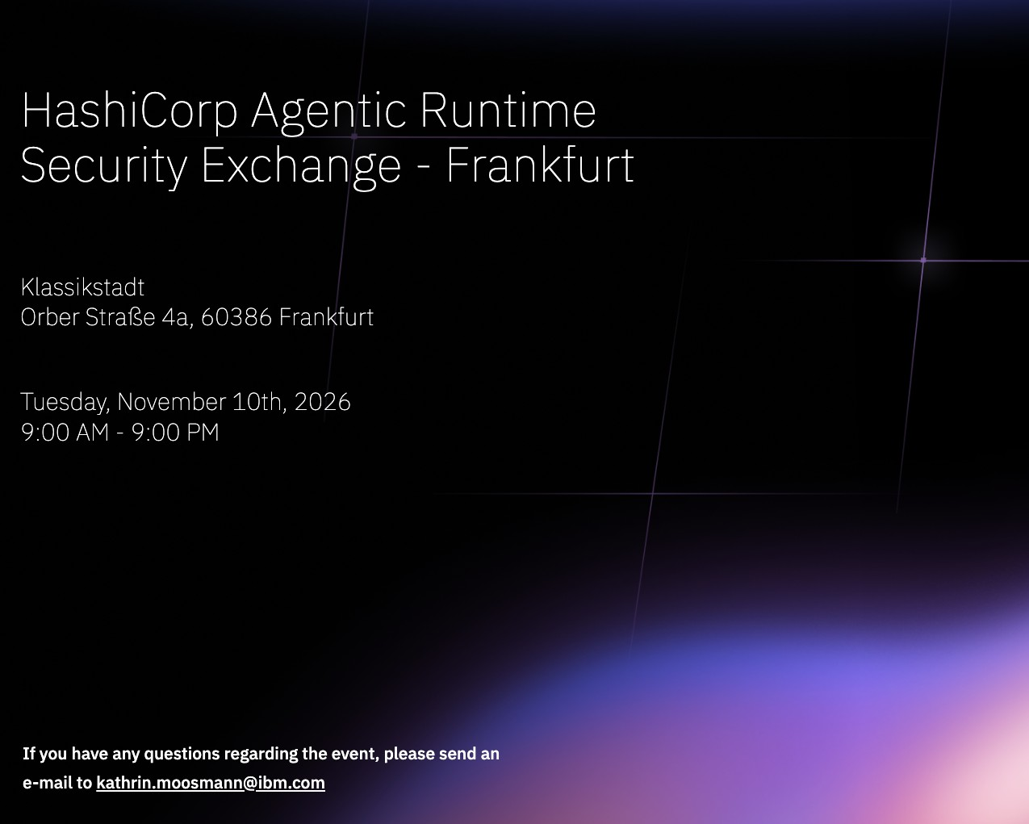

Agentic Runtime Security Exchange Frankfurt
Event | November 10 | Business Track | Practitioner Track
Join industry peers at this thought leadership event as we explore how agentic AI, non-human identities, IAM gaps, and runtime security risks are reshaping real-world deployments.
Gain practical insights into securing the agentic runtime and aligning identity, access, and governance models to safely scale AI-driven initiatives.

