Slide 1

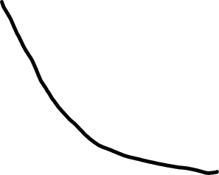




Word-wise error
SGD
Momentum
LBFGS
Number of effective pass

