Slide 1

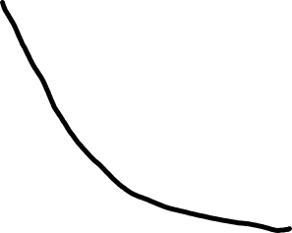




Training objective value
SGD
Momentum
LBFGS
Effective number of passes

