Slide 1
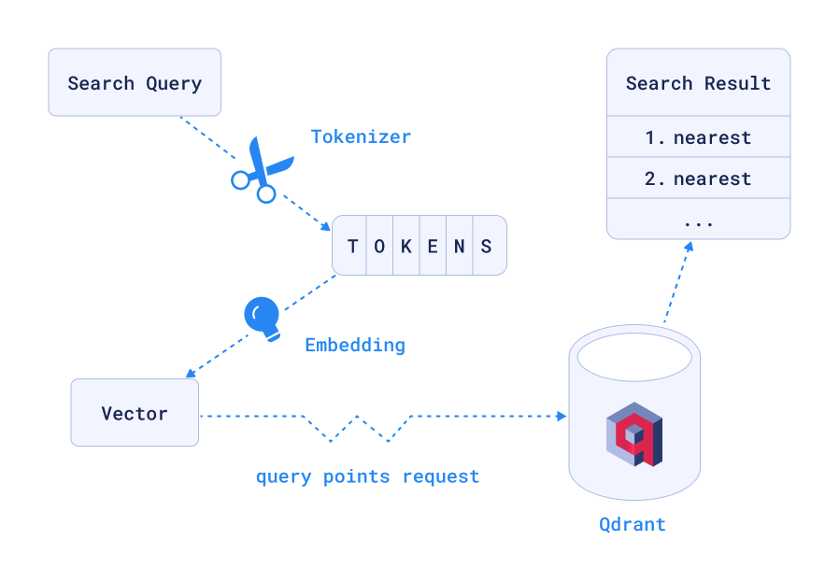
SEMANTIC SEARCH
QDRANT VECTOR DATABASE
Notes:
16 billion in a fraction of seconds

Slide 2

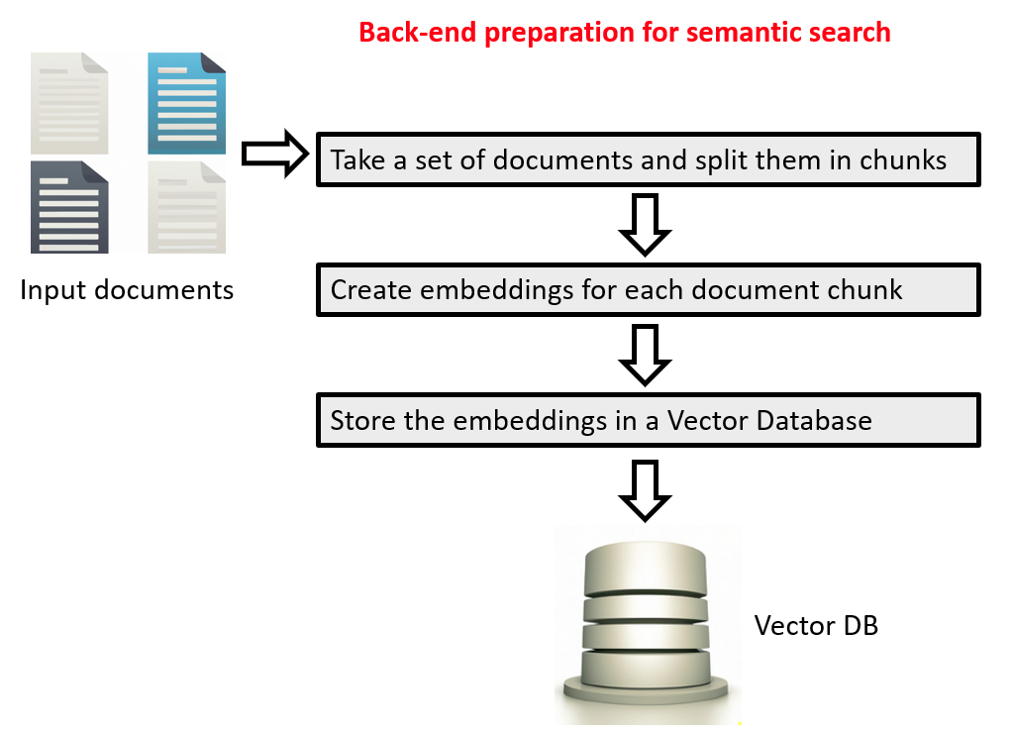
SEMANTIC SEARCH
VECTOR DATABASE: Open-source Qdrant
Confidential
Notes:
16 billion in a fraction of seconds

Slide 3
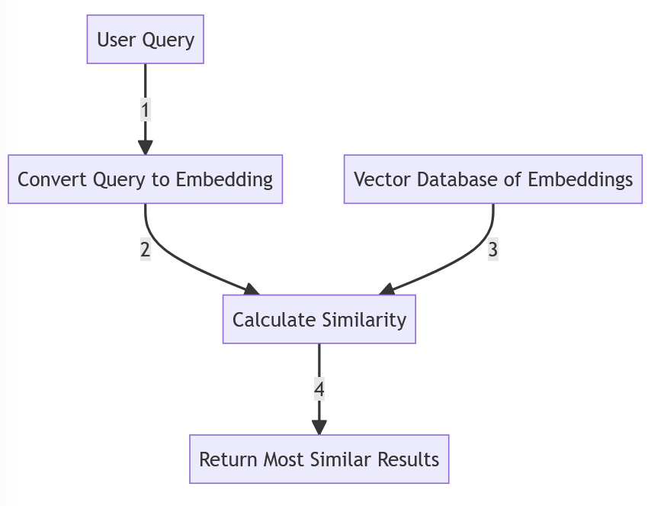
EMBEDDINGS SEMANTIC SEARCH
Notes:
16 billion in a fraction of seconds

Slide 4









Competition
Local is the key drive(r): we DON’T share your data
We made a step forward removing the need for AI to depend on cloud solutions and created an entirely local process.
Traditional local search
Generative AI
LLM
KG
Local process
Your company data
in their clouds
Confidential

