Slide 1
Clinical Decision Support Assistant Using Generative AI
Prepared by
Nikita Pawar
MS Information Technology
Arizona State University
Cotiviti Internship Assessment

Slide 2
Presentation Overview
Problem Statement
Project Objective
Technologies Used
Application Workflow
Proof of Concept Demo
Benefits to Cotiviti
Future Enhancements
Conclusion

Slide 3
Problem Statement
Healthcare professionals review large volumes of unstructured clinical notes every day.
Challenges:
Time-consuming manual review
Difficult to identify high-risk patients quickly
Documentation burden
Solution:
Develop an AI-powered Clinical Decision Support Assistant using Google Gemini.

Slide 4
Technologies Used
• Python
• Streamlit
• Google Gemini 2.5 Flash
• google-generativeai
• python-dotenv
• Visual Studio Code

Slide 5
Application Workflow
Clinical Notes → Gemini AI Analysis → Patient Summary → Risk Level → Key Findings → Recommended Next Steps

Slide 6
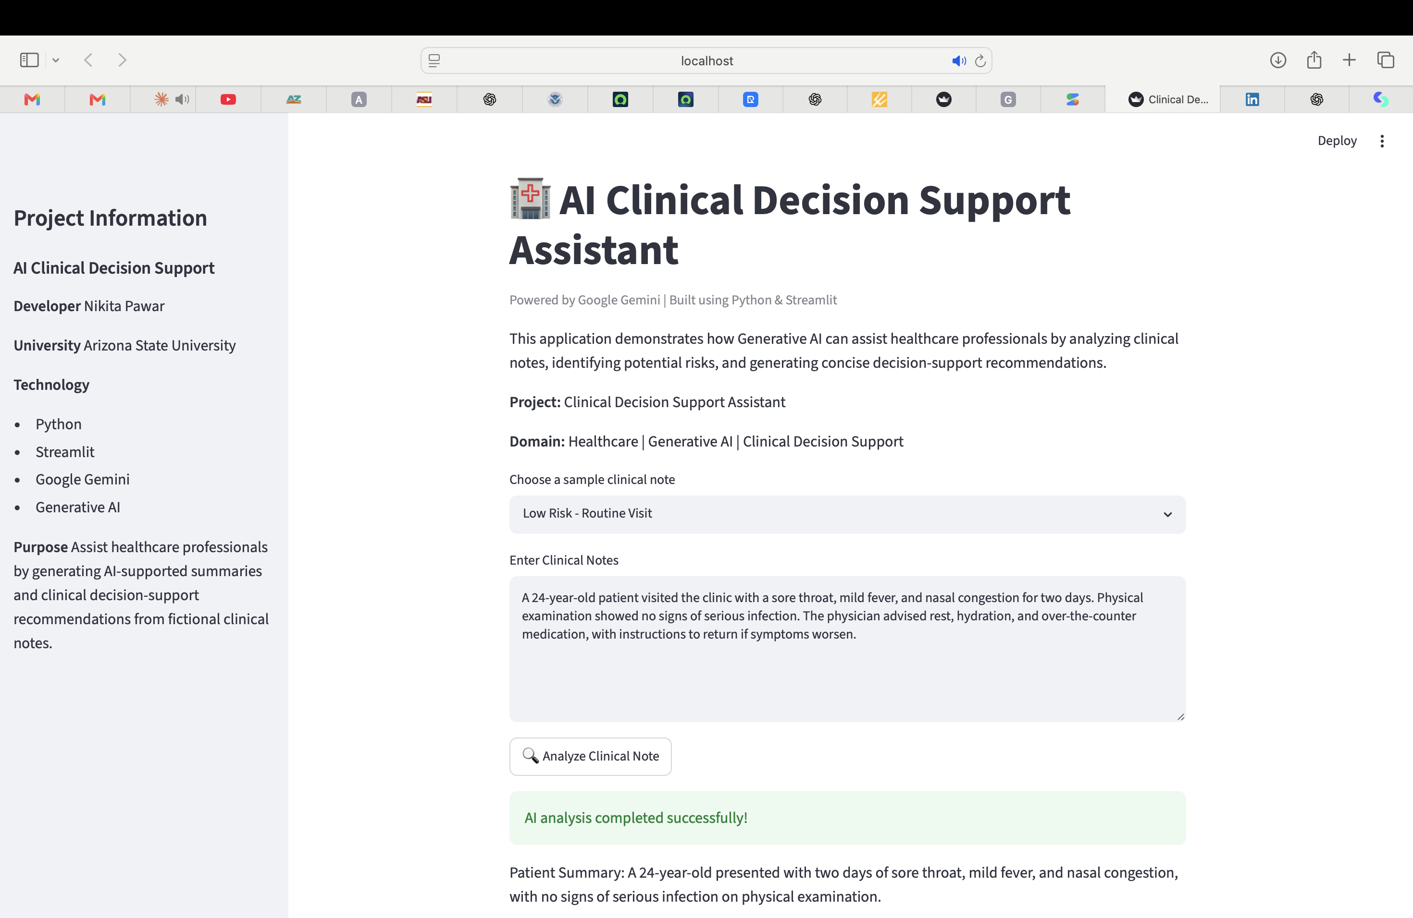
Proof of Concept
Features:
• User-friendly interface
• Three sample clinical cases
• AI-generated patient summary
• Risk classification
• Clinical recommendations

Slide 7
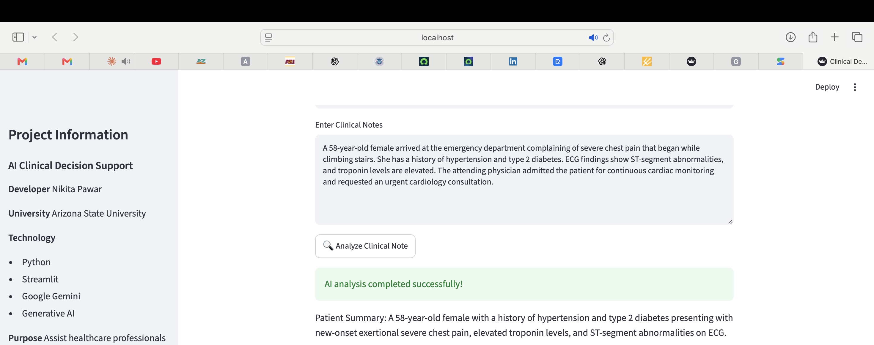
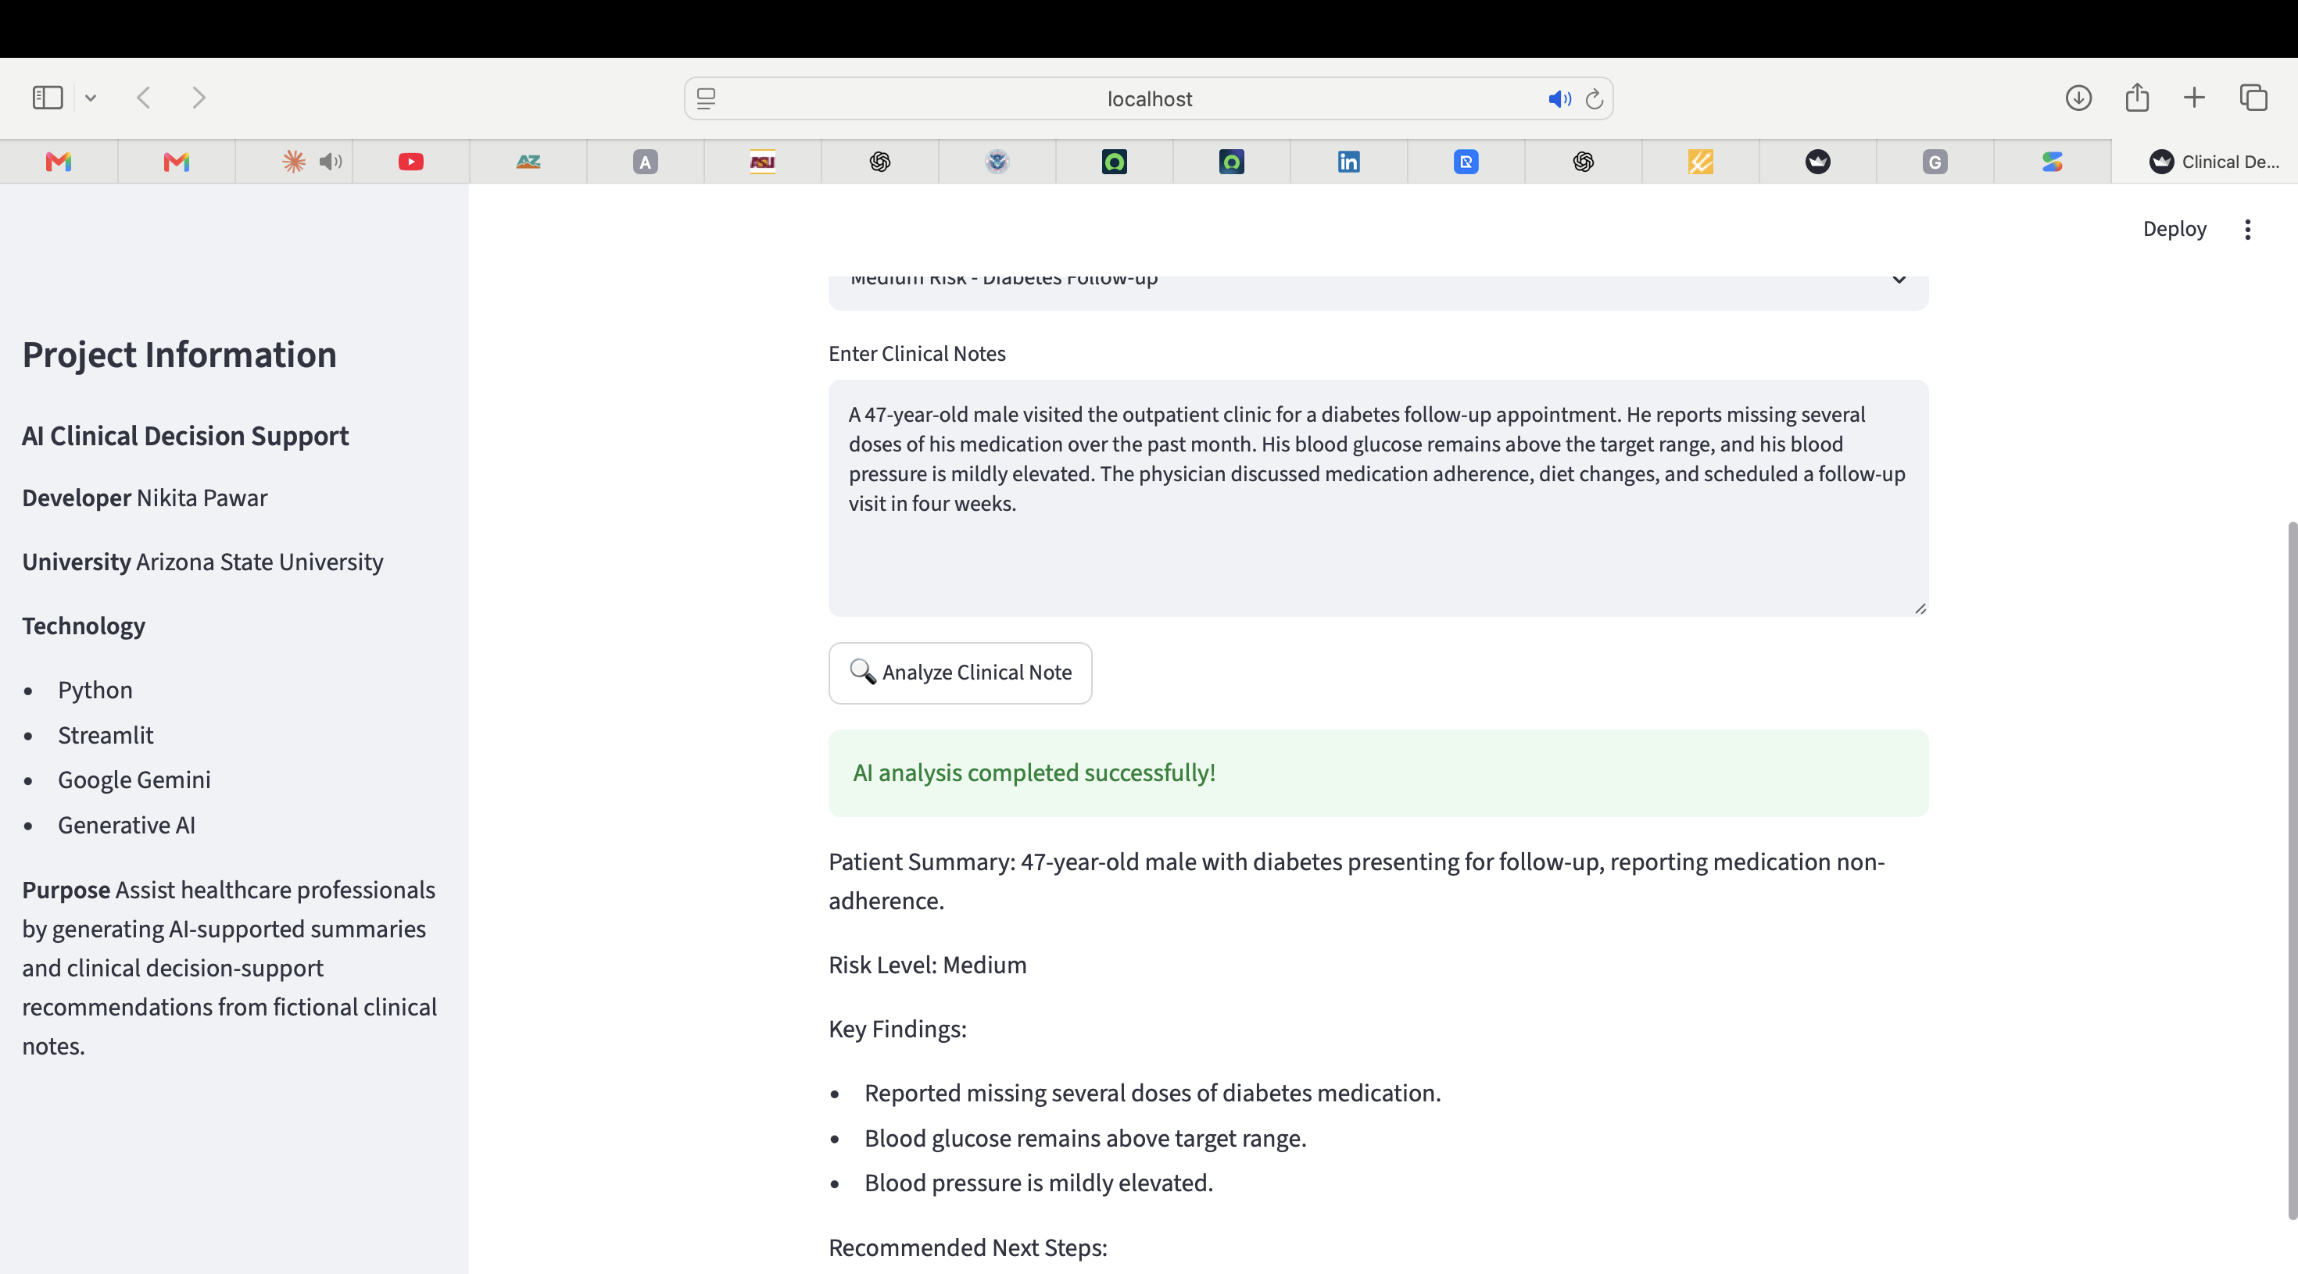
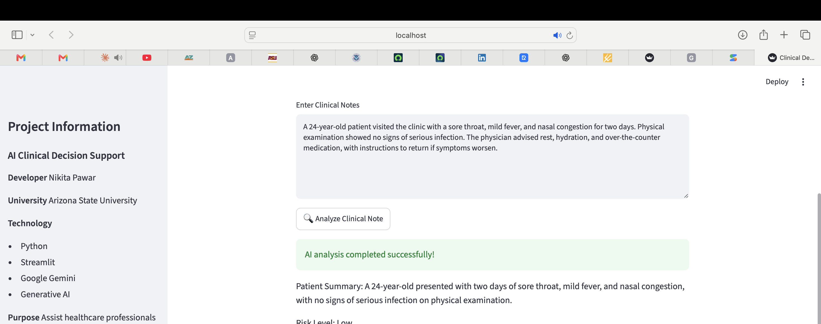
Sample Results
High Risk: Cardiac emergency
Medium Risk: Diabetes follow-up
Low Risk: Routine illness

Slide 8
Benefits to Cotiviti
• Faster clinical note review
• Reduced manual effort
• Improved documentation consistency
• Better identification of high-risk cases
• Improved operational efficiency

Slide 9
Future Enhancements
• EHR integration
• Predictive analytics
• Explainable AI
• Medical coding support
• Multilingual support
• Enhanced security

Slide 10
Conclusion
• Working Generative AI proof of concept
• Supports clinical decision-making
• Improves workflow efficiency
• AI assists clinicians—not replaces them

Slide 11

THANK YOU!

