Slide 1

Problem Statement and Team Details
Problem Statement:
Team Name:
Team Leader Name: K. BHAVANA
Institute Name: KL UNIVERSITY, HYDERABAD, BOWREMPET
Team Leader Email ID: 2420030332@klh.edu.in
Managing money is tough — whether for a startup founder, a student fest organizer, or a small business owner.
NTB – Next Tech Builders

Slide 2
Problem and Solution
Problem:
Startups and SMEs often lack dedicated CFOs for strategic financial guidance.
Current financial tools are too complex, require expertise, and consume time.
No simple way to test “what-if” budget scenarios like hiring, pricing, or spending changes.
Decision-making suffers due to limited visibility on ROI, cash flow, and profitability.
High cost of professional financial consulting makes it inaccessible for small businesses.
Solution (CFO Helper Agent):
A web-based financial simulator for quick decision-making.
Interactive sliders to adjust spending, product pricing, and hiring in real time.
Backend powered by Python (FastAPI/Flask) for accurate financial calculations.
Generates key insights: Revenue, Expenses, Profit, ROI, and Cash Flow.
Provides auto-generated reports in INR for business planning.
Affordable, user-friendly, and accessible to startups, SMEs, and students.
Bridges the gap between raw data and strategic financial insights.

Slide 3
Methodology & Implementation
\Approach:
Problem Identification: The approach started with recognizing the difficulties startups face in managing and forecasting finances effectively. UI/UX Design: To make financial planning simple, an interactive interface with sliders for spending, pricing, and hiring was created. Financial Model: A calculation model was designed to estimate revenue, expenses, profit, ROI, and cash flow, ensuring accuracy in forecasting. Visualization & Insights: Charts and reports were integrated to provide clear insights and easy interpretation of financial outcomes. Scalability: The system was developed to remain affordable, scalable, and user-friendly for SMEs and students.
Implementation:
Frontend Development: The interface was built using HTML, CSS, and JavaScript, featuring interactive sliders, real-time results, and visualizations through Chart.js. Backend Processing: Python with Flask/FastAPI was used to create an API server that handled calculations and generated forecasts and reports in INR. Integration: The frontend communicated with the backend via JSON-based API calls, ensuring instant updates of financial results on the UI. Output Generation: The system displayed revenue, expenses, profit, ROI, and cash flow, while also enabling users to generate downloadable reports for decision-making.

Slide 4
Technology Used
Technology Used:
Frontend: Built with HTML, CSS, and JavaScript to provide an interactive and user-friendly interface. Sliders and dynamic updates make financial planning intuitive.
Visualization: Chart.js is used to create responsive and visually appealing financial charts for better insights.
Backend: Python (Flask/FastAPI) is implemented as the API server to handle calculations, forecasting, and report generation in INR.
Integration: The frontend communicates with the backend through REST API (JSON), ensuring smooth data flow and real-time updates.
Deployment: The system can be hosted on platforms like Heroku, Render, or AWS, making it scalable and accessible to users anywhere.

Slide 5
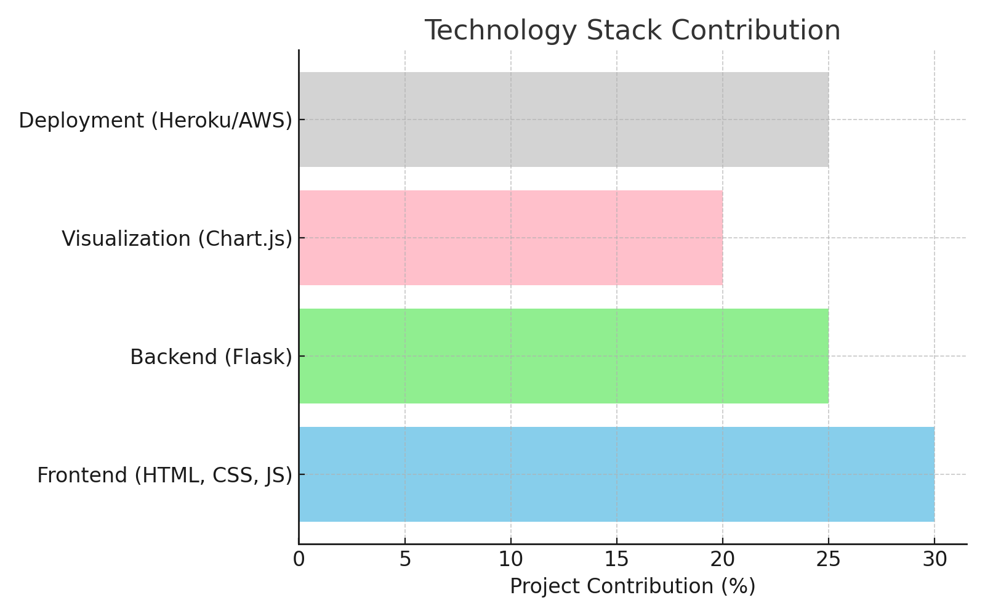
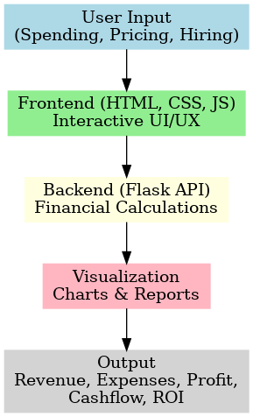
Flowchart & Supporting Images

Slide 6
Feasibility: Uses lightweight and simple technologies (HTML, CSS, JS, Python Flask). Minimal infrastructure requirement; can be hosted on affordable cloud platforms (Heroku, Render). Modular design allows easy scaling with real-time data integration. Low-cost solution, suitable even for small businesses and students. Market Use: Helps startups & SMEs in budget forecasting and financial planning. Useful for student event organizers to plan fests and competitions. Supports freelancers & small business owners in managing expenses and profits. Fills the gap between complex financial tools and basic spreadsheets. Strong potential in FinTech & SaaS markets due to increasing demand for accessible financial solutions.
Feasibility and Market Use

Slide 7
The CFO Helper Agent tackles a common challenge: the difficulty of managing budgets, forecasting outcomes, and making “what if” decisions with clarity.
Unlike static spreadsheets, it delivers dynamic, interactive simulations that adapt instantly to changes in spending, hiring, or pricing.
The solution leverages AI-backed calculations and data visualization, ensuring financial forecasts are both accurate and easy to understand.
Its scalability makes it relevant for diverse users — from students managing event budgets to SMEs and startups planning their runway.
With integration of Flexprice for billing and Pathway for real-time updates, it is future-ready for SaaS deployment.
Conclusion

Slide 8
GitHub Link: https://github.com/nikitha-471/finzy-project

