Slide 1
CREDIT CARD CLIENTS ANALYSIS AND RECOMMENDATIONS
Nikitha Ramchander

Slide 2
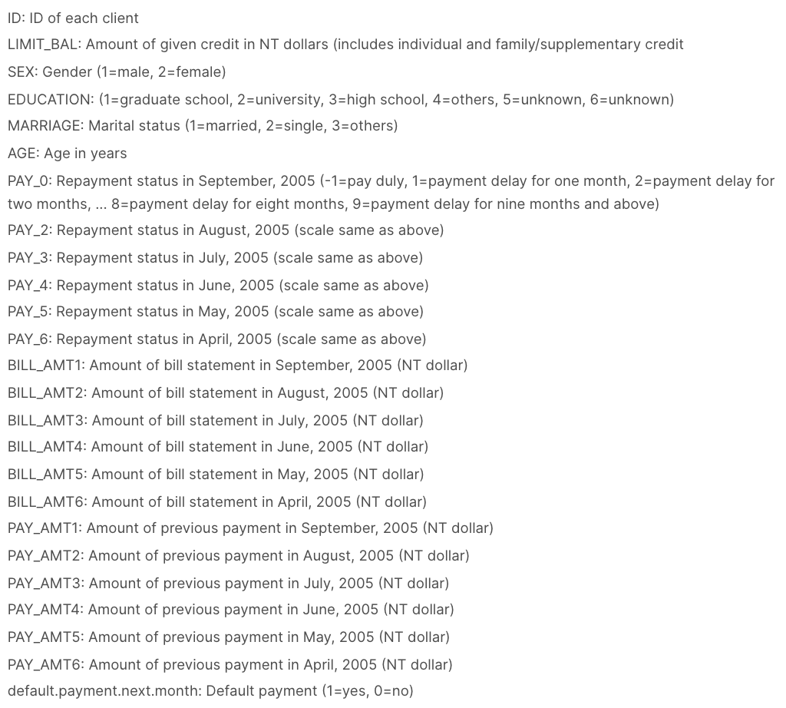
Overview
Clients defaulting
payments for the next month in Taiwan
Taiwan Currency
22% of the clients will default
payment next month
Goal: Which variables are the strongest
predictors of default payment?
Notes:
Categorical Features:
Sex, Education, Marriage,
Pay_0 - 6
Numerical Features:
Age, Pay_Amt 1 – 6,
Bill_Amt 1- 6

Slide 3
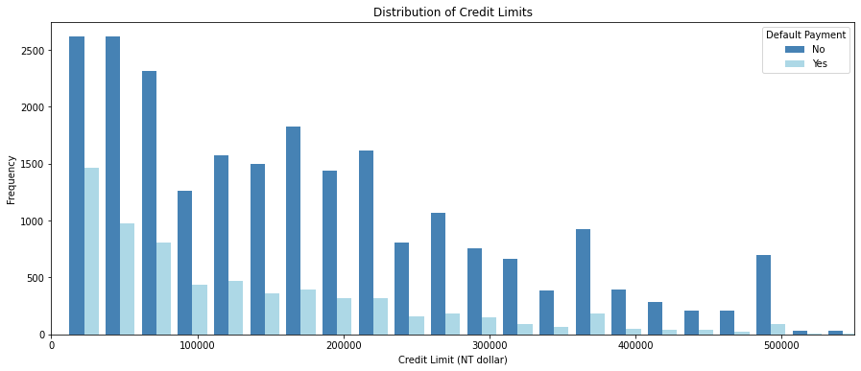
Distribution of Credit Limits
Insight: In general more people have lower credit limits. There is a high amount of people that have and haven’t defaulted payment in the lower limit balance.

Slide 4
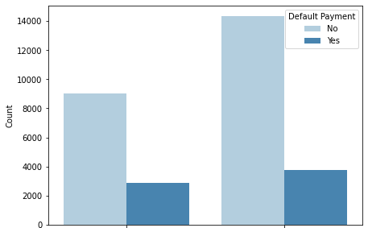
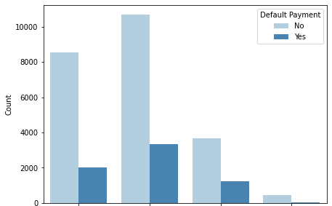
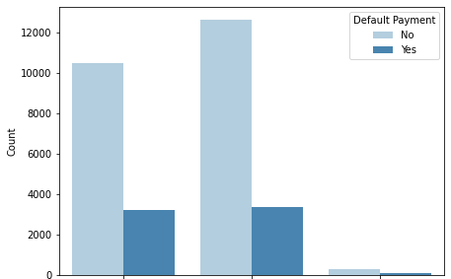
Gender, Education, and Marriage
How does the probability of default payment vary by categories of different demographic variables?
Sex
Education
Marriage
Male
Female
Graduate
Married
Single
Others
Undergraduate
High School
Others
Insight:
The probability of Men defaulting their payment is higher than Women.
Higher the education, the lower the probability of defaulting payment next month.
The probability of Married couples defaulting their payments is higher than Single.

Slide 5
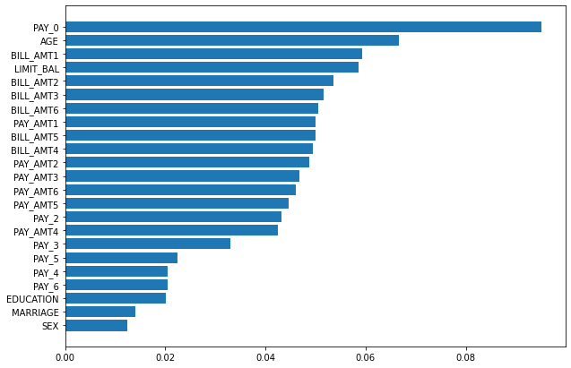
Best Fit Classification Algorithm
Random Forests
Accuracy: 81%
Main focus:
If they want to make sure they’re
only approving loans for people
that will pay them back
Precision: 63%
Correct for clients that
you do predict will default

Slide 6
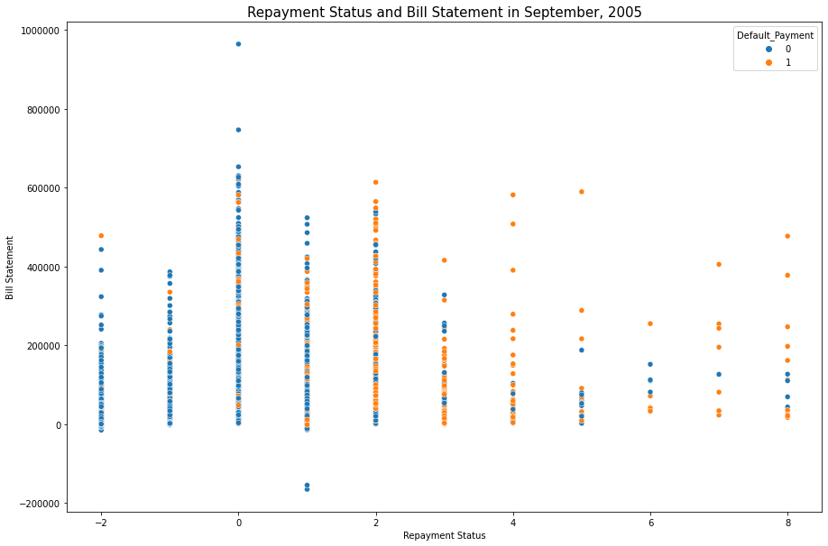
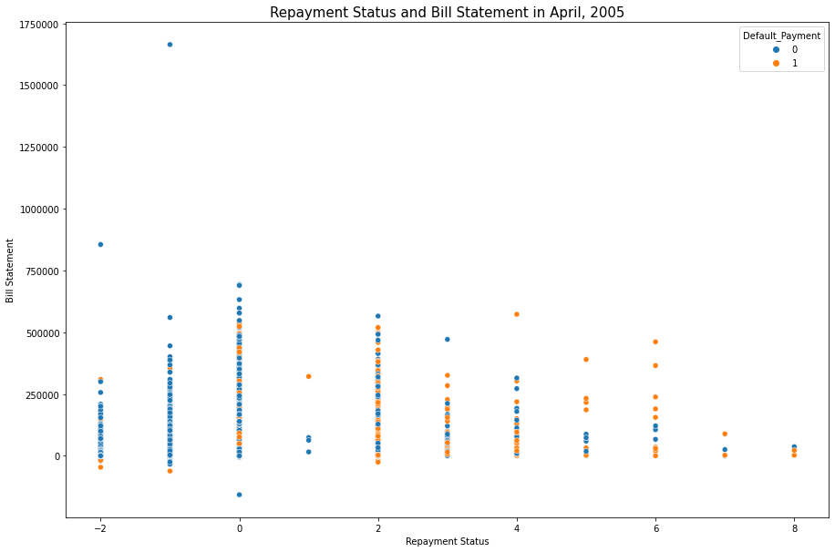
Repayment Status vs. Bill Statement
Insight: Credit card clients that delay their payment for two months and more are more likely to default their payment for the next month.
Notes:
Here is an important insight with 2 months being big factor

Slide 7

Recommendations
Gather more realistic info before issuing credit cards:
Verify salary and give an appropriate credit limit
Basic necessities or big spenders
What are some strategic initiatives we could do to prevent people from delaying their payment?
Positive Incentives:
If you don’t delay the payment a second time = double Cashback/Points
Negative Policy:
Double the late payment fee, double the interest rate

Slide 8
Thank you
Collaborated on code with:
Noelle Brown

