Slide 1


Department of Computer Science and Engineering
Major Project Phase-I
SELF-CALIBRATING MULTI-MODAL EDGE AI NODE FOR INDUSTRIAL MACHINE ANOMALY DETECTION
Team No : 163
Under the Supervision Of
Dr. Meenakshi Malhotra
Presented By:
Nikitha D (ENG23CS0384)
Rajika Saha (ENG23CS0415)
Monalisa (ENG23CS0368)
Sunand P Chowdary (ENG23CS0387)
Notes:
Introduce the team, guide and project. Project title is the registered title; sound is validated so far, sound + vibration fusion is the next phase.

Slide 2
Overview
1. Abstract
2. Project Objectives and Requirement Specification
3. Innovation & Potential Impact
4. Literature Survey and Research Gap
5. Proposed Methodology & High-Level Design
6. Implementation Progress (about 40%)
7. Results and Implementation Screenshots
8. Challenges, Mitigation and Future Plan
9. Team Contribution and Deliverables
10. References
Notes:
Agenda follows the review rubric: problem and literature, methodology and design, implementation progress, then challenges, plan and contributions.

Slide 3
Abstract
Small and medium enterprises (SMEs) run fans, pumps and slide rails until they break, because faults usually go unnoticed until the machine fails or stops. A sudden failure can injure workers, halt production for days, waste broken products, and waste energy and resources, which harms the environment. Existing monitoring systems are costly and need cloud connectivity. We are therefore building a low-cost edge AI device (ESP32-S3 microcontroller, digital microphone and vibration sensor) around a small unsupervised autoencoder that learns what a machine sounds like when it is healthy and raises an alert when the sound changes. However, factories use many types and brands of fans, so training one model for all of them is inefficient. At installation, 60 healthy clips (about 10 minutes) calibrate the device to its own machine: they set the feature levels and the alert level, with no retraining and no fault examples.
On the public MIMII dataset, tested on machines the model never heard, calibration lifts AUC from near chance (fans, pumps) to 0.92-0.96 for fans, pumps and sliders at 6 dB, and models of 2.4k-6.9k parameters match a 50k-parameter baseline. Valves and heavy noise are not solved because of impracticality. Hardware, sound-vibration fusion and the energy and noise estimate are the next phase.
Notes:
Say the problem, the idea, the result and the limits in that order. Mention honestly that valves and heavy noise do not work yet and that nothing runs on hardware yet.

Slide 4
Project Objectives
Purpose and Objectives
Build a low-cost, offline edge node that detects machine faults from sound, adapts to each machine by calibration, and estimates the extra energy and noise a fault causes. Targets: ROC-AUC above 0.90, no cloud, no retraining per machine.
Problem and relevance
Small factories (MSMEs) notice failures late; commercial monitors cost more and need cloud. Faulty motors also waste power. SIH theme: Smart Industrial Automation. SDG 7, 9, 12.
Scope boundaries
In scope: sound-based detection, calibration, tiny models, laptop simulation now, ESP32-S3 next. Not yet: valves, fault-type diagnosis, thermal sensing, a formal environmental impact assessment.
Key Deliverables
Calibrated detector with evaluation suite and dashboard (done); ESP32-S3 prototype; test-rig results with sound, vibration and temperature; research paper; patent filing.
Notes:
Objectives are unchanged from the proposal. The AUC target of 0.90 is met for fans and sliders at 6 dB; say clearly that it is not met for valves or heavy noise.

Slide 5
Requirement Specification & Validation
Target users
Small and medium factories running fans, pumps, slide rails and valves; maintenance staff without data-science skills.
Expected outcomes and goals
Offline green/red alert on the device; setup on a new machine after about 10 minutes of healthy sound; ROC-AUC above 0.90 (met for fans and sliders at 6 dB so far).
Tech / tools
Python, PyTorch, librosa, scikit-learn; MIMII (sound) and CWRU (vibration) datasets. Planned: ESP32-S3, INMP441 microphone, MPU6050, C++ firmware.
Assumptions & constraints
Machine is healthy during calibration; calibrate in the noise the machine runs in; one microphone; no hardware in hand yet, so all results are laptop simulations.
Validation
Leave-one-machine-out test with one machine (ID 06) sealed from all design choices; 3 random seeds; AUC, precision, recall, F1, false-alarm rate; own-recording test.
Notes:
Requirements and how we validate them. The sealed machine and three seeds are what make the numbers trustworthy.

Slide 6
Innovation & Potential Impact
Innovation aspects
Adapts to a new machine from about 10 minutes of healthy sound: no retraining, no fault examples.
Differentiators
Tiny models (2.4k-6.9k parameters); tested on machines never seen in training, with failures reported.
Creative problem solving
Per-machine feature standardisation plus a per-machine alert level; ablation shows both are needed.
Potential impact
Earlier fault detection in small factories: less downtime, scrap and wasted power.
SDG alignment
SDG 7 (affordable and clean energy), SDG 9 (industry, innovation), SDG 12 (responsible production).
Scalability and future scope
Same pipeline for other machine types; add vibration and temperature; many low-cost nodes.
Commercialization / deployment
Target about Rs 1,500 hardware per node (proposal estimate); patent filing planned.
Academic & research contribution
Leave-one-machine-out calibration study on MIMII with open scripts and results; paper planned.
Notes:
Do not say first or novel method. Per-domain statistics are an existing idea (AdaFlow is the closest). Our contribution is the low-cost, tiny-model version tested on unseen machines with failures reported.

Slide 7
Literature Survey
Author / Paper | Venue, year | Technology / design | Results shared by author | What we infer
Purohit et al., MIMII Dataset [1] | DCASE Workshop 2019 | 8-microphone array; dense autoencoder baseline | AUC 0.45-0.99 per machine; 6 dB averages: fan 0.91, pump 0.81, slider 0.88, valve 0.67 | Our benchmark. Per-machine training; no adaptation to a new machine
Abbasi et al., OutlierNets [2] | arXiv 2021 | Compact autoencoders, as few as 686 parameters (2.7 KB) | Accuracy comparable to much larger models; up to 21x lower CPU latency | Tiny models exist; no adaptation to a new machine, no vibration
Kolok et al., Low-Cost IoT Predictive Maintenance [3] | Sensors 2025 | ESP32 + MPU6050 + INMP441; Isolation Forest on a laptop | ROC-AUC 0.78, accuracy 0.73 (paper also quotes 93.4%) | Vibration only, one fault type; microphone not used; figures inconsistent
Yamaguchi et al., AdaFlow [4] | ICASSP 2019 | Density model with adaptive batch normalisation | Adapts to a new distribution in one pass (abstract); no numbers noted | Closest idea to our calibration; we have read the abstract only
Chen, Bondi, Das, few-shot adaptation [5] | arXiv 2022 | Meta-learning for new machine conditions from few samples | Not stated on the abstract page | Adapts from few samples, with a heavier method than ours
Only papers whose abstract or full text we opened are listed. Numbers are the authors' own and are not directly comparable with ours.
Notes:
Say honestly that only MIMII shares our data; other papers use different data and metrics, so we do not rank ourselves against them. AdaFlow is the closest idea.

Slide 8
Research Gap
What exists
Gap we address
Machine-sound benchmarks (MIMII, DCASE) train one model per machine or use large models.
Tiny autoencoders exist, but without adapting to a new machine.
Low-cost ESP32 monitors we found are vibration-only.
Adaptation methods (AdaFlow, few-shot) are heavier; we found no low-cost-chip results for them.
New-machine gap: without calibration, AUC is near 0.5 for fans and pumps on a healthy new machine.
Cost gap: tiny model, about 10 minutes of healthy sound, no fault examples, no retraining.
Evidence gap: leave-one-machine-out tests with failures reported (valves, heavy noise).
Open in our search: energy and noise estimate of a fault on a low-cost node (search was narrow).
We do not claim a new method. The closest idea is AdaFlow (ICASSP 2019), which uses adaptive normalisation; our contribution is the low-cost, tiny-model version with a leave-one-machine-out test.
Notes:
This is the research gap slide. Keep the claim narrow: adaptation from few healthy clips on a tiny model, tested on unseen machines. The energy and noise gap is only 'not found in a narrow search'.

Slide 9
High-Level Design: What Is Built
A. Training (laptop, once per machine type)
Healthy sound of OTHER machines of the same type
Log-mel features
64 ms window, 32 ms step
Train small autoencoder
(healthy sound only)
One small model per machine type
B. Installation and monitoring (laptop simulation; chip planned)
New machine sound
(microphone 1)
Log-mel features
Calibrate:
standardise + alert level
(60 healthy clips)
Autoencoder:
rebuilding error = score
Score above alert level?
GREEN: normal
RED: alert
Alert level = average + 3 x spread of the scores of 30 healthy clips (after 30 other clips set the feature levels).
Solid boxes are built and tested on a laptop with recorded clips. Nothing runs on the chip yet.
Data: MIMII sound dataset (microphone channel 1 of 8 only, because the device has one microphone).
Notes:
Walk left to right. Training uses other machines only. Calibration happens on the new machine and has two jobs: feature levels and the alert level. This part is built and tested on a laptop.

Slide 10
Proposed Methodology & Technical Design
Method, step by step
Model per machine type
1. Cut the sound into 64 ms windows every 32 ms; 64-band log-mel (32 for sliders); channel 1 only.
2. Train the autoencoder on healthy sound of other machines; each machine standardised on its own.
3. Calibrate on the new machine: 30 healthy clips give each feature's average and spread.
4. The next 30 clips set the alert level: average + 3 x spread of their scores.
5. Score = rebuilding error of a clip; above the alert level is RED.
Type | Layers | Params | KB (32-bit / INT8*)
Fan | 64-32-32-8-32-32-64 | 6,856 | 26.8 / 6.7
Pump | 64-16-8-16-64 | 2,408 | 9.4 / 2.4
Slider | 32-32-16-32-32 | 3,184 | 12.4 / 3.1
Valve | 64-32-16-32-64 | 5,264 | 20.6 / 5.1
Baseline [1] | 320-64-64-8-64-64-320 | 50,760 | 198 / 50
*INT8 sizes are estimates; quantisation is not done yet.
Model chosen per type by a rule fixed in advance: smallest design within 0.02 AUC of the best, tuned on machines 00, 02, 04; machine 06 sealed.
Baseline = our copy of the Hitachi model, used to check our pipeline.
Notes:
This slide is the technical core. Features are the same for every machine; only the number of bands and the model size differ per type. The baseline was used to prove our pipeline matches Hitachi's published results.

Slide 11
High-Level Design: Final System (Proposed)
Dashed = planned, needs hardware. None of this runs on the chip yet.
INMP441 microphone
(I2S, 16 kHz)
ESP32-S3
Features: FFT + 64-band log-mel (esp-dsp)
Decision: sound score + vibration (late fusion, to be tested)
Calibration + alert level (saved in flash)
MPU6050 vibration
sensor (I2C)
INT8 autoencoder (TFLite Micro)
Green / red LED
Energy and noise estimate of a fault
(INA219 power sensor + reference sound meter)
Test rig: record sound + vibration + temperature together to test fusion
Thermal sensing is future work; this phase addresses heat indirectly (earlier detection, extra power drawn).
Public vibration data (CWRU) is from a different machine than the sound data, so fusion needs our own rig or a paired dataset [7].
Notes:
This is the planned final system. Everything is dashed because nothing here is built on hardware yet. Fusion is a hypothesis to test, not a result.

Slide 12
Implementation Progress (about 40%)
Module | What was done | Status
Dataset inventory | 54,057 MIMII files checked; counts match Hitachi's table | Done
Feature extraction | Log-mel for all files (64, 32, 128 bands); checked against a hand calculation | Done
Baseline reproduction | Hitachi model rebuilt; 48 cases; correlation 0.97 with their table | Done
Calibration study | Controls, 3 seeds, ablation (alert level only vs full calibration) | Done
Model selection | 12 designs compared; sealed test machine; 2.4k-6.9k parameters chosen | Done
Noise-mismatch test | Calibrate at one noise level, test at another | Done
Final evaluation | 144 runs: 4 types x 3 noise levels x 4 machines x 3 seeds, all metrics | Done
Dashboard + own-recording test | 5-tab interface; first test on our own fan with a phone microphone | Done (first test)
Vibration (CWRU) | Fabricated channel removed; sensor-noise margin test | Done
Hardware, C features, INT8, fusion | Not started | Planned
About 40% is our own estimate: the offline pipeline is done; hardware and on-chip work have not started.
Notes:
The 40% is a team estimate and should be said as such. Everything marked Done runs on a laptop; the hardware part is not started.

Slide 13
Results: Validation and Calibration
Our copy of Hitachi's model [1]
6 dB AUC | Ours | Hitachi
Fan | 0.93 | 0.91
Pump | 0.76 | 0.81
Slider | 0.89 | 0.88
Valve | 0.71 | 0.67
Correlation 0.97 over 48 cases: our pipeline is correct.
Without calibration a healthy new machine looks faulty: AUC near 0.5 for fans and pumps.
Alert level alone removes false alarms (fan 53% to 2%) but detection stays low (14%); standardising with the machine's own numbers restores it. Both are needed.
Small models (2.4k-6.9k parameters) match the 50,760-parameter baseline.
Notes:
Chart: 6 dB, four machines per type, two seeds (ablation file). Baseline versus Hitachi shows our pipeline matches their published table. Hitachi trains per machine; we test on machines never seen in training, so the comparison is not perfectly equal.

Slide 14
Results: Final Evaluation
Machine | AUC at 6 / 0 / -6 dB | Recall (6 dB) | False alarms (6 dB) | Sealed machine 06, AUC (6 dB)
Fan | 0.92 / 0.83 / 0.71 | 66% | 5% | 1.00
Pump | 0.96 / 0.84 / 0.75 | 89% | 35% | 0.97
Slider | 0.94 / 0.84 / 0.72 | 73% | 4% | 1.00
Valve | 0.56 / 0.52 / 0.51 | 1% | 2% | 0.52
Works: fans, pumps and sliders separate healthy from faulty (AUC 0.92-0.96 at 6 dB).
Weak point, the alert level: pumps give 35% false alarms; fans and sliders catch only 66% and 73% of faults.
Not solved: valves (AUC about 0.5) and heavy noise (slider recall 3% at -6 dB).
Noise change: calibrated quiet, tested noisy gives 44% false alarms against 8% when matched; calibrate in the real noise.
Mean over 4 held-out machines and 3 seeds. Precision and accuracy assume a half-faulty test set.
Notes:
Source: final evaluation results file, 144 runs. Show the sealed machine column separately; it is the fairest test but is one machine per type. Say the alert-level rule is the weakest part and is the first thing we will fix.

Slide 15
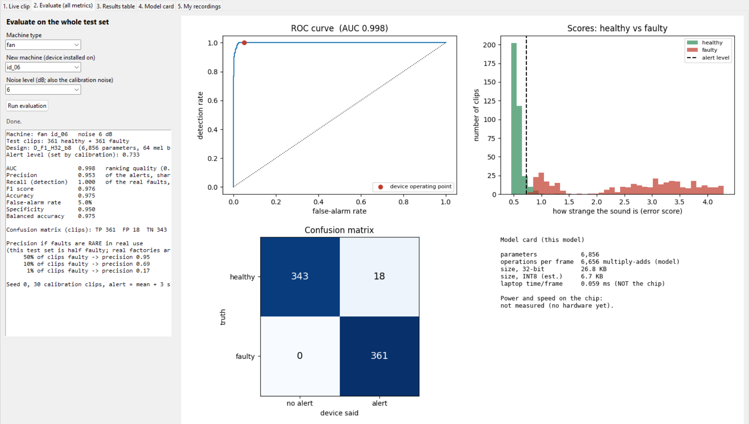
Screenshot: Evaluation Dashboard
Evaluate tab: fan machine 06, 6 dB, 361 healthy + 361 faulty test clips. AUC 0.998, recall 100%, false alarms 5% (18 of 361), precision 0.953.
Note: machine 06 fans are the easiest case. If only 1% of clips were faulty, precision would fall to 0.17.
Notes:
Simulation on a laptop with recorded clips. Explain the ROC curve, the score histogram with the alert level, and the confusion matrix. Be open that this is the easiest machine.

Slide 16
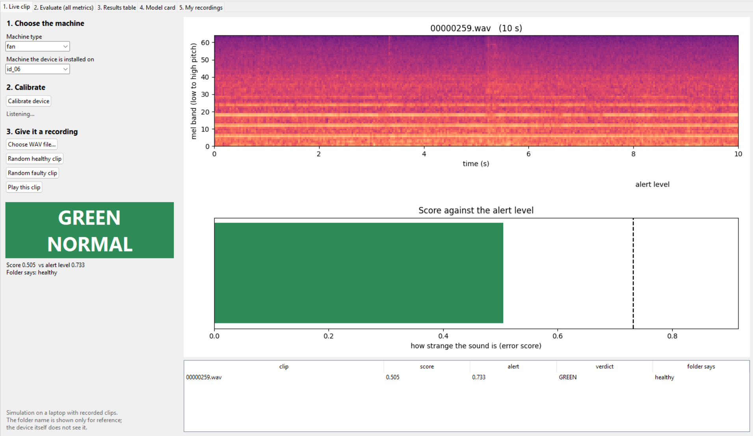
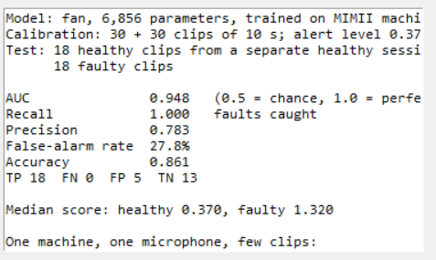
Screenshot: Live Clip and Own Recording
Own fan with a phone microphone
Live clip: the calibrated device says GREEN (score 0.505 is below the alert level 0.733).
Own-recording test: model trained on MIMII only; 30 + 30 healthy clips calibrate it; 18 healthy + 18 faulty clips are tested.
AUC 0.948 and all 18 faults caught, but 28% false alarms: the alert level sits close to the healthy scores. One machine, few clips: a first check, not proof.
Notes:
The window says it is a simulation on a laptop with recorded clips. The folder name is shown for reference only; the model never sees it. The own-recording result is a first test; say the false-alarm rate openly.

Slide 17
Challenges and Mitigation
Challenge | What we found | Mitigation | Status
Early results used simulated sound | The '100% accuracy' was meaningless | Deleted; restarted on real MIMII data | Done
Vibration script invented a channel; data too easy | Healthy file had no such channel; AUC about 1.0 | Clean pipeline; sensor-noise margin test | Done
New machine looks faulty | AUC near 0.5 for fans and pumps | Per-machine calibration (60 clips) | Done
Alert-level rule unbalanced | Pumps 35% false alarms; fans/sliders recall 66-73% | Compare other rules on tuning machines, confirm on sealed machine | Open
Valves not detected | AUC about 0.5 at all noise levels | Test worst-frame scoring and other features | Open
Noise changes after calibration | 44% false alarms if calibrated quiet | Calibrate in real noise or on a mix | Partly done
Heavy noise (-6 dB) | AUC about 0.7; slider recall 3% | Vibration sensor; needs paired data | Open
No hardware yet | Nothing measured on the chip | Order parts after the 10 Nov go/no-go | Open
Notes:
Be upfront about the open items. The alert-level rule and valves are the two biggest. Early mistakes were found by checking our own work and fixed.

Slide 18
Future Work Plan
When | Work | Target
Now to 10 Nov | Compare alert-level rules; test extra scores (Mahalanobis, PCA) on the autoencoder output; valve worst-frame test; INT8 quantisation; re-run own-recording test and save numbers | Fix pump / fan / slider alert level; go/no-go decision on hardware and scope
By 30 Nov | KSCST proposal; patent draft | Submissions
Month 4 | Audio-in, decision-out simulation in Python; feature extraction in C checked against Python | Same features on laptop and chip
Month 5 | ESP32-S3 bring-up, firmware, DSP and model on chip | Run on hardware
Month 6 | On-chip calibration; test rig; record sound + vibration + temperature together; fusion test | Does vibration help in heavy noise?
Month 6.5-7 | Speed, memory, power, noise and energy measurements; paper and report | Validated prototype, manuscript
Notes:
Dates: go/no-go on hardware proposed for 10 November, KSCST proposal due 30 November. The first step is fixing the alert level because it is the main weakness in the results.

Slide 19
Team Contribution
Team member | USN | Contribution (to be filled by the team)
Nikitha D | ENG23CS0384 | [add your modules and experiments]
Rajika Saha | ENG23CS0415 | [add your modules and experiments]
Monalisa | ENG23CS0368 | [add your modules and experiments]
Sunand P Chowdary | ENG23CS0387 | [add your modules and experiments]
Every member should be ready to explain their own part and answer questions on the whole pipeline.
Notes:
Fill this slide in before the review: the rubric asks for individual contribution. Do not leave the bracketed text.

Slide 20
List of Deliverables
Deliverable | Status
Calibrated detector (Python) with results files for every experiment | Done
Evaluation suite and 5-tab dashboard (live clip, evaluate, results, model card, own recordings) | Done
Own-recording test tool (phone or any microphone) | Done (first test)
Literature survey and project guide | Done
INT8 model and feature extraction in C | Planned
ESP32-S3 prototype with LED output | Planned
Test-rig results: sound, vibration, temperature | Planned
Energy and noise estimate of a fault | Planned
Research paper and patent filing | Planned
Notes:
Done items can be shown live in the dashboard. Planned items depend on hardware.

Slide 21
References
[1] H. Purohit et al., "MIMII Dataset: Sound Dataset for Malfunctioning Industrial Machine Investigation and Inspection," DCASE Workshop, 2019. arXiv:1909.09347.
[2] S. Abbasi, M. Famouri, M. J. Shafiee, A. Wong, "OutlierNets: Highly Compact Deep Autoencoder Network Architectures for On-Device Acoustic Anomaly Detection," arXiv:2104.00528, 2021.
[3] P. Kolok, M. Hodon, P. Sevcik, L. Hotz, N. Remy, "Low-Cost IoT-Based Predictive Maintenance Using Vibration," Sensors, vol. 25, no. 21, p. 6610, 2025.
[4] M. Yamaguchi, Y. Koizumi, N. Harada, "AdaFlow: Domain-Adaptive Density Estimator with Application to Anomaly Detection and Unpaired Cross-Domain Translation," ICASSP, 2019. arXiv:1812.05796.
[5] B. Chen, L. Bondi, S. Das, "Learning to Adapt to Domain Shifts with Few-shot Samples in Anomalous Sound Detection," arXiv:2204.01905, 2022.
[6] W. A. Smith, R. B. Randall, "Rolling element bearing diagnostics using the Case Western Reserve University data: A benchmark study," Mech. Syst. Signal Process., vol. 64-65, pp. 100-131, 2015.
[7] W. Jung et al., "Vibration, acoustic, temperature, and motor current dataset of rotating machine under varying operating conditions for fault diagnosis," Data in Brief, vol. 48, 109049, 2023.
Notes:
Only papers we opened (abstract or full text) are listed. CWRU [6] and the Jung dataset [7] are the vibration and paired-data sources.

