Slide 1


Department of Computer Science and Engineering
Major Project Phase-I
SELF-CALIBRATING MULTI-MODAL EDGE AI NODE FOR INDUSTRIAL MACHINE ANOMALY DETECTION
Team No : 163
Under the Supervision Of
Dr. Meenakshi Malhotra
Presented By:
Nikitha D (ENG23CS0384)
Rajika Saha (ENG23CS0415)
Monalisa (ENG23CS0368)
Sunand P Chowdary (ENG23CS0387)
Notes:
Introduce the team, guide and project title.

Slide 2
Overview
1. Abstract
2. Project Objectives and Requirement Specification
3. Innovation & Potential Impact
4. Literature Survey and Research Gap
5. High-Level Design and Methodology (sound, vibration, fusion)
6. Implementation Progress
7. Results and Implementation Screenshots
8. Challenges, Mitigation and Future Plan
9. Team Contribution and Deliverables
10. References
Notes:
Agenda follows the review rubric: problem and literature, methodology and design, implementation progress, then challenges, plan and contributions.

Slide 3
Abstract
Small and medium enterprises (SMEs) run fans, pumps and slide rails until they break, because faults usually go unnoticed until the machine fails or stops. A sudden failure can injure workers, halt production for days, waste broken products, and waste energy and resources, which harms the environment. Existing monitoring systems are costly and need cloud connectivity. We are therefore building a low-cost edge AI device (ESP32-S3 microcontroller, digital microphone and vibration sensor) around a small unsupervised autoencoder that learns what a machine sounds like when it is healthy and raises an alert when the sound changes. However, factories use many types and brands of fans, so training one model for all of them is inefficient. At installation, 60 healthy clips (about 10 minutes) calibrate the device to its own machine: they set the feature levels and the alert level, with no retraining and no fault examples.
On the public MIMII dataset, tested on machines the model had never heard, calibration lifts AUC from near chance (fans, pumps) to 0.92-0.96 for fans, pumps and sliders at 6 dB, and models of 2.4k-6.9k parameters match a 50k-parameter baseline. Valves and heavy noise are not solved yet. Separate vibration experiments found that a CNN performs better than an autoencoder for the motor alone; the motor-health output is planned to support the sound decision and reduce false alarms. Hardware, sound-vibration fusion and the energy and noise estimate are the next phase.
Notes:
Problem, idea, calibration, results, limits, vibration and fusion, in that order. Say honestly that valves and heavy noise are not solved and nothing runs on hardware yet.

Slide 4
Project Objectives
Purpose and Objectives
Purpose: detect faulty industrial machines early, on the device itself, at low cost.
Objectives: (1) learn each machine's healthy behaviour from sound and vibration; (2) adapt to a new machine with a short calibration, without retraining; (3) reach ROC-AUC above 0.90 with a low false-alarm rate; (4) run offline on an ESP32-S3; (5) estimate the extra energy and noise a fault causes.
Problem and relevance
Small and medium factories run machines until they fail, so faults are found late and cause downtime, injury risk, scrap and wasted energy. Commercial monitors are costly and need cloud connectivity, which is unreliable inside factories. The work fits the SIH theme Smart Industrial Automation and SDGs 7, 9 and 12.
Scope boundaries
In scope: sound-based anomaly detection with calibration (built and tested on a laptop with public data), vibration-based motor health, and their combination on our own rig. Not in scope for now: identifying the type of fault, thermal sensing, and a formal environmental impact assessment.
Key Deliverables
Calibrated sound detector with evaluation suite and dashboard (done); vibration health model; fusion logic; ESP32-S3 prototype with LED output; test-rig results; energy and noise estimate; research paper and patent filing.
Notes:
The AUC target of 0.90 is met for fans and sliders at 6 dB; say clearly that it is not met for valves or heavy noise.

Slide 5
Requirement Specification & Validation
Target users
Small and medium factories running fans, pumps, motors and slide rails, and their maintenance staff, who need a simple green/red indication without data-science skills or cloud services.
Expected outcomes and goals
A standalone, low-cost device that alerts offline; setup on a new machine after about 10 minutes of healthy sound; ROC-AUC above 0.90 with a low false-alarm rate; a measured estimate of the extra energy and noise a fault causes.
Tech / tools
Python, PyTorch, librosa and scikit-learn for modelling; MIMII (sound) and CWRU (vibration) datasets. Planned: ESP32-S3, INMP441 microphone, MPU6050 vibration sensor, INA219 power sensor, C++ firmware with TFLite Micro.
Assumptions & constraints
The machine is healthy while calibrating, and calibration is done in the noise it normally runs in. One microphone is used. No hardware is in hand yet, so all results so far come from laptop simulations with recorded data.
Validation
Leave-one-machine-out testing (the model never sees the test machine), one machine sealed from all design choices, 3 random seeds, and AUC, precision, recall, F1 and false-alarm rate reported. A test on our own fan with a phone microphone.
Notes:
Requirements and how we validate them. The sealed machine and three seeds are what make the numbers trustworthy.

Slide 6
Innovation & Potential Impact
Innovation aspects
A multi-modal node: a sound autoencoder that calibrates to each machine in about 10 minutes, supported by vibration-based motor health to reduce false alarms.
Differentiators
Tiny models (2.4k-6.9k parameters) and no retraining or fault examples for sound; tested on machines unseen in training, with failures reported.
Creative problem solving
Per-machine standardisation plus a per-machine alert level (both needed, shown by ablation); a revised alert-level rule; other models may be combined with the autoencoder.
Potential impact
Earlier fault detection in small factories: less downtime, scrap, injury risk and wasted energy.
SDG alignment
SDG 7 (affordable and clean energy), SDG 9 (industry, innovation and infrastructure), SDG 12 (responsible consumption and production).
Scalability and future scope
Same pipeline for other machine types; more sensors such as temperature; many low-cost nodes working locally.
Commercialization / deployment
Target about Rs 1,500 hardware per node (proposal estimate); patent filing planned for the hardware-tied method.
Academic & research contribution
Leave-one-machine-out calibration study on MIMII, a sound-versus-vibration model comparison, open scripts and results; paper planned.
Notes:
Do not say first or novel method. Per-domain statistics are an existing idea; our contribution is the low-cost, tiny-model, multi-modal version tested on unseen machines with failures reported.

Slide 7
Literature Survey (1 of 2)
Author’s Name/ Paper Title | Conference/Journal Name and year | Technology/ Design | Results shared by author | What you infer
Notes:
Table to be filled in by the team.

Slide 8
Literature Survey (2 of 2)
Author’s Name/ Paper Title | Conference/Journal Name and year | Technology/ Design | Results shared by author | What you infer
Notes:
Table to be filled in by the team.

Slide 9
Research Gap
What exists (papers reviewed so far)
Gap we address
Sound benchmarks (MIMII, DCASE) mostly train one model per machine, or use large models.
Tiny autoencoders exist, but without adapting to a new machine.
Low-cost ESP32 monitors we found rely on a single sensor, usually vibration.
Adaptation methods (AdaFlow, few-shot) are heavier, and the abstracts we read do not show them on a low-cost chip.
New-machine gap: without calibration, AUC is near 0.5 for fans and pumps on a healthy new machine.
Cost gap: a tiny model, about 10 minutes of healthy sound, no fault examples and no retraining.
Multi-modal gap: sound and vibration are rarely combined on one low-cost node. Vibration is not affected by airborne noise, so it can support the sound decision when sound alone is weak.
Evidence gap: leave-one-machine-out tests with the failures reported (valves, heavy noise).
Open in our search: the extra energy and noise caused by a fault, estimated on a low-cost node (search was narrow).
We do not claim a new method. The closest idea is AdaFlow (ICASSP 2019), which adapts a model with adaptive normalisation. Our contribution is a low-cost, tiny-model, multi-modal version with a leave-one-machine-out test.
Notes:
Keep the claim narrow. The energy and noise gap is only 'not found in a narrow search'. Update this slide once the literature tables are filled.

Slide 10
High-Level Design
Insert the architecture diagram here
Solid = built and tested on a laptop with recorded clips. Dashed = planned, needs hardware.
Notes:
Architecture diagram goes here. Explain it with the next slide.

Slide 11
System Workflow Explained
1 Capture
The INMP441 microphone samples sound at 16,000 times per second; the MPU6050 measures vibration of the machine.
2 Features
Sound is cut into 64 ms windows every 32 ms and turned into 64 log-mel numbers (energy in 64 pitch bands). Vibration is turned into strength features (RMS) over 32 ms frames.
3 Calibration
At installation the device listens to 60 healthy clips (about 10 minutes): the first 30 give each feature's usual level and spread, the next 30 set the alert level.
4 Models
A small autoencoder trained on healthy sound gives a score (rebuilding error). A vibration model gives the motor's health. Other models may be added alongside the autoencoder if they improve results.
5 Decision
The sound score is compared with the alert level. The motor-health output is planned to support this decision and cut false alarms (fusion; to be tested).
6 Output
A green or red LED shows the result. Power and noise readings are logged for the extra energy and noise estimate.
Built and tested on a laptop: steps 2, 3 and the sound part of 4 and 5. Planned: the vibration model in the device, fusion, hardware and step 6.
Notes:
Walk through the six blocks. Be clear about what is built (sound pipeline) and what is planned (hardware, fusion).

Slide 12
Methodology: Sound Features
Data. MIMII sound dataset: fans, pumps, slide rails and valves, four machines of each, healthy and faulty clips, at three noise levels (6, 0 and -6 dB). Only microphone 1 of the 8-microphone array is used, because our device has one microphone.
Windows. The sound is cut into windows of 1024 samples (64 ms) that move forward 512 samples (32 ms). The overlap means no short event is cut at a window edge.
Spectrum. An FFT turns each window into 513 pitch values; squaring gives the energy at each pitch.
Mel bands. The 513 values are grouped into 64 bands (32 for sliders), narrow at low pitch and wide at high pitch like human hearing, then a logarithm is taken (decibel-like).
Result. 64 numbers every 32 ms. A 10-second clip is a table of 64 bands by 313 time steps. The Hitachi baseline joins 5 time steps (320 numbers); our final models use 1.
Settings and why
Setting | Value
Window | 1024 (64 ms)
Step | 512 (32 ms)
Power | 2 (energy)
Bands | 64 (slider 32)
Frames | 1 (baseline 5)
Window, step and power are copied from Hitachi's baseline so our results can be compared with theirs. We tested bands and stacked frames ourselves: more bands help slightly, and stacking frames did not help.
Notes:
Features are the same for every machine; only the number of bands and the model size differ per type. The settings come from Hitachi's baseline.

Slide 13
Methodology: Model, Calibration, Alert Level
Autoencoder. A small network squeezes its input to a few numbers and tries to rebuild it. It is trained on healthy sound only, so healthy sound is rebuilt well and a fault is rebuilt badly. The rebuilding error of a clip is its score.
Calibration (two jobs). On the new machine, 30 healthy clips give each feature's average and spread, used to standardise the sound; 30 more clips are scored and set the alert level.
Alert level. Average + 3 x spread of those 30 scores; a clip above it is RED. This is a rule of thumb that we have not tuned.
Known weakness. The rule is too strict for pumps (35% false alarms) and too lenient for fans and sliders (recall 66% and 73%). We plan to revise it (see future plan).
Model per machine type
Type | Layers | Params
Fan | 64-32-32-8-32-32-64 | 6,856
Pump | 64-16-8-16-64 | 2,408
Slider | 32-32-16-32-32 | 3,184
Valve | 64-32-16-32-64 | 5,264
Baseline | 320-64-64-8-64-64-320 | 50,760
Each design was chosen by a rule fixed in advance: the smallest model within 0.02 AUC of the best, tuned on machines 00, 02, 04, with machine 06 sealed.
The baseline is our copy of Hitachi's model, used to check our pipeline (correlation 0.97 with their table).
Notes:
The model never decides by itself what is too bad; the alert level is a separate number computed from healthy scores during calibration.

Slide 14
Vibration Branch: Motor Health
Data. CWRU bearing dataset: one healthy recording and three fault types (inner race, ball, outer race), drive-end and fan-end sensors sampled at 12 kHz.
Cleaning. Remove the DC offset and spikes, band-pass 10-5000 Hz, cut into 32 ms frames, then take vibration strength (RMS) per frame.
Low-cost sensor test. Imitating an MPU6050 (low-pass 260 Hz, 1 kHz sampling) loses almost nothing on these faults (AUC 0.99 or more). Detection collapses once the sensor's own noise equals the machine's vibration.
Model comparison. A CNN and an autoencoder were trained on motor vibration data. The CNN gave better results for the motor alone. Note: the CNN needs labelled fault examples; the autoencoder does not.
Problems fixed. An old script invented a missing channel for the healthy file; it was replaced by a clean pipeline. CWRU is a thin and easy dataset, so near-perfect scores say little about our method.
Sensor-noise margin
Added noise | Faults found
none | 100%
0.5 x | 98%
1 x | 36%
2 x | 5%
Noise as a multiple of the healthy machine's vibration strength (CWRU, MPU-like path, no network).
CNN vs autoencoder (motor)
Model | Dataset | Result
CNN
Autoencoder
Notes:
Fill in the CNN versus autoencoder table with the dataset and metric the team used. The CNN is supervised, so it needs fault examples; the autoencoder does not.

Slide 15
Fusion Plan: Sound and Vibration
Vibration sensor
Vibration model (CNN / autoencoder)
Motor health
Decision logic: motor health adjusts the sound decision
Green / red LED
Microphone
Sound autoencoder: score
Alert level
Why. Sound weakens in heavy noise (fan AUC 0.92 down to 0.71; slider recall 3% at -6 dB) and gives false alarms on pumps (35%). Vibration is not affected by airborne noise.
Idea. The vibration model reports the motor's health. When the motor looks healthy, the sound alert needs stronger evidence (a higher alert level); when the motor looks abnormal, a lower level is accepted. This should reduce false alarms.
Alert-level rule. We will also revise the rule of thumb itself (average + 3 x spread), comparing other multipliers, percentile and median-based rules.
Other models. Other models may be used together with the autoencoder if they give better results; none is decided.
How we will test. Sound and vibration must come from the same machine. MIMII and CWRU are different machines, so this needs our own rig or a paired dataset (Jung et al. 2023). Status: planned, not yet tested.
Notes:
This slide explains how the multi-modal part will work. It is a hypothesis to test on paired data, not a result. Dashed boxes are planned.

Slide 16
Implementation Progress
Module | What was done | Status
Dataset inventory | 54,057 MIMII files checked; counts match Hitachi's table | Done
Feature extraction | Log-mel for all files (64, 32 and 128 bands); checked against a hand calculation | Done
Baseline reproduction | Hitachi model rebuilt; 48 cases; correlation 0.97 with their table | Done
Calibration study | Controls, 3 seeds, ablation (alert level only versus full calibration) | Done
Model selection | 12 designs compared; sealed test machine; 2.4k-6.9k parameters chosen | Done
Noise-mismatch test | Calibrate at one noise level, test at another | Done
Final evaluation | 144 runs: 4 types, 3 noise levels, 4 machines, 3 seeds, all metrics | Done
Dashboard and own-recording test | 5-tab interface; first test on our own fan with a phone microphone | Done (first test)
Vibration pipeline (CWRU) | Clean pipeline, sensor-noise test; CNN versus autoencoder comparison | Done
Fusion, hardware, C code, INT8 | Not started | Planned
Roughly 40% of the planned work is complete (team estimate): the offline pipeline is done; hardware and on-chip work have not started.
Notes:
Everything marked Done runs on a laptop; the hardware part is not started. The 40% is a team estimate and should be said as such.

Slide 17
Results: Validation and Calibration
Our copy of Hitachi's model
6 dB AUC | Ours | Hitachi
Fan | 0.93 | 0.91
Pump | 0.76 | 0.81
Slider | 0.89 | 0.88
Valve | 0.71 | 0.67
Correlation 0.97 over 48 cases: our pipeline reproduces Hitachi's published results.
Without calibration, a healthy new machine looks faulty to a model trained on other machines: AUC is near 0.5 for fans and pumps.
Both parts are needed: setting only the alert level removes false alarms (fan 53% to 2%) but detection stays low (14%); standardising with the machine's own numbers restores detection.
Small models (2.4k-6.9k parameters) match the 50,760-parameter baseline.
Notes:
Chart: 6 dB, four machines per type, two seeds. Hitachi trains per machine; we test on machines never seen in training, so the comparison is not perfectly equal.

Slide 18
Results: Final Evaluation
Machine | AUC at 6 / 0 / -6 dB | Recall (6 dB) | False alarms (6 dB) | Sealed machine 06, AUC (6 dB)
Fan | 0.92 / 0.83 / 0.71 | 66% | 5% | 1.00
Pump | 0.96 / 0.84 / 0.75 | 89% | 35% | 0.97
Slider | 0.94 / 0.84 / 0.72 | 73% | 4% | 1.00
Valve | 0.56 / 0.52 / 0.51 | 1% | 2% | 0.52
Works: fans, pumps and sliders separate healthy from faulty clips (AUC 0.92-0.96 at 6 dB), including on a sealed machine the design never used.
Weak point, the alert level: pumps give 35% false alarms, while fans and sliders catch only 66% and 73% of faults. The same rule is too strict for one machine type and too lenient for the others.
Not solved: valves (AUC about 0.5) and heavy noise (slider recall 3% at -6 dB).
Noise change: calibrated quiet and tested noisy gives 44% false alarms, against 8% when matched; calibrate in the real noise.
Mean over 4 held-out machines and 3 seeds. Precision and accuracy assume a half-faulty test set.
Notes:
Show the sealed machine column separately; it is the fairest test but is one machine per type. The alert-level rule is the weakest part.

Slide 19
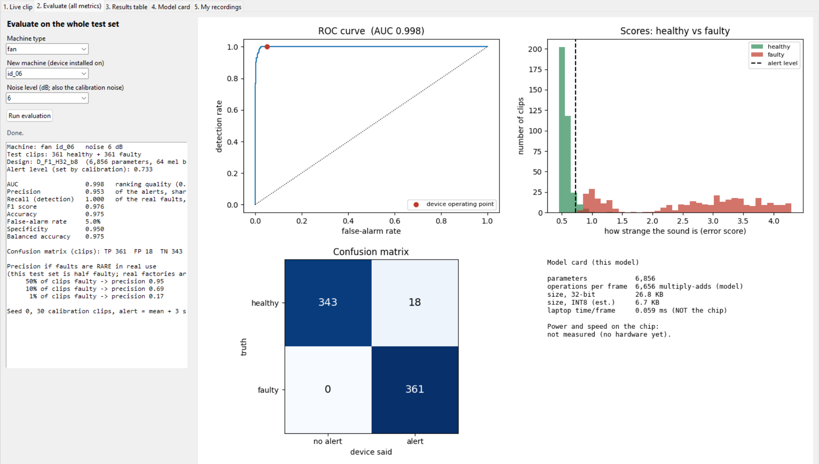
Screenshot: Evaluation Dashboard
Evaluate tab: fan machine 06, 6 dB, 361 healthy + 361 faulty test clips. AUC 0.998, recall 100%, false alarms 5% (18 of 361), precision 0.953.
Note: machine 06 fans are the easiest case. If only 1% of clips were faulty, precision would fall to 0.17.
Notes:
Simulation on a laptop with recorded clips. Explain the ROC curve, the score histogram with the alert level, and the confusion matrix.

Slide 20
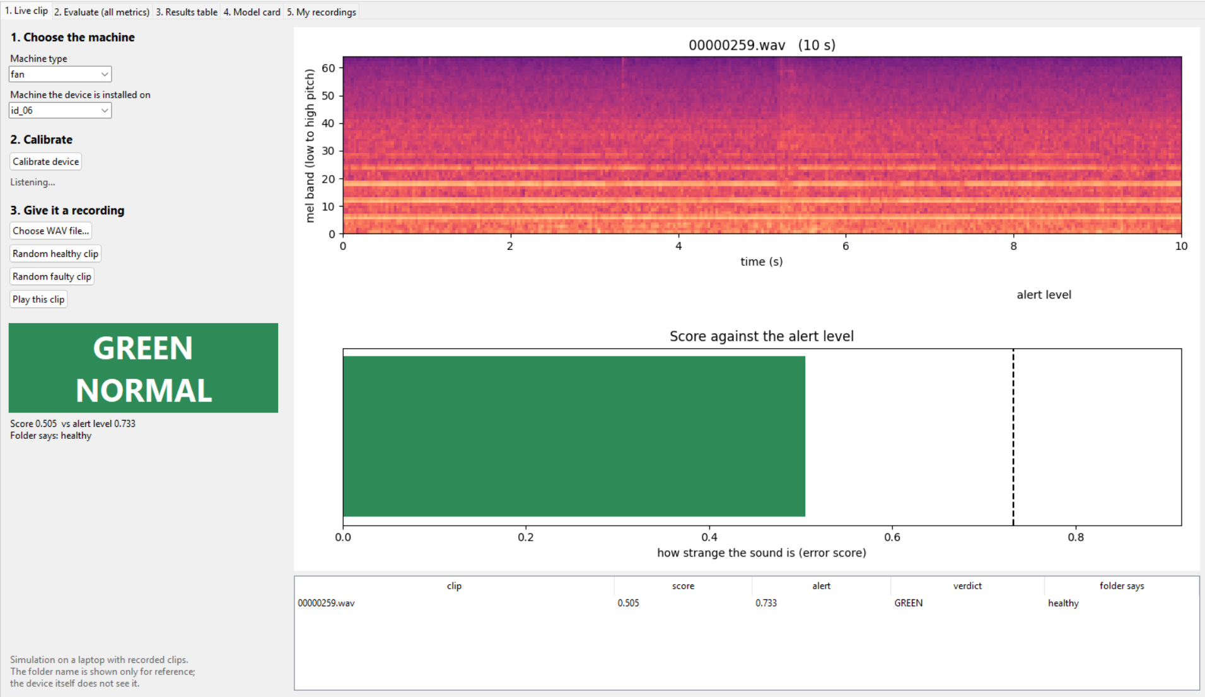
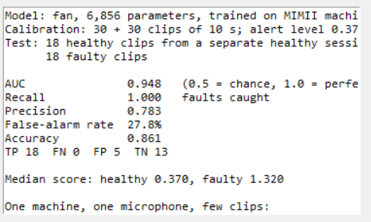
Screenshot: Live Clip and Own Recording
Own fan with a phone microphone
Live clip: the calibrated device says GREEN (score 0.505 is below the alert level 0.733).
Own-recording test: the model is trained on MIMII only; 30 + 30 healthy clips calibrate it; 18 healthy and 18 faulty clips are tested.
AUC 0.948 and all 18 faults caught, but 28% false alarms: the alert level sits close to the healthy scores. One machine and few clips: a first check, not proof.
Notes:
The window says it is a simulation on a laptop with recorded clips. The folder name is shown for reference only; the model never sees it.

Slide 21
Challenges and Mitigation
Challenge | What we found | Mitigation | Status
Early results used simulated sound | The '100% accuracy' was meaningless | Deleted; restarted on real MIMII data | Done
Vibration script invented a channel; data too easy | Healthy file had no such channel; AUC about 1.0 | Clean pipeline; sensor-noise margin test | Done
New machine looks faulty | AUC near 0.5 for fans and pumps | Per-machine calibration (60 clips) | Done
Alert-level rule unbalanced | Pumps 35% false alarms; fans and sliders recall 66-73% | Revise the rule; motor health to help the decision | Open
Valves not detected | AUC about 0.5 at all noise levels | Test worst-frame scoring and other features | Open
Noise changes after calibration | 44% false alarms if calibrated quiet | Calibrate in real noise or on a mix | Partly done
Heavy noise (-6 dB) | AUC about 0.7; slider recall 3% | Vibration support; needs paired data | Open
CNN needs fault examples | Better for the motor, but supervised | Compare fairly; keep the autoencoder for unseen faults | Open
No hardware yet | Nothing measured on the chip | Order parts after the 10 Nov go/no-go | Open
Notes:
Be upfront about the open items. The alert-level rule and valves are the two biggest.

Slide 22
Future Work Plan (1 of 2): Better Detection
Work | What we will do | Why
Revise the alert-level rule | Compare the current rule (average + 3 x spread) with other multipliers, percentile-based and median-based rules. Choose on the tuning machines, confirm once on the sealed machine and at 0 and -6 dB. | Pumps give 35% false alarms while fans and sliders miss faults: one rule is wrong in both directions.
Combine models | Test whether other models used together with the autoencoder give better recall at low false alarms. The candidates are not fixed; only what helps on the tuning machines is kept. | Aim for better results than the autoencoder alone.
Valves | Score the worst frames of a clip instead of the clip average; try other features. | Valves are unsolved (AUC about 0.5).
Vibration model | Document the CNN versus autoencoder comparison (data, split, metrics) and repeat it on the clean pipeline. | The CNN did better for the motor alone; we need a fair, reproducible comparison.
Decisions and filings | Hardware go/no-go on 10 Nov; KSCST proposal by 30 Nov; patent draft. | Fixed dates.
Notes:
These are options to evaluate, not decided results. No specific extra model is committed to.

Slide 23
Future Work Plan (2 of 2): Hardware and Fusion
When | Work | Target
Month 4 | Audio-in, decision-out simulation in Python; feature extraction in C, checked against the Python version; INT8 quantisation. | Same features on laptop and chip
Month 5 | ESP32-S3 bring-up, firmware, FFT and log-mel on the chip, model running on the chip. | System runs on hardware
Month 6 | On-chip calibration; test rig; record sound, vibration and temperature together; implement and test the motor-health-assisted decision. | Does vibration reduce false alarms and help in heavy noise?
Month 6.5-7 | Measure speed, memory and power; measure noise and energy of faults; benchmarking; paper and final report. | Validated prototype and manuscript
Months follow the project proposal timeline for next semester.
Notes:
Fusion is tested only once sound and vibration are recorded from the same machine on our own rig.

Slide 24
Team Contribution
Team member | USN | Contribution (to be filled by the team)
Nikitha D | ENG23CS0384 | [add your modules and experiments]
Rajika Saha | ENG23CS0415 | [add your modules and experiments]
Monalisa | ENG23CS0368 | [add your modules and experiments]
Sunand P Chowdary | ENG23CS0387 | [add your modules and experiments]
Every member should be ready to explain their own part and answer questions on the whole pipeline.
Notes:
Fill this slide in before the review: the rubric asks for individual contribution.

Slide 25
List of Deliverables
Deliverable | Status
Calibrated sound detector (Python) with results files for every experiment | Done
Evaluation suite and 5-tab dashboard (live clip, evaluate, results, model card, own recordings) | Done
Own-recording test tool (phone or any microphone) | Done (first test)
Vibration pipeline and model comparison | Done
Literature survey and project guide | Done
Revised alert-level rule and combined-model study | Planned
Fusion logic (motor health helping the sound decision) | Planned
INT8 model and feature extraction in C; ESP32-S3 prototype with LED output | Planned
Test-rig results with sound, vibration and temperature; energy and noise estimate | Planned
Research paper and patent filing | Planned
Notes:
Done items can be shown live in the dashboard. Planned items depend on hardware.

Slide 26
References
[1] H. Purohit et al., "MIMII Dataset: Sound Dataset for Malfunctioning Industrial Machine Investigation and Inspection," DCASE Workshop, 2019. arXiv:1909.09347.
[2] M. Yamaguchi, Y. Koizumi, N. Harada, "AdaFlow: Domain-Adaptive Density Estimator with Application to Anomaly Detection and Unpaired Cross-Domain Translation," ICASSP, 2019. arXiv:1812.05796.
[3] W. A. Smith, R. B. Randall, "Rolling element bearing diagnostics using the Case Western Reserve University data: A benchmark study," Mech. Syst. Signal Process., vol. 64-65, pp. 100-131, 2015.
[4] W. Jung et al., "Vibration, acoustic, temperature, and motor current dataset of rotating machine under varying operating conditions for fault diagnosis," Data in Brief, vol. 48, 109049, 2023.
[5] Add the papers from the literature tables here.
Notes:
Keep only papers that were opened. Add the literature-table papers here.

