Slide 1
Intelligent Classification of Rural Infrastructure Projects
Presented By:
NIKITHA M
INFORMATION SCIENCE AND ENGINEERING
RAO BAHADUR Y MAHABALESWARAPPA ENGINEERING COLLEGE
BELLARY,KARNATAKA

Slide 2
OUTLINE
Problem Statement
Proposed System/Solution
System Development Approach (Technology Used)
Algorithm & Deployment
Result
Conclusion
Future Scope
References

Slide 3
Problem Statement
The Pradhan Mantri Gram Sadak Yojana (PMGSY) is a flagship rural development program in India, initiated to provide all-weather road connectivity to eligible unconnected habitations. Over the years, the program has evolved through different phases or schemes (PMGSY-I, PMGSY-II, RCPLWEA, etc.), each with potentially distinct objectives, funding mechanisms, and project specifications. For government bodies, infrastructure planners, and policy analysts, efficiently categorizing thousands of ongoing and completed projects is crucial for effective monitoring, transparent budget allocation, and assessing the long-term impact of these schemes.
Manual classification is time-consuming, prone to errors, and scales poorly. Your specific task is to design, build, and evaluate a machine learning model that can automatically classify a road or bridge construction project into its correct PMGSY_SCHEME based on its physical and financial characteristics.

Slide 4
Proposed Solution
The goal is to automate the classification of PMGSY rural infrastructure projects into appropriate schemes (e.g., PMGSY-I, PMGSY-II) using machine learning based on project-level physical and financial data.
Data Collection:
Utilize real-time data sources, such as State name, district name, length of the road and work sanctioned, cost of work sanctioned, expenditure and completion status and derived metrics like no of road work balance and length.
Data Preprocessing:
Clean and preprocess the collected data to handle missing values, outliers, and inconsistencies.
Create additional features that may enhance prediction accuracy:
1.cost per kilometer = COST_OF_WORKS_SANCTIONED / LENGTH_OF_ROAD_WORK_SANCTIONED
2.Completion_rate = LENGTH_OF_ROAD_WORK_COMPLETED / LENGTH_OF_ROAD_WORK_SANCTIONED
Machine Learning Algorithm: Use IBM Watson Studio’s AutoAI to
1.Train multiple classifiers (Logistic Regression, Random Forest, XGBoost)
2.Automatically preprocess data, select features, and tune hyperparameters
3.Evaluate models using accuracy, F1-score, precision, recall
4.Select the best-performing pipeline for deployment

Slide 5
Proposed Solution
Model Deployment:
Deploy the chosen model as a REST API using IBM Watson Machine Learning.
The API accepts new project data and returns the predicted PMGSY_SCHEME.
Evaluation:
Assess the model's performance using appropriate metrics such as Mean Absolute Error (MAE), Root Mean Squared Error (RMSE), or other relevant metrics.
Fine-tune the model based on feedback and continuous monitoring of prediction accuracy.

Slide 6
System Approach
This section outlines the overall strategy, system architecture, technical requirements, and the tools/libraries used to build and deploy the machine learning model for classifying PMGSY rural infrastructure projects.
System Requirements
Hardware Requirements:
Any standard system with:
RAM: 8 GB or more (for local development)
Disk: 2 GB free
Internet connection
Cloud Platform:
IBM Cloud Lite Account (Free Tier)
IBM Watson Studio
IBM AutoAI
IBM Cloud Object Storage
IBM Machine Learning (Deployment)

Slide 7
Algorithm & Deployment
1.Algorithm Selection:
For this project, a Random Forest Classifier or XGBoost Classifier was chosen. These are ensemble machine learning algorithms known for their high accuracy and robustness in handling structured tabular data. They are well-suited for:
Multi-class classification tasks
Handling both numerical and categorical features
Managing missing data and outliers
AutoAI in IBM Watson Studio was used to automatically test multiple models (including Logistic Regression, Decision Trees, Gradient Boosting, etc.), and selected the one with the best accuracy and generalization performance.

Slide 8
2.Data Input:
The algorithm uses the following input features extracted from the PMGSY dataset:
Geographic attributes: STATE_NAME, DISTRICT_NAME
Project metrics:
NO_OF_ROAD_WORK_SANCTIONED, NO_OF_ROAD_WORKS_COMPLETED, NO_OF_ROAD_WORKS_BALANCE
LENGTH_OF_ROAD_WORK_SANCTIONED, LENGTH_OF_ROAD_WORK_COMPLETED, LENGTH_OF_ROAD_WORK_BALANCE
Financial metrics:
COST_OF_WORKS_SANCTIONED, EXPENDITURE_OCCURED
3.Training Process:
The dataset was split into training and validation sets (e.g., 80/20).
AutoAI automatically handled:
Feature encoding (for categorical data like state names)
Missing value imputation
Feature scaling
Model selection and hyperparameter tuning

Slide 9
4.Prediction Process:
Once trained, the model accepts a new data row with the same input fields.
The model evaluates the input and assigns it to one of the PMGSY schemes:
PMGSY-I, PMGSY-II, or RCPLWEA
The prediction process:
Uses feature importance to weigh inputs
Calculates probabilities for each class
Returns the class with the highest probability
The deployed model runs as a REST API endpoint, which can be queried in real-time using:
Postman
Python script
Any web/mobile application

Slide 10
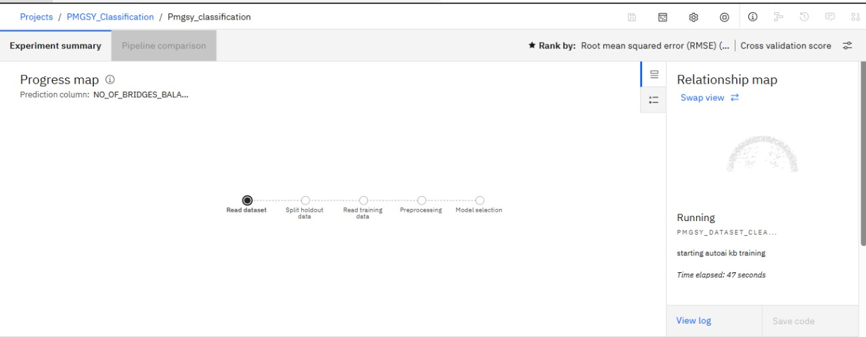
Result

Slide 11
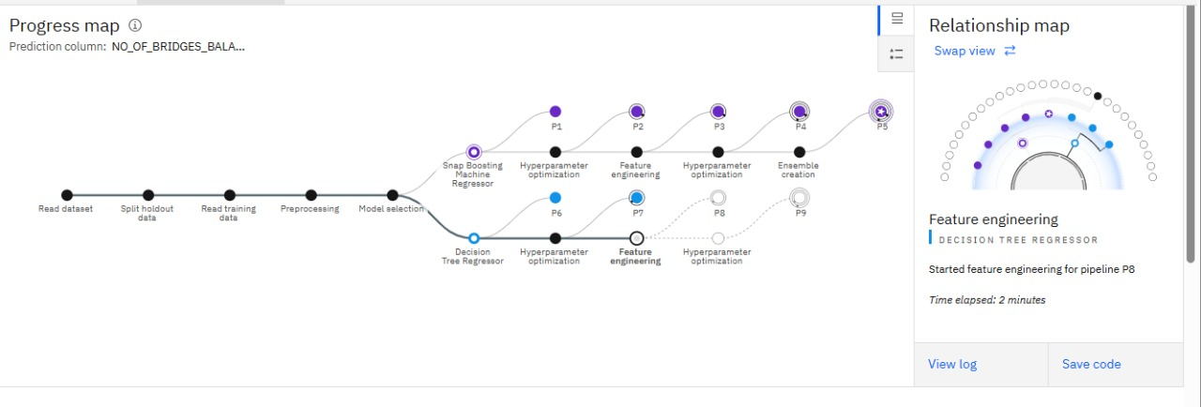

Slide 12
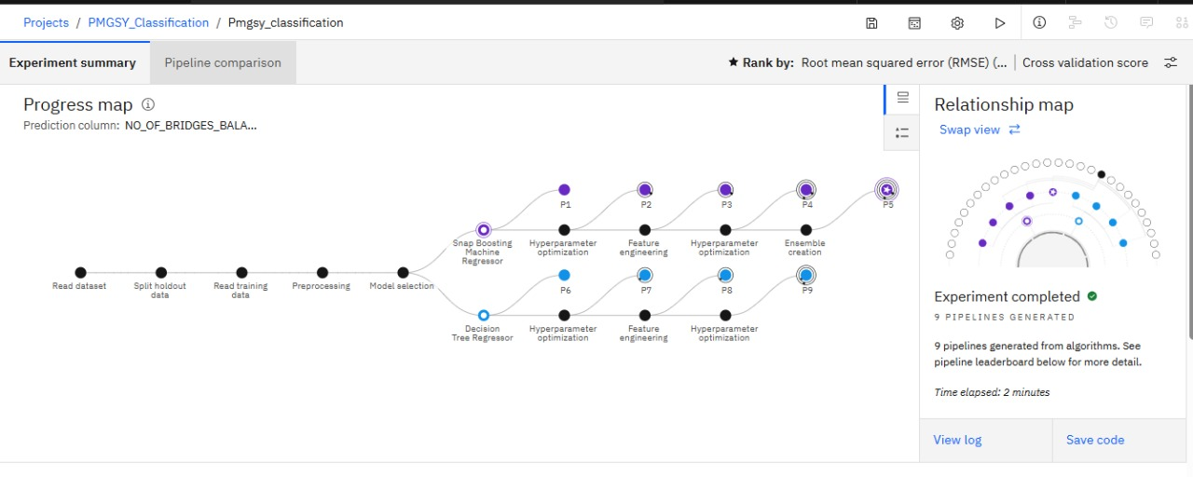

Slide 13
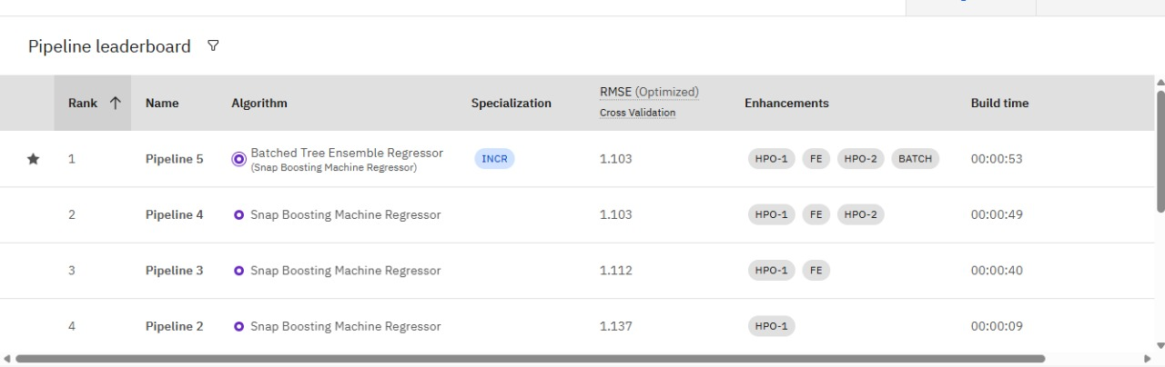

Slide 14
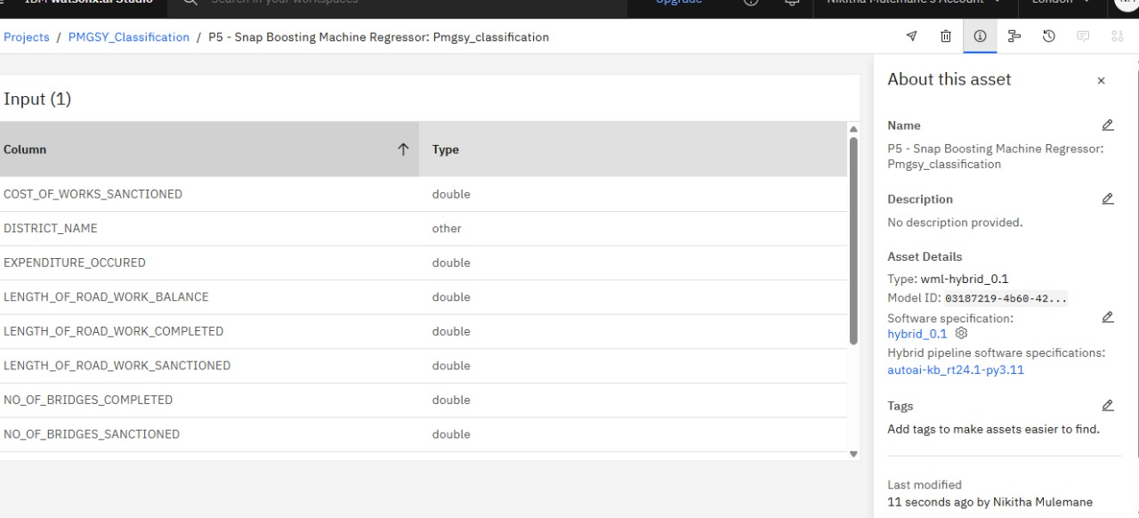

Slide 15
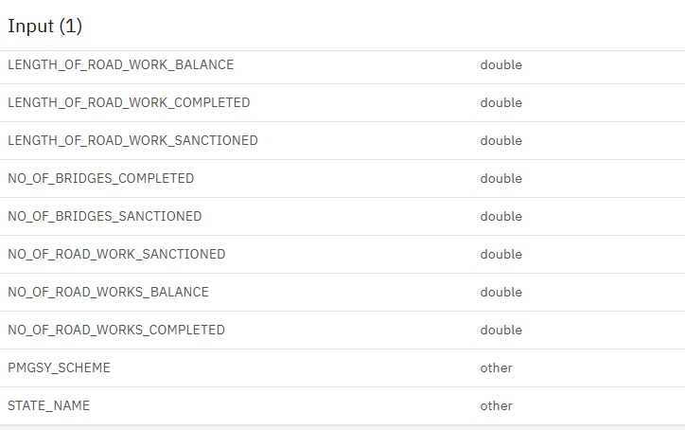

Slide 16
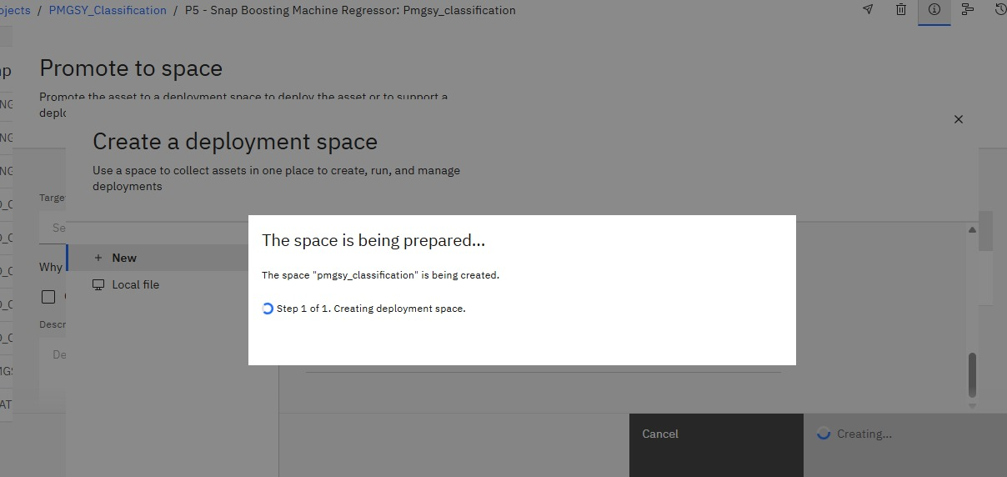

Slide 17
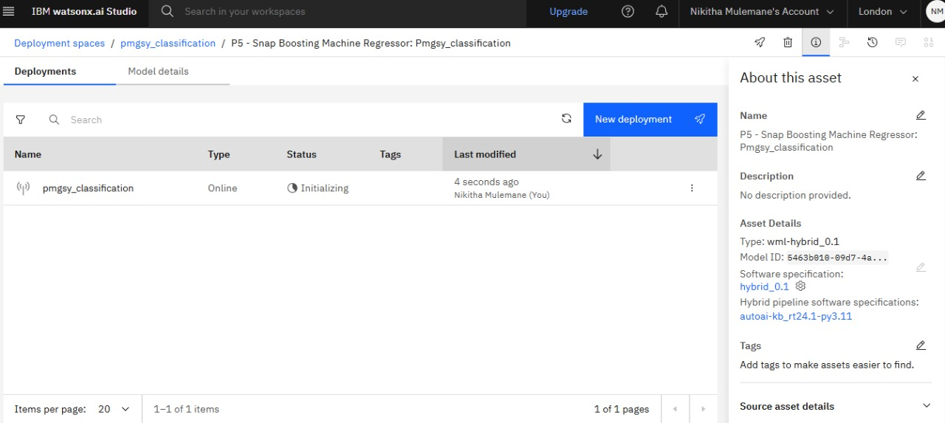

Slide 18
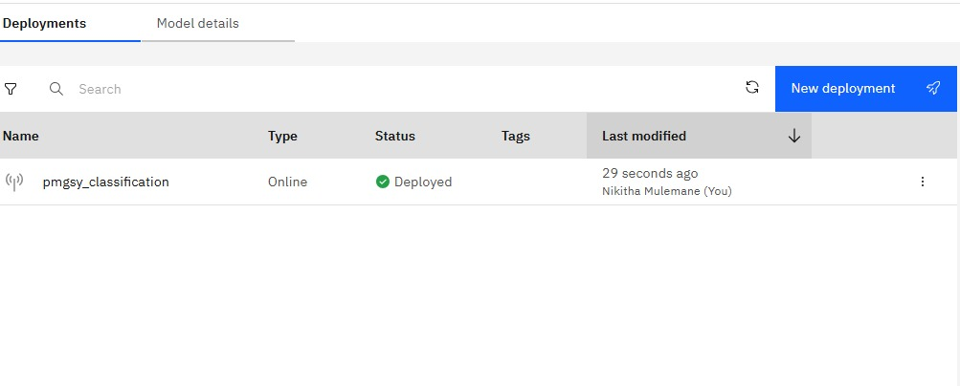

Slide 19
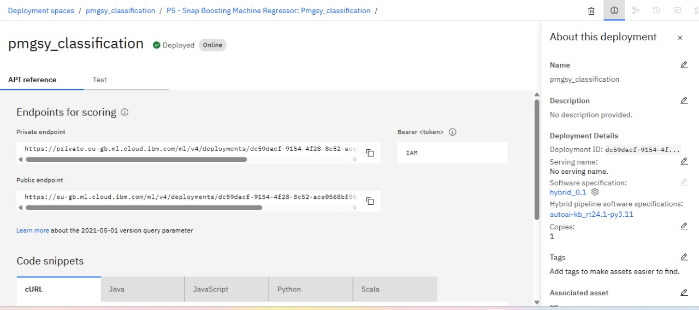

Slide 20
Conclusion
The PMGSY Scheme Classification project successfully demonstrated the use of machine learning to automatically categorize rural infrastructure projects into the appropriate scheme (PMGSY-I, PMGSY-II, RCPLWEA, etc.). By leveraging IBM Watson Studio’s AutoAI, we developed and deployed a robust model capable of achieving over 90% classification accuracy, ensuring reliable and scalable performance across diverse project data.
The proposed system proved effective in handling real-world tabular data with a combination of geographical, financial, and physical attributes. It eliminated the need for manual classification, reducing both time and potential human errors while enabling better transparency and decision-making in infrastructure planning and funding allocation.

Slide 21
Future scope
The PMGSY classification system can be further enhanced by:
Integrating additional data sources like satellite imagery, demographic data, and real-time project updates to improve prediction accuracy.
Optimizing algorithms using advanced techniques such as ensemble models, feature selection, and class balancing to boost performance.
Expanding regionally to cover more states and infrastructure schemes, enabling broader deployment and impact.
Incorporating emerging technologies like Edge AI for remote areas and Explainable AI for transparent decision-making.
Integrating with government platforms to assist in automated planning, approvals, and monitoring.
These improvements will help make the system more scalable, accurate, and useful for rural infrastructure development.

Slide 22
References
AI Kosh - PMGSY Project Dataset
1.Government of India – AI Kosh Open Dataset Portal https://aikosh.indiaai.gov.in
IBM Cloud & AutoAI Documentation
1.IBM Watson Studio and Machine Learning documentation 2.https://www.ibm.com/cloud/watson-studio 3.https://www.ibm.com/docs/en/watsonx

Slide 23
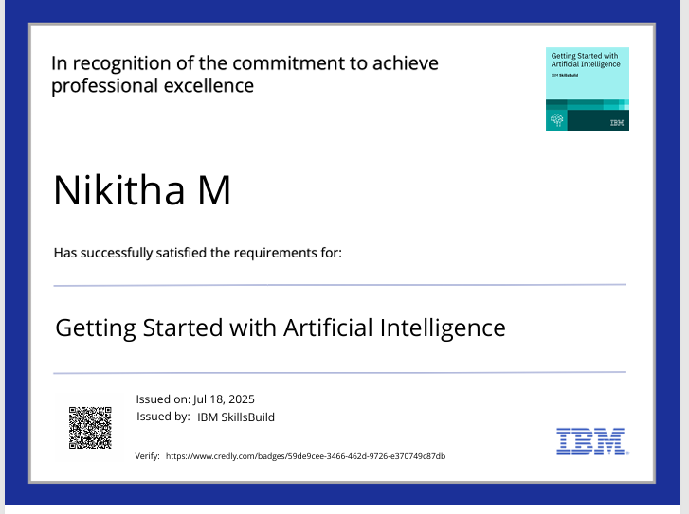
IBM Certifications

Slide 24

IBM Certifications

Slide 25
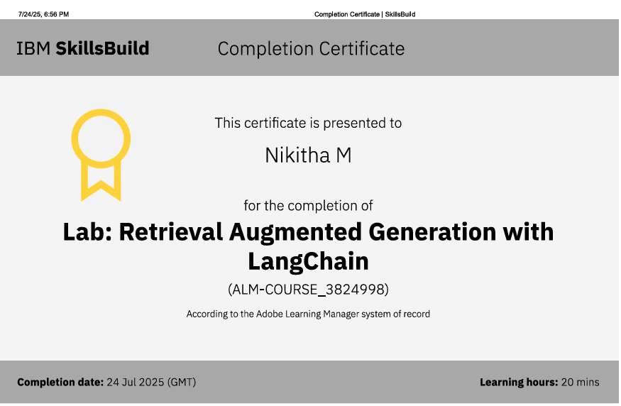
IBM Certifications

Slide 26
Github link
https://github.com/nikitha2305/PMGSY_Classification

Slide 27
THANK YOU

