Slide 1
PROJECT TITLE
CAPSTONE PROJECT
Presented By:Nikitha George
Student Name : Nikitha George
College Name & Department : Saintgits College Of Engineering,CSE

Slide 2
OUTLINE
Problem Statement
Technology used
Wow factor
End users
Result
Conclusion
Git-hub Link
Future scope

Slide 3
Problem Statement
Conventional encryption methods store secret messages in text or binary formats, making them susceptible to detection. This project leverages image-based steganography to embed messages within images by subtly modifying pixel values, ensuring secure and undetectable communication. The objective is to develop a robust encoding and decoding mechanism that preserves the image’s visual integrity while enabling confidential data transmission.

Slide 4
Technology used
Programming Language: Python
Libraries & Frameworks:
OpenCV (cv2): Facilitates image processing, including reading, modifying, and storing images.
NumPy: Enables efficient manipulation of pixel data and numerical operations.
OS: Supports file management and image handling tasks

Slide 5
Wow factors
Stealthy Data Concealment: Embeds messages within pixel values, ensuring they remain imperceptible to the human eye.
Automated Message Length Encoding: Eliminates manual input by seamlessly storing message length within the image.
RGB Channel Distribution: Enhances security by dispersing encoded data across the Red, Green, and Blue channels.
Secure Access Control: Implements password-protected decryption to restrict access to authorized users.
Preserved Visual Integrity: Embeds data with minimal distortion, maintaining the image’s original quality.

Slide 6
End users
Cybersecurity Professionals: Enables secure communication and covert data transmission.
Journalists & Whistleblowers: Provides a discreet method for sharing sensitive information.
Government & Intelligence Agencies: Supports confidential data exchange and covert operations.
General Users: Offers a simple yet effective way to conceal private messages within images.

Slide 7
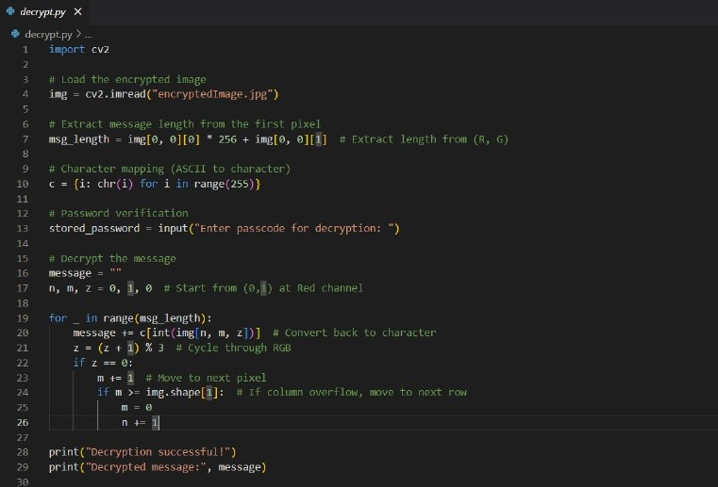
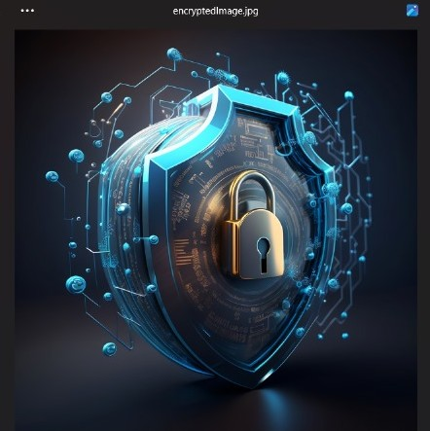
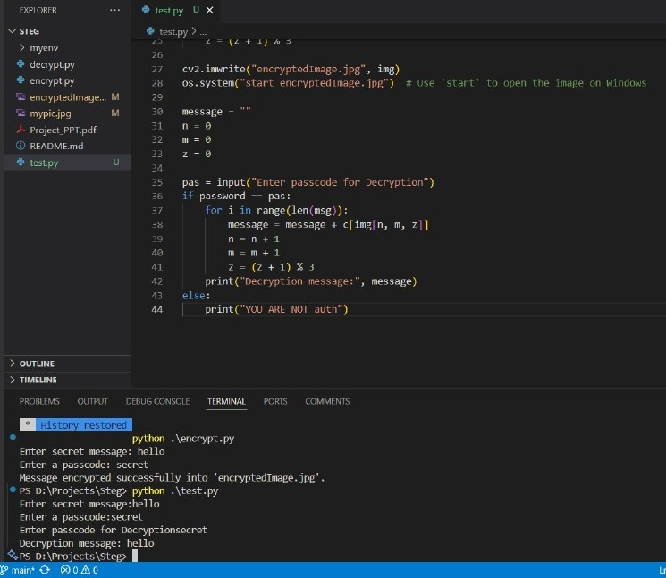
Results

Slide 8
Conclusion
This project leverages image-based steganography to securely conceal messages within images while maintaining their visual integrity. By utilizing pixel manipulation and password protection, it ensures confidentiality and restricted access. This approach offers a discreet, secure, and efficient method for covert communication.

Slide 9
GitHub Link
https://github.com/nikithageorge/StegoSecure/

Slide 10
THANK YOU

