Slide 1

MAJOR PROJECT
Submitted in partial fulfillment for the requirements for the award of degree of
BACHELOR ENGINEERING
of
COMPUTER SCIENCE AND ENGINEERING
For the Academic Year 2023-24
Submitted by:
Gunda Nikitha Srinivas 1MJ20CS074
Iswarya V 1MJ20CS086
Krithi Naga Sai Vangala 1MJ20CS0101
Nisha Elizabeth Renji 1MJ20CS137

Slide 2
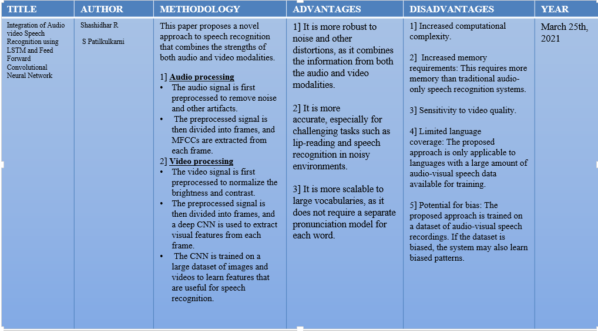
LITERATURE SURVEY

Slide 3
LITERATURE SURVEY
TITLE | AUTHOR | METHODOLOGY | ADVANTAGES | DISADVANTAGES | YEAR
Concatenative Speech Recognition using Morphemes | Afshan Jafri | The CSRM approach works as follows: 1] A pronunciation dictionary is created by concatenating the pronunciations of morphemes. 2] A recognition lattice is generated for the input speech signal. 3] A decoding algorithm is used to search the lattice for the most likely sequence of morphemes. This sequence is then converted into a word sequence. | 1] It is more scalable to large vocabularies. 2]It is more robust to out-of-vocabulary (OOV) words. 3] It is more efficient in terms of computation and memory requirements. | 1] Increased complexity: Because it requires the decomposition of words into morphemes and the construction of a pronunciation dictionary and recognition lattice using the pronunciations of morphemes. 2] Limited language coverage: CSRM is only applicable to languages with concatenative morphology. 3]Reduced accuracy: CSRM systems may have lower accuracy than word-based ASR systems for languages with a large number of morphemes. | January 2021

Slide 4
LITERATURE SURVEY
TITLE | AUTHOR | METHODOLOGY | ADVANTAGES | DISADVANTAGES | YEAR
Automatic speech recognition system | Ishrat Sultana Nirmaljeet Kaur Pannu | The major objective of this research are: Recognizes discrete words from Hindi language controls some action depending on the provided input. The input voice is captured using a microphone It is then preprocessed using algorithms like DTW, HMM. Then deploying it on an embedded system. | Enhanced Efficiency and Productivity: ASR significantly improves efficiency by enabling hands-free operation, allowing users to dictate text, control devices, and perform tasks without typing ImprovedAccessibilitymore accessible to individuals with limited mobility or speech impairments. It allows them to interact with devices, access information, without relying on traditional input methods. | Accuracy Limitations: ASR systems are not always 100% accurate, especially in challenging environments with background noise, accents, or multiple speakers. This can lead to misinterpretations, errors in transcriptions, and frustration for users. Dependency on Training Data: ASR systems are trained on large amounts of speech data, and their accuracy depends on the quality and representativeness of this data. Biases or limited coverage in the training data can lead to poor performance for specific accents, dialects, or domains. . | December, 2021

Slide 5
LITERATURE SURVEY
TITLE | AUTHOR | METHODOLOGY | ADVANTAGES | DISADVANTAGES | YEAR
A Model for the Application of Automatic Speech Recognition for Generating Lesson Summaries | Phillip Blunt Bertram Haskins | The methodology for developing an ASR-based lesson summary generation system typically involves the following steps: Data Collection and Preparation Speech Recognition Extractive Summarization Text Generation Evaluation Refinement and Iteration | Facilitating Language Learning and Comprehension: For students it provide exposure to natural speech patterns and enhance vocabulary acquisition. Promoting Active Learning and Reflection: Lesson summaries can serve as prompts for active learning strategies, encouraging students to reflect on the material, ask questions, and engage in deeper analysis. . | Limited Understanding of Context and Nuances: they may struggle to understand the context of lecture discussion, or interpret subtle nuances in speech. This can lead to summaries that lack depth and fail to capture the full meaning of the spoken material. Potential for Misinterpretation and Biases: ASR systems can misinterpret homophones or confuse words with similar pronunciation. Can lead to errors in the summaries that may confuse or mislead students. Additionally, ASR systems may reflect biases present in the training data, potentially perpetuating stereotypes or overlooking important perspectives. | March 2021

Slide 6
LITERATURE SURVEY
TITLE | AUTHOR | METHODOLOGY | ADVANTAGES | DISADVANTAGES | YEAR
Harris Hawke’s Sparse Auto Encoder Networks for Automatic Speech Recognition System | Mohammed Hasan Ali Mustafa Musa Jaber Sura Khalid Abd Ajed Rehman, Mazhar Javed Awan, Adzgauskiene Saeed Ali Bahaj | Focuses on ASR technique – Automatic Speech Recognition Uses Jim-Schwoebel datasets Spectral Deduction and Fourier Transformation for pre-processing Feature extraction to enhance ASR HHSAE Recognizer is fed acoustic model+ language model | Reduces misclassification error rate problems Maintains robustness availability of the system Ensures a 99.18% accuracy | Challenging due to different dialects, speeds, and traditions vary in actual applications | 2022

Slide 7
LITERATURE SURVEY
TITLE | AUTHOR | METHODOLOGY | ADVANTAGES | DISADVANTAGES | YEAR
Electroglottograph- Based Speech Emotion Recognition via Cross-Modal Distillation | Lijiang Chen Jie Ren Xia Mao Qi Zhao | To build efficient SER model – Speech Emotion Recognition EGG signals reflect direct movement of vocal chords using alterate current. Cross-modal emotional distillation (CMED) is proposed using the Teacher-Student model. T-S has 3 parts: Feature Extraction Emotion Encoder Classifier | Around 60% accuracy on the S70 subset of the Chinese Dual-model Database 30-40% accuracy on the EMO-DB | It is a challenge to make emotion available in different languages.. | 2022

Slide 8
LITERATURE SURVEY
TITLE | AUTHOR | METHODOLOGY | ADVANTAGES | DISADVANTAGES | YEAR
Developing a Speech Recognition System for Recognizing Tonal Speech Signals Using a Convolutional Neural Network | Sakshi Dua, Sethuraman Sambath Kumar, Yasser Albagory, Rajakumar Ramalingam, Ankur Dumka, Rajesh Singh, Mamoon Rashid, Anita Gehlot, Sultan S. Alshamrani and Ahmed Saeed AlGhamdi | Focuses on CNN’s role in robust and uncommon speech signals. Uses speech signals of Punjabi lang. Feature Extraction done using MFCC,Librosa Segmentation using Praat sw In CNN, 6 layers of:2D convulation Max Pooling 256 Dense Layers Fully Connected Layer and Softmax Layer forclassification | 89.15% accuracy rate and 10.56% WER Efficient framework and hyperparameter | Limited effectiveness for sequential datasets. | 2022

Slide 9
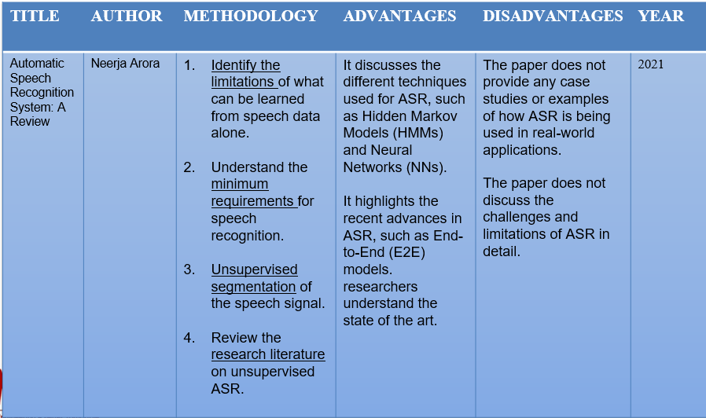
LITERATURE SURVEY

Slide 10
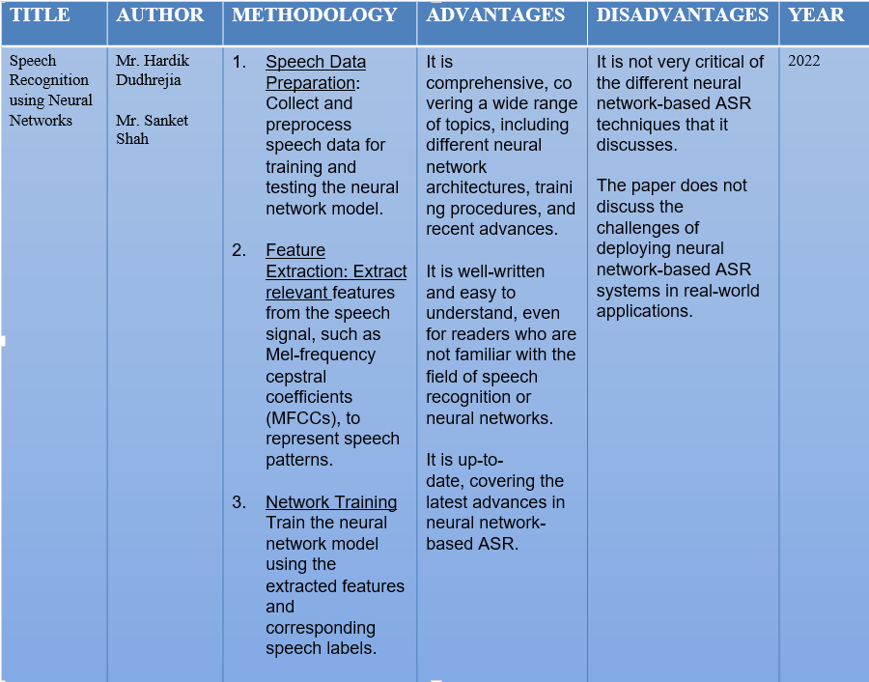
LITERATURE SURVEY

Slide 11
TAKE AWAYS FROM BASE PAPER
Sensitivity to Noise and Background Audio: ASR systems are highly susceptible to noise and background audio, which can significantly impact their accuracy. In noisy environments, such as busy streets or crowded rooms, ASR systems may struggle to distinguish between the target speaker's voice and ambient sounds, leading to misinterpretations and errors.
Accents and Dialects: ASR systems are often trained on large datasets of speech from a variety of accents and dialects. However, they may still have difficulty understanding speakers with strong accents or unique pronunciations. This can be particularly challenging for multilingual applications or when dealing with speakers from diverse backgrounds.
Speaker-Dependent Performance: ASR systems are often speaker-dependent, meaning that they are trained on a specific individual's voice patterns and may struggle to recognize other speakers accurately. This can be a limitation for applications that require interaction with multiple users or where speaker enrollment is not feasible.
Limited Vocabulary and Domain-Specific Training: ASR systems typically have a limited vocabulary, which can restrict their ability to recognize specialized terms or phrases used in specific domains. For instance, an ASR system trained on general conversation may not be able to handle medical terminology or legal jargon effectively.

Slide 12
PROPOSED SYSTEM
Preprocessing and face alignment are crucial: Before lip reading, it is essential to preprocess the video data to enhance the facial features and align the face to a canonical view. This may involve techniques like facial landmark detection.
Feature extraction captures visual cues: Feature extraction is the process of converting the facial video frames into a representation that captures the relevant visual cues for lip reading. Common feature extraction methods include facial landmarks tracking, optical flow analysis, and mouth shape extraction.
Temporal modeling captures lip movements: Temporal modeling is essential for lip reading as it captures the dynamic changes in lip movements over time. This is typically done using techniques like long short-term memory (LSTM) networks.
Language modeling incorporates context: Language modeling incorporates knowledge of language to improve the accuracy of lip reading. It predicts the likelihood of word sequences, helping the system disambiguate between similar-looking mouth shapes.

Slide 13
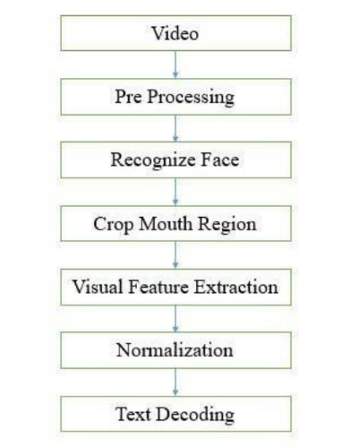
PROPOSED SYSTEM

Slide 14


