Slide 1


Capstone Project
TITLE :
customer churn Forecasting [Telecom]
Gahan.P
Nikitha.H.S
Yogesh Baghel
Vijay Krishna

Slide 2

Introduction
In the telecom industry, customers are able to choose from multiple service providers and actively switch from one operator to another.
In this highly competitive market, the telecommunications industry experiences an average of 15-25% annual churn rate.
Given the fact that it costs 5-10 times more to acquire a new customer than to retain an existing one, customer retention has now become even more important than customer acquisition. So ,we need to analyse telecom industry data and predict high value customers who are at high risk of churn and identify main indicators of churn.
In this project, you will analyse customer-level data of a leading telecom firm, build predictive models to identify customers at high risk of churn and identify the main indicators of churn.

Slide 3
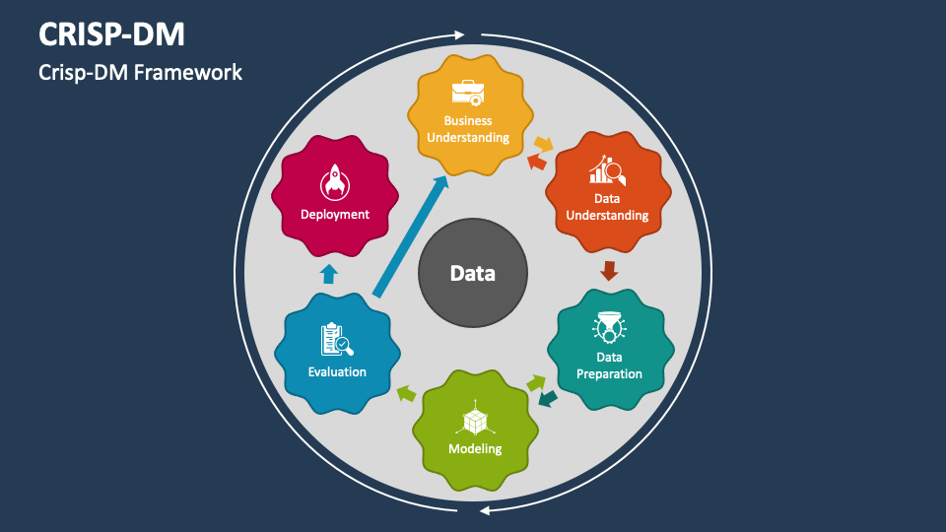
Project Flow - Overview
Defining Business Problem
Data Collection
EDA and Feature Engineering
Data Preprocessing
Model Building
Model Evaluation
Model Deployment

Slide 4

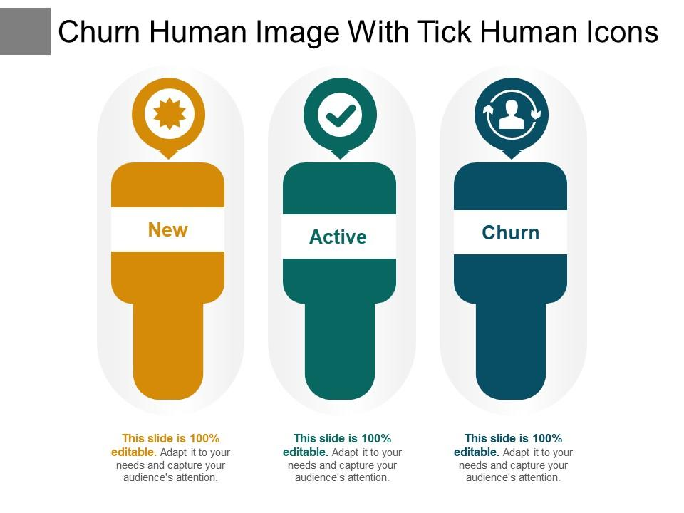



Problem Definition
In the rapidly evolving landscape of the telecommunications industry, customer churn poses a critical challenge for service providers. As subscribers have an increasing array of options, retaining customers is paramount for sustainable business growth. The objective of this project is to develop an effective churn prediction model using a telecom dataset, enabling the identification of customers at risk of churning.
Three phases of customer lifecycle
Good phase
Action phase
Churn phase
6th & 7th
Month:customer is happy
8th month: customer experience starts to sore in this phase, unhappy with service quality due to offers provided by other competitors.
9th month:
customer is said to have churned

Slide 5
Data Preprocessing
Missing Value Treatment
Columns | Total | Percentage
arpu_3g_6 | 74846 | 74.846748
night_pck_user_6 | 74846 | 74.846748
total_rech_data_6 | 74846 | 74.846748
arpu_2g_6 | 74846 | 74.846748
max_rech_data_6 | 74846 | 74.846748
fb_user_6 | 74846 | 74.846748
av_rech_amt_data_6 | 74846 | 74.846748
date_of_last_rech_data_6 | 74846 | 74.846748
count_rech_2g_6 | 74846 | 74.846748
count_rech_3g_6 | 74846 | 74.846748
Out of 226 columns 166 have null values

Slide 6
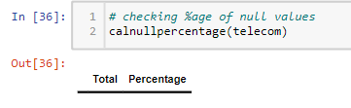
Feature engineering
Identifying CHURN CUSTOMERS
Now tag the churned customers (churn=1, else 0) based on the fourth month as follows: Those who have not made any calls (either incoming or outgoing) AND have not used mobile internet even once in the churn phase. The attributes you need to use to tag churners are:
total_ic_mou_9
total_og_mou_9
vol_2g_mb_9
vol_3g_mb_9
After tagging churners, remove all the attributes corresponding to the churn phase (all attributes having ‘ _9’, etc. in their names).
Non-churn 0 | 91.86
Churn 1 | 8.14
approximately 92% customers not churned and 8% customers got churned. Also, we can see class imbalance is there and we will deal with it later
We imputed null values using KNN imputer so ,after imputation of KNN there is no null values

Slide 7
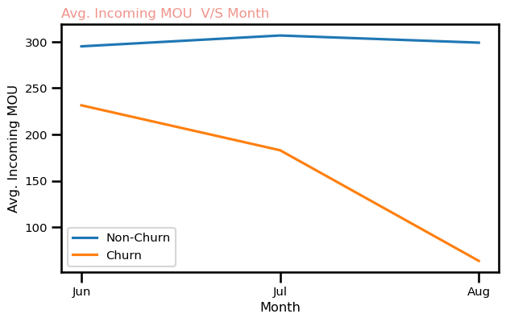
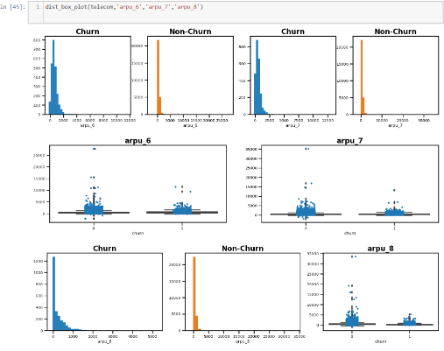
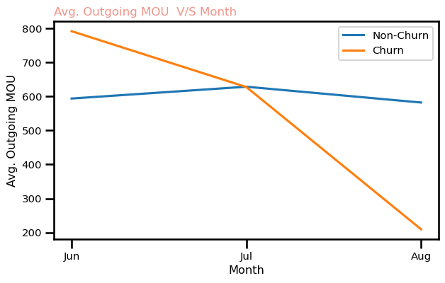
Data Visualisation and EDA
average revenue per user is decreasing for churn customers in 8th month.Also there are lots of outlier exists in revenue as some customers might using higher data and recharging frequently.
Ratio is getting dropped for churn customers,
However ,for non churn its increasing

Slide 8
Handling Skewness
Creating dummy variables for categorical variables that is one hot encoding
Handling Imbalance Dataset
Lets find out if numerical predictor variables are largely skewed or not
There are many techniques available. I am using ADASYN(Adaptive Synthetic) which is an improved version of SMOTE. What it does is same as SMOTE just with a minor improvement. After creating those sample it adds a random small values to the points thus making it more realistic. In other words instead of all the sample being linearly correlated to the parent they have a little more variance in them i.e they are bit scattered.
columns | Skewness
roam_og_to_ic_mou_8 | 168.378029
avg67_isd_og_to_ic_mou | 153.210816
isd_og_to_ic_mou_8 | 148.243237
og_others_6 | 110.070897
avg67_roam_og_to_ic_mou | 108.020078
avg67_isd_og_mou | 88.242880
isd_og_mou_8 | 88.041259
avg67_spl_ic_mou | 58.158701
avg67_ic_others | 55.167106
loc_og_to_ic_mou_8 | 54.529646
As we can see from skewness values, predictor variables are highly skewed. We need to take care of skewness,we did quantile transformer

Slide 9
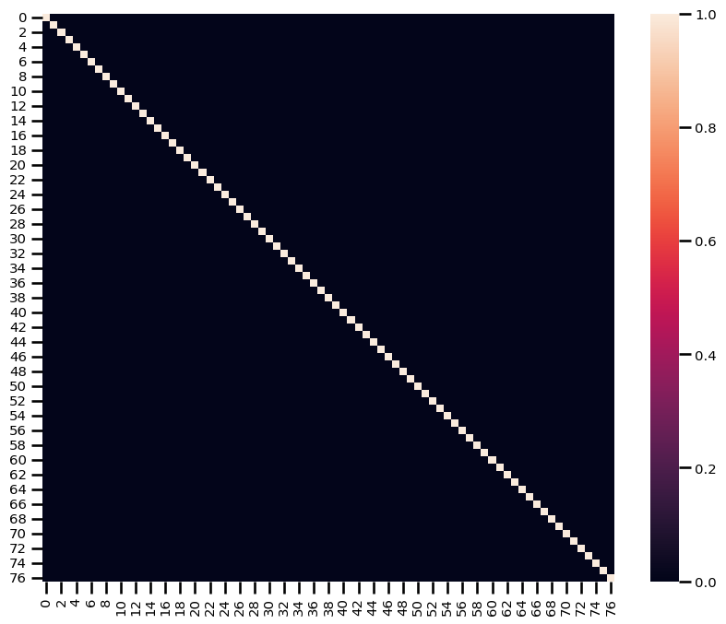
Splitting the data by using Train_Test_Split
X_train, X_test, y_train, y_test = train_test_split(X, y, test_size=0.2, random_state=randm_state)
print(X_train.shape)
print(X_test.shape)
(24,000 ,205)
(6001,205)
after splitting ,implemented SMOTE
Feature Scaling is done
Applying PCA
All principal components are uncorrelated with each other

Slide 10
Model Building
Model | class | Precision | recall | f1-score | Accuracy
Naive Bayes Classifier | 0 | 0.95 | 0.97 | 0.96 | 0.92
 | 1 | 0.51 | 0.39 | 0.44
Logistic Regression | 0 | 0.99 | 0.86 | 0.92 | 0.86
(Default parameters) | 1 | 0.33 | 0.85 | 0.48
Logistic Regression | 0 | 0.99 | 0.68 | 0.81 | 0.70
(Tuned Hyperameters) | 1 | 0.20 | 0.94 | 0.33
KNN | 0 | 0.95 | 0.98 | 0.96 | 0.93
(Default parameters) | 1 | 0.60 | 0.42 | 0.49
KNN | 0 | 0.95 | 0.97 | 0.96 | 0.93
(Tuned Hyperameters) | 1 | 0.56 | 0.40 | 0.47
Random Forest | 0 | 0.99 | 0.83 | 0.90 | 0.83
(Tuned Hyperameters) | 1 | 0.29 | 0.85 | 0.44
Gradient Boosting | 0 | 0.97 | 0.96 | 0.96 | 0.93
 | 1 | 0.56 | 0.60 | 0.58
Tuned XGBoost Model | 0 | 0.93 | 1.00 | 0.96 | 0.93
(Tuned Hyperameters) | 1 | 0.79 | 0.06 | 0.12

Slide 11
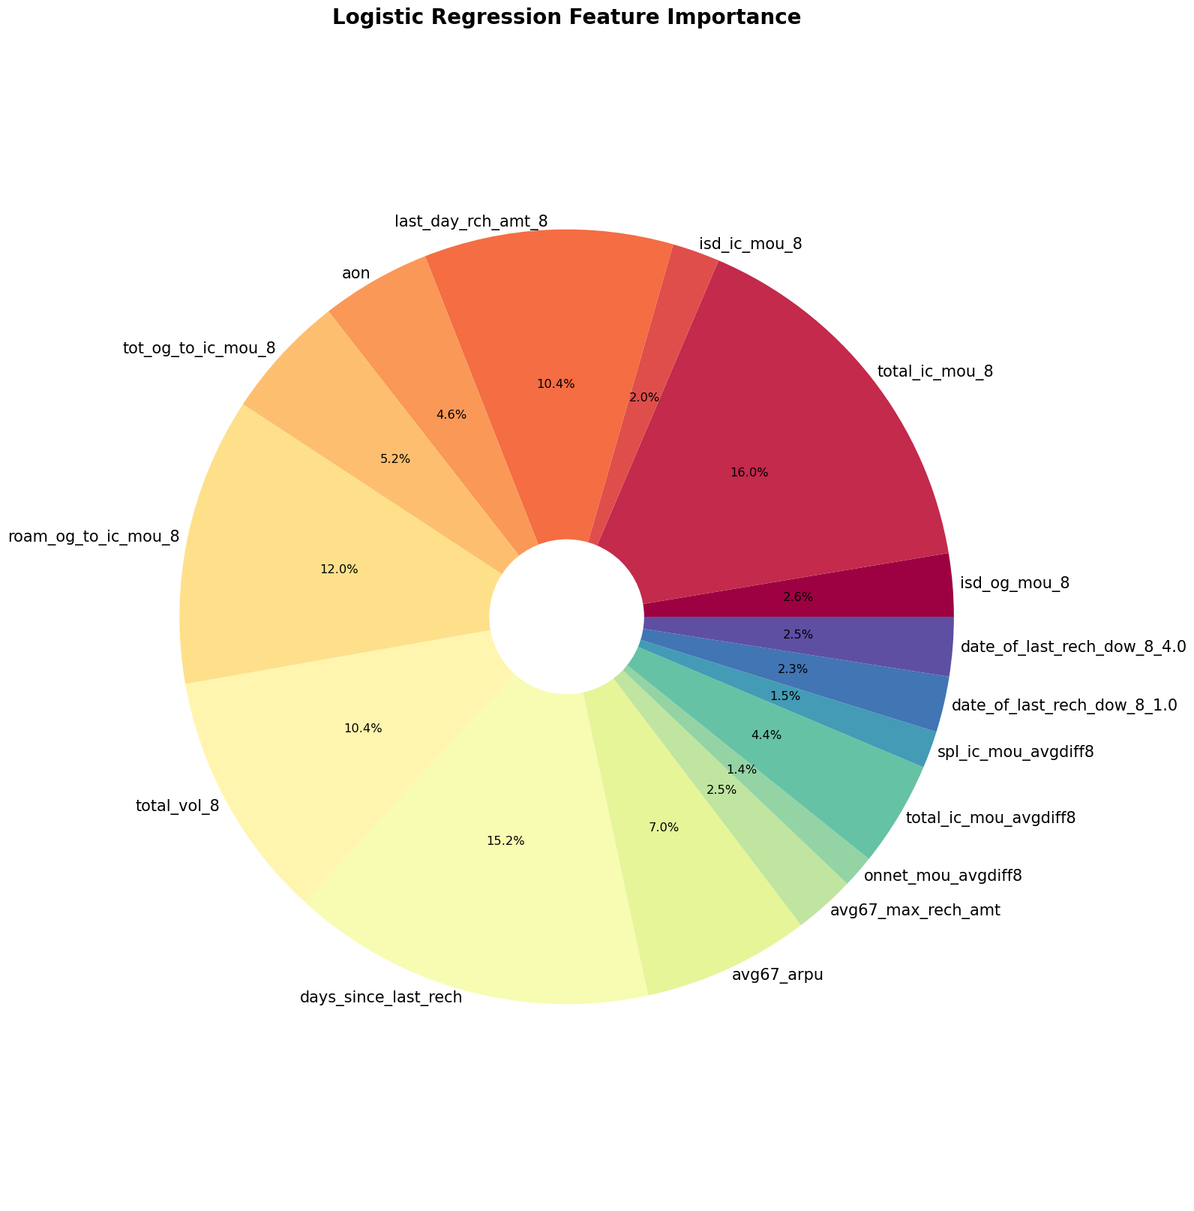

Slide 12
Top 10 features for Business should consider while predicting customers who are likely to churn and can make business decision on those.
Below are the features importances in their decreasing order:
total_ic_mou_8 (total incoming minutes of usage for 8th month)
days_since_last_rech (days since last recharge)
roam_og_to_ic_mou_8(roaming outgoing to incoming ratio of minute of usage for 8th month)
total_vol_8 (total volume of data usage (2g + 3g) for 8th month
last_day_rch_amt_8 (last day recharge amount for 8th month)
avg67_arpu( avergae revenure per user average for 6th and 7th month)
tot_og_to_ic_mou_8 (total outgoing to incoming minutes of usage for 8th month)
total_ic_mou_avgdiff8 (total incoming minutes of usage average 6th and 7th month difference from 8th month)
aon (age on network)
avg67_max_rech_amt(average of 6th and 7th month maximum recaherge amount)
From logistic regression using 16 feature variables I got:
Recall Score= 87%
Accuracy = 85%
ROC AUC= 85%
Specificity= 84%

Slide 13
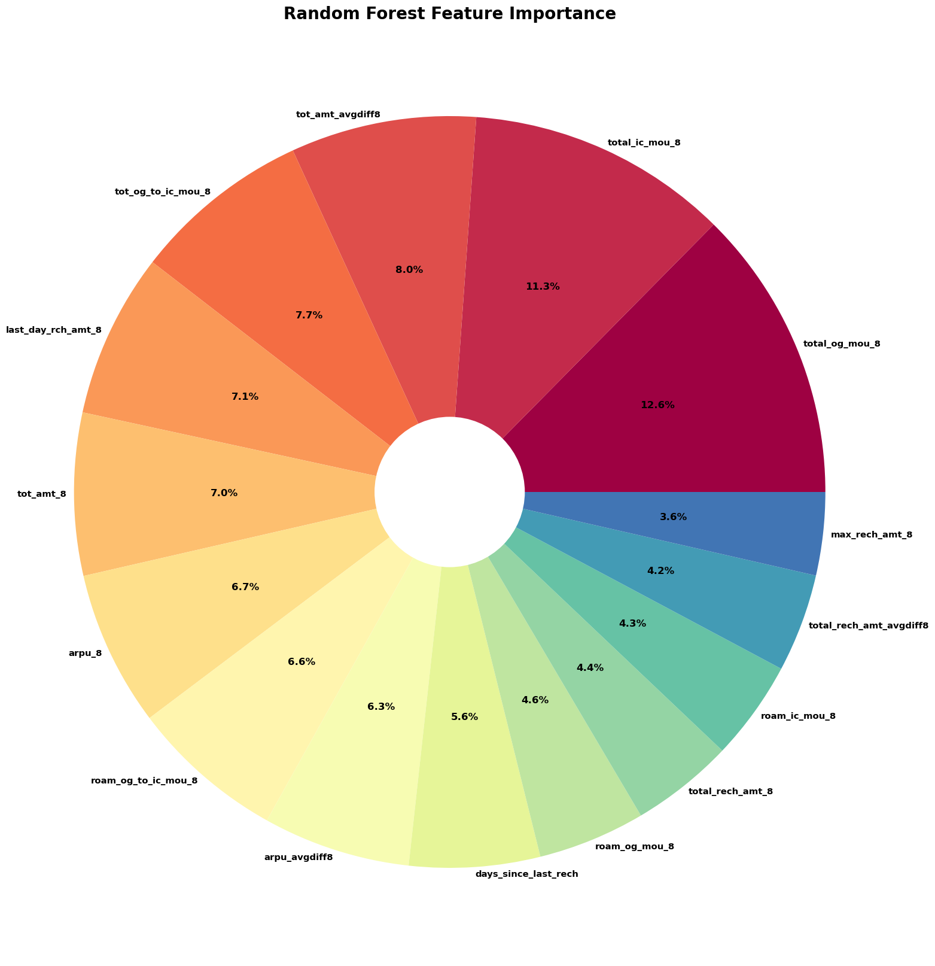

Slide 14
Top 10 feature variables for business which will be very helpful in business making decision and give additional
benefits/discount to customers who are likely to churn
total_og_mou_8 (Total outgoing minutes of usage for 8th month)
total_ic_mou_8 (Total incoming minutes of usage for 8th month)
tot_amt_avgdiff8 (Total amount 6th and 7th month average difference from 8th month)
ot_og_to_ic_mou_8 (outgoing to incoming minutes of usage ratio for 8th month
last_day_rch_amt_8 (last dat recharge amount for 8th month)
tot_amt_8 (total amount for 8th month)
roam_og_to_ic_mou_8 (roaming outgoing to incoming minutes of usage for 8th month)
arpu_avgdiff8 ( avergae revenure per user 6th and 7th month average from 8th month)
arpu_8 ( avergae revenure per user for 8th month)
days_since_last_rech (days since last recharge)
From logistic regression using 16 feature variables I got:
Recall Score= 86%
Accuracy = 86%
ROC AUC= 86%
Specificity= 86%
As we can see both logistic regression and random forest classifier provides us similar predictor variables for making business decision to decrease or stop customer from churning who are likely to churn. Telcom company can introduce promotional offers to those customers who are likely to churn. Also, we have implemented all our models for high value customers. Now, Business people can make decision on those most important preidctor variables. Since, we have use different models for predicting these feature variable and difference techniques for feature selection we are getting similar predicting variable but order is slightly different. Hence we recommend Telecom company to consider these feature variables which are strong indicators to manage customer churn.

Slide 15
THANK YOU!!!

