Slide 1
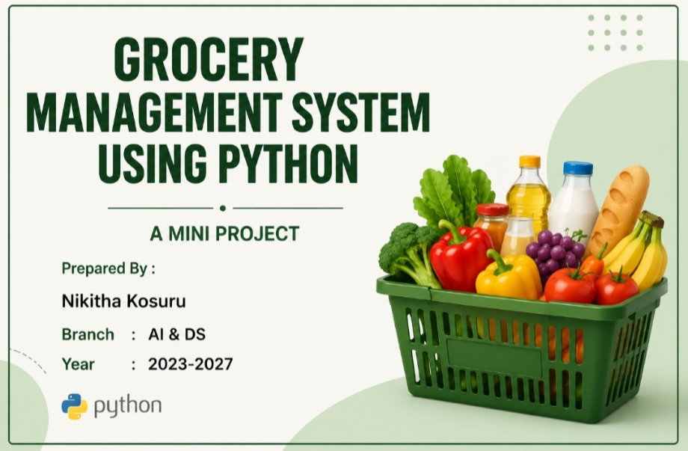

Slide 2
Abstract:
The Groceries Management System is a simple Python project. It helps users calculate grocery bills quickly and accurately.The user enters product details, and the program calculates the total amount. If the bill is more than ₹1000, a discount is given automatically.

Slide 3
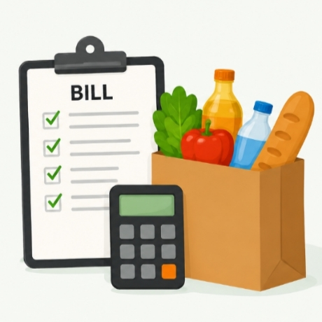
Introduction:
grocery shops, bill calculation is done every day.
Manual calculation takes more time
and may cause mistakes.
This system helps to:Calculate bills quicklyReduce mistakesSave timeMake billing easy.

Slide 4
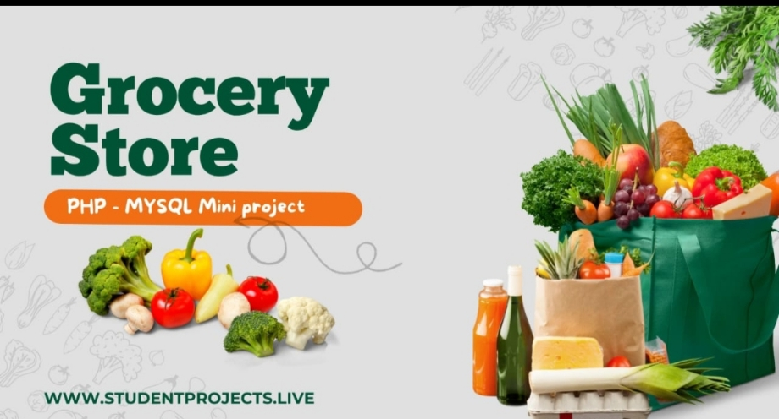
Objectives:
The main goals of this project are:Add grocery itemsEnter price and quantityCalculate item amountCalculate total billGive discount when neededDisplay final bill.
Working of the Project:
How the Project WorksUser enters item name.User enters item price.User enters quantity.Program calculates amount.Amount is added to total bill.User can add more items.Final bill is displayed.

Slide 5
Source code:
print("GROCERY MANAGEMENT SYSTEM")
total = 0
while True:
item = input("Enter Item Name: ")
price = float(input("Enter Item Price: "))
quantity = int(input("Enter Quantity: "))
amount = price * quantity
total = total + amount
print("Item:", item)
print("Amount:", amount)
choice = input("Add another item? (yes/no): ")
if choice.lower() != "yes":
break

Slide 6
print("\n----- BILL -----")
print("Total Amount =", total)
discount = 0
if total > 1000:
discount = total * 0.1
final_bill = total - discount
print("Discount =", discount)
print("Final Bill =", final_bill)
print("Thank You Visit Again")

Slide 7
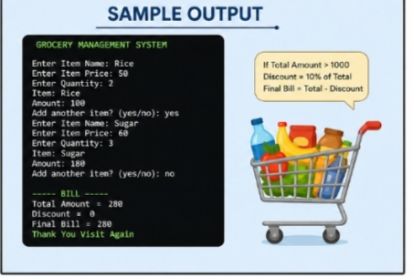

Slide 8
Advantages & Disadvantages
Advantages:
Fast bill calculation
Saves time
Reduces mistakes
Easy to use
User friendly
Limitations:
No database
No graphical interface
Only basic billingSingle user system

Slide 9
Conclusion:
The Groceries Management System is a simple and useful Python project. It helps users calculate grocery bills quickly and correctly. This project shows basic Python concepts such as variables, loops, conditions, and user input.

Slide 10
🙏 Thank You! ✨

