Slide 1


Slide 2
Introduction:
A Student Portfolio is a simple web page used to collect and display student information. HTML forms help users enter details such as name, email, phone number, skills, and other personal information.FeaturesUser-friendly formEasy data collectionBeginner-friendly HTML projectUses different input types.

Slide 3
Objectives:
To create a student portfolio form.To learn HTML form elements.To understand different input types.To collect student information.To improve web development skills.
Software Requirements:
SoftwareVisual Studio Code
Google Chrome Browser
HTML
HardwareComputer or
LaptopInternet Connection (Optional)

Slide 4
<!DOCTYPE html>
<html>
<head>
<title>Portfolio Form</title>
</head>
<body>
<h1>Student Portfolio</h1>
Name:
<input type="text"><br><br>
Email:
<input type="email"><br><br>
Phone Number:
<input type="tel"><br><br>

Slide 5
Date of Birth:
<input type="date"><br><br>
Gender:
<input type="radio" name="gender"> Male
<input type="radio" name="gender"> Female
<br><br>
Skills:
<input type="checkbox"> HTML
<input type="checkbox"> Python
<input type="checkbox"> Java
<br><br>
Upload Resume:
<input type="file"><br><br>
Favorite Color:
<input type="color"><br><br>
Submit:
<input type="submit" value="Submit">
</body>
</html>

Slide 6
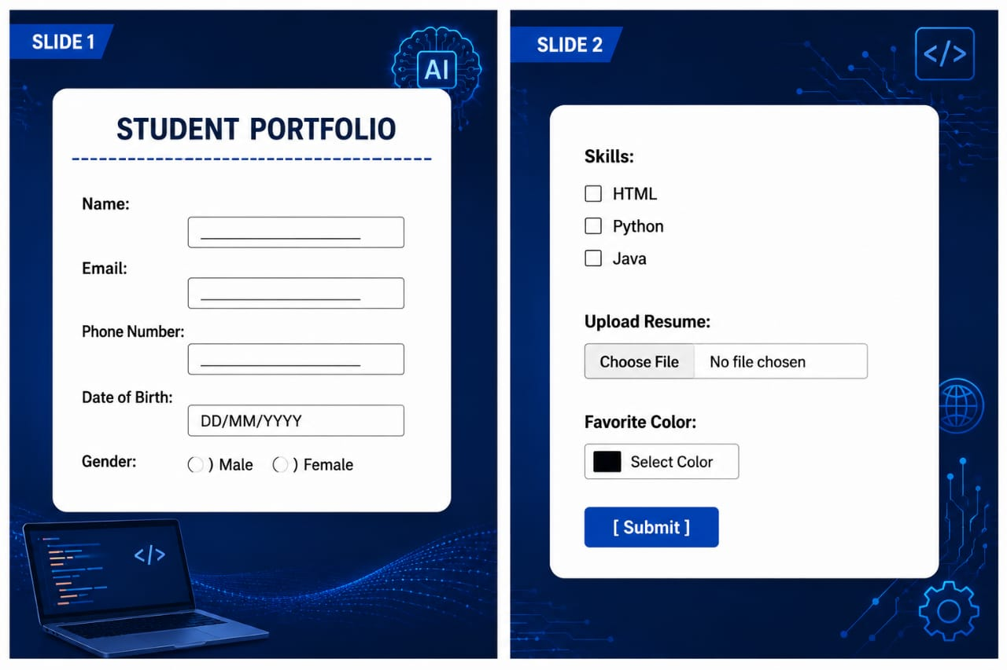

Slide 7
Applications:
Student Registration Forms
Online Application Forms
Personal Portfolio Websites
Resume Collection Systems
College ProjectsLearning
Conclusion:
This project successfully creates a Student Portfolio using HTML. Different input types are used to collect user information efficiently. The project helps beginners understand HTML forms and web page development.

Slide 8


