Slide 1

HEALTH INSURANCE
COST PREDICTION
BY
NIKITHA SINGH -1DT21AI040
SOUMYA BENUR -1DT21AI054
SWARA N-1DT21AI058
UNDER GUIDANCE OF
Prof-MAHALAKSHMI G
Department of AIML

Slide 2
INTRODUCTION
in the rapidly evolving landscape of healthcare and insurance, accurate prediction of health insurance costs has become paramount.
this project aims to leverage machine learning techniques to develop a predictive model for health insurance costs. by integrating diverse data sources and employing advanced algorithms, the project seeks to enhance the accuracy and efficiency of cost prediction.
this initiative is not merely about forecasting expenses; it’s about transforming how insurance companies assess risk, price policies, and manage claims. the ultimate goal is to create a more equitable, efficient, and responsive health insurance system.
Department of AIML

Slide 3
SURVEY PAPER
HEALTH INSURANCE COST PREDICTION USING MACHINE LEARNING
–AUTHOR K BHATIA
Actuarial modeling in health insurance has become crucial for setting effective premiums, essential for attracting and retaining insured individuals and managing existing plans.
However, building accurate predictive models is challenging due to various factors influencing medical insurance costs, such as demographics, health status, lifestyle, and plan specifics. The COVID-19 pandemic has highlighted the need for a transparent insurance system. Machine learning (ML) has been effective in predicting high-cost patient expenditures, leading insurers to adopt ML for better policy and premium settings. Nonetheless, ML's black-box nature can introduce bias, but Explainable AI (XAI) methods enhance transparency and acceptability, improving accountability and control in patient care. This paper compares three ensemble ML models—XGBoost, GBM, and RF—for predicting medical insurance costs using a dataset from Kaggle. XGBoost achieved the highest R2 score (86.470%) and lowest RMSE (2231.524) but required substantial computing resources. The RF model had the best MAE (1379.960) and MAPE (5.831%) and was the fastest and most memory-efficient. The GBM model had larger prediction errors compared to XGBoost and RF.
Department of AIML

Slide 4
HEALTH COST PREDICTION SYSTEM
AUTHOR –SAZZAD HOSSEN
This study explores how different regression models can forecast insurance costs, comparing models such as Multiple Linear Regression, Generalized Additive Model, Support Vector Machine, Random Forest Regressor, CART, XGBoost, k-Nearest Neighbors, Stochastic Gradient Boosting, and Deep Neural Network. The Stochastic Gradient Boosting model was identified as the best approach, achieving an MAE of 0.17448, RMSE of 0.38018, and R-squared value of 85.8295. The research utilizes various machine learning regression models and deep neural networks to predict health insurance charges using a dataset from Kaggle. The findings, summarized in Table IV, show that Stochastic Gradient Boosting offers the best performance with an RMSE of 0.380189, MAE of 0.17448, and an accuracy of 85.82%. This model outperforms other regression models in estimating insurance costs. Using ML for forecasting can help insurance providers attract consumers, save time in plan formulation, and improve profitability by efficiently managing large datasets.
Department of AIML

Slide 5
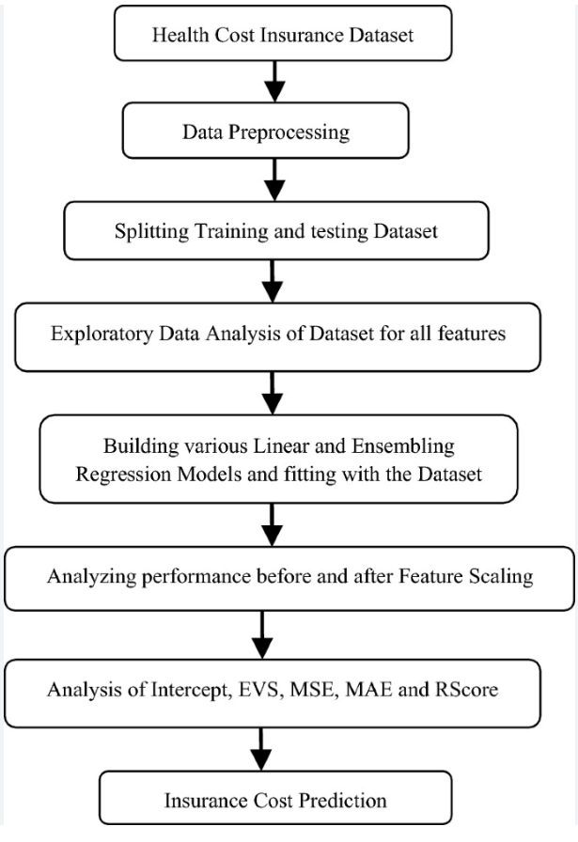
DESIGN- FLOWCHART
Department of AIML

Slide 6
IMPLEMENTATION
1. Pricing and Underwriting
Premium Calculation: Insurers can set more accurate premiums based on the predicted risk of individual policyholders.
Risk Assessment: Assess the risk profile of new applicants more accurately and quickly, leading to better underwriting decisions.
2. Customer Segmentation
Personalized Plans: Offer tailored insurance plans to different segments of customers based on their predicted healthcare costs.
Marketing Strategies: Develop targeted marketing campaigns for different customer segments.
3. Cost Management
Identifying High-Cost Patients: Predict which policyholders are likely to incur high costs and proactively manage their health to reduce expenses.
Resource Allocation: Allocate healthcare resources more efficiently based on the predicted needs of different segments of the insured population.
Department of AIML

Slide 7
4. Fraud Detection
Anomaly Detection: Identify unusual patterns in claims that could indicate fraudulent activity.
Claims Auditing: Automatically flag suspicious claims for further review.
5. Improving Healthcare Outcomes
Preventive Care: Identify individuals who may benefit from preventive care interventions to reduce the likelihood of high future costs.
Chronic Disease Management: Predict and manage chronic conditions more effectively to prevent costly complications.
6. Operational Efficiency
Automation of Claims Processing: Streamline the claims process by predicting the expected cost and automatically approving claims within certain thresholds.
Reducing Administrative Costs: Decrease the administrative burden by automating parts of the pricing, underwriting, and claims processes.
Department of AIML

Slide 8
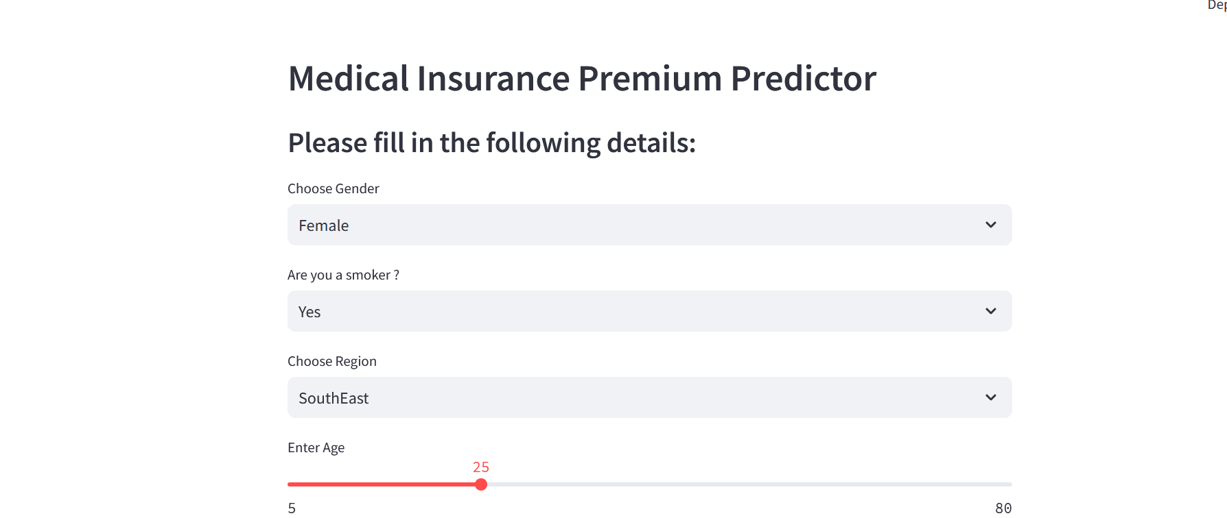
SCREENSHOTS
Department of AIML

Slide 9
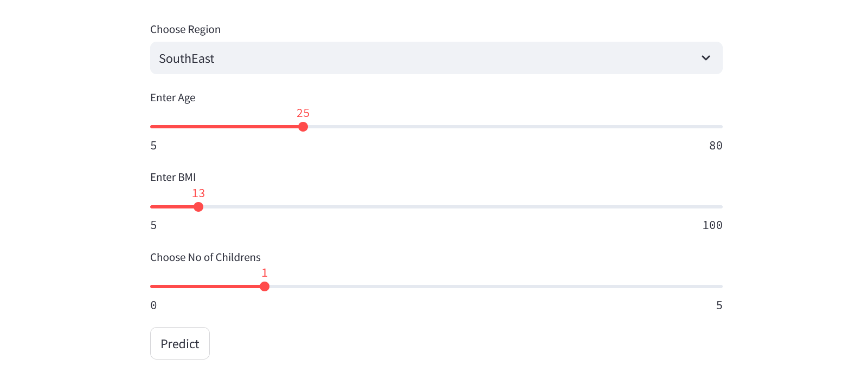
Department of AIML

Slide 10
FUTURE ENHANCEMENT
Incorporate Additional Data Sources
Electronic Health Records (EHRs): Integrate more detailed health records to improve predictive accuracy.
Social Determinants of Health: Include data on social factors such as socioeconomic status, education, and environment.
Wearable Device Data: Utilize data from wearable health devices for real-time monitoring and prediction.
Integration with Health Management Programs
Chronic Disease Management: Use predictions to develop targeted interventions for chronic disease patients.
Wellness Programs: Create personalized wellness programs to reduce long-term costs.
Department of AIML

Slide 11
CONCLUSION
By utilizing machine learning, health insurance companies can tackle the challenges of cost prediction, leading to more accurate, efficient, and fair pricing and risk assessment. This approach ultimately boosts customer satisfaction, operational efficiency, and the financial stability of the insurance sector.
Department of AIML

Slide 12
BOOK REFERENCES
Learn to Code HTML. and CSS: Develop and Style Websites (Web Design Courses) Its Kindle Edition by Shay Howe
The Joy of PHP Programming: A Beginner’s Guide – by Alan Forbes
WEBSITE REFERENCES
Web Development Learning
https://www.w3schools.com/whatis/
https://www.geeksforgeeks.org/html/
Code-github
Dataset-kaggle
Streamlit Learning
https://www.youtube.com/watch?v=PqgSnJlnAx0
Department of AIML

Slide 13
THANK YOU
Department of AIML

