Slide 1

SMART LAB ASSISTANT

Slide 2






OUR TEAM:
NIKITHA SRI .T
CLOUD ENGINEER
LIKITHA . A
CLOUD ENGINEER
SRIVALLI.K
BACKEND DEVELOPER
PAVANI. S
FRONTEND DEVELOPER
SUVAMSA.B
FRONTEND DEVELOPER
ALEKHYA.D
BACKEND DEVELOPER

Slide 3
Problem statement
Students face challenges in accessing real-time usage of basic lab equipment.
Sometimes they wont be able to cope up or can’t attend the lab due to some reasons.
Seeking instant clarification of doubts is not possible due to time constraints .

Slide 4
OBJECTIVE
This is designed to enhance the practical learning experience in laboratories. This system aims to provide students with seamless access to lab content, offer real-time assistance in addressing doubts, and facilitate efficient communication between students and faculty.

Slide 5
Features
1
3
2
4
Lab Content
Reliability
Visual facility
Digital lab manuals, Equipment details
Recorded video
Of faculty
Assistance
Links
Chatbot integration, FAQ’s troubleshooting
Real time applications access

Slide 6
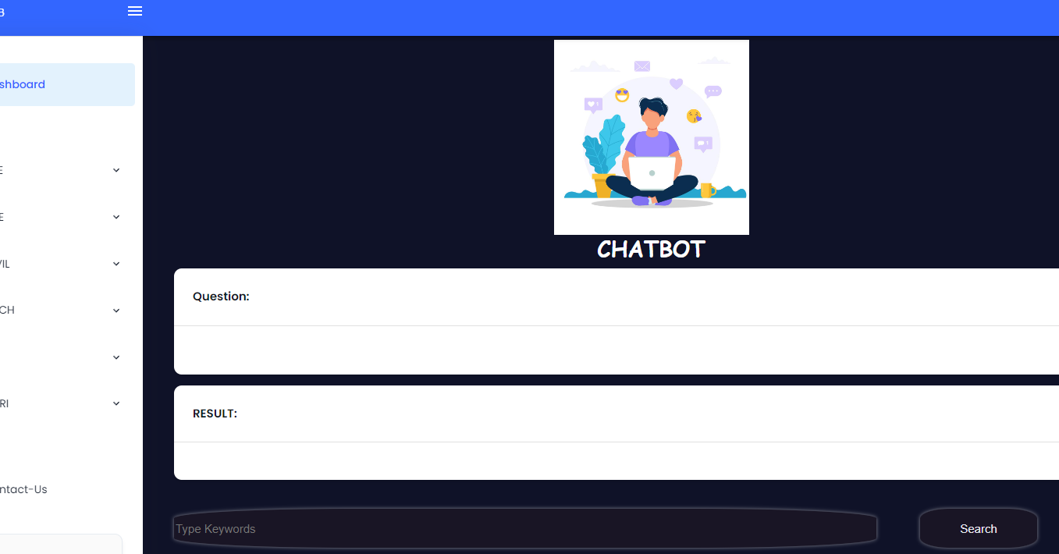
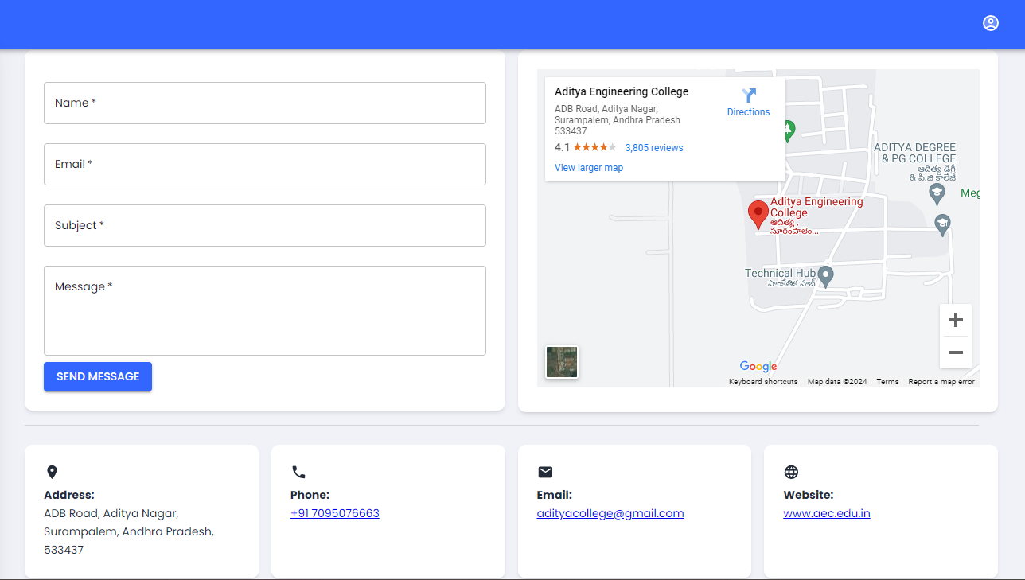

Slide 7
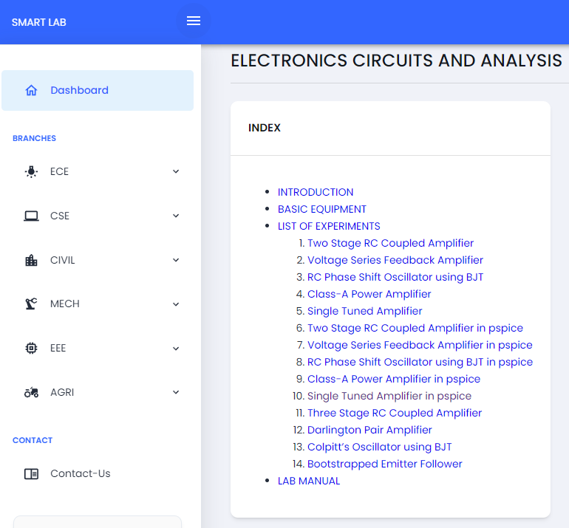
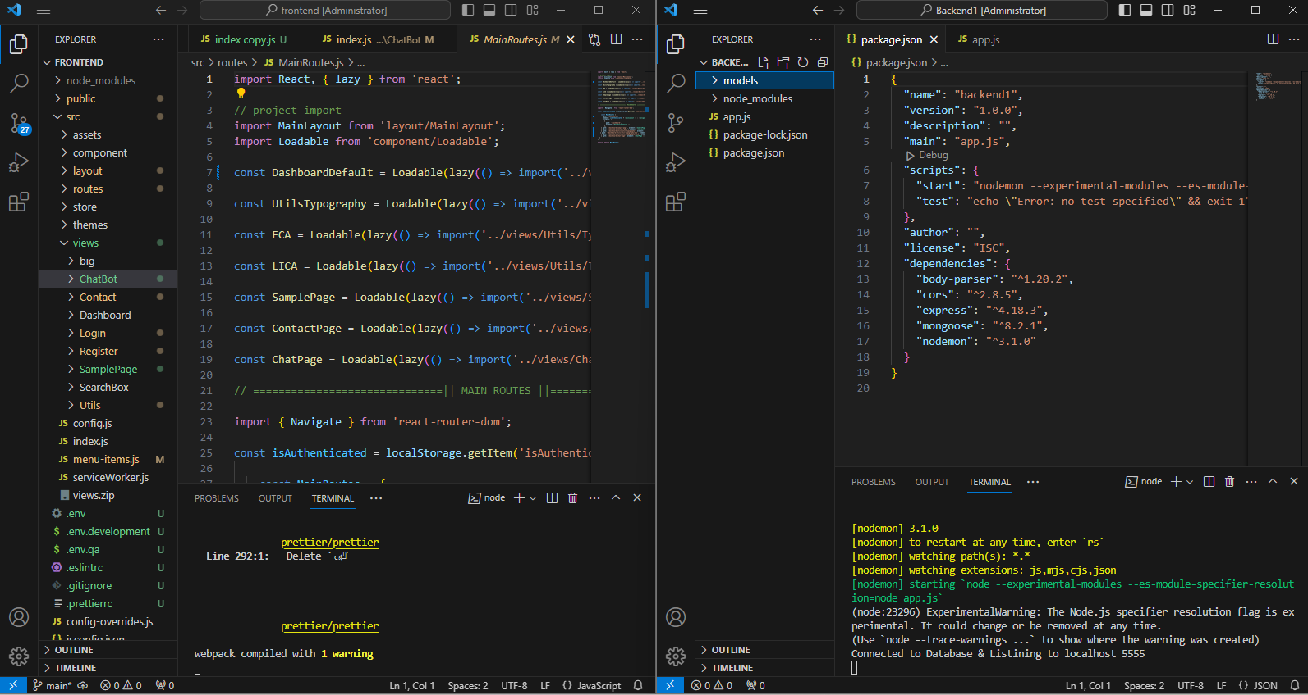

Slide 8
Advantages
Our application have various advantages related to labs, doubts clarification
And finding different things at a place.
Improved Communication
24/7 Accessibility
Practical Demonstrations
Self-paced learning
Resource Sharing

Slide 9
Technologies Used
Our project uses modern and versatile technology to deliver robust functionality and seamless user experience
Frontend
Backend
OCI Services
HTML
CSS
JavaScript
Bootstrap
ReactJS
Node.js
MongoDB
Express.js
Compute
Networking
Storage
Security

Slide 10
Conclusion:
The smart lab assistant aims to revolutionize the practical learning experience in laboratories. It enhances the quality of practical education and improves student learning outcomes.
With our platform, you have everything you need in one place, from experiment protocols to safety guidelines. we've got you covered everything.
Whether you're a beginner or an experienced student, the Smart Lab Assistant is here to support you.

Slide 11
Thank you…

