Slide 1
Sales Forecasting & Anomaly Detection
Internship Project at Flipkart Pvt. Ltd
Presented by: Vajja Sri Nikitha
Date: 24-10-2025

Slide 2
Project Overview
Objective: Analyze historical sales data, identify anomalies, and forecast future sales trends.
Approach: Combination of statistical modeling and machine learning.

Slide 3
Data & Preparation
Dataset: Monthly aggregated sales data.
Process: Data cleaning, transformation, and temporal structuring for analysis.

Slide 4
Methodology
Techniques applied:
- SARIMA for time-series forecasting.
- IsolationForest for anomaly detection.
Evaluation Metric: Mean Absolute Error (MAE).

Slide 5
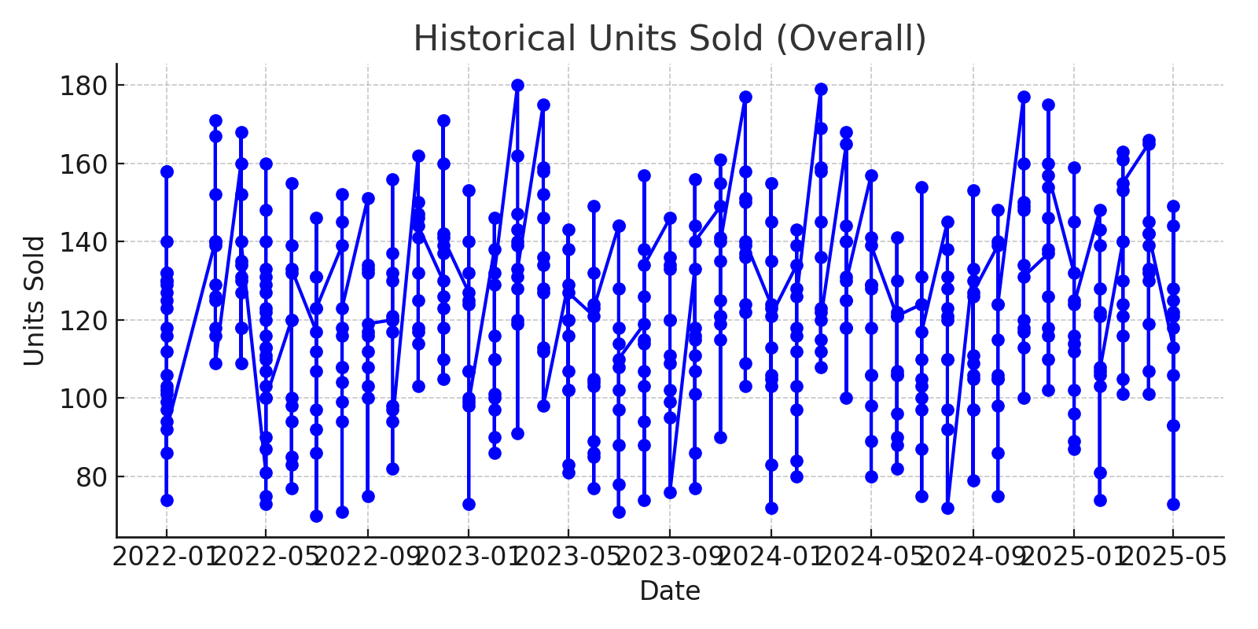
Results - Historical Trends

Slide 6
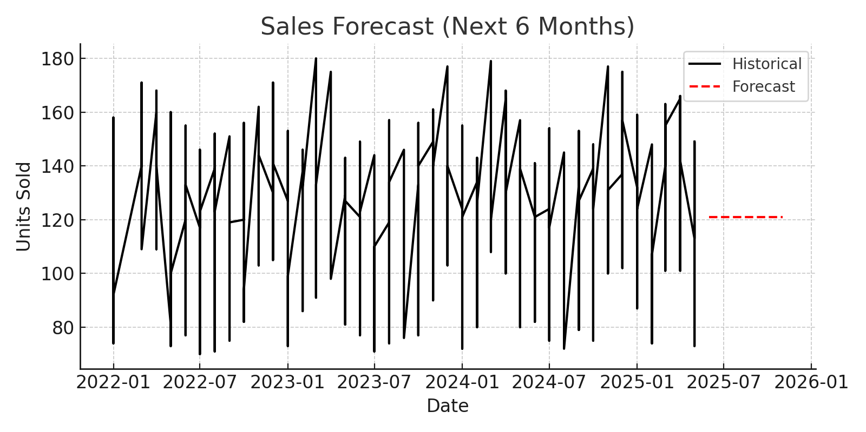
Results - Forecast

Slide 7
Business Insights
Seasonal patterns observed with stable sales growth.
Forecasts predict consistent performance.
Insights assist in demand and inventory planning.

Slide 8
Reproducibility
Steps:
1. Run Sales_forecasting.py.
2. Input dataset path and parameters.
3. Outputs include forecasts, anomalies, and visual reports.

