Slide 1

Global Robotics
Market Intelligence
Big Data Analytics & DBMS Project
An end-to-end workflow using Python, PostgreSQL, DBeaver, Databricks, Delta Lake and Power BI
Nikith Pagadala | Roll No. 25024 | PGDM 2025–2027
Badruka School of Management, Hyderabad
Dataset note: synthetic / illustrative records, not verified market data.
Notes:
Good morning everyone. My project is called Global Robotics Market Intelligence. It is an end-to-end Big Data Analytics and DBMS workflow: I take one CSV file and move it through Python, PostgreSQL, DBeaver, Databricks, Delta Lake and finally Power BI. One important point from the start: the dataset is synthetic, so all numbers describe the file, not the real robotics market.

Slide 2






Project at a Glance
Turning a 50,000-row robotics dataset into a documented, quality-checked analytical asset.
PostgreSQL
Structured storage and SQL
DBeaver
SQL client and saved scripts
Python
Profiling, EDA and charts
Databricks
Spark-based processing
Goal: show how databases, Python, Spark and dashboards work together to support business interpretation.
Delta Lake
Bronze, Silver, Gold tables
Power BI
KPIs and dashboard
Notes:
This slide gives the big picture. The goal is not to claim real market facts. The goal is to show a transparent method: how a raw file becomes a documented, quality-checked analytical asset. Six tools are used, each with a clear role: PostgreSQL stores the data, DBeaver is the SQL client, Python profiles and charts, Databricks runs Spark, Delta Lake organises the layers, and Power BI presents the results.

Slide 3
Business Problem and Questions
Which countries contribute the most revenue?
The Problem
How can a multi-dimensional robotics dataset become a repeatable analytical workflow while keeping its synthetic, unverified limits visible?
Risk if ignored: mixed currencies, and illustrative revenue read as real sales.
1
How does revenue differ by industry, product and channel?
2
What monthly patterns appear over time?
3
Which data-quality issues need attention?
4
How can a governed pipeline make limitations visible?
5
Notes:
The central problem: how do we organise a multi-dimensional dataset into a repeatable workflow, without misleading anyone about its synthetic nature? Without clear definitions, people can mix currencies or treat illustrative revenue as real sales. We frame five business questions: top countries, differences by industry, product and channel, monthly patterns, data-quality issues, and how a governed pipeline can keep limitations visible.

Slide 4



Objectives, Scope and Limitations
Objectives
Scope
Limitations
Profile and document all 35 fields
Check missing, duplicate and date quality
Compare revenue across key dimensions
Build SQL, Python, Spark and Power BI outputs
Uploaded CSV file only
Descriptive analytics, not forecasting
No claims on real market size, customers or vendor relationships
Records are synthetic and illustrative
USD-labelled fields, but currency codes vary
Fit scores are not technical validation
Notes:
Objectives: inspect and document the fields, measure data quality, compare revenue across dimensions, and build outputs in SQL, Python, Spark and Power BI. Scope: only the uploaded file. We do not claim real market size or real customers. Limitations: the data is synthetic, the money fields are labelled USD while currency codes vary by country, and fit scores are not real technical validation.

Slide 5
Dataset Overview
50,000
35
0
0
Records
Fields
Missing cells (0.000%)
Exact duplicate rows
What the file contains
Order dates: 01 Jan 2024 to 26 Sep 2026
7 countries, 10 industries, 5 product categories
File size: about 28.9 MB
0 duplicate transaction IDs
Synthetic-data warning
Records are labelled as synthetic transactions, not actual sales. Revenue, cost and profit are arithmetic summaries of illustrative data, not real market size.
Notes:
The file has 50,000 records and 35 fields. Data quality is clean on the surface: zero missing cells, zero exact duplicate rows and zero duplicate transaction IDs. Dates run from 1 January 2024 to 26 September 2026. There are 7 countries, 10 industries and 5 product categories. The amber box is the key warning: the records are synthetic, so every total in this presentation describes the file only.

Slide 6
End-to-End Methodology
1
Raw data
2
Profiling
3
PostgreSQL
Preserve the original CSV unchanged
Check schema, missing cells and duplicates
Store the data and run SQL queries in DBeaver
4
Python
5
Databricks + Delta
6
Power BI
Clean, explore and chart the data
Spark processing in Bronze, Silver, Gold
KPIs, visuals and slicers for managers
Same definitions in SQL, Python, Spark and Power BI, then reconcile the totals
Notes:
The method is a controlled sequence. One: preserve the raw file. Two: profile it. Three: load it into PostgreSQL and query through DBeaver. Four: use Python for cleaning, analysis and charts. Five: repeat the logic in Databricks with Spark and store layers in Delta Lake. Six: present validated outputs in Power BI. The key principle at the bottom: every tool must use the same definitions so the totals can be reconciled.

Slide 7
How Big Data Solved the Problem
Challenge | Big Data / DBMS approach | Outcome
A 35-field file is hard to inspect by hand | Python profiling and PostgreSQL storage | Quality verified: 0 missing, 0 duplicates
Raw and cleaned data get mixed up | Delta Lake Bronze, Silver and Gold layers | Traceable, auditable transformations
Tools may give different totals | Shared KPI definitions and reconciliation checks | Consistent, comparable numbers
Managers need quick answers | Power BI KPIs, visuals and slicers | Interactive, decision-ready view
The file is only 28.9 MB, so Spark demonstrates a repeatable, scalable pipeline rather than a strict need.
Notes:
This slide answers "how did Big Data help?" Each row is a challenge, the Big Data or DBMS technique used, and the outcome. Profiling and a relational database confirm quality. Delta Lake layers keep raw, cleaned and aggregated data separate so every change is traceable. Shared definitions and reconciliation make results trustworthy across tools. Power BI turns it into a decision-ready view. To be honest: 28.9 MB does not truly need Spark, so we use it to demonstrate a pipeline that would scale.

Slide 8
PostgreSQL and DBeaver Analysis
Design choices
Load a staging table first; keep the raw CSV
NUMERIC(18,2) for revenue, cost and profit
DATE type for order_date
Primary key only after uniqueness is proven
DBeaver is the client; save queries as .sql files
Sample queries run in DBeaver
-- Revenue by country
SELECT country_name,
SUM(revenue_usd) AS synthetic_revenue
FROM public.robotics_market
GROUP BY country_name
ORDER BY synthetic_revenue DESC;
-- Monthly trend
SELECT DATE_TRUNC('month', order_date) AS m,
SUM(revenue_usd) AS synthetic_revenue
FROM public.robotics_market
WHERE order_date IS NOT NULL
GROUP BY 1 ORDER BY 1;
Notes:
PostgreSQL gives a structured, queryable copy of the data. I load a staging table first, use NUMERIC for money to avoid floating-point errors, and a DATE type for order_date. I only add a primary key after proving the transaction IDs are unique. DBeaver is the graphical client, not a database: I write and save the queries there. The two queries shown give revenue by country and the monthly trend. Note: I label the output "synthetic revenue", never "market sales".

Slide 9
Python: Profiling and Core Metrics
import pandas as pd
df = pd.read_csv("robotics_market.csv")
print(df.shape) # (50000, 35)
print(df.isna().sum().sum()) # 0 missing
print(df.duplicated().sum()) # 0 duplicates
df["order_date"] = pd.to_datetime(
df["order_date"], dayfirst=True)
margin = (df.estimated_gross_profit_usd.sum()
/ df.revenue_usd.sum()) # 0.2278
$2.04B
Revenue field total
$464.2M
Estimated gross profit
22.78%
Aggregate estimated margin
Raw copy is kept; duplicates are inspected, never auto-deleted.
Notes:
Python gives repeatable profiling. I read the CSV with pandas and confirm 50,000 rows and 35 columns, no missing cells and no duplicates. Dates are parsed day-first. The margin is total estimated gross profit divided by total revenue, which is 22.78 percent, not an average of row-level margins. Totals: revenue about 2.04 billion, estimated profit about 464 million. Remember, these are sums of synthetic records. Cleaning policy: keep a raw copy and never delete duplicates automatically.

Slide 10
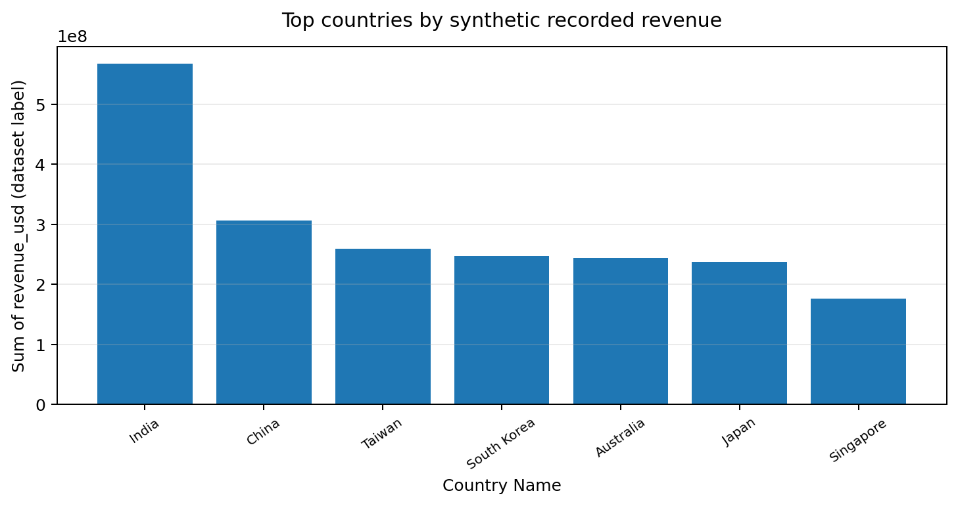
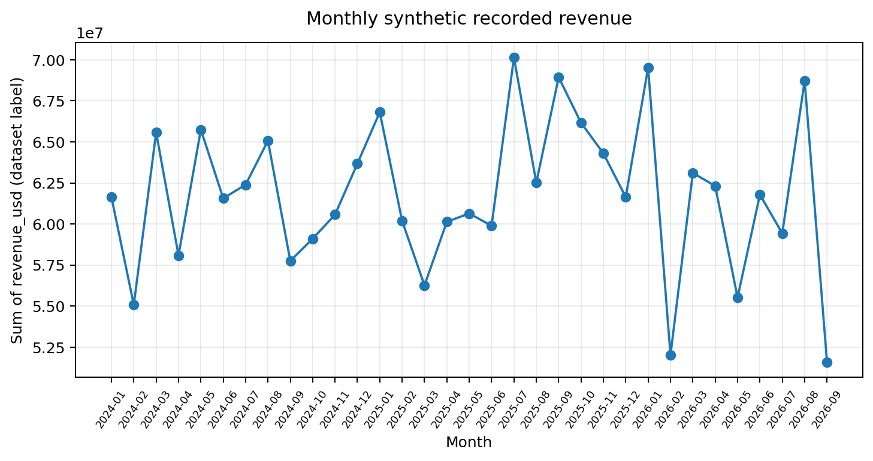
Python Visualisations
Figure 1. Top countries
India leads with $568.0M, about 27.9% of the revenue field total.
Figure 4. Monthly revenue
Monthly totals move between roughly $52M and $70M, with no clear trend.
Rankings and trends describe the synthetic file only: no demand or seasonality claims.
Notes:
Two of the five charts produced in Python. On the left, India has the highest revenue field total, about 568 million dollars, roughly 28 percent of the total. On the right, monthly totals fluctuate between about 52 and 70 million dollars without a clear direction. I read these as ranking and variation only. Because the data is synthetic, I do not claim seasonality or real demand.

Slide 11
Databricks, Spark and Delta Lake
B
Bronze
S
Silver
G
Gold
Raw records plus ingestion metadata
Typed, standardised and quality-flagged
KPI tables by month, country, industry
# Bronze: read the raw CSV and store it as Delta
raw = spark.read.option('header', True).option('inferSchema', True).csv(input_path)
raw.write.format('delta').mode('overwrite').save(bronze_path)
# Gold: revenue and profit by country
gold_country = (silver.groupBy('country_name')
.agg(F.sum('revenue_usd').alias('synthetic_revenue_total'),
F.sum('estimated_gross_profit_usd').alias('estimated_profit_total')))
Notes:
Databricks provides managed Spark. We use the Delta Lake medallion pattern. Bronze keeps raw records exactly as imported, plus ingestion metadata. Silver applies explicit type conversion, standardised labels and quality flags. Gold holds aggregated KPI tables. The code shows reading the CSV, writing it as a Delta table, and building a country-level Gold table. Validation: Bronze count must match the source, and Gold totals must reconcile to the base table. Show your own notebook output cells here when presenting.

Slide 12
Building the Power BI Dashboard
1
Get Data: import the CSV
Record Count = COUNTROWS('RoboticsMarket')
Synthetic Revenue Total =
SUM('RoboticsMarket'[revenue_usd])
Estimated Gross Profit Total =
SUM('RoboticsMarket'[estimated_gross_profit_usd])
Estimated Gross Margin % =
DIVIDE([Estimated Gross Profit Total],
[Synthetic Revenue Total])
2
Power Query: set data types and parse dates day-first
3
Model: one table named RoboticsMarket
4
DAX: create four KPI measures
5
Build visuals and add slicers
Slicers: order date, country, industry, product category, sales channel, verification status
Notes:
Here is the process in Power BI. First, import the CSV with Get Data. In Power Query, set the correct data types and parse the dates day-first. The model is a single table. Then I write four DAX measures: record count, revenue total, gross profit total, and gross margin percentage. DIVIDE is used so a zero denominator never causes an error. Finally I build the visuals and add slicers for date, country, industry, product, channel and verification status.

Slide 13
Power BI Dashboard: Management View
Dashboard prototype built from the report’s computed values (synthetic dataset; not verified market sales)
Record Count
Synthetic Revenue Total
Est. Gross Profit Total
Est. Gross Margin %
50,000
$2.04B
$464.2M
22.78%
Notes:
This is the management view of the dashboard: a note at the top that the data is synthetic, four KPI cards in one row, and three comparison charts below. KPIs: 50,000 records, about 2.04 billion in revenue field total, 464 million estimated gross profit, and a 22.78 percent margin. India is the top country, AI Infrastructure is by far the largest product category, and OEM/Integrator is the largest sales channel. TIP FOR PRESENTING: replace this slide, or add next to it, a screenshot of your actual Power BI canvas (including the monthly trend line chart and slicers) as evidence. The report states a Python chart or PPT mock-up is not a .pbix file.

Slide 14
Key Findings from the Dataset
27.9%
of revenue comes from India, the top country
69.9%
of revenue sits in AI Infrastructure products
32.5%
of revenue flows through OEM/Integrator channels
Notes:
Key findings, all within the synthetic file. Robotics OEM is the top industry at about 391 million. India accounts for 27.9 percent of the revenue field total. AI Infrastructure products make up 69.9 percent, which is a very strong concentration. OEM/Integrator is the largest channel at 32.5 percent. Important question for discussion: does this concentration reflect real demand or simply how the dataset was generated? Also, the industry chart shows the top 8 of 10 industries. Rankings should always be read together with record counts.

Slide 15




Recommendations and Conclusion
Data governance
Keep a source register, data dictionary and cleaning log
Currency control
Confirm the currency basis before comparing money values
Verified data
Replace synthetic records before any real decision
Dashboard ownership
Assign owners for refresh, KPI definitions and access
Conclusion
A transparent blueprint from raw CSV to dashboard: clear definitions, validation checks and honest labelling matter as much as the tools.
Thank you
Questions?
Notes:
Four recommendations: strengthen data governance, resolve the currency question before comparing financial values, replace synthetic data with verified data before real decisions, and give the dashboard clear ownership. Conclusion: the main lesson is that clear definitions, validation and honest labelling matter as much as the technology. Thank you, and I am happy to take questions.

