Slide 1
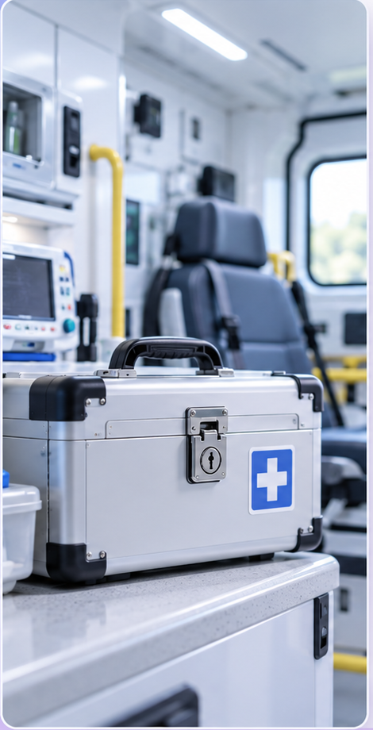
TempSafe
Smart temperature monitoring for a Controlled Drug Box
Problem
• Loss of Efficacy: Sensitive controlled drugs (Morphine, Fentanyl) degrade when exposed to heat.
• Heat Risk: Ambulance storage temperatures often exceed safe limits.
• The Blind Spot: Without tracking, it’s impossible to know exposure duration.
♨
◷
Exposure
Time
⚠
Continuous
Monitoring
Alerts
Tracks temperature inside the Controlled Drug Box in real time.
Records how long temperature remains above the safe limit.
Uses LED visual feedback, a buzzer, and phone notifications.
✚
Why It Matters
Less manual work. Actionable alerts only.

