Slide 1
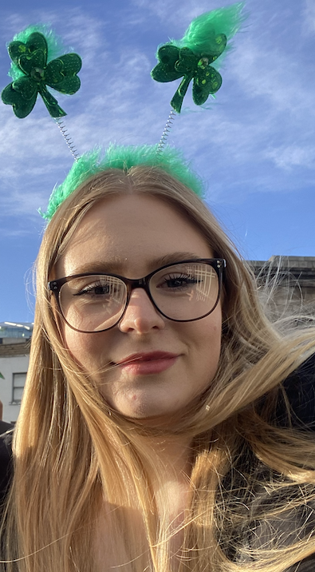
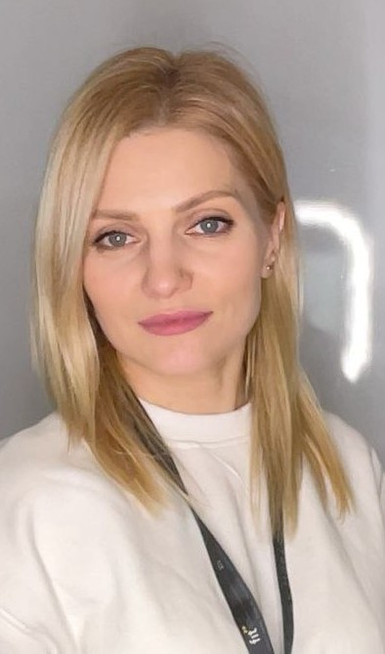

Dundalk Institute of Technology
App: TempSafe
Team: Smart box
DkIT
Smart Temperature Monitoring for a Controlled Drug Box
Nikita Smiichyk
  Maryna Hordiienko
Hanna Bokariuk
Backend/Database, Testing
Hardware, UI/UX/UD
Front-End, UI/UX/UD
Team member 1
Team member 2
Team member 3
GROUP
COURSE
ASSESSMENT THEME
Sd3a
BSc (Hons) Computing in
Software Development
Smart Temperature Monitoring for
a Controlled Drug Box
MODULE
Universal Design Project
09/10/2026

Slide 2
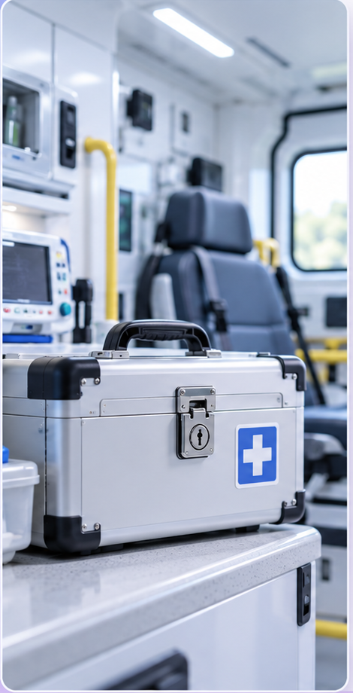
TempSafe
Smart temperature monitoring for a Controlled Drug Box
Problem
• Loss of Efficacy: Sensitive controlled drugs (Morphine, Fentanyl) degrade when exposed to heat.
• Heat Risk: Ambulance storage temperatures often exceed safe limits.
• The Blind Spot: Without tracking, it’s impossible to know exposure duration.
♨
Continuous
Monitoring
◷
Exposure
Time
⚠
Alerts
Samples box temperature every 30 seconds.
Logs out-of-range readings; estimated duration is optional.
Uses a single-colour LED and online phone alerts; buzzer optional.
✚
Why It Matters
Less manual work. Actionable alerts only.

Slide 3
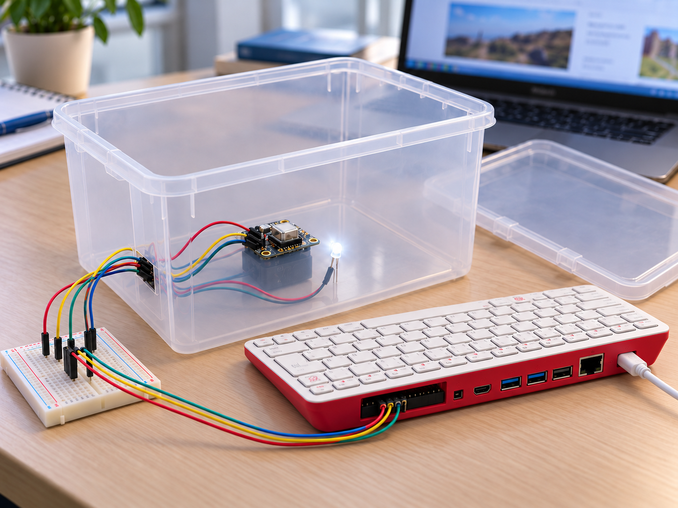
How TempSafe works
One prototype box · wired components
Remote access over Wi-Fi
USER'S JOURNEY
STEP 1
Receive an alert
STEP 2
Check the app
STEP 3
Review the box history
PROTOTYPE CONCEPT
COMPONENT CONNECTIONS
USB-C power
Mains supply
Plastic box
SCD-41
Temperature sensor
Power + I²C
Jumper wires
Breadboard
Temporary connections
Raspberry Pi 400
GPIO header
Single-colour LED
Warning light
Wires + resistor
Wi-Fi / Internet
Laptop
Raspberry Pi Connect
AI-generated illustration
SCD-41 → Pi 400
MQTT over TLS
Mobile application
→
→
Temperature samples + local LED
Broker → backend + MySQL
Status + history + phone alerts
Notes:
Planned student prototype, demonstrated on a bench with no medicines. One physical box, with multiple users assigned to the same box ID. The existing SCD-41 provides the temperature measurement for this release. Its humidity and CO2 capabilities are outside the application scope. The photographed white dome module is not the temperature sensor used for this project. The physical LED is single-colour and lights for Warning or Alert, with distinct blinking for sensor failure. Application colours are separate. Phone notifications are Must Have and require connectivity, permission and a delivery channel to be selected and tested. Buzzer is Should Have. During an outage the Pi stores sample attempts locally and uploads them with original times after reconnection. Shannon follows her service procedures; the prototype makes no clinical decisions. Hardware: Raspberry Pi 400 powered from mains and connected over Wi-Fi. A separate computer accesses it using https://connect.raspberrypi.com/devices for remote desktop or shell access. This development access is separate from the TempSafe application and device data flow. The simple plastic or wooden box is still to be selected; the image illustrates a plastic option. Source: https://www.raspberrypi.com/documentation/services/connect.html and https://www.adafruit.com/product/5190. Image: generated using OpenAI image generation on 8 October 2026 as a concept illustration, not a photo of completed hardware. Device observations are published to a cloud MQTT broker over TLS. The ingestion worker stores them in MySQL and acknowledges committed sample IDs; the browser accesses FastAPI over HTTPS. This pub-sub design follows the IoT G-CA1 brief. Sources: project functional requirements, hardware parts list and initial test plan in this repository.

Slide 4
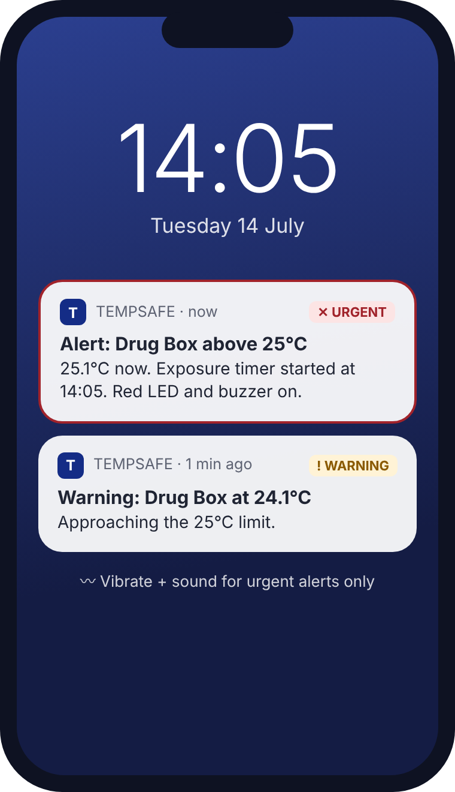
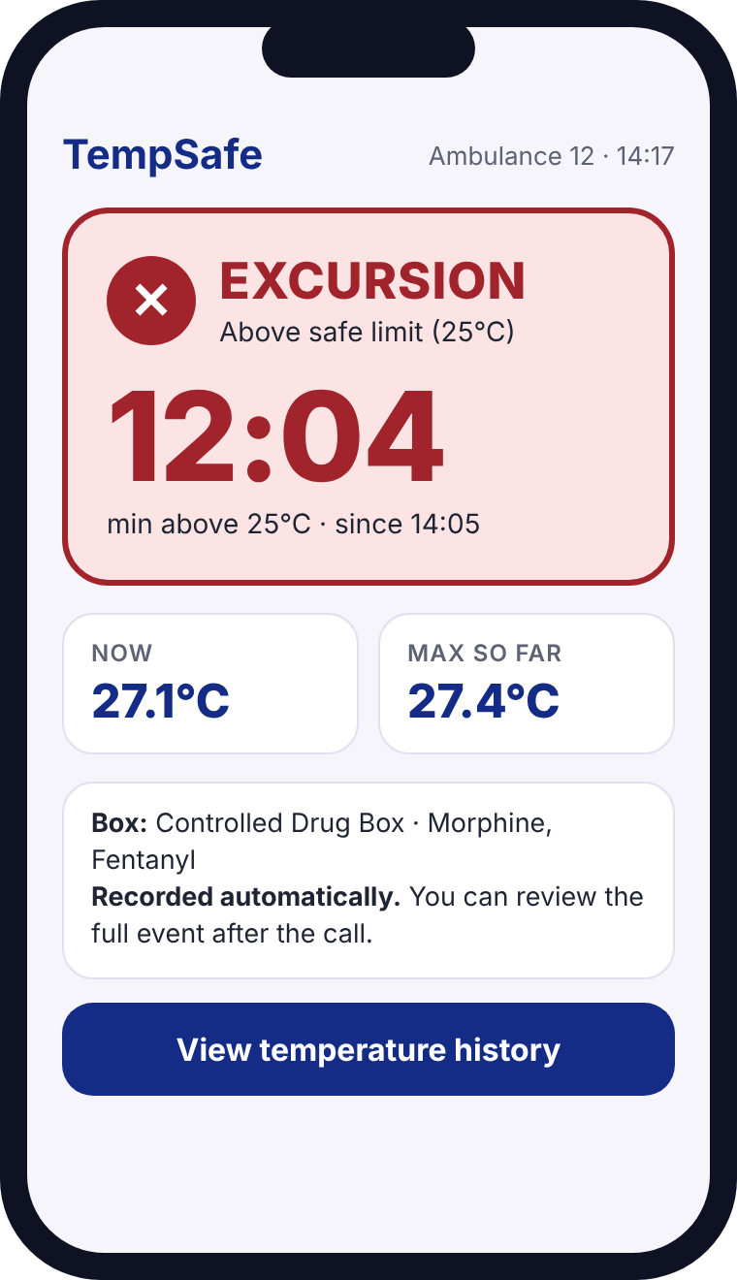
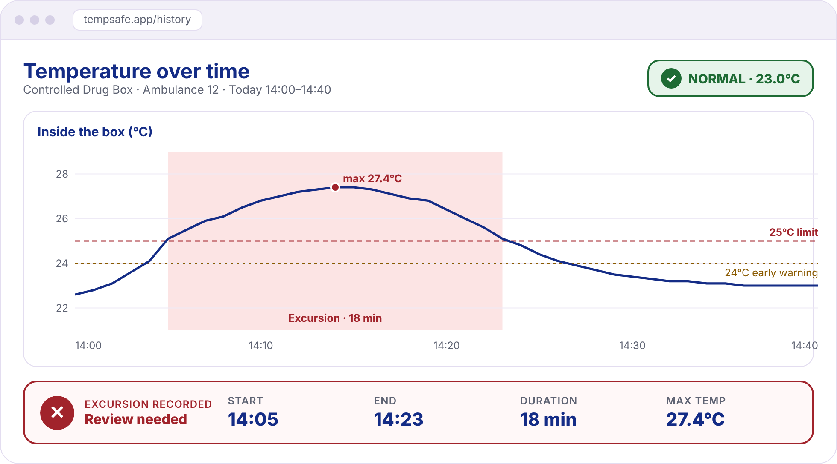



Shannon's Dashboard
Early UI concepts: optional summaries; red LED wording superseded
1
DURING THE CALL
The alert reaches her
2
ONE GLANCE
Status + optional estimate
3
AFTER THE CALL
The full record
Not colour alone
icon + word + °C
State-change alerts
warning → urgent
Recorded observations
gaps shown · estimates optional
Notes:
(~45 seconds)
This is the proposed interface journey using synthetic demonstration data. The application is not yet implemented.
One: she is with a patient. At 14:04 she gets a quiet warning at 24 degrees. At 14:05 the box goes above 25: the single-colour LED remains lit and the optional buzzer sounds if implemented, and she gets one urgent alert. Repeated unchanged states are suppressed; delivery requires connectivity, permission and supported Web Push.
Two: when she has a free second, one glance at the app tells her everything: Alert, freshness and the latest temperature; an optional estimated excursion summary can show 12 minutes and a maximum of 27.4 degrees. The status is never just colour: there is always an icon, a word and the temperature.
Three: after the call she opens the web dashboard. She sees the temperature over time and the recorded observations, including gaps and errors. If implemented, the estimated summary can show a period from 14:05 to 14:23 and a maximum of 27.4 degrees; it does not prove continuous exposure. With this she can follow her service's policy and seek the appropriate review of the medicine. TempSafe gives her the facts; Shannon makes the decision.

