Slide 1
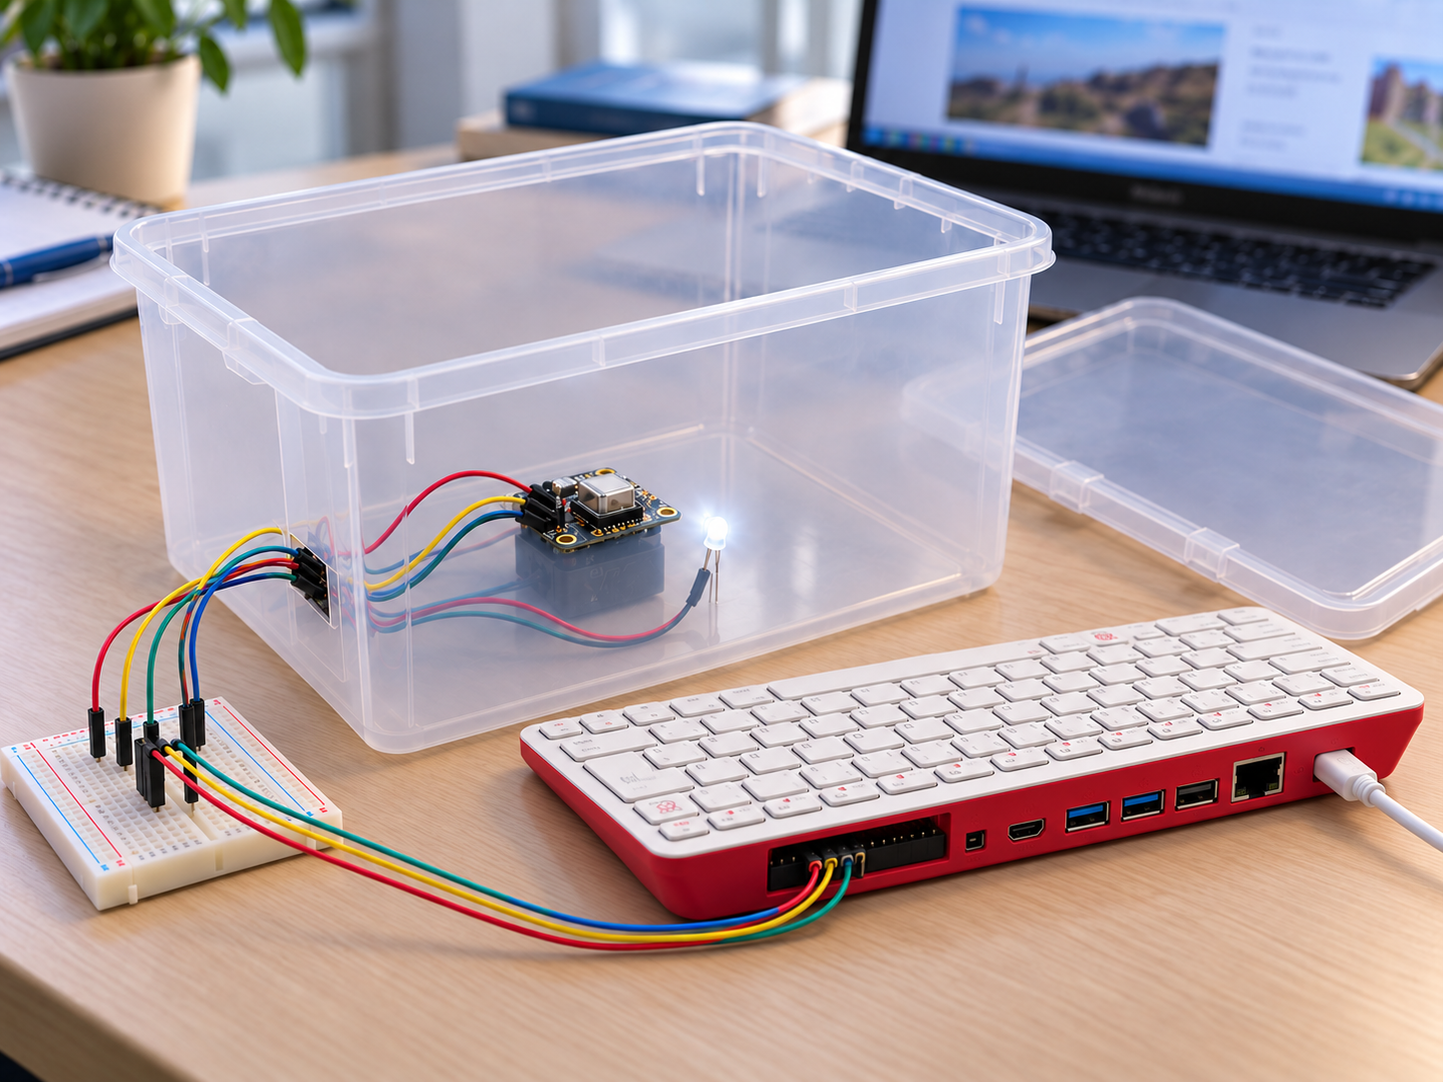
How TempSafe works
One prototype box · wired components
Remote access over Wi-Fi
SHANNON'S JOURNEY
STEP 1
Receive an alert
STEP 2
Check the app
STEP 3
Review the box history
PROTOTYPE CONCEPT
COMPONENT CONNECTIONS
USB-C power
Mains supply
Plastic box
SCD-41
Temperature sensor
Power + I²C
Jumper wires
Breadboard
Temporary connections
Raspberry Pi 400
GPIO header
Single-colour LED
Warning light
Wires + resistor
Wi-Fi / Internet
Laptop
Raspberry Pi Connect
AI-generated illustration
SCD-41 → Pi 400
HTTPS API
Mobile application
→
→
Temperature samples + local LED
FastAPI + MySQL
Status + history + phone alerts
Notes:
Planned student prototype, demonstrated on a bench with no medicines. One physical box, with multiple users assigned to the same box ID. The existing SCD-41 provides the temperature measurement for this release. Its humidity and CO2 capabilities are outside the application scope. The photographed white dome module is not the temperature sensor used for this project. The physical LED is single-colour and lights for Warning or Alert, with distinct blinking for sensor failure. Application colours are separate. Phone notifications are Must Have and require connectivity, permission and a delivery channel to be selected and tested. Buzzer is Should Have. During an outage the Pi stores sample attempts locally and uploads them with original times after reconnection. Shannon follows her service procedures; the prototype makes no clinical decisions. Hardware: Raspberry Pi 400 powered from mains and connected over Wi-Fi. A separate computer accesses it using https://connect.raspberrypi.com/devices for remote desktop or shell access. This development access is separate from the TempSafe application and device API data flow. The simple plastic or wooden box is still to be selected; the image illustrates a plastic option. Source: https://www.raspberrypi.com/documentation/services/connect.html and https://www.adafruit.com/product/5190. Image: generated using OpenAI image generation on 8 October 2026 as a concept illustration, not a photo of completed hardware. Sources: project functional requirements, hardware parts list and initial test plan in this repository.

