Slide 1
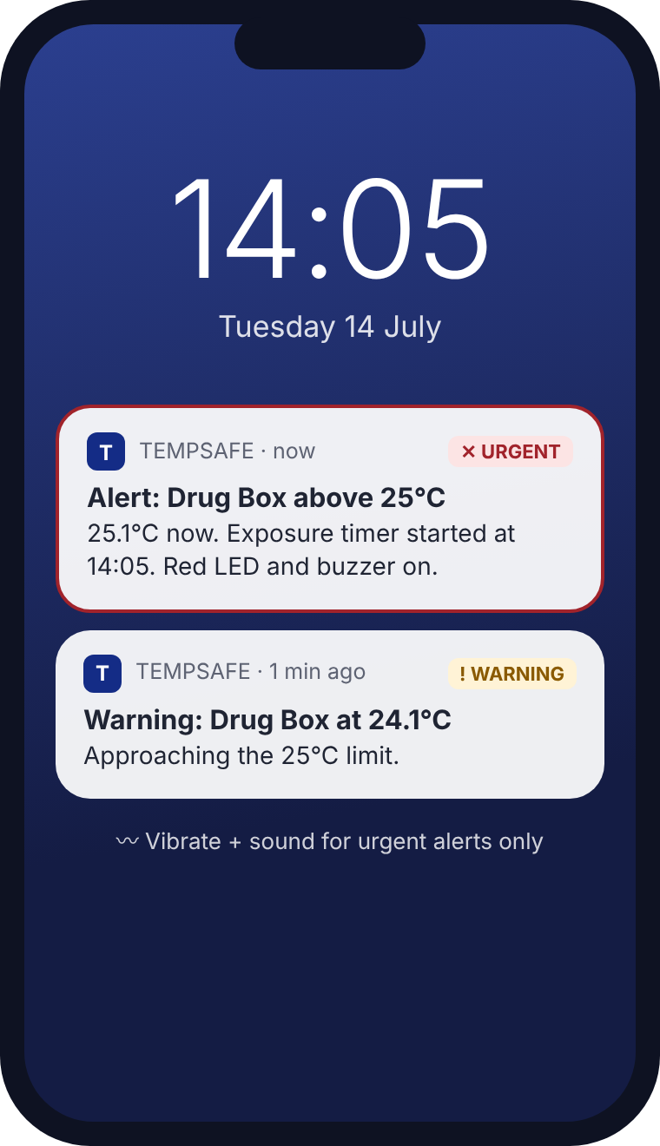
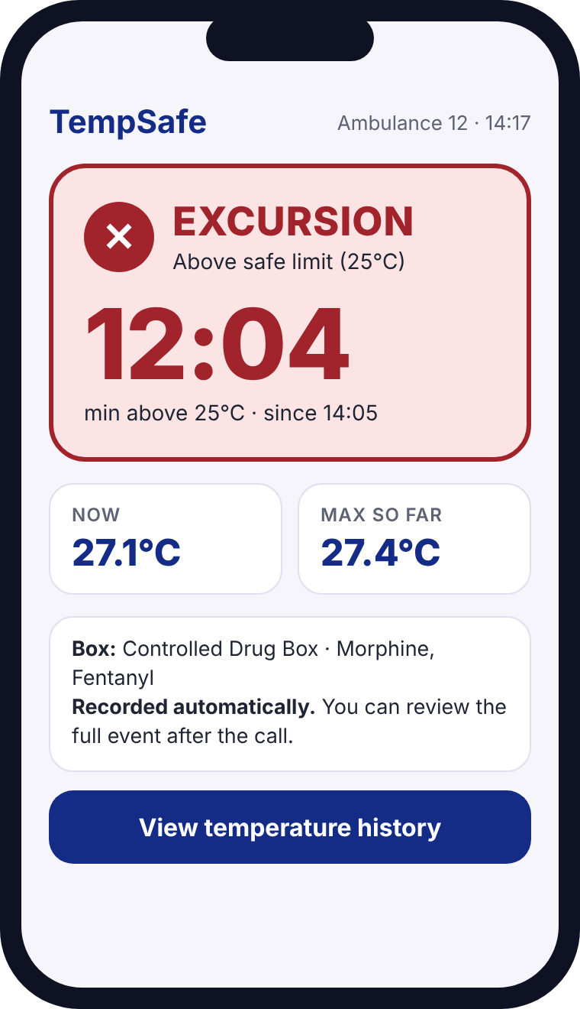
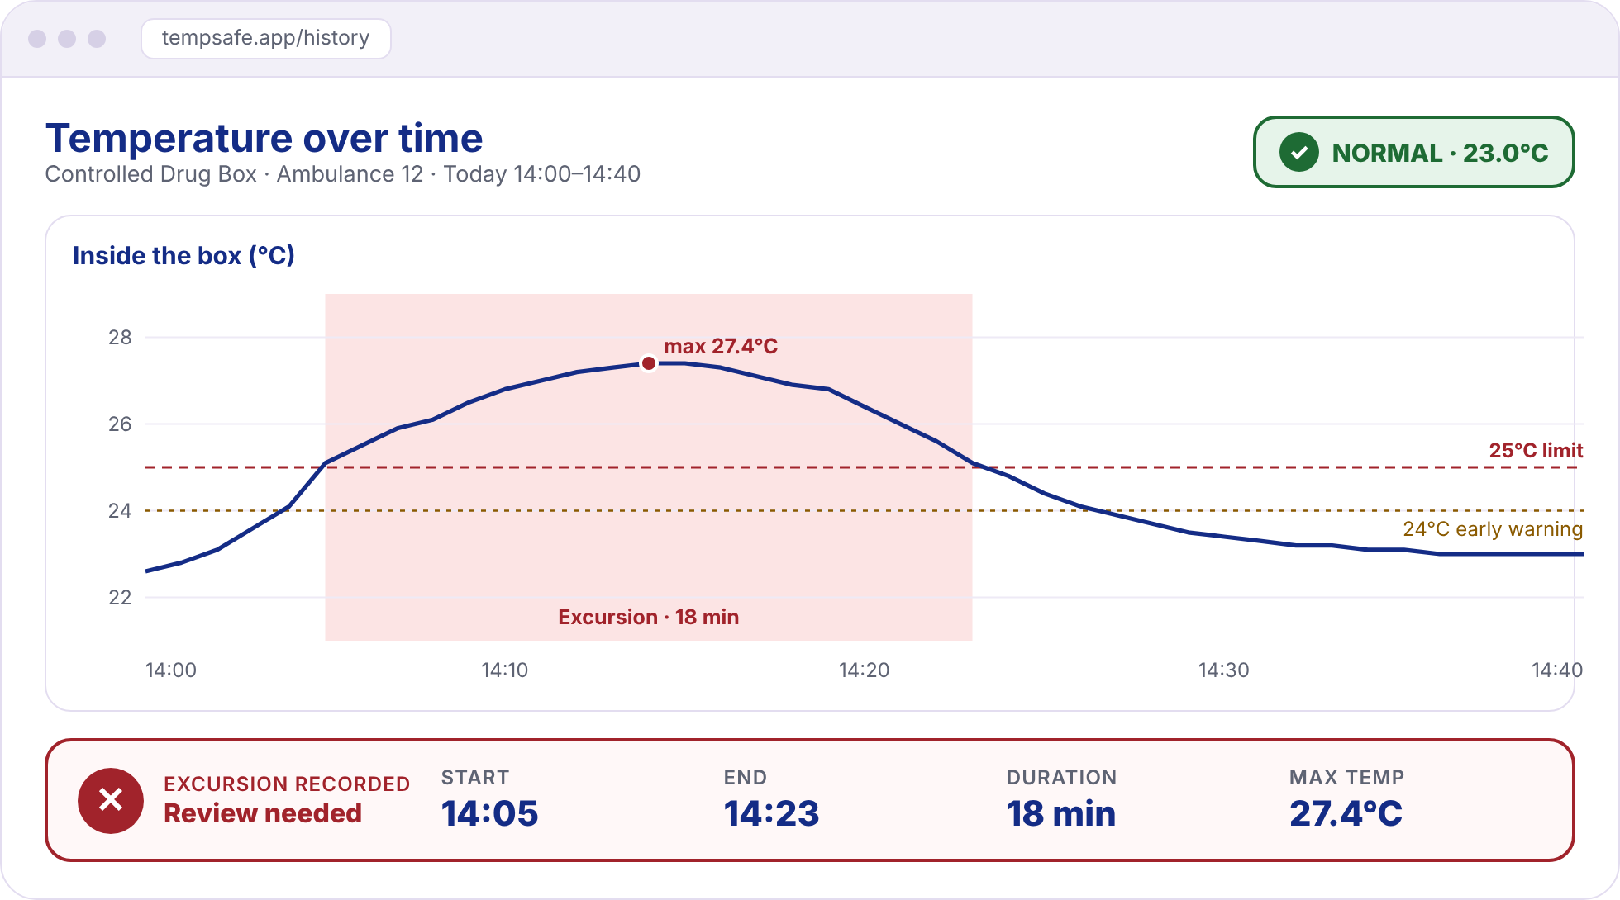



Shannon's Dashboard
Mock-up · sample data
From the alert to the decision — what she sees, when she needs it
1
DURING THE CALL
The alert reaches her
2
ONE GLANCE
Status + exposure timer
3
AFTER THE CALL
The full record
Not colour alone
icon + word + °C
Only 2 alerts
warning → urgent
Nothing lost
start · end · max
Notes:
(~45 seconds)
This is how Shannon actually sees TempSafe.
One: she is with a patient. At 14:04 she gets a quiet warning at 24 degrees. At 14:05 the box goes above 25: the red LED and buzzer come on, and she gets one urgent alert. Only two notifications, nothing else.
Two: when she has a free second, one glance at the app tells her everything: EXCURSION, and a big timer — 12 minutes above the limit, maximum 27.4 degrees. The status is never just colour: there is always an icon, a word and the temperature.
Three: after the call she opens the web dashboard. She sees the temperature over time and the full record our database tracked: start 14:05, end 14:23, 18 minutes, maximum 27.4 degrees. With this she can follow her service's policy and decide if the medicine is still safe. TempSafe gives her the facts; Shannon makes the decision.

