Slide 1
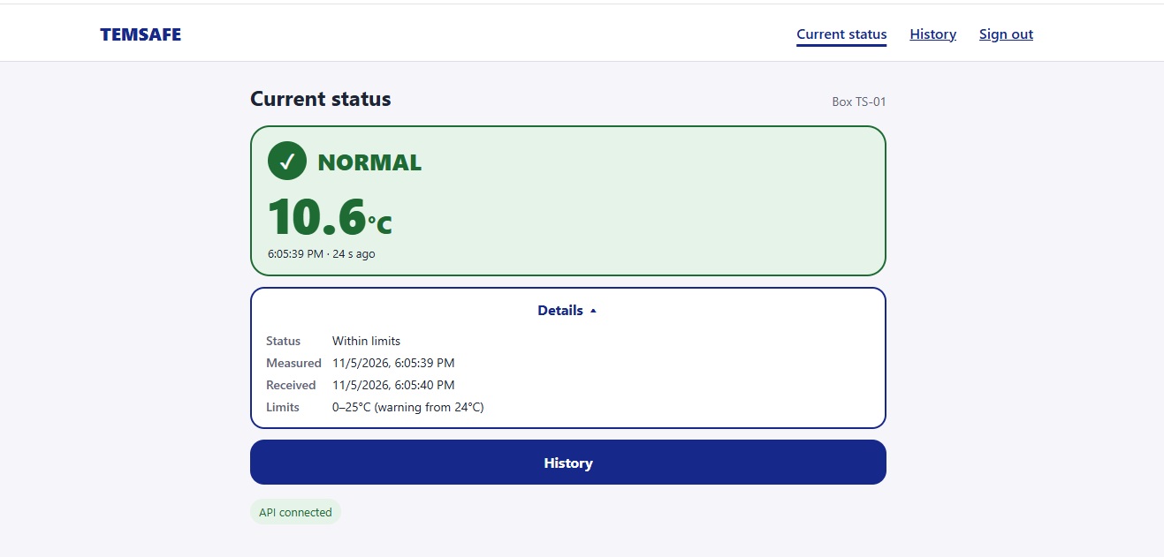
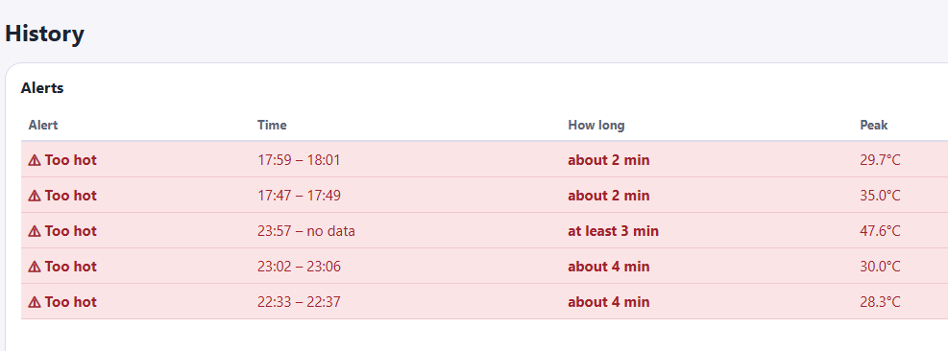
Usability Evaluation Findings & Planned Improvements
!
Alert: High temperature detected
View
1
2
1. Current Status: Show an unread temperature alert and add a View event button.
Last measured: 11/05/2026 6:05pm
2. Details: Remove duplicated information and show one clear timestamp —
Last measured.
Date
5 Nov 2026
3. History: Add the date to each event.
3

