Slide 1

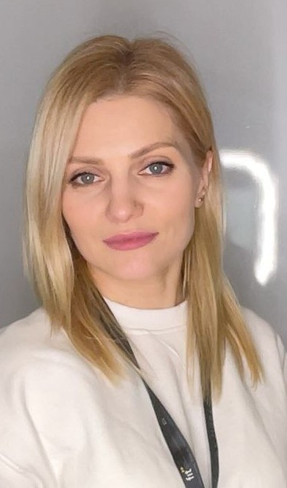

Web app: TempSafe
Team: Smart box
DkIT
Dundalk Institute of Technology
Smart Temperature Monitoring for a Controlled Drug Box
Nikita Smiichyk
  Maryna Hordiienko
Hanna Bokariuk
Backend/Database, Testing
Hardware, UI/UX/UD
Front-End, UI/UX/UD
Team member 1
Team member 2
Team member 3
GROUP
COURSE
SCRUMWISE
MAHARA
Sd3a
BSc (Hons) Computing in
Software Development
https://www.scrumwise.com/scrum/#/overview/project/l8-yr3-sd3a-2026-27-smart-box/id-31429-139568-58
https://mahara.dkit.ie/view/view.php?t=d5eb1c4882b906581f3a
MODULE
Universal Design Project
06/11/2026

Slide 2

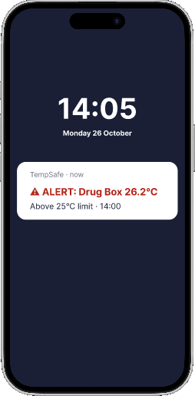
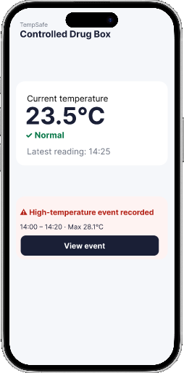
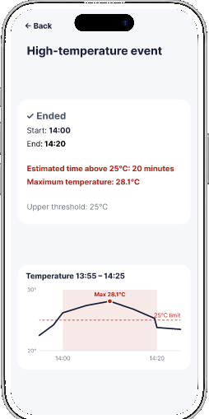
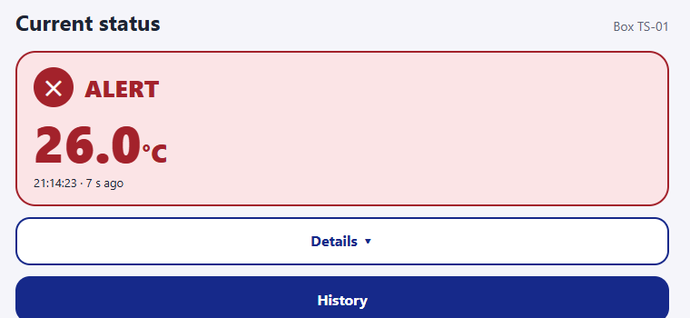
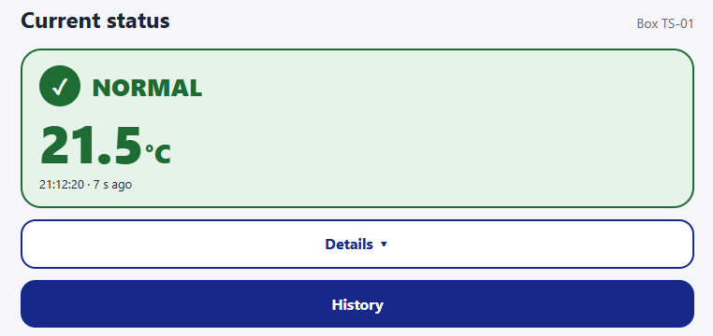
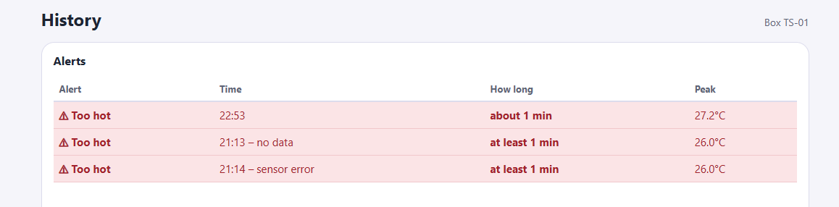
Shannon's main use case
UX and Universal Design
Reviewing a temperature excursion after patient care
Shannon Rice
Advanced Paramedic · Ireland
1
Alert
2
Status
3
Event
14:00 · during the call
26.2°C · above 25°C
14:25 · one glance
Normal again · 23.5°C
After the call
20 min · peak 28.1°C
FIGMA
FIGMA
FIGMA
Goal
Keep temperature-sensitive drugs safe
Pain points
Can't leave a patient to check the box
Too many notifications distract her
Scenario
A hot day in the ambulance
WEBSITE
WEBSITE
WEBSITE
How might we help Shannon notice a problem in one glance, without distracting her?
UD Principle 4 · Perceptible
Never colour alone: icon + word + °C

Slide 3
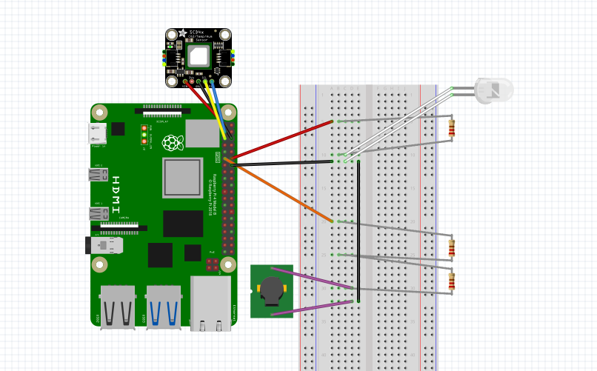
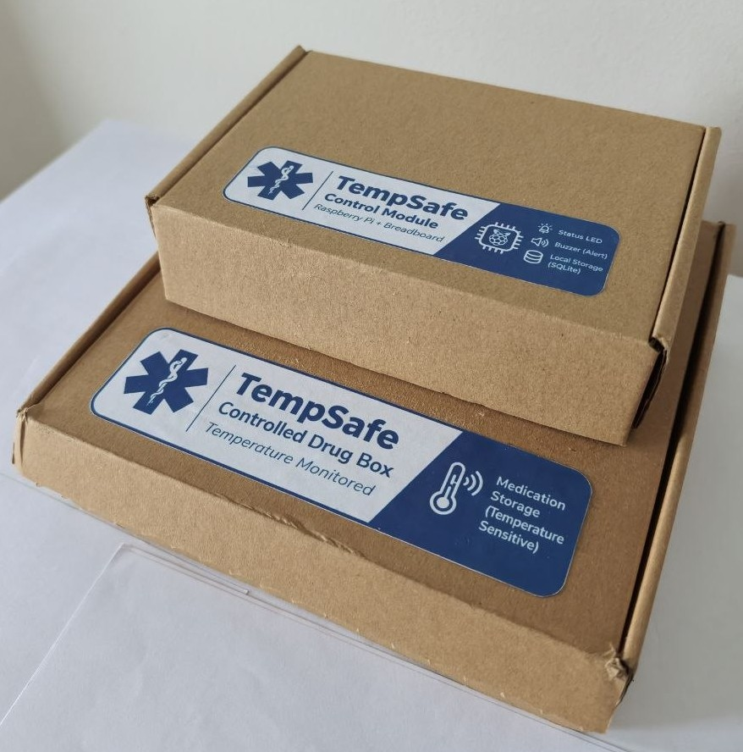
Hardware & IoT Prototype
Components
SCD41 temperature sensor
Raspberry Pi 5
Single-colour LED
Passive buzzer
Three 220 Ω resistors
Breadboard and jumper wires
What the system does
The SCD-41 measures the temperature approximately every 30 seconds. Readings are stored locally in SQLite and sent via MQTT.
Warning → 💡 LED ON
Alert → 💡 LED ON + 🔊 Buzzer ON
Normal → ⛔ LED OFF + 🔇 Buzzer OFF
Two-module prototype
Drug Box: medication + temperature sensor
Control Module: Raspberry Pi + LED + buzzer
The Raspberry Pi is kept outside the monitored box to reduce heat influence on the sensor.

Slide 4







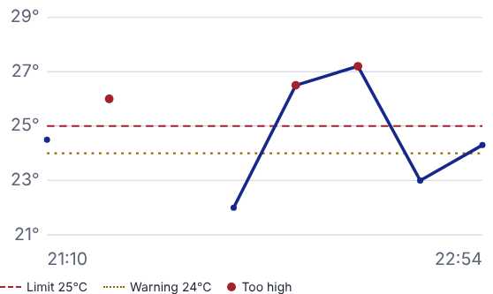
TempSafe system architecture
Backend and database
Medication box
EC2 /
UBUNTU
SERVER
MQTT broker
MQTT worker
Routes messages
Checks the box ID and
Temperature sensor
by topic
saves valid readings
Web browser
Stores readings
Nginx
FastAPI
Forwards web requests
Checks access and
to FastAPI
returns box history
Send reading
Return readings
Request history
Confirm reading saved
MoSCoW prioritisation
Project priorities
ONLY PRIORITY CHANGE
FR-13 Estimate time outside temperature limits
Should Have → Must Have
By the time Shannon checks the box, it may be back in range.
She still needs the duration and peak.
What have we delivered?
15 requirements / Reviewed 6 November 2026
Priority | ✓ Done (3) | ◐ In progress (10) | ◯ Planned (2)
Must Have | FR-05 Reading classification FR-10 Duplicate and late uploads | FR-01 Sign-in/out · FR-02 Box access FR-03 Temperature recording FR-04 Latest reading and age FR-06 LED warning · FR-07 History FR-08 Contact loss · FR-09 Offline buffer FR-13 Time outside limits | FR-14 Phone notifications
Should Have | FR-11 Dashboard auto-refresh | FR-15 Audible buzzer alert | FR-12 Mark a flagged sample as reviewed
Could Have | Possible follow-up: a native mobile app.
Won’t Have this time | Outside this release: active cooling, GPS, lid detection, extra sensors and ambulance-system integration; patient or medication records, automated clinical decisions and clinical deployment.
Notes:
Architecture
Follow one reading across the top row. The box sends it to the MQTT broker, which routes it to our worker. The worker checks the message format and box ID, saves the reading in MySQL, then sends confirmation back. If the connection drops before the box receives that confirmation, the box sends the same reading again. The sample ID lets the worker recognise a repeat, so it appears only once in history.
Now follow the lower row. When Shannon opens History, her browser asks for the readings. Nginx forwards the HTTPS request to FastAPI. FastAPI checks that she has access to this box, reads its history from MySQL and returns the data through Nginx. The browser draws the temperature graph.
Click once. The blue panel rises to show the project’s MoSCoW review.
MoSCoW prioritisation
FR-13 was the only requirement we moved. At first we thought the temperature graph was enough. Then we considered what Shannon would need after a call: the box might be back in range, but she would still need to know how long it was outside the limits and the peak temperature. That made an excursion summary essential. We mark the duration as an estimate because we only know what the sensor recorded.
At our 6 November code review, three of the fifteen requirements were complete: reading classification, handling duplicate and delayed uploads, and automatic dashboard refresh. Ten were in progress and two were planned. The Pi records temperatures, but always treats its clock as reliable. The website already estimates the duration and peak of an excursion. We kept FR-13 in progress because a missing sample can still join two periods together.
The two planned features have different priorities. Phone notifications are a Must Have because staff may be away from the box. Recording that someone reviewed a flagged sample is a Should Have: staff can still inspect the history without it. A native mobile app is a possible follow-up. Active cooling and clinical deployment are outside this monitoring prototype.
Sources: docs/requirements/moscow-prioritisation.md (6 November 2026 code review), docs/requirements/main-use-case.md, docs/mqtt.md, backend/temsafe/mqtt.py, backend/temsafe/api/boxes.py and deploy/tempsafe-nginx.conf. The monitor shows the project website. AWS, MySQL and FastAPI artwork from Devicon. NGINX mark from Simple Icons.

Slide 5
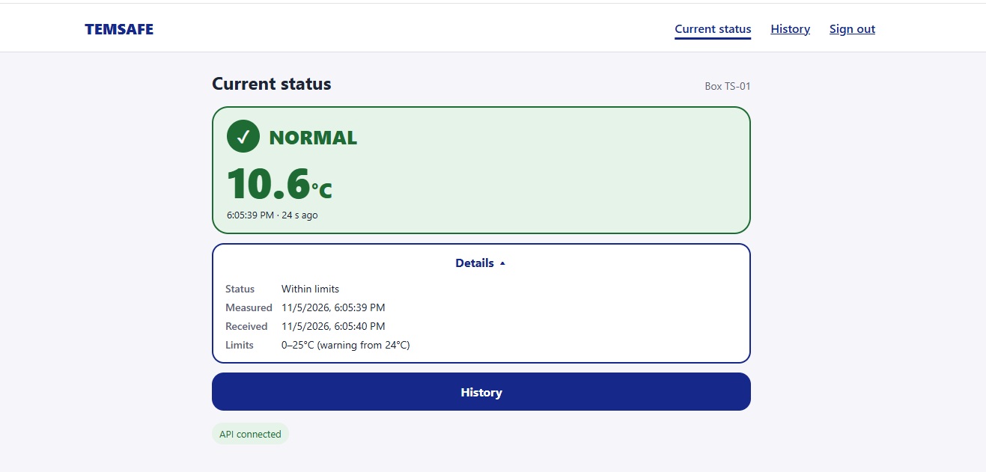
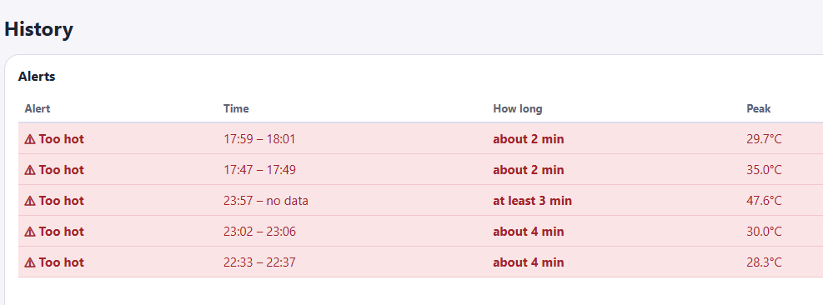
Usability Evaluation Findings & Planned Improvements
!
Alert: High temperature detected
View
1
2
1. Current Status: Show an unread temperature alert and add a View event button.
Last measured: 11/05/2026 6:05pm
2. Details: Remove duplicated information and show one clear timestamp —
Last measured.
Date
5 Nov 2026
3. History: Add the date to each event.
3

Slide 6
TempSafe
Thank you for
your attention
Any questions?
We’re happy to answer them.

