Slide 1
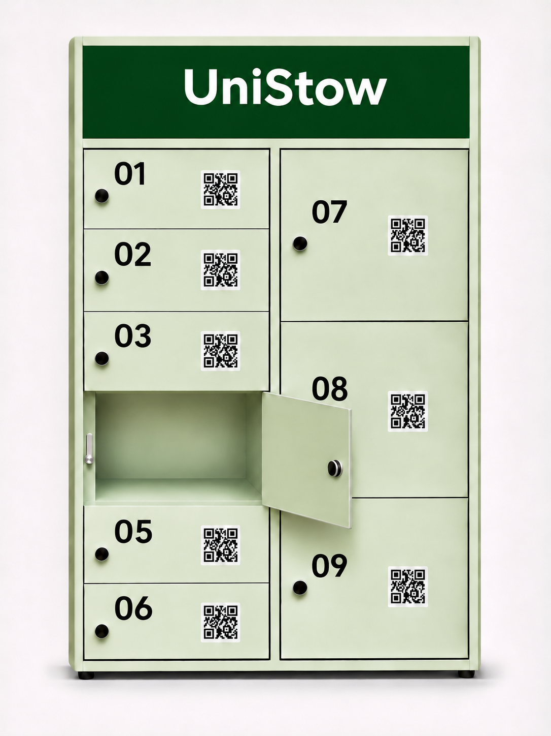
INDIVIDUAL IoT PROJECT
UniStow
A campus locker students can reserve, pay for and open online.
Nikita Smiichyk
Progress review · 11 November 2026

Slide 2
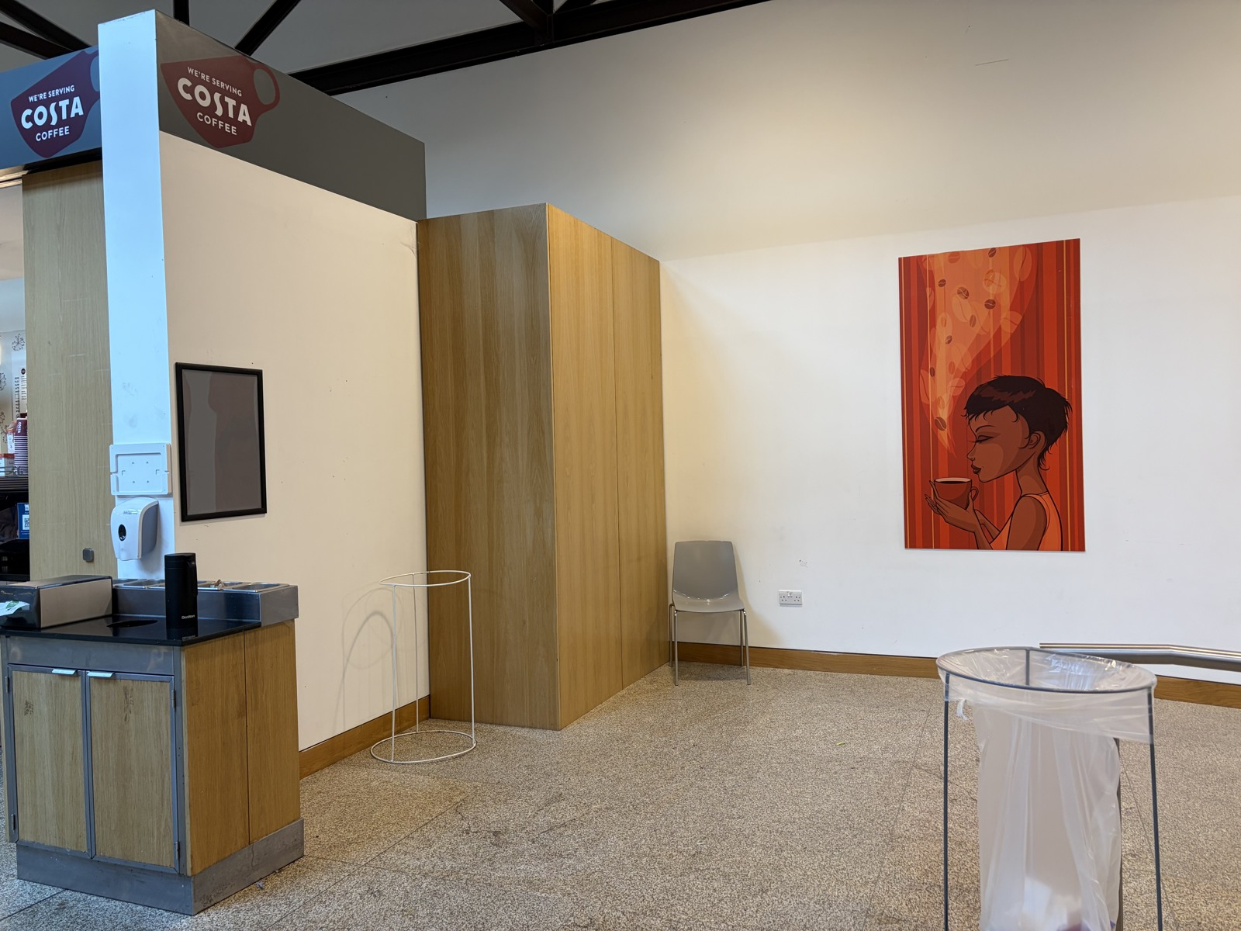
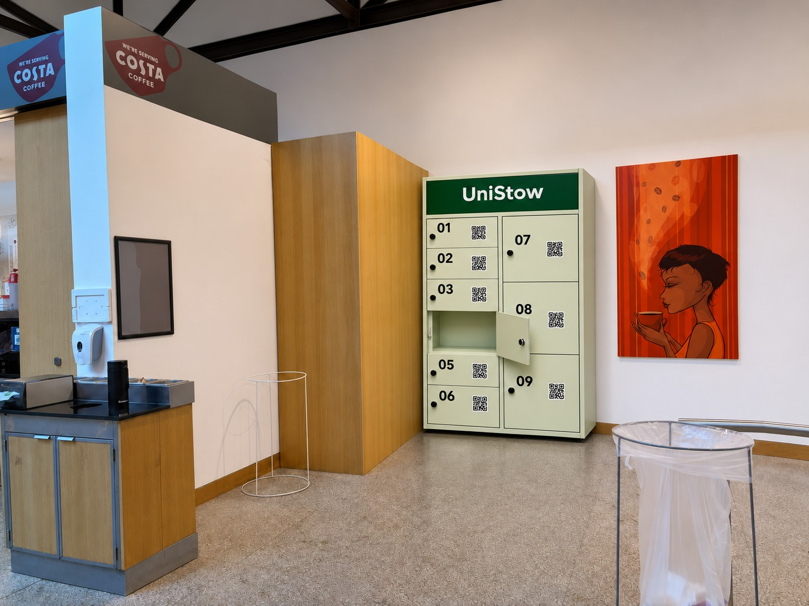
FUTURE PROTOTYPE
UniStow in the campus canteen
Before · Campus canteen
After · Proposed locker placement
AI visualisation of the proposed lockers.

Slide 3
SYSTEM ARCHITECTURE
From the website to Locker 4
AWS EC2 / Docker Compose
HTTPS · 443
MQTT/TLS · 8883
Browser
NGINX
FastAPI
Mosquitto
Raspberry Pi
Student
unistow.app
Web pages and API
MQTT broker
Locker 4
PostgreSQL
Hardware
Rentals and payments
Servo and door sensor
Opening the locker
FastAPI sends an open command via Mosquitto. The Pi reports the door state over MQTT.
Device heartbeat
The Pi also reports its status to FastAPI over HTTPS through NGINX.
Payment
The student pays in Stripe Checkout (test mode). Stripe sends payment events to FastAPI.

Slide 4
BACK END AND API
How the API authorises an opening
1
Reserve
The server checks availability, calculates the price and places a time-limited hold.
POST /api/rentals
2
Confirm payment
A verified Stripe event confirms the test payment.
POST /api/stripe/webhook
3
Request access
The server checks the renter, payment, deadline and controller readiness before issuing a short-lived command.
POST /api/rentals/{id}/open
4
Finish collection
The rental ends after the controller confirms the matching collection command.
POST /api/rentals/{id}/finish

Slide 5
DATABASE
PostgreSQL prevents double booking
Accounts
Passwords and session tokens are stored as hashes.
users · sessions
Bookings
A unique index allows only one unfinished rental per locker. Each command has an expiry and a controller ID.
lockers · rentals · locker_commands
Payments
The API records Stripe references and processed webhook IDs so a repeated webhook can be recognised.
payments · payment_events
Extra days
One daily charge is allowed per rental and date. Recovery payments remain linked to the original rental.
overdue_charges · overdue_payments

Slide 6
DOMAIN AND AWS
unistow.app
The public site runs on an Ubuntu EC2 instance in Stockholm.
DNS and HTTPS
Docker Compose
Cloud security
Cloudflare DNS points to an Elastic IP. The www address redirects to the main site, which returned HTTP 200 on 10 November.
Docker Compose runs Nginx, FastAPI, PostgreSQL 16 and Eclipse Mosquitto. PostgreSQL uses a persistent volume.
Nginx verifies the app certificate. FastAPI verifies the database certificate. The 20 GiB EBS root volume is encrypted and SSH access is restricted.

Slide 7

HARDWARE AND MQTT
How MQTT connects FastAPI and Locker 4
The physical prototype
A Raspberry Pi 400 reads the magnetic door contact and drives the SG92R servo.
Live MQTT connection
FastAPI sends opening commands through Mosquitto. Locker 4 publishes the door state and signals when it is ready.
The existing HTTPS device API handles heartbeats and confirms the end of a rental.

Slide 8
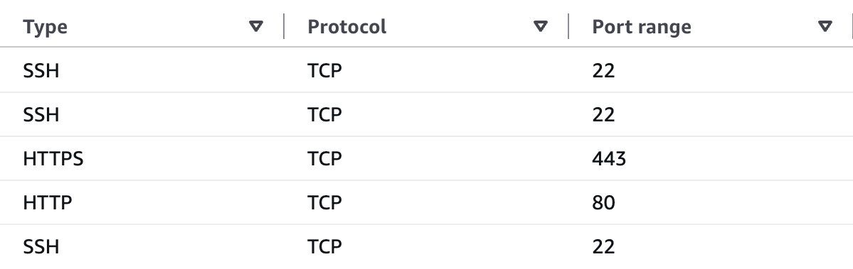
BROKER DEPLOYMENT
Eclipse Mosquitto is running on EC2
Verified with Locker 4
UniStow security group
The Pi verified the TLS certificate for unistow.app:8883 and acknowledged a test command from EC2. Door readings resumed after a service restart.
Access controls
The cloud broker rejected an anonymous login. Local tests also verified that each client can publish only to its assigned topic.
Inbound rules for launch-wizard-2 before the Pi connected over TCP 8883.

Slide 9
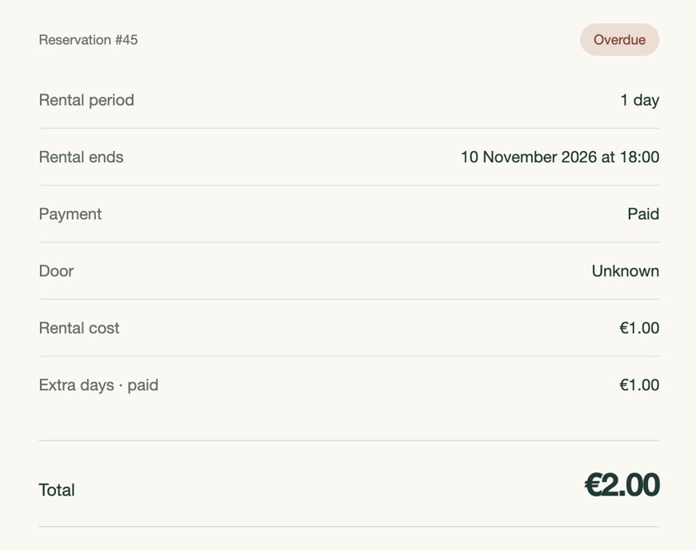
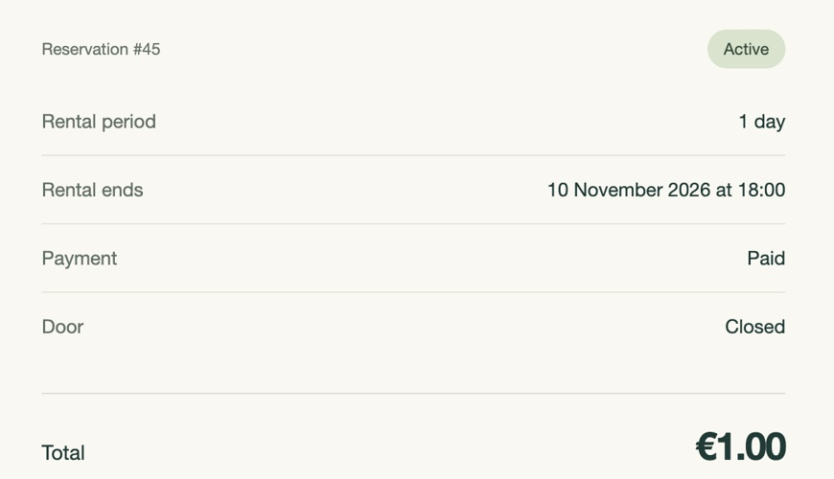
FRONT END AND PAYMENT TEST
Rental 45 crossed its 18:00 deadline
Before 18:00 · €1.00
After 18:00 · €2.00
Stripe collected one €1 late charge. The Pi confirmed collection and rental 45 ended at 22:45.

Slide 10
GITHUB ISSUES
Issues remain open
#19
Unpaid balances
Prevent a new booking while an account owes money. Keep collection and repayment available.
#18
Email notifications
Send rental and payment updates to the renter.
#13
Final submission
Finish the wiring and architecture diagrams, screencast and submission documents.

