Slide 1
ICA CHECKPOINT 1
UniStow
Short-term storage.
Access through a web app.
Nikita Smiichyk
github.com/nikitsya/PayBox

Slide 2
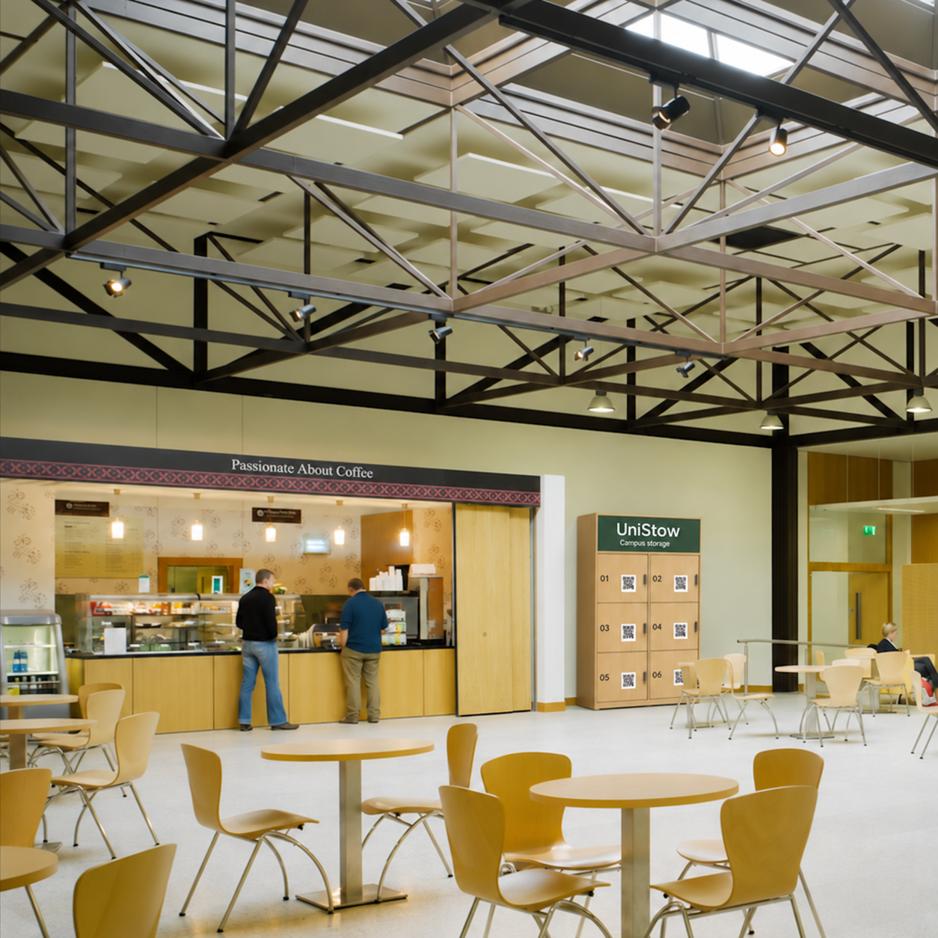
The project idea
A locker for a day on campus
A student visiting campus needs somewhere to leave a bag or personal belongings for a few hours without a long-term rental.

Slide 3
The planned rental journey
01
Choose and reserve
Sign in, check availability and view the rental end time.
02
Pay in test mode
The server verifies the Stripe payment notification.
03
Open the locker
The Raspberry Pi receives an authorised unlock request.
04
Retrieve and finish
Reopen during the rental, then empty and close the locker.

Slide 4
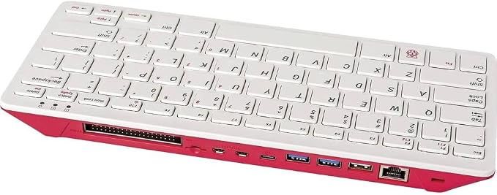
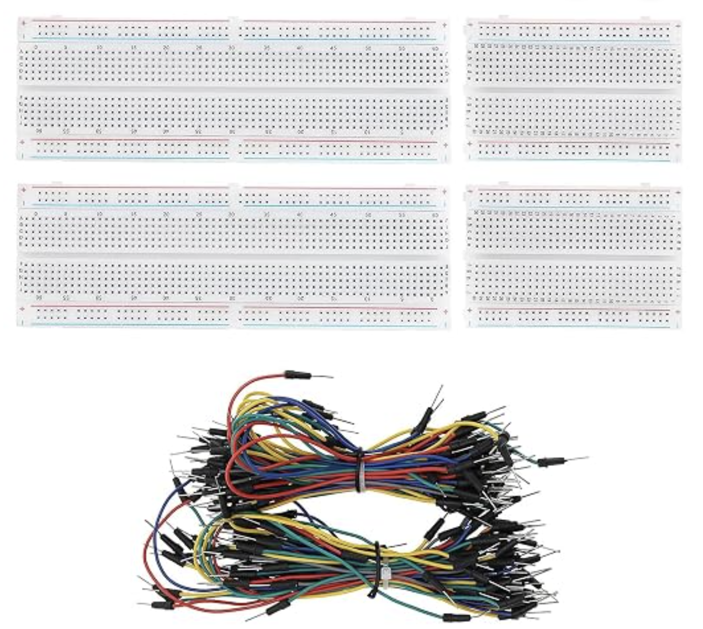
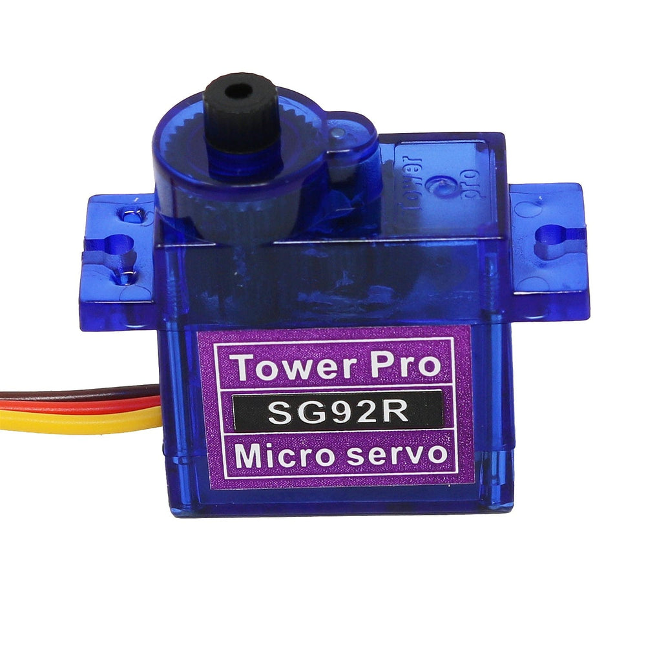
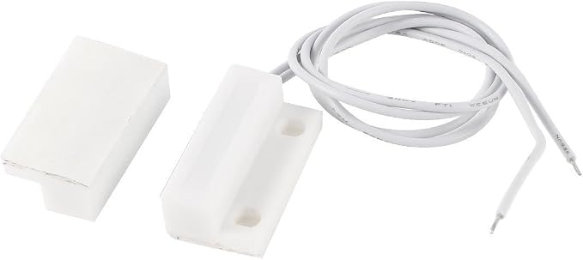
Hardware and sensor availability
Component | Purpose | Current status
Raspberry Pi | Device controller | Available
Breadboard and jumper wires | Circuit connections | Available
Servo motor | Moves the latch | Ordered
Door contact sensor | Reports open or closed | Ordered

Slide 5
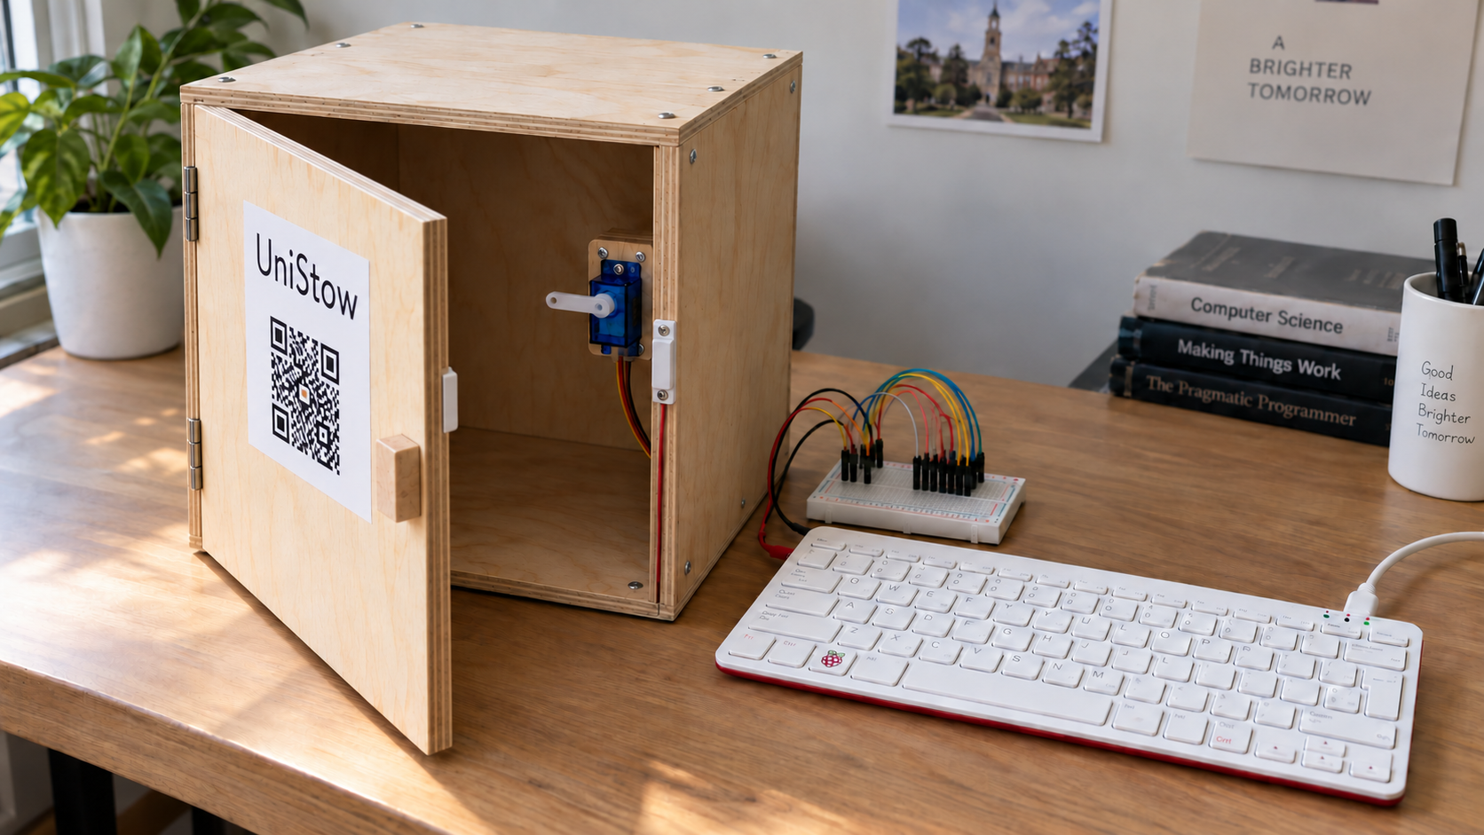
Prototype Concept

Slide 6
Planned technology stack
Layer | Proposed technology | Responsibility
Frontend | Flask templates, HTML, CSS, JavaScript | Accessible rental and account pages
Backend | Python and Flask | Authentication, rental rules, payment processing, device commands
Database | PostgreSQL | Users, lockers, rentals, payment records, device events
Payments | Stripe test environment | Simulated checkout and payment notifications
Device messaging | PubNub | Backend-to-device commands and device-to-backend status
IoT controller | Raspberry Pi and Python | Latch control, sensor readings, command acknowledgements
Hosting | AWS with a custom domain | Cloud-hosted application
Web serving | Nginx and a production WSGI server | HTTPS entry point and Flask hosting
Version control | Git and GitHub | Source code, documentation, and development history

Slide 7
Proposed system architecture
PostgreSQL
Door sensor
Commands
Browser
HTTPS
Flask on AWS
Nginx + WSGI
PubNub
Raspberry Pi
Stripe test mode
Servo latch
Status and acknowledgements return through PubNub.

