Slide 1


Space Runner Game
JavaScript UI & DOM – Team Work
"Aladdin"
Team
Telerik Software Academy
academy.telerik.com

Slide 2
Team Members
Име / Фамилия
Николай Ваташки -
Мартин Тонков -
Петя Петрова -
Георги Анчев -
GitHub Username
nikivat
mTonkov
Petiap
GeorgiAnchev
https://github.com/nikivat/Aladdin

Slide 3
Gameplay and Implementation
The developed game “Space Runner” makes use of the HTML5 Canvas and SVG frameworks as means for the creation of its presentation layer (GUI).
The game engine is implemented in JavaScript and includes all basic game components – player movement mechanics, object generation, collision detection, gameplay interactions and scoring.
The player is in a spaceship travelling through a meteorite field. The goal is to advance through the obstacles (meteorites), which are being generated at various rate, as far as possible. The trip is limited by the available fuel and the ability of the player to escape collision with the meteorites. If the fuel runs out, or the ship crashes - the game ends.
The gameplay provides several mechanics allowing the spaceship to continue its journey:
Fuel refills – The engine generates at random fuel refill barrels, which might be caught by the spaceship, refilling its tank to 100%.
Defensive shooting – The spaceship is supplied with a shooting system, allowing it to break the incoming meteorites, this freeing the way ahead.

Slide 4
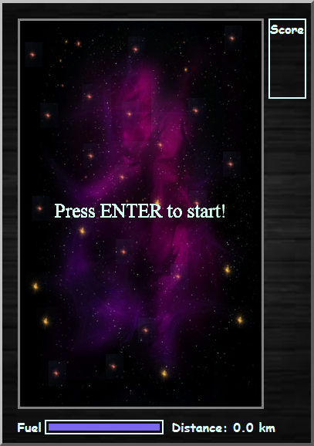
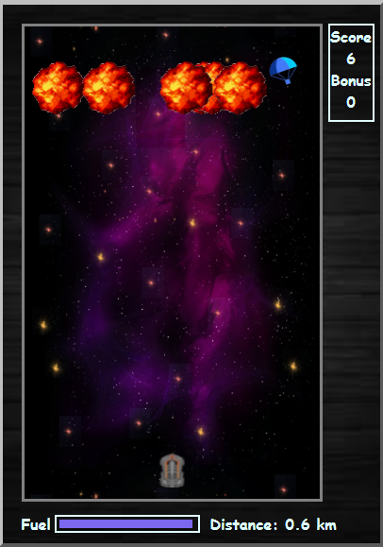
Game UI Overview

Slide 5
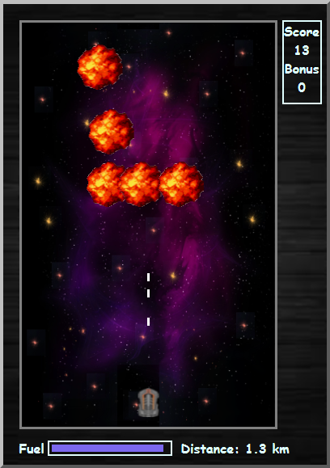
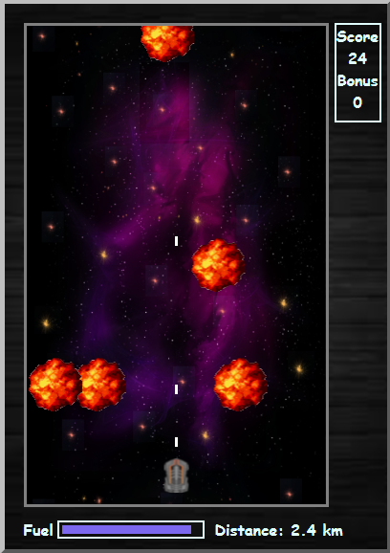
Game UI Overview

Slide 6
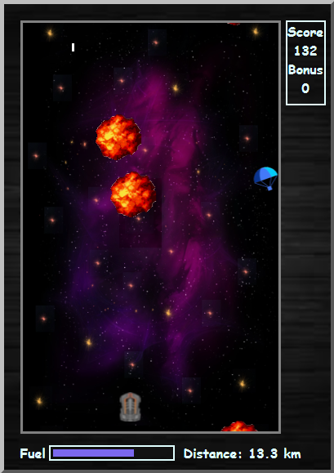
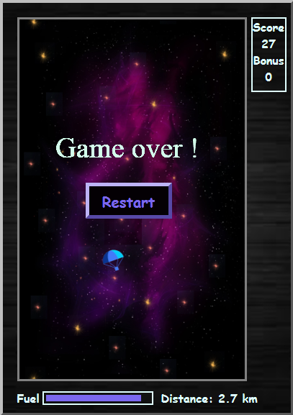
Game UI Overview

Slide 7
Live demo!

Slide 8
Thank you for the attention!

