Slide 1
COURSERA CAPSTONE IBM APPLIED DATA SCIENCE CAPSTONE
Opening a new Indian restaurant in Bangalore,India
BY
Anand Kumar Singh

Slide 2
BUSINESS PROBLEM
The objective of this capstone project is to analyse and select the best location in Bangalore city to open a new Indian restaurant. Using Data science methodology and machine learning techniques like clustering, This project provide the solution to the business question: If anyone want to open a good Indian restaurant in Bangalore where they should open it ?

Slide 3
DATA
• Data required
List of neighbourhoods in Bangalore
Latitude and longitude coordinates of the neighbourhoods
Venue data, particularly data related to shopping malls
• Sources of data
➢Wikipedia page for neighbourhoods
(https://en.wikipedia.org/wiki/Category:Neighbourhoods_in_Bangalore)
➢Geocoder package for latitude and longitude coordinates
➢Foursquare API for venue data

Slide 4
METHODOLOGY
• Web scraping Wikipedia page for neighbourhoods list
• Get latitude and longitude coordinates using Geocoder
• Use Foursquare API to get venue data
• Group data by neighbourhood and taking the mean of the frequency of occurrence of each venue category
• Filter venue category by Shopping Mall
• Perform clustering on the data by using k-means clustering
• Visualize the clusters in a map using Folium

Slide 5
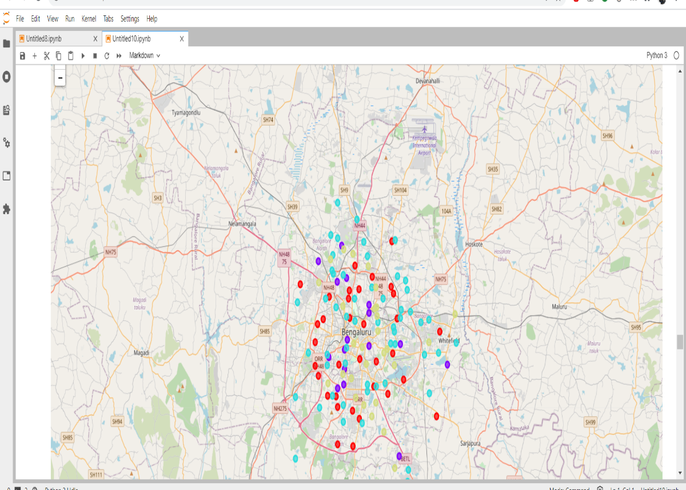
RESULTS
• Categorized the neighbourhoods
into 4 clusters :
Cluster 0: Neighbourhoods with
high number of shopping malls
Cluster 1: Neighbourhoods with
smallest concentration of Indian Restaurant
Cluster 2: Neighbourhoods with a highest concentration of Indian Restaurant.
Cluster 3: Neighbourhood with moderate Concentration of Restaurant

Slide 6
DISCUSSION
An observations of from the map and clusters shows that the most of the Indian restaurants are situated in Central Bangalore area. By analyzing each cluster it gives the output that cluster 0 have 34 Indian restaurant across the city, and cluster2 being the most in number i.e 54 Indian restaurants, So This projects states that to get out the maximum profit and getting the best result to open a new Indian restaurant someone should consider opening it in cluster1 area because it has the lowest numbers of restaurant in that area.

Slide 7
RECOMMENDATIONS
• Open new Indian Restaurant in neighbourhoods in cluster 1 with little to no competition
• Can also open in neighbourhoods in cluster 3 with moderate competition if have unique restaurant theme to stand out from the competition.
• Avoid neighbourhoods in cluster 0 & cluster 2 high concentration of Indian Restaurant and intense competition.

Slide 8
CONCLUSIONS
• Answer to business question: The neighbourhoods in cluster 1 are the most preferred locations to open a new Indian Restaurant
• Findings of this project will help the relevant stakeholders to capitalize on the opportunities on high potential locations while avoiding overcrowded areas in their decisions to open a new Indian Restaurant.

Slide 9
THANK YOU!

