Slide 1

MINI PROJECT
By: anand kumar singh
H12036

Slide 2
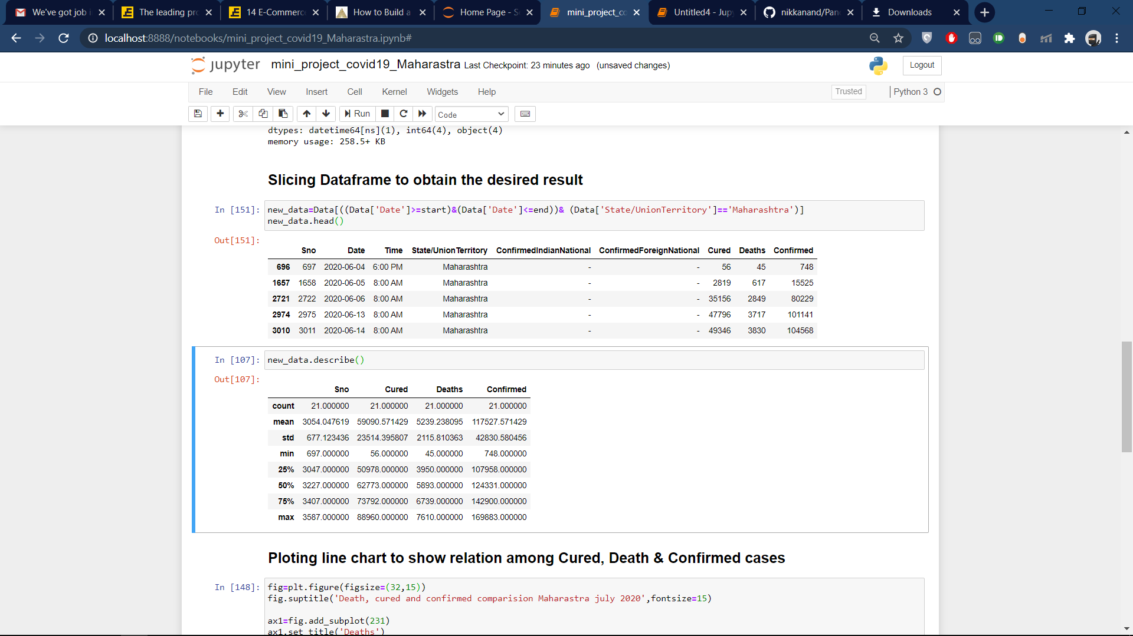
Information about total number of death , cured and confirmed covid19 cases in Maharastra in July 2020

Slide 3
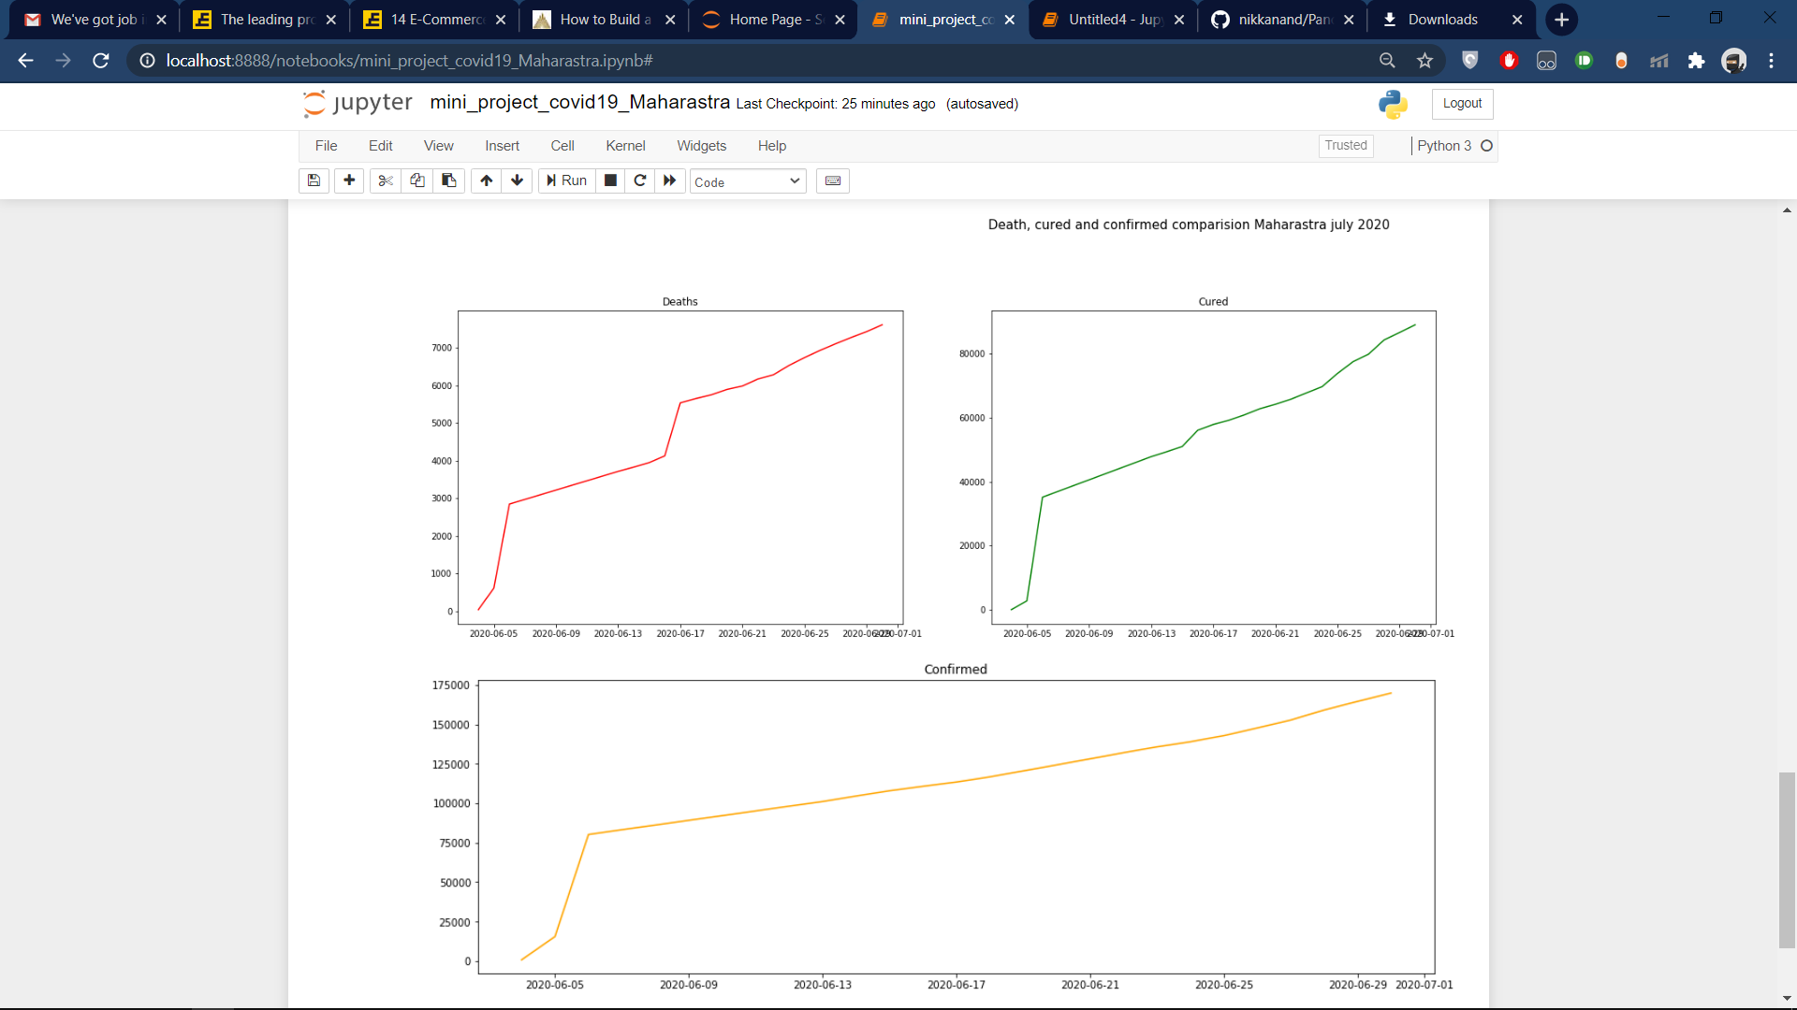
Relation between Death,Cured & confirmed cases(line charts)

Slide 4
Your best quote that reflects your approach… “It’s one small step for man, one giant leap for mankind.”
- Neil Armstrong

