Slide 1
CONSTELLATION PHOTOMETRY
Satellite Attitude & Shape from 30,000 Star Trackers
Turning a 10,000-satellite fleet's star trackers into an opportunistic photometric sensor network — and inverting the aggregated visual magnitudes into spin state, convex shape, catalog identity, array configuration, and catalog deviations.
<1 ms / 0.1°
20/21
20/21
+0.55 m²
baseline spin period / pole recovery
attitude-mode classifications correct
library identifications correct
seeded missing-antenna deviation detected
nikkelj/photometry · PRs #1–#3 · simulation + inversion stack + catalog-scale funnel, 18 passing tests

Slide 2
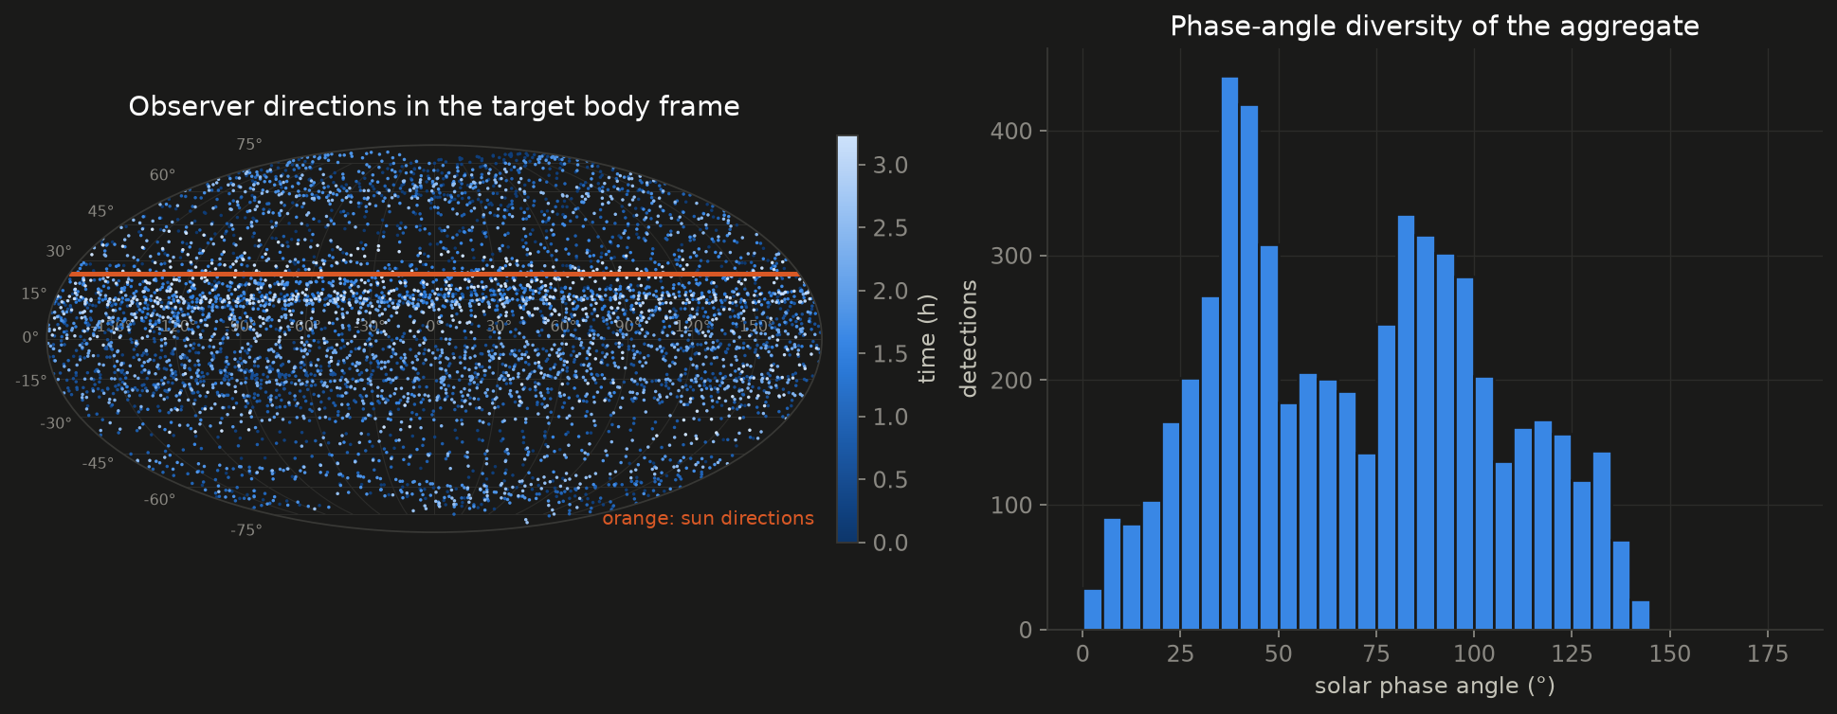
CONCEPT
Why a constellation beats a telescope
One ground telescope sees one light curve — a single slowly-moving line of sight. The classical light-curve inversion problem is ill-posed for exactly that reason. 10,000 satellites × 3 star trackers, canted +5° above the local horizontal, opportunistically detect any object above the shell thousands of times per day, from hundreds of directions at once — a tomographic sampling of the target's reflected light field. Each detection: time, line of sight, apparent magnitude. Range is known from multi-observer orbit determination, so every sample becomes range-normalized brightness at one (sun, observer) direction pair.
Observer directions in the target body frame over one day (left) and the phase-angle diversity of the aggregate (right) — coverage no single site can produce.
5,703
14–142°
detections, 588 observers — one 3.2 h baseline arc
solar phase angle span of the same arc

Slide 3
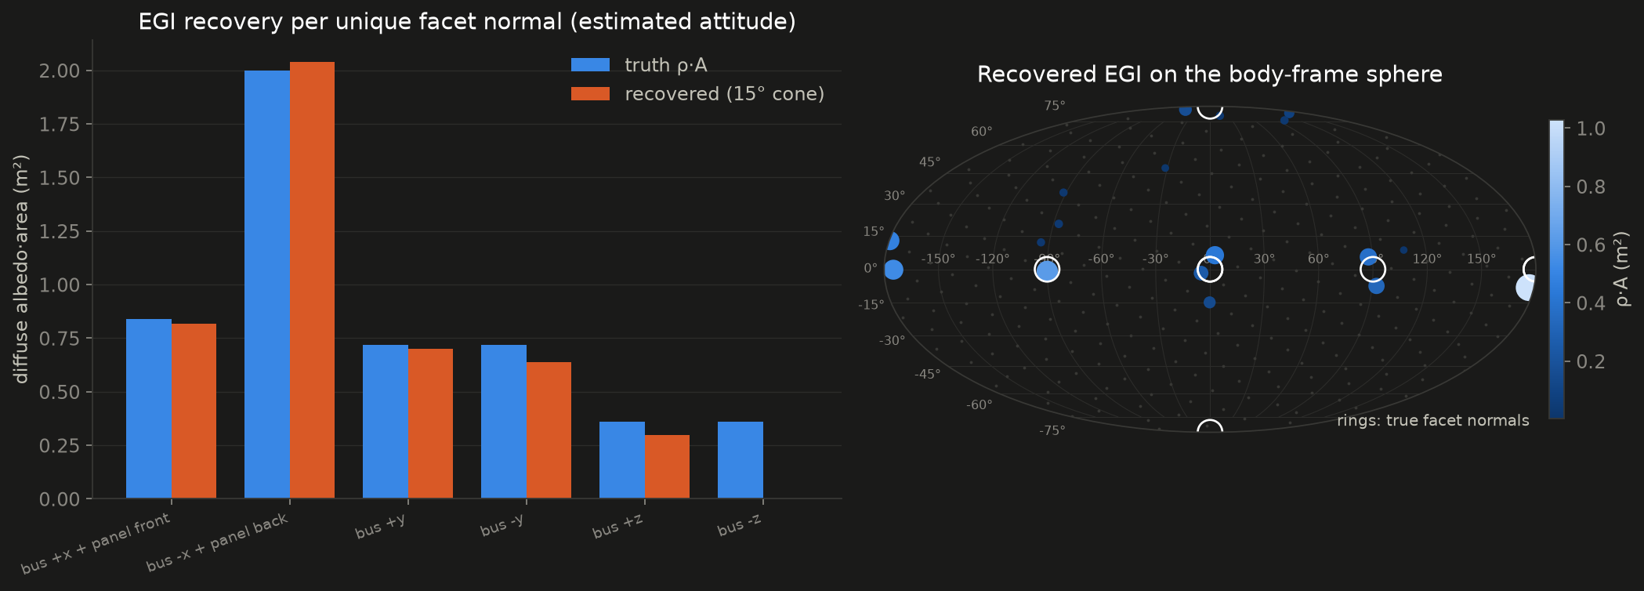
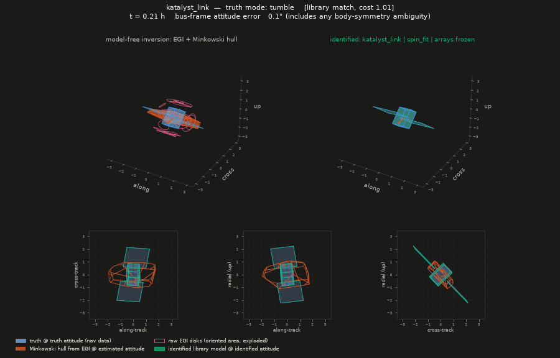
CONCEPT
The EGI — what photometry can and cannot know
Extended Gaussian Image: for every surface patch, take its outward normal direction and its reflecting area, and pile the area onto a sphere of directions. The EGI is “reflecting area per unit direction.” It is ALL photometry can see. An unresolved dot's brightness is a weighted integral of oriented area — position on the body is unrecoverable. A panel mounted left of the bus and the same panel mounted right produce identical light curves. It is ENOUGH to get a body back. Minkowski's theorem: a valid EGI corresponds to exactly one convex body (up to translation). We invert brightness → EGI (convex least squares), then EGI → solid (variational support-functional solve). vs photogrammetry: photogrammetry triangulates point positions from resolved images. Photometry is the unresolved limit — no pixels on target, ever — so we get the direction-space dual of a surface model: oriented area, no positions.
Recovered EGI vs truth for the baseline box-wing: 99% of recovered area within 15° of true facet normals.
Raw EGI disks (magenta, positions deliberately exploded — they have none), the Minkowski solid (orange), truth (blue).

Slide 4
MODELING PROGRESSION
Truth side — making the simulated world real
T1
Sensor fleet
Walker shell 100×100 @ 550 km/53°, three +5°-canted trackers per sat, FOV / sun exclusion / Earth-limb / eclipse. Finding: up-canted trackers only see objects ABOVE the shell.
T2
Radiometry
Facet BRDFs — Lambert + Phong per material (MLI, solar cells, white paint, antenna). Glints carry the sharpest attitude information.
T3–T4
Targets
Generic box-wing baseline, then a 7-satellite library from open-source dimensions: Starlink v1.5 / v2 mini / v2 mini DTC, BlueWalker 3, Hubble, ISS, Katalyst LINK.
T5–T6
Attitude & articulation
LVLH-hold ops, knife-edge low-drag, sun-point, inertial pointing, propeller tumble — plus per-facet solar-array gimbals (1-axis / 2-axis) tracking the sun.
T7
Saturation as censoring
Saturated streaks recorded as brighter-than-cap lower bounds, not dropped. ISS-class targets are ~80% censored.
T8
Torque-free tumble
Full Euler dynamics, triaxial inertia, nutating ω (energy conserved to 3e-8) — LINK's actual anomaly class.

Slide 5
MODELING PROGRESSION
Algorithm side — the inversion stack
A1–A2
Spin state
Arc-sized Lomb–Scargle + pole grid (sphere × phase × body spin axis) + refinement
period sub-ms, pole 0.1°
A3
Shape (EGI)
Joint Lambert + specular NNLS, dead-column pruning, scale-aware ridge
99% of area on true normals
A4
Mode classifier
Named operational laws + fitted spin / inertial families
20/21 scenarios
A5
Minkowski solid
Variational support-functional solve (L-BFGS-B, analytic gradient)
slab proportions exact
A6
Library ID
Model × attitude family × array config, 0.5-mag offset prior for size
20/21 — DTC vs v2 mini separable
A7–A8
Deviation alerts
Symmetry-group refinement + signed residual EGI + alert criteria
20/21 decisions fleet-wide
A9
Censoring-aware costs
One-sided Tobit terms, stratified sampling, coherent period ladder
ISS size info restored
A10
Torque-free fit
Window-laddered multi-start over inertia + rate + attitude
attitude error halved

Slide 6
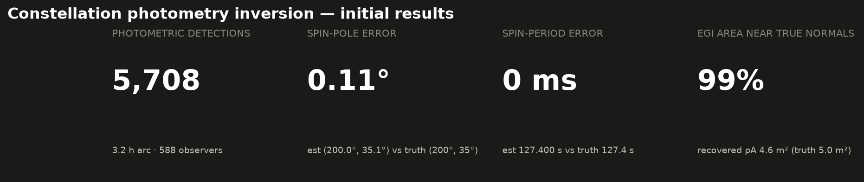
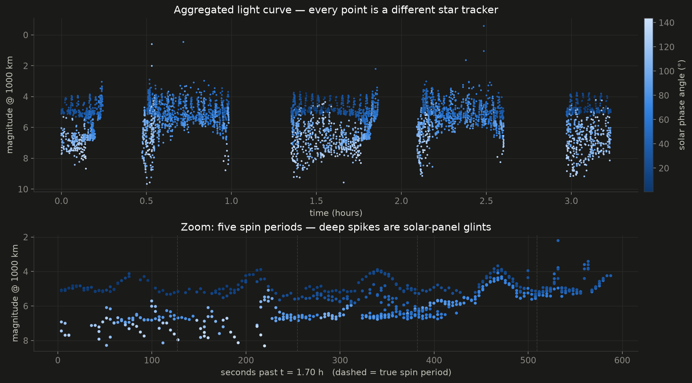
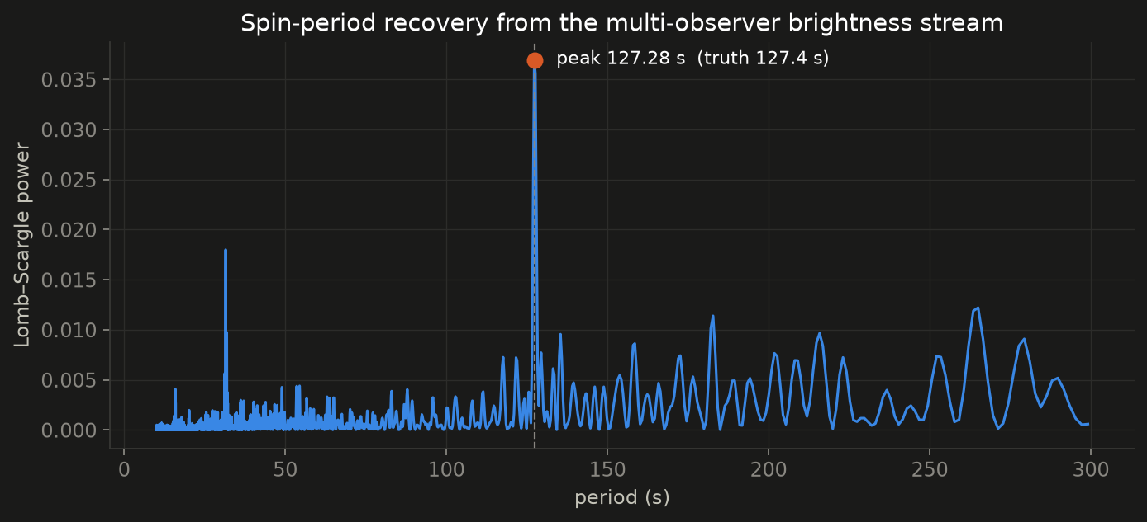
RESULTS — BASELINE
Tumbling box-wing, one 3.2-hour arc
Every point in the light curve is a different star tracker. The multi-observer periodogram peak is razor sharp — the alias structure that plagues single-site light curves is gone.

Slide 7
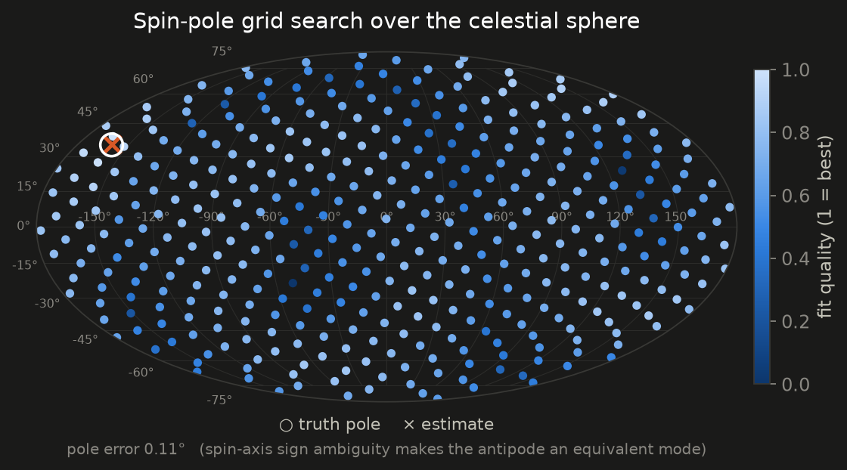
RESULTS — BASELINE
Spin pole and shape from magnitudes alone
Pole search: global grid over the celestial sphere; the antipodal twin is the spin-axis sign ambiguity, carried explicitly. EGI recovery: the anti-sunward facet is never illuminated during the arc and is correctly reported unobservable — the algorithm knows what it cannot know.

Slide 8
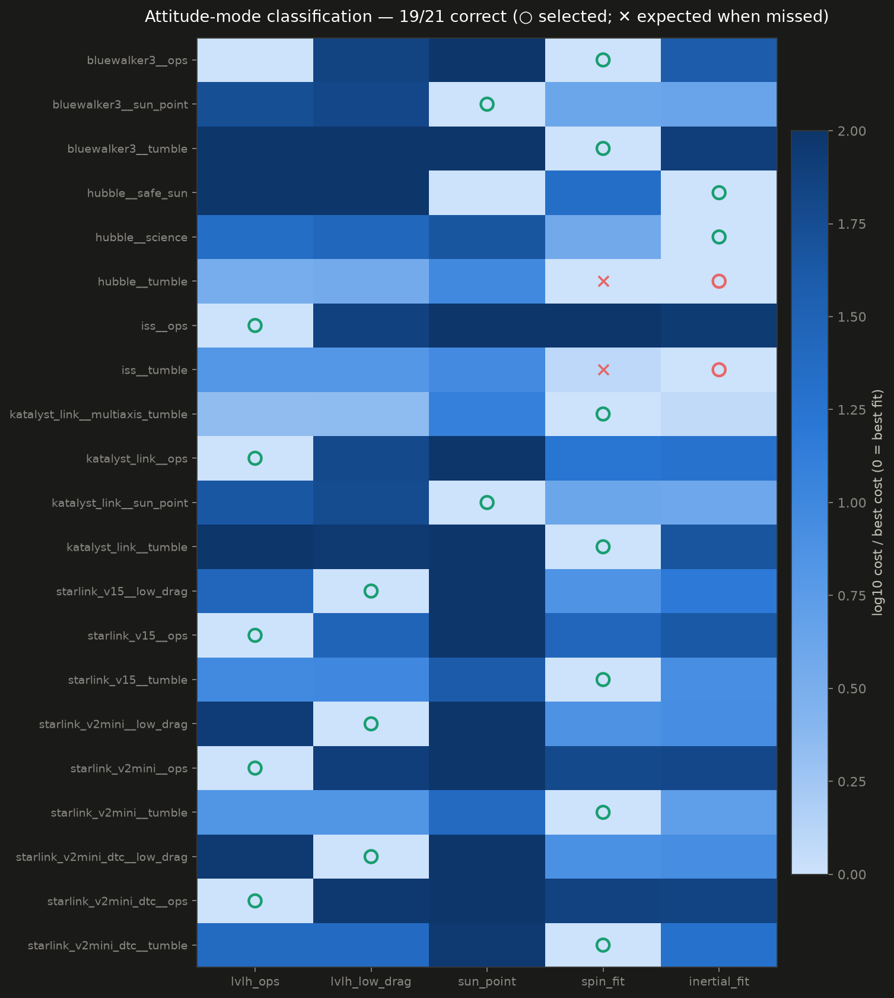
RESULTS — FLEET STUDY
21 scenarios × 24 hours: mode classification
Seven satellites × their operational modes, each simulated for a day and classified against a bank of attitude hypotheses. 20/21 correct. The single miss is physics, not software: Hubble tumbling about its own cylinder axis is photometrically near-static — an axisymmetric body's rotation about its symmetry axis is unobservable. Sun-tracking arrays are not body-fixed: ops-mode shape recovery correctly returns the bus + fixed antennas only, with the array's area appearing at the sun direction in the body frame.

Slide 9
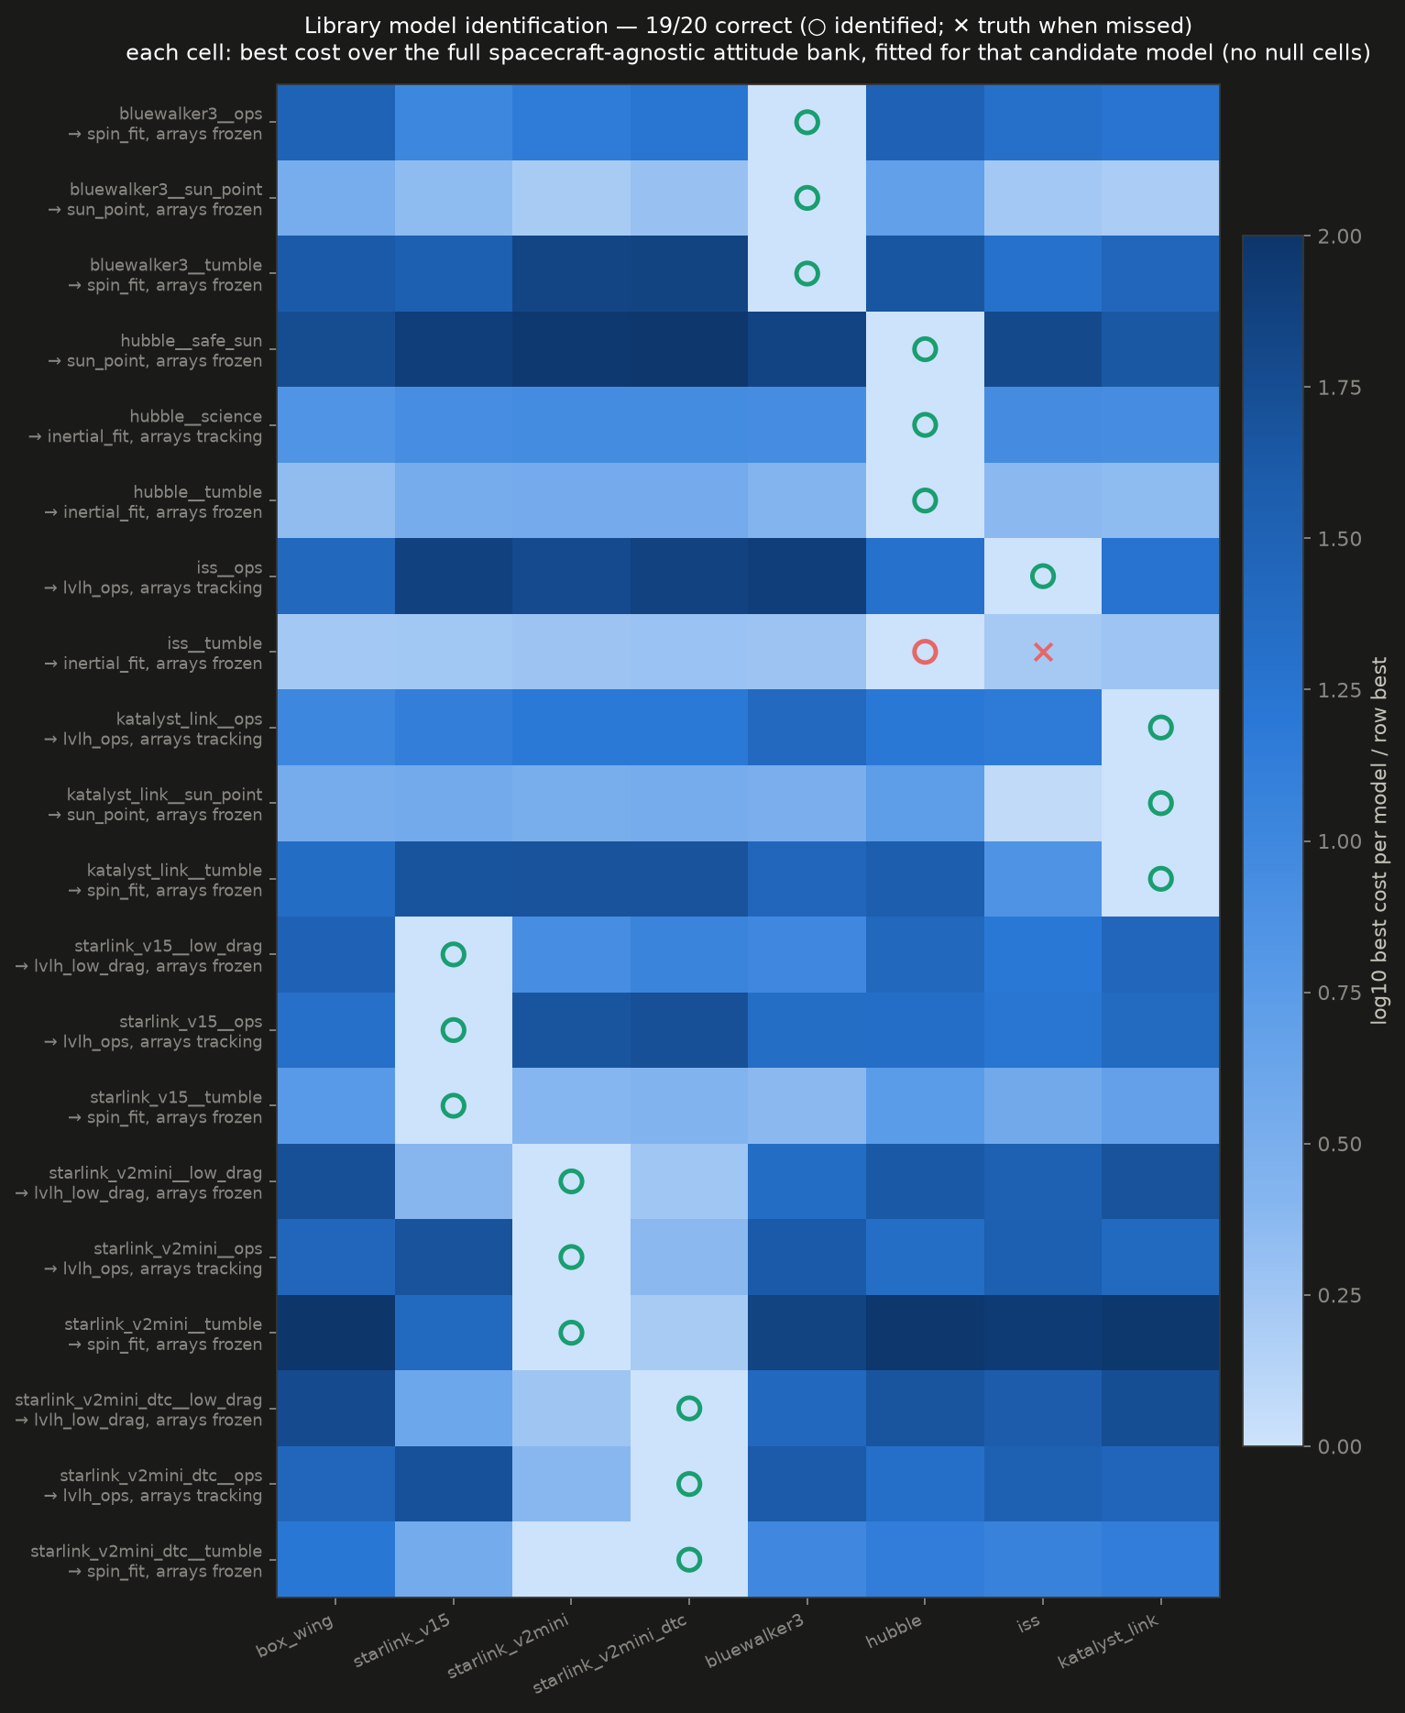
RESULTS — IDENTIFICATION
Which catalog object is this, in what state?
How to read the grid: the attitude bank is spacecraft-agnostic — LVLH-hold, knife-edge, sun-point, fitted spin, fitted inertial, × array configs where the model has gimbals. Every cell = the best cost of that ENTIRE bank fitted for that candidate model, normalized per row. No null cells: the fitted families always produce a best-effort attitude, so impostors get finite-but-poor costs, and odd pairings (a knife-edge ISS) simply lose and never win a row. 20/21 correct, including v2 mini DTC vs plain v2 mini (cost 1.09 vs 2.64 — a half-bus-length antenna is photometrically detectable) and arrays-tracking vs frozen. The one miss (tumbling ISS → “Hubble”) fits nothing well — best cost ~29 where real matches score ~1 — so a fielded system reports “no confident match”.

Slide 10
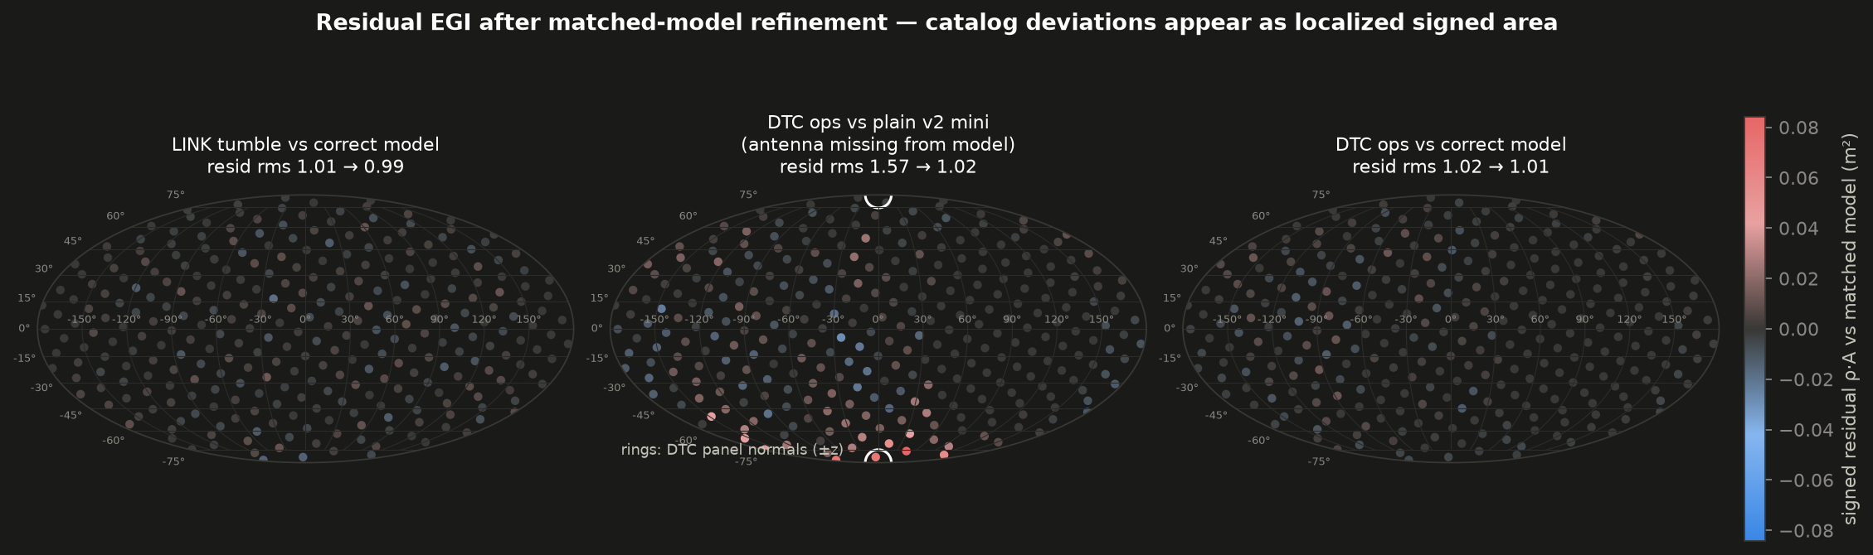
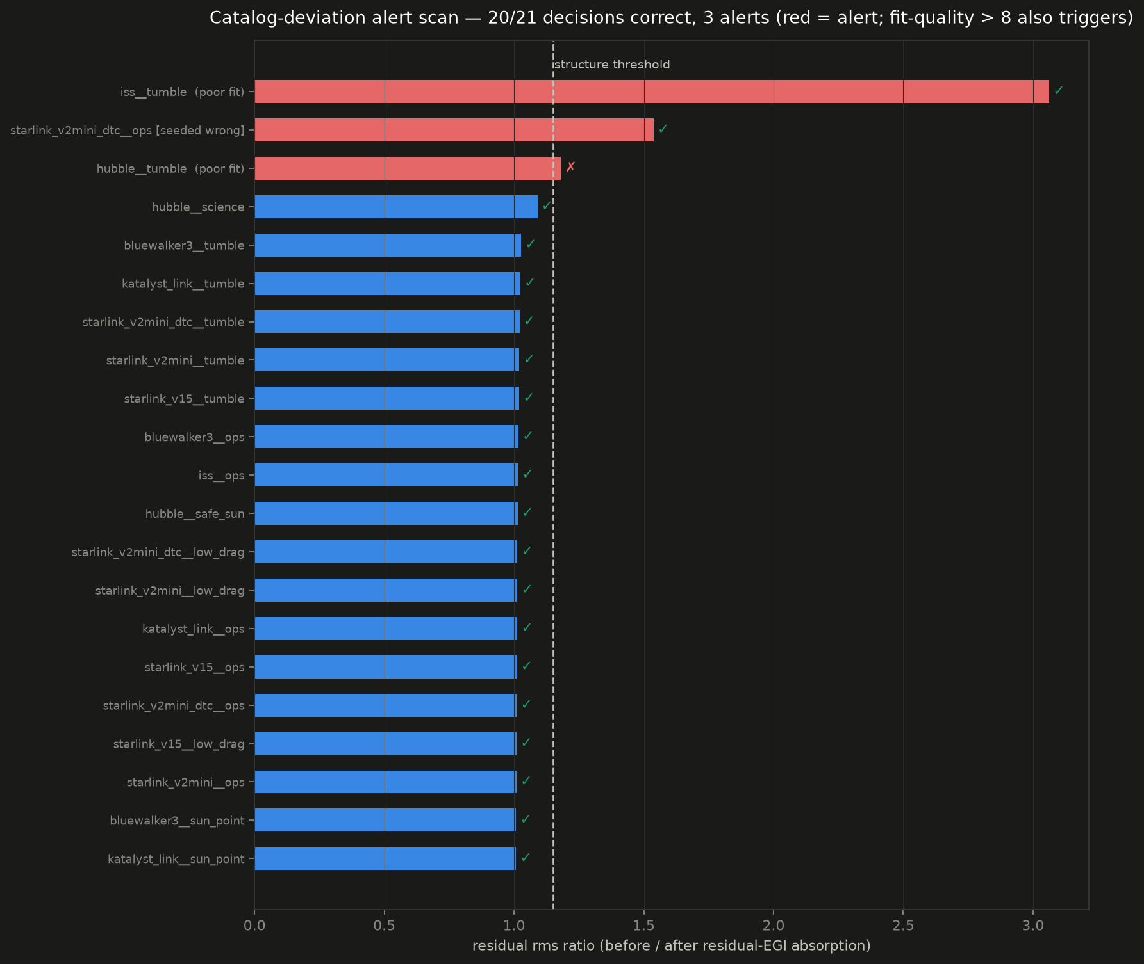
RESULTS — DEVIATION DETECTION
Does reality match the catalog?
Signed residual EGI on top of the matched model: a missing antenna shows up as +0.55 m² of localized area at the right normal (middle panel); correct models leave noise. Fleet alert scan: 20/21 decisions correct. The one flag is arguably a true positive — the identified attitude genuinely cannot explain Hubble's frozen arrays sweeping with the real rotation.

Slide 11
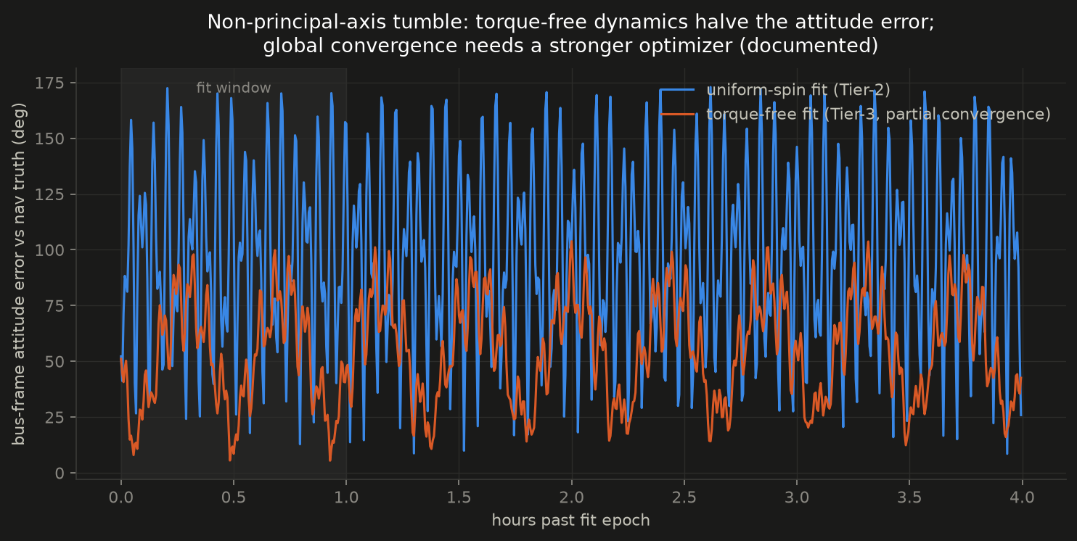
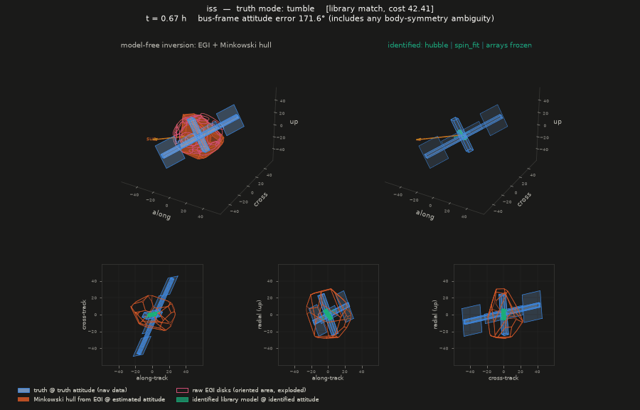
RESULTS — HARD CASES
Saturation censoring and multi-axis tumbles
Censoring: an ISS saturates the trackers on its bright spin phases — exactly the samples that carry the spin. One-sided “brighter-than-cap” terms restore size information (truth-attitude ISS fits at 0.18 vs 8.8+ for impostors); the global attitude search under 80% censoring is the open piece. Multi-axis tumble: torque-free dynamics halve the attitude error vs the best uniform-spin fit (97.8° → 50.7° in-window; 56.0° over a 4 h prediction), recovering the dominant rate component to 4%. Full convergence needs a stronger global optimizer — the machinery is verified (truth scores 1.04 through the exact fit path).
The one misidentification, visibly wrong: a tiny Hubble tube inside the real ISS — flagged by its outlier cost.

Slide 12
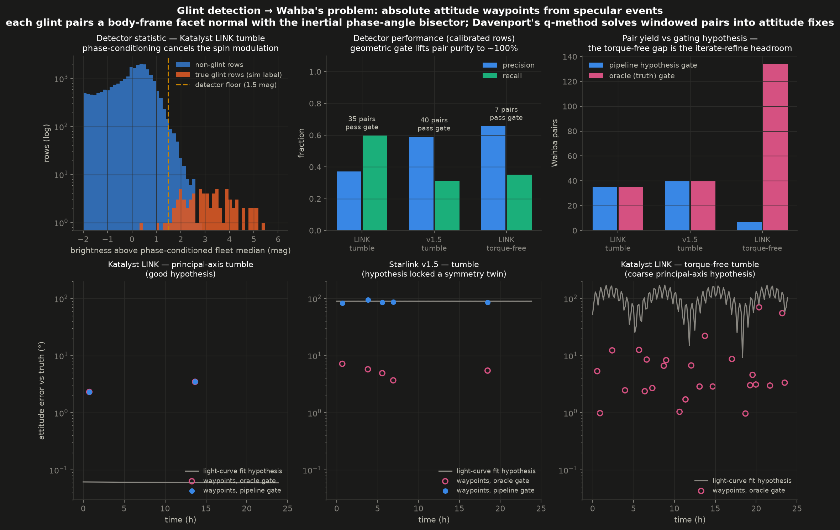
RESULTS — GLINT GEOMETRY
Wahba's problem: attitude waypoints from specular events
A glint is the one moment photometry yields a direction: the phase-angle bisector (known in ECI) coincides with a facet normal (known in the body frame). Each confirmed glint is a matched vector pair — the input to Wahba's problem — and Davenport's q-method turns a window of pairs into an absolute attitude fix. Detector: brightness vs the fleet median at the same rotational phase (cancels the spin modulation); geometric gating assigns the facet and lifts pair purity to ~100%. Waypoints at 2.9° (LINK tumble). Correct correspondences resolve the v1.5 symmetry twin scalar photometry cannot (5.5° vs 86°). 25 waypoints @ 3.4° live in the torque-free arc under oracle gating vs 7 pairs under the current coarse hypothesis — the iterate-refine headroom that will seed the Tier-3 dynamics fit.

Slide 13
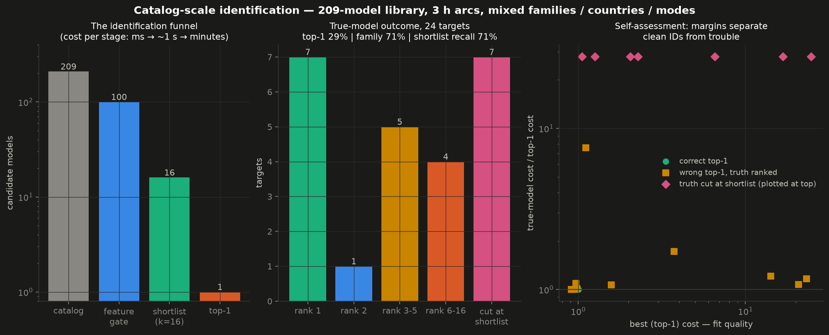
RESULTS — CATALOG SCALE
209 models: identity becomes class + configuration
24 sampled targets (11 families, 38 countries, mixed modes, two with off-pointed arrays), 3 h arcs, full funnel: feature gate (ms) → two-channel shortlist (~2 s) → matcher (~3 min). Exact identity 29% · family/class 71%. 10 of 17 misses picked a same-family photometric twin fitting within 1.2× of truth — the serial number is not in the data once the catalog holds look-alikes; class, size, and configuration are.
Self-assessment survives scale: every correct ID fits at cost ≤ 1.0; 13/17 wrong ones flag themselves (cost 1.05–25 or shortlist cut). The confident-but-wrong residue is exactly the twin set. Operational product: the ranked shortlist with margins — “one of these three 3U cubesats, ops attitude, arrays tracking” — plus orbit-catalog correlation as the free tie-breaker.

Slide 14
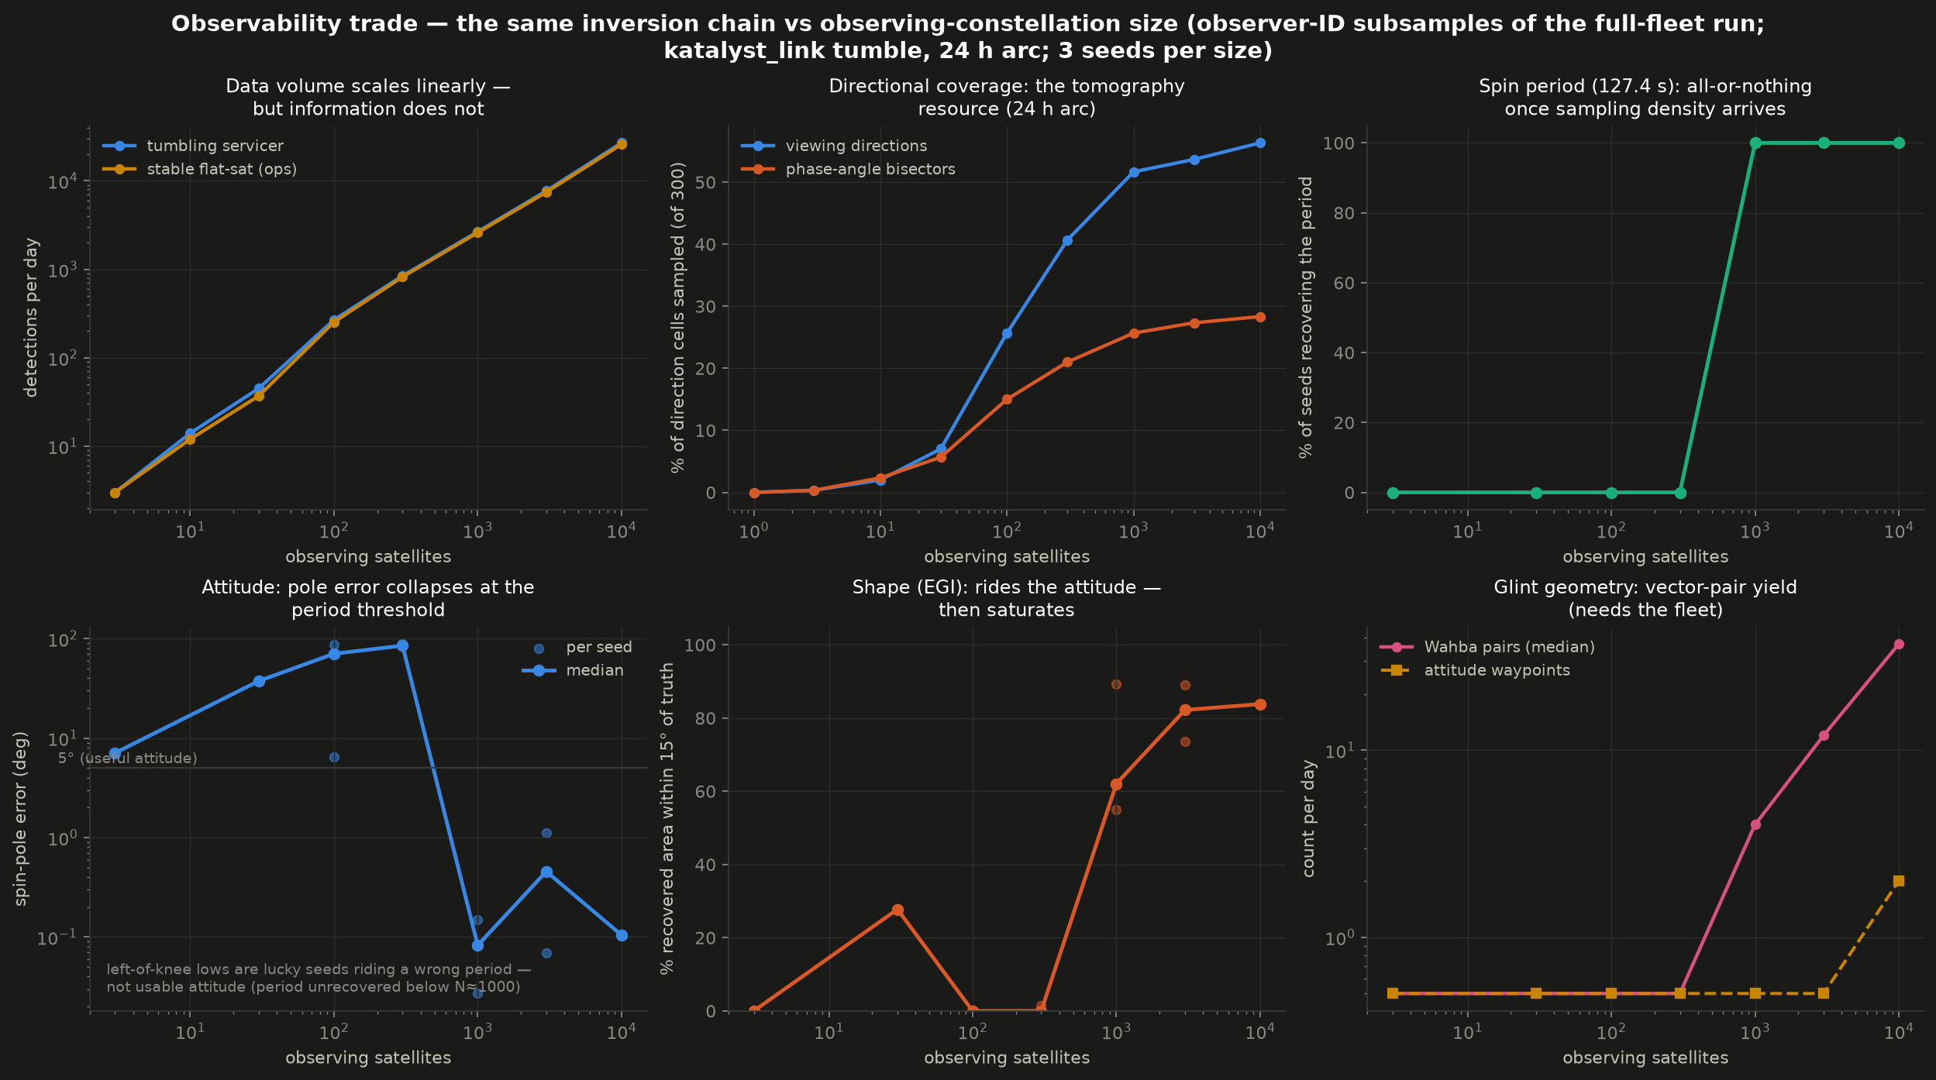
RESULTS — OBSERVABILITY TRADE
How many observers before the tomography turns on?
A smaller constellation is an observer-ID subsample of the full-fleet run — same shell, same chain, N of 10,000 IDs kept. The answer is a phase transition at N ≈ 300–1,000: period recovery 0/3 seeds at 300, 3/3 at 1,000 — and the instant it locks, pole error collapses 85° → 0.1° and EGI jumps to 55–89%, both already at full-fleet quality. Binding resource: sampling density, not geometry. Directional coverage saturates (~50%, sun-capped at 56%) before period success climbs. And there is no single-observer regime: 1 satellite ≈ 0–3 detections/day. What still scales at 10k: Wahba vector pairs (0 → 4 → 12 → 37/day) — the glint channel earns the full fleet after every scalar metric saturates.

Slide 15
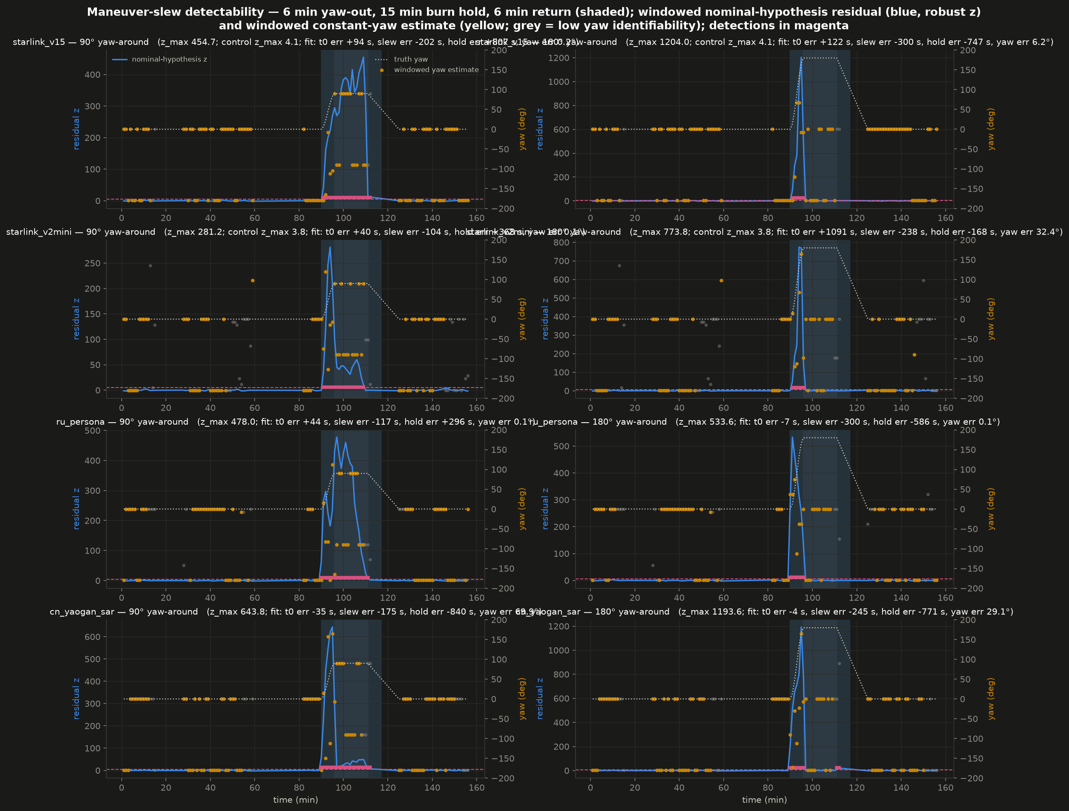
RESULTS — MANEUVER SLEWS
Pre-burn 90/180° yaw-arounds: detect always, characterize by symmetry
6 min yaw-out, 15 min burn hold, 6 min return — 4 craft × {90°, 180°} + controls. Detection: 8/8 at robust-z 281–1204, latency ≤ 60 s, controls ≤ 4.1, zero false alarms. Even the 2-axis-array flat-sat is loud: panel backs and bus edges swing even when the cells stay sun-locked. 90° holds: fully characterized — hold yaw to 0.1–0.2°, slew start ±0.5–2 min; durations softer (shallow smoothstep tails). 180° holds are invisible on mirror-symmetric buses — residual returns to baseline mid-burn; the two transients carry everything. Both seen → burn bracketed to ~1 min (Persona: −7 s); fit interpolating a flat basin can slide (v2 mini: +18 min). Product ordering: windowed z + yaw track is the robust detector; the parametric slew fit is the refinement.

Slide 16
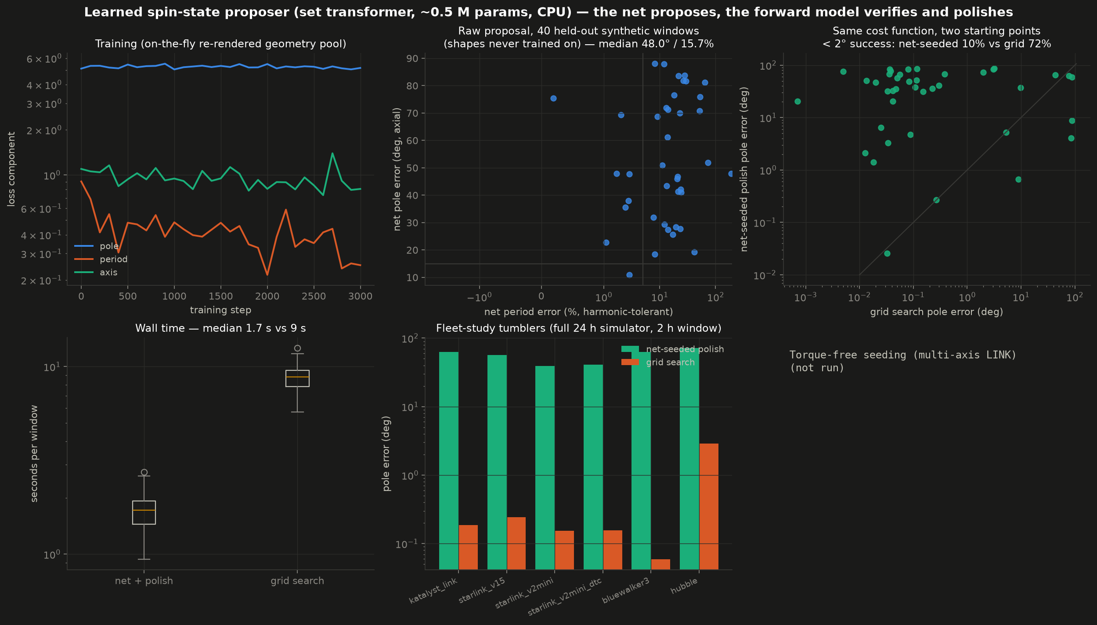
RESULTS — A LEARNED PROPOSER
Neural net: proposes in milliseconds, physics verifies — an honest negative so far
Where a net could earn its keep: every open problem was a search failure, never an information failure. Set transformer over detection tokens (0.5 M params), trained on a geometry-pool label factory (ms per exact-label example), proposals polished by the SAME forward-model cost the grid uses. Iteration log: raw time → chance; Fourier time → chance (a shallow net must rediscover autocorrelation — the periodogram's job); phase-fold at the Tier-0 period → harmonic & body-axis heads learn, pole head collapses; pole classification over the search grid → memorizes 24 examples perfectly, still chance on the stream. Measured: net-seeded polish < 2° on 10% of held-out windows vs 72% for the grid (1.7 s vs 9 s); top-4 seeds rescued two windows the grid failed (union 75%). The SO(3) pole is exactly the part amortization exists for, and exactly where the label signal is thinnest (only Tier-0-solvable windows carry it). Verdict: go/no-go fails at CPU budget; pipeline verified sound; ~33k examples seen vs the ~10⁶ amortized inference needs. Kept: the label factory, the verifier discipline, and a 10-line classical lesson — seed the simplex from several grid minima.

Slide 17
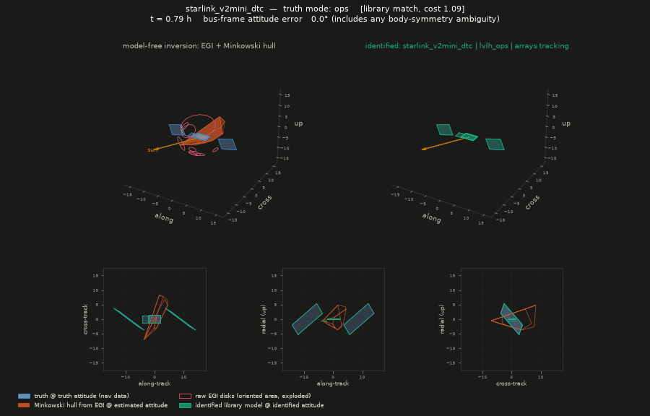
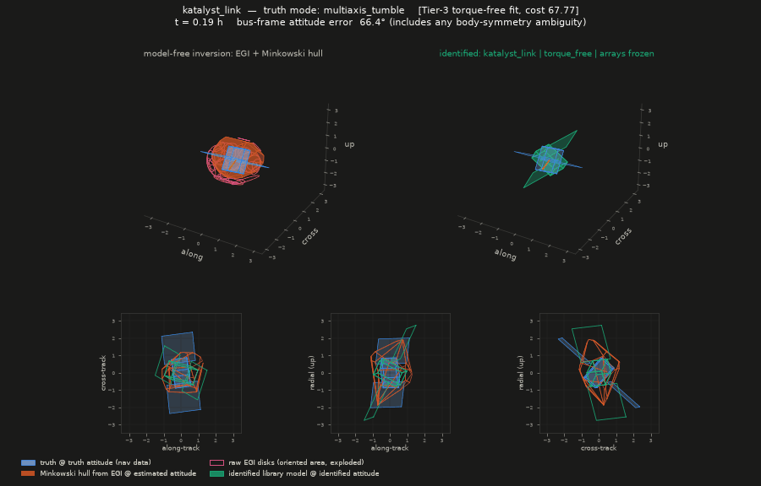
RESULTS — VALIDATION MOVIES
Watching the inversion against nav truth
Left: truth (blue) + model-free inversion — Minkowski solid (orange), raw EGI disks (magenta). Right: identified library model at identified attitude/articulation (green). Bottom: LVLH-plane projections. 21 animations in results/movies/ — the GIF below animates in slideshow mode.
DTC ops: truth arrays articulate toward the sun; identification correct incl. “arrays tracking”
LINK multi-axis tumble with the Tier-3 torque-free fit in the right panel

Slide 18
PATH TO OPERATIONS
Wiring the experiment to real data
The seam is already built: every algorithm consumes only the ObservationSet schema — one row per calibrated detection (time, observer, line of sight, sun, range, magnitude, sigma, bias, censored flag). Real integration = filling that table.
Tracker transient streams
Star trackers already detect non-stellar objects every frame — the star-ID rejects. The product to downlink: time, centroid + attitude → inertial LOS, streak-integrated magnitude, saturation flag.
Bridge: ground photometry
MMT-9 public light curves, commercial SDA networks, SatObs flash periods — degraded single-site geometry, but real BRDFs and noise to confront the calibration pipeline early.
Orbits & references
Space-Track / operator ephemerides for association and range; Gaia DR3 G-band as the per-frame photometric zero point; DE440 sun; ILRS truth orbits for calibrators.
Calibration loop
Run the stack on the constellation's own satellites (telemetered attitude, CAD shape) with truth held fixed — solve per-sensor biases, color terms, and BRDF materials instead. Continuous, free truth.
Hard parts, named
Streak photometry (trailed PSF flux) and fleet-scale association. First light: predict known targets' transits through each FOV and harvest only those windows.
Code adapters
EphemerisOrbit wrapper for real orbits behind the LVLH hypotheses; Earthshine term in radiometry; passband refit of material coefficients; robustness knobs retuned on real residuals.
Full guide: docs/real-data-integration.md — field-by-field schema mapping, reduction pipeline, worked loader skeleton.

Slide 19
SYNTHESIS
Standing findings and where to head next
Altitude envelope
ROADMAP
+5°-canted trackers only see objects above the shell — ISS, Hubble, LINK are invisible to a 550 km shell at their real altitudes.
Glint-seeded torque-free fitting: close the iterate-refine loop (7 → 134 pairs measured headroom), fit dynamics through Wahba waypoints
Close the funnel gaps: third shortlist channel for inertial pointers, arc-aware fingerprints, off-pointed array hypotheses, orbit-catalog tie-breaking among twins
Maneuver-window change-point scanning: freeze the match, score in time bins, recurse on the bins that fail
Harmonic-aware censored period ladder — closes the last curated misidentification (ISS-class tumblers)
Per-sensor photometric bias estimation: 30k sensors, cooperative constellation targets as truth
Real tracklets: reduce to the ObservationSet schema and the identical stack runs
Censoring is the tall pole
Bright spin phases are the saturated ones: calibrated-only data shrinks objects and hides spin. The saturation timing pattern is itself signal.
Ambiguities are structural
90° plate swaps, 180° tube flips, pole antipodes — search them explicitly, report them as posterior modes.
Articulation is information
Arrays tracking vs frozen is directly identifiable; a pointed telescope still sun-tracks its arrays.

