Slide 1
Heaps & Priority Queues
(Walls & Mirrors - Remainder of Chapter 11)

Slide 2
Overview
Array-Based Representation of a Complete Binary Tree
Heaps
The ADT Priority Queue
Heap Implementation of the ADT Priority Queue
Heapsort

Slide 3
Complete Binary Tree
Recall that a binary tree of height h is said to be complete if it is full down to level h – 1, and level h is filled from left to right.
Examples:
Now, recall our array-based representation of a binary tree:

Slide 4
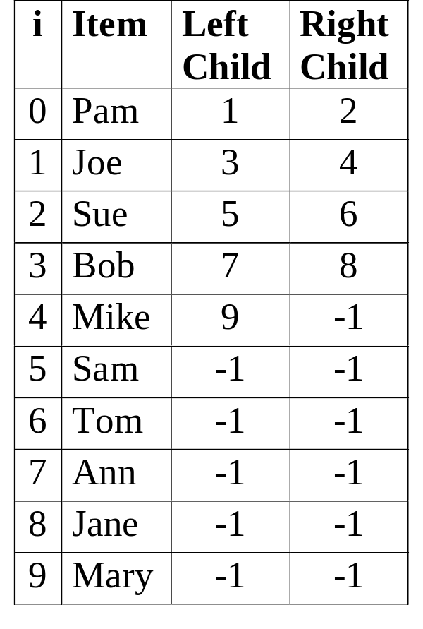
Array-Based Representation of a Binary Tree
root
0
Pam
free
10
Joe
Sue
Bob
Mike
Sam
Tom
Ann
Jane
Mary

Slide 5
Left Child & Right Child in a Complete, Array-Based Binary Tree
Suppose that the nodes of a binary tree are stored in an array as follows:
  First, store the root, which is at level 1.
  Next, store the nodes at level 2;
  Then, store the nodes at level 3;
  . . .
Suppose also that at every level, the nodes are stored from left to right.
If the binary tree is complete, then for any node at array position i, its left child will be at position 2*i + 1, and its right child will be at position 2*i + 2.

Slide 6
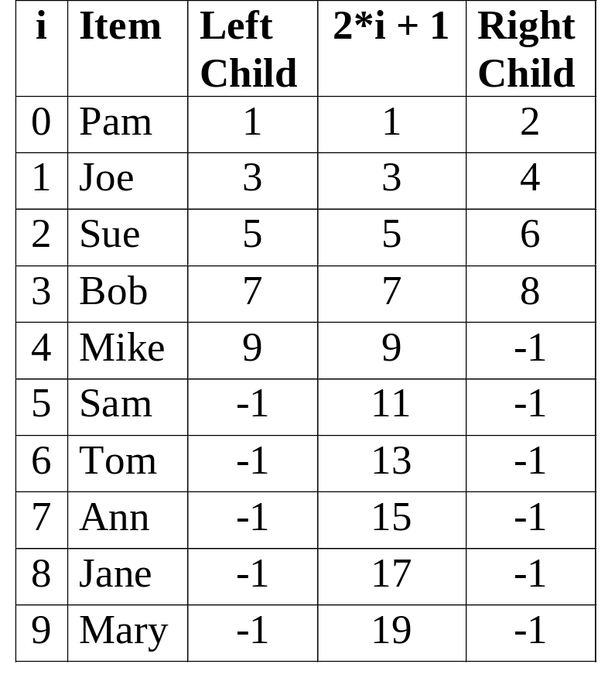
Left Child & Right Child in a Complete, Array-Based Binary Tree
Pam
Joe
Sue
Bob
Mike
Sam
Tom
Ann
Jane
Mary
LeftChild(i) = 2*i + 1
RightChild(i) = 2*i + 2

Slide 7
Parent in a Complete,
Array-Based Binary Tree
If the array-based binary tree is complete, then for any node at array position i, its parent will be at position
⎣ (i – 1) / 2 ⎦
Examples:
i = 4: ⎣ (i – 1) / 2 ⎦ = ⎣ 3 / 2 ⎦ = 1
i = 3: ⎣ (i – 1) / 2 ⎦ = ⎣ 2 / 2 ⎦ = 1
i = 2: ⎣ (i – 1) / 2 ⎦ = ⎣ 1 / 2 ⎦ = 0
i = 1: ⎣ (i – 1) / 2 ⎦ = ⎣ 0 / 2 ⎦ = 0
i = 0: ⎣ (i – 1) / 2 ⎦ = ⎣ -1/ 2 ⎦ = -1

Slide 8
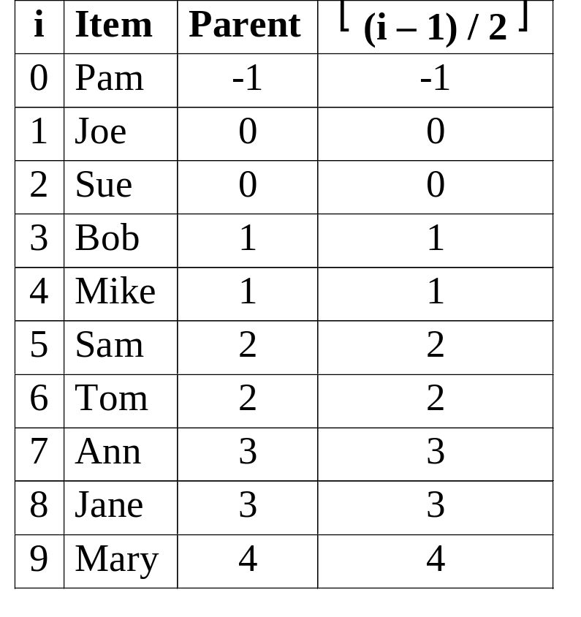
Parent in a Complete,
Array-Based Binary Tree
Pam
Joe
Sue
Bob
Mike
Sam
Tom
Ann
Jane
Mary
Parent(i) = ⎣ (i – 1) / 2 ⎦

Slide 9
Array-Based Representation of a Complete Binary Tree
Conclusion: For an array-based representation of a complete binary tree, there is an easy way to determine the parent and children of any node without following left and right child indices (or pointers).
Consequently, in this case, it is sufficient to store the data items only, and indices (or pointers) to parents and children are not necessary.

Slide 10
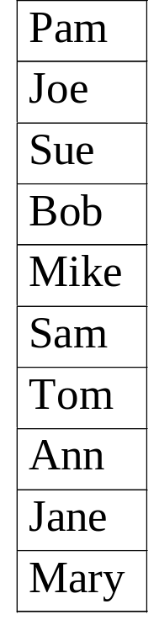
Array-Based Representation of a
Complete Binary Tree
Pam
Joe
Sue
Bob
Mike
Sam
Tom
Ann
Jane
Mary

Slide 11
Heaps
A heap is a complete binary tree that is either:
empty, or
consists of a root and two subtrees, such that
  both subtrees are heaps, and
  the root contains a search key that is ≥ the search key of each of its children.

Slide 12
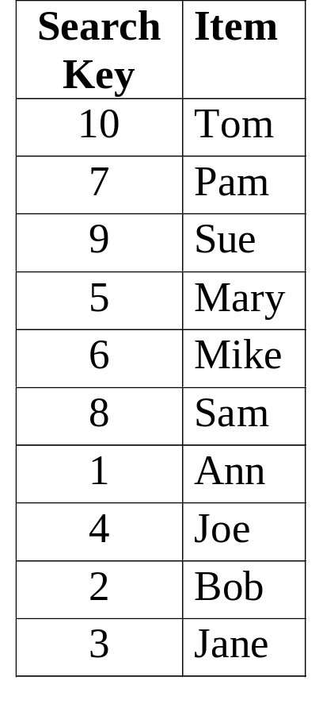
Array-Based Representation of a
Heap
10
Tom
7
9
Pam
Sue
5
6
8
1
Mary
Mike
Sam
Ann
4
2
3
Joe
Bob
Jane

Slide 13
Array-Based Representation of a
Heap
Note that, for any node, the search key of its left child is not necessarily ≤ or ≥ the search key of its right child.
The only constraint is that any parent node must have a search key that is ≥ the search key of both of its children.
Note that this is sufficient to ensure that the item with the greatest search key in the heap is stored at the root.
In the array-based representation we have discussed, the item with the greatest search key will always be at position 0 of the array.

Slide 14
The ADT Priority Queue
A priority queue is an ADT in which items are ordered by a priority value. The item with the highest priority is always the next to be removed from the queue. (Highest Priority In, First Out: HPIFO)
Supported operations include:
  Create an empty priority queue
  Destroy a priority queue
  Determine whether a priority queue is empty
  Insert a new item into a priority queue
  Retrieve, and then delete from the priority queue the item with the highest priority value
We shall implement a priority queue using a heap.

Slide 15
PriorityQ: Array-Based Implementation
const int MaxItems = 100; // max # items in PriorityQ
typedef int KeyType; // PriorityQ search-keys are int’s
struct dataItem // all data for an item is put into
{ KeyType key; // one struct for convenience
// other data members are included here
};
typedef dataItem PQItemType; // items in PriorityQ are dataItems
// returns pqItem’s search-key
KeyType getKey( const PQItemType &pqItem )
{ return( pqItem.key );
}

Slide 16
PriorityQ: Array-Based Implementation
typedef PQItemType HeapItemType;
class PriorityQ
{
public:
// declarations of public member functions
private:
HeapItemType items[MaxItems];
int size;
};

Slide 17
PriorityQ: Public Member Function Definitions
// default constructor, which creates a new empty PriorityQ
PriorityQ::PriorityQ( ) : size( 0 ) { }
// copy constructor and destructor are supplied by the compiler
// returns true if the PriorityQ is empty, otherwise returns false
bool PriorityQ::pqIsEmpty( ) const
{ return size = = 0;
}

Slide 18
PriorityQ: Retrieve & Delete
Consider the operation, “Retrieve, and then delete from the priority queue the item with the highest priority value.”
In a heap where search keys represent the priority of the items, the item with the highest priority is stored at the root.
Consequently, retrieving the item with the highest priority value is trivial.
However, if the root of a heap is deleted we will be left with two separate heaps.
We need a way to transform the remaining nodes back into a single heap.

Slide 19
PriorityQ: Public Member Function Definition
// retrieve, and then delete from the PriorityQ the item
// with the highest priority value
bool PriorityQ::pqRetrieve( PQItemType &priorityItem )
{ if( pqIsEmpty( ) ) return false;
// set priorityItem to the highest priority item in the PriorityQ,
// which is stored in the root of a heap
priorityItem = items[ 0 ];
// move item from the last node in the heap to the root,
// and delete the last node
items[ 0 ] = items[ – – size ];
// transform the resulting semiheap back into a heap
heapRebuild( 0 );
return true;
}

Slide 20
Semiheap
A semiheap is a complete binary tree in which the root’s left and right subtrees are both heaps.
10
25
45
55
45
55
60
15
50
35
20
5
10
40
30
25

Slide 21
Rebuilding a Heap: Basic Idea
Problem: Transform a semiheap with given root into a heap.
Let key( n ) represent the search key value of node n.
1) If the root of the semiheap is not a leaf, and
key( root ) < key( child of root with larger search key value )
then swap the item in the root with the child containing the larger search key value.
2) If any items were swapped in step 1, then repeat step 1 with the subtree rooted at the node whose item was swapped with the root. If no items were swapped, then we are done: the resulting tree is a heap.

Slide 22
Retrieve & Delete: Example
move 25 to here
60
Retrieve the item with the highest priority value (= 60) from the root.
Move the item from the last node in the heap (= 25) to the root, and delete the last node.
55
45
15
50
35
20
5
10
40
30
25

Slide 23
Rebuilding a Heap: Example (Cont’d.)
swap 25 with the
item in this node
25
The resulting data structure is a semiheap, a complete binary tree in which the root’s left and right subtrees are both heaps.
To transform this semiheap into a heap, start by swapping the item in the root with its child containing the larger search key value.
55
45
15
50
35
20
5
10
40
30

Slide 24
Rebuilding a Heap: Example (Cont’d.)
55
Note that the subtree rooted at the node containing 25 is a semiheap.
As before, swap the item in the root of this semiheap with its child containing the larger search key value.
25
45
15
50
35
20
5
10
40
30
swap 25 with the
item in this node

Slide 25
Rebuilding a Heap: Example (Cont’d.)
55
Note that the subtree rooted at the node containing 25 is a semiheap.
As before, swap the item in the root of this semiheap with its child containing the larger search key value.
50
45
15
25
35
20
5
10
40
30
swap 25 with the
item in this node

Slide 26
Rebuilding a Heap: Example (Cont’d.)
55
Note that the subtree rooted at the node containing 25 is a semiheap with two empty subtrees.
Since the root of this semiheap is also a leaf, we are done.
The resulting tree rooted at the node containing 55 is a heap.
50
45
15
40
35
20
5
10
25
30

Slide 27
PriorityQ: Private Member Function Definition
// transform a semiheap with the given root into a heap
void PriorityQ::heapRebuild( int root )
{ int child = 2 * root + 1; // set child to root’s left child, if any
if( child < size ) // if root’s left child exists . . .
{ int rightChild = child + 1;
if( rightChild < size &&
getKey( items[ rightChild ] ) > getKey( items[ child ] ) )
child = rightChild; // child has the larger search key
if( getKey( items[ root ] ) < getKey( items[ child ] ) )
{ swap( items[ root ], items[ child ] );
heapRebuild( child );
}
}
}

Slide 28
PriorityQ Insert: Basic Idea
Problem: Insert a new item into a priority queue, where the priority queue is implemented as a heap.
Let key( n ) represent the search key value of node n.
1) Store the new item in a new node at the end of the heap.
2) If the node containing the new item has a parent, and
key( node containing new item ) > key( node’s parent )
then swap the new item with the item in its parent node.
3) If the new item was swapped with its parent in step 2, then repeat step 2 with the new item in the parent node. If no items were swapped, then we are done: the resulting tree is a heap containing the new item.

Slide 29
PriorityQ Insert: Example
55
Suppose that we wish to insert an item with search key = 47.
First, we store the new item in a new node at the end of the heap.
50
45
15
40
35
20
5
10
25
30
47

Slide 30
PriorityQ Insert: Example (Cont’d.)
55
Since the search key of the new item (= 47) > the search key of its parent (= 35), swap the new item with its parent.
50
45
15
40
35
20
5
10
25
30
47

Slide 31
PriorityQ Insert: Example (Cont’d.)
55
Since the search key of the new item (= 47) > the search key of its parent (= 45), swap the new item with its parent.
50
45
15
40
47
20
5
10
25
30
35

Slide 32
PriorityQ Insert: Example (Cont’d.)
55
Since the search key of the new item (= 47) ≤ the search key of its parent (= 55), we are done.
The resulting tree is a heap containing the new item.
50
47
15
40
45
20
5
10
25
30
35

Slide 33
PriorityQ: Public Member Function Definition
// insert newItem into a PriorityQ
bool PriorityQ::pqInsert( const PQItemType &newItem )
{ if( size > MaxItems ) return false;
items[ size ] = newItem; // store newItem at the end of a heap
int newPos = size, parent = (newPos – 1) / 2;
while( parent >= 0 &&
getKey( items[ newPos ] ) > getKey( items[ parent ] ) )
{ swap( items[ newPos ], items[ parent ] );
newPos = parent;
parent = (newPos – 1) / 2;
}
size++; return true;
}

Slide 34
Heap-Based PriorityQ: Efficiency
In the best case, no swaps are needed after an item is inserted at the end of the heap. In this case, insertion requires constant time, which is O( 1 ).
In the worst case, an item inserted at the end of a heap will be swapped until it reaches the root, requiring O( height of tree ) swaps. Since heaps are complete binary trees, and hence, balanced, the height of a heap with n nodes is ⎡ log₂ (n + 1) ⎤. Therefore, in this case, insertion is O( log n ).
In the average case, the inserted item will travel halfway to the root, which makes insertion in this case also O( log n ).
The “retrieve & delete” operation spends most of its time rebuilding a heap. A similar analysis shows that this is O( log n ) in the best, average, and worst cases.
The average and worst case performance of these operations is the same as for a balanced, binary tree.

Slide 35
Heapsort: Basic Idea
Problem: Arrange an array of items into sorted order.
1) Transform the array of items into a heap.
2) Invoke the “retrieve & delete” operation repeatedly, to extract the largest item remaining in the heap, until the heap is empty. Store each item retrieved from the heap into the array from back to front.
Note: We will refer to the version of heapRebuild used by Heapsort as rebuildHeap, to distinguish it from the version implemented for the class PriorityQ.

Slide 36
Transform an Array Into a Heap:
Basic Idea
We have seen how the consecutive items in an array can be considered as the nodes of a complete binary tree.
Note that every leaf is a heap, since a leaf has two empty subtrees. (Note that the last node in the array is a leaf.)
It follows that if each child of a node is either a leaf or empty, then that node is the root of a semiheap.
We can transform an array of items into a heap by repetitively invoking rebuildHeap, first on the parent of the last node in the array (which is the root of a semiheap), followed by each preceding node in the array (each of which becomes the root of a semiheap).

Slide 37
Transform an Array Into a Heap: Example
6
3
5
7
2
4
10
9
0
1
2
3
4
5
6
7
rebuildHeap
The items in the array, above, can be considered to be stored in the complete binary tree shown at right.
Note that leaves 2, 4, 9 & 10 are heaps; nodes 5 & 7 are roots of semiheaps.
rebuildHeap is invoked on the parent of the last node in the array (= 9).
6
3
5
7
2
4
10
9

Slide 38
Transform an Array Into a Heap: Example
6
3
5
9
2
4
10
7
0
1
2
3
4
5
6
7
rebuildHeap
Note that nodes 2, 4, 7, 9 & 10 are roots of heaps; nodes 3 & 5 are roots of semiheaps.
rebuildHeap is invoked on the node in the array preceding node 9.
6
3
5
9
2
4
10
7

Slide 39
Transform an Array Into a Heap: Example
6
3
10
9
2
4
5
7
0
1
2
3
4
5
6
7
rebuildHeap
Note that nodes 2, 4, 5, 7, 9 & 10 are roots of heaps; node 3 is the root of a semiheap.
rebuildHeap is invoked on the node in the array preceding node 10.
6
3
10
9
2
4
5
7

Slide 40
Transform an Array Into a Heap: Example
6
9
10
3
2
4
5
7
0
1
2
3
4
5
6
7
rebuildHeap
Note that nodes 2, 4, 5, 7 & 10 are roots of heaps; node 3 is the root of a semiheap.
rebuildHeap is invoked recursively on node 3 to complete the transformation of the semiheap rooted at 9 into a heap.
6
9
10
3
2
4
5
7

Slide 41
Transform an Array Into a Heap: Example
6
9
10
7
2
4
5
3
0
1
2
3
4
5
6
7
rebuildHeap
Note that nodes 2, 3, 4, 5, 7, 9 & 10 are roots of heaps; node 6 is the root of a semiheap.
The recursive call to rebuildHeap returns to node 9.
rebuildHeap is invoked on the node in the array preceding node 9.
6
9
10
7
2
4
5
3

Slide 42
Transform an Array Into a Heap: Example
10
9
6
7
2
4
5
3
0
1
2
3
4
5
6
7
10
Note that node 10 is now the root of a heap.
The transformation of the array into a heap is complete.
9
6
7
2
4
5
3

Slide 43
Transform an Array Into a Heap (Cont’d.)
Transforming an array into a heap begins by invoking rebuildHeap on the parent of the last node in the array.
Recall that in an array-based representation of a complete binary tree, the parent of any node at array position, i, is
⎣ (i – 1) / 2 ⎦
Since the last node in the array is at position n – 1, it follows that transforming an array into a heap begins with the node at position
⎣ (n – 2) / 2 ⎦ = ⎣ n / 2 ⎦ – 1
and continues with each preceding node in the array.

Slide 44
Transform an Array Into a Heap: C++
// transform array a[ ], containing n items, into a heap
for( int root = n/2 – 1; root >= 0; root – – )
{
// transform a semiheap with the given root into a heap
rebuildHeap( a, root, n );
}

Slide 45
Rebuild a Heap: C++
// transform a semiheap with the given root into a heap
void rebuildHeap( ItemType a[ ], int root, int n )
{ int child = 2 * root + 1; // set child to root’s left child, if any
if( child < n ) // if root’s left child exists . . .
{ int rightChild = child + 1;
if( rightChild < n && a[ rightChild ] > a[ child ] )
child = rightChild; // child indicates the larger item
if( a[ root ] < a[ child ] )
{ swap( a[ root ], a[ child ] );
rebuildHeap( a, child, n );
}
}
}

Slide 46
Transform a Heap Into a Sorted Array
After transforming the array of items into a heap, the next step in Heapsort is to:
  invoke the “retrieve & delete” operation repeatedly, to extract the largest item remaining in the heap, until the heap is empty. Store each item retrieved from the heap into the array from back to front.
If we want to perform the preceding step without using additional memory, we need to be careful about how we delete an item from the heap and how we store it back into the array.

Slide 47
Transform a Heap Into a Sorted Array:
Basic Idea
Problem: Transform array a[ ] from a heap of n items into a sequence of n items in sorted order.
Let last represent the position of the last node in the heap. Initially, the heap is in a[ 0 .. last ], where last = n – 1.
1) Move the largest item in the heap to the beginning of an (initially empty) sorted region of a[ ] by swapping a[0] with a[ last ].
2) Decrement last. a[0] now represents the root of a semiheap in a[ 0 .. last ], and the sorted region is in a[ last + 1 .. n – 1 ].
3) Invoke rebuildHeap on the semiheap rooted at a[0] to transform the semiheap into a heap.
4) Repeat steps 1 - 3 until last = -1. When done, the items in array a[ ] will be arranged in sorted order.

Slide 48
Transform a Heap Into a Sorted Array: Example
0
1
2
3
4
5
6
7
a[ ]:
10
9
6
7
2
4
5
3
Heap
10
We start with the heap that we formed from an unsorted array.
The heap is in a[0..7] and the sorted region is empty.
We move the largest item in the heap to the beginning of the sorted region by swapping a[0] with a[7].
9
6
7
2
4
5
3

Slide 49
Transform a Heap Into a Sorted Array: Example
0
1
2
3
4
5
6
7
a[ ]:
3
9
6
7
2
4
5
10
Semiheap
Sorted
rebuildHeap
a[0..6] now represents a semiheap.
a[7] is the sorted region.
Invoke rebuildHeap on the semiheap rooted at a[0].
3
9
6
7
2
4
5

Slide 50
Transform a Heap Into a Sorted Array: Example
0
1
2
3
4
5
6
7
a[ ]:
9
3
6
7
2
4
5
10
Becoming a Heap
Sorted
rebuildHeap
rebuildHeap is invoked recursively on a[1] to complete the transformation of the semiheap rooted at a[0] into a heap.
9
3
6
7
2
4
5

Slide 51
Transform a Heap Into a Sorted Array: Example
0
1
2
3
4
5
6
7
a[ ]:
9
7
6
3
2
4
5
10
Heap
Sorted
a[0] is now the root of a heap in a[0..6].
We move the largest item in the heap to the beginning of the sorted region by swapping a[0] with a[6].
9
7
6
3
2
4
5

Slide 52
Transform a Heap Into a Sorted Array: Example
0
1
2
3
4
5
6
7
a[ ]:
5
7
6
3
2
4
9
10
Semiheap
Sorted
rebuildHeap
a[0..5] now represents a semiheap.
a[6..7] is the sorted region.
Invoke rebuildHeap on the semiheap rooted at a[0].
5
7
6
3
2
4

Slide 53
Transform a Heap Into a Sorted Array: Example
0
1
2
3
4
5
6
7
a[ ]:
7
5
6
3
2
4
9
10
Heap
Sorted
rebuildHeap
Since a[1] is the root of a heap, a recursive call to rebuildHeap does nothing.
a[0] is now the root of a heap in a[0..5].
We move the largest item in the heap to the beginning of the sorted region by swapping a[0] with a[5].
7
5
6
3
2
4

Slide 54
Transform a Heap Into a Sorted Array: Example
0
1
2
3
4
5
6
7
a[ ]:
4
5
6
3
2
7
9
10
Semiheap
Sorted
rebuildHeap
a[0..4] now represents a semiheap.
a[5..7] is the sorted region.
Invoke rebuildHeap on the semiheap rooted at a[0].
4
5
6
3
2

Slide 55
Transform a Heap Into a Sorted Array: Example
0
1
2
3
4
5
6
7
a[ ]:
6
5
4
3
2
7
9
10
Heap
Sorted
a[0] is now the root of a heap in a[0..4].
We move the largest item in the heap to the beginning of the sorted region by swapping a[0] with a[4].
6
5
4
3
2

Slide 56
Transform a Heap Into a Sorted Array: Example
0
1
2
3
4
5
6
7
a[ ]:
2
5
4
3
6
7
9
10
Semiheap
Sorted
rebuildHeap
a[0..3] now represents a semiheap.
a[4..7] is the sorted region.
Invoke rebuildHeap on the semiheap rooted at a[0].
2
5
4
3

Slide 57
Transform a Heap Into a Sorted Array: Example
0
1
2
3
4
5
6
7
a[ ]:
5
2
4
3
6
7
9
10
Becoming a Heap
Sorted
rebuildHeap
rebuildHeap is invoked recursively on a[1] to complete the transformation of the semiheap rooted at a[0] into a heap.
5
2
4
3

Slide 58
Transform a Heap Into a Sorted Array: Example
0
1
2
3
4
5
6
7
a[ ]:
5
3
4
2
6
7
9
10
Heap
Sorted
a[0] is now the root of a heap in a[0..3].
We move the largest item in the heap to the beginning of the sorted region by swapping a[0] with a[3].
5
3
4
2

Slide 59
Transform a Heap Into a Sorted Array: Example
0
1
2
3
4
5
6
7
a[ ]:
2
3
4
5
6
7
9
10
Semiheap
Sorted
rebuildHeap
a[0..2] now represents a semiheap.
a[3..7] is the sorted region.
Invoke rebuildHeap on the semiheap rooted at a[0].
2
3
4

Slide 60
Transform a Heap Into a Sorted Array: Example
0
1
2
3
4
5
6
7
a[ ]:
4
3
2
5
6
7
9
10
Heap
Sorted
a[0] is now the root of a heap in a[0..2].
We move the largest item in the heap to the beginning of the sorted region by swapping a[0] with a[2].
4
3
2

Slide 61
Transform a Heap Into a Sorted Array: Example
0
1
2
3
4
5
6
7
a[ ]:
2
3
4
5
6
7
9
10
Semiheap
Sorted
rebuildHeap
a[0..1] now represents a semiheap.
a[2..7] is the sorted region.
Invoke rebuildHeap on the semiheap rooted at a[0].
2
3

Slide 62
Transform a Heap Into a Sorted Array: Example
0
1
2
3
4
5
6
7
a[ ]:
3
2
4
5
6
7
9
10
Heap
Sorted
a[0] is now the root of a heap in a[0..1].
We move the largest item in the heap to the beginning of the sorted region by swapping a[0] with a[1].
3
2

Slide 63
Transform a Heap Into a Sorted Array: Example
0
1
2
3
4
5
6
7
a[ ]:
2
3
4
5
6
7
9
10
Heap
Sorted
a[1..7] is the sorted region.
Since a[0] is a heap, a recursive call to rebuildHeap does nothing.
We move the only item in the heap to the beginning of the sorted region.
2

Slide 64
Transform a Heap Into a Sorted Array: Example
0
1
2
3
4
5
6
7
a[ ]:
2
3
4
5
6
7
9
10
Sorted
Since the sorted region contains all the items in the array, we are done.

Slide 65
Heapsort: C++
void heapsort( ItemType a[ ], int n )
{ // transform array a[ ] into a heap
for( int root = n/2 – 1; root >= 0; root – – )
rebuildHeap( a, root, n );
for( int last = n – 1; last > 0; )
{ // move the largest item in the heap, a[ 0 .. last ], to the
// beginning of the sorted region, a[ last+1 .. n–1 ], and
// increase the sorted region
swap( a[0], a[ last ] ); last – – ;
// transform the semiheap in a[ 0 .. last ] into a heap
rebuildHeap( a, 0, last );
}
}

Slide 66
Heapsort: Efficiency
rebuildHeap( ) is invoked ⎣ n / 2 ⎦ times to transform an array of n items into a heap. rebuildHeap( ) is then called n – 1 more times to transform the heap into a sorted array.
From our analysis of the heap-based, Priority Queue, we saw that rebuilding a heap takes O( log n ) time in the best, average, and worst cases.
Therefore, Heapsort requires
O( [ ⎣ n / 2 ⎦ + (n – 1) ] * log n ) = O( n log n )
time in the best, average and worst cases.
This is the same growth rate, in all cases, as Mergesort, and the same best and average cases as Quicksort.
Knuth’s analysis shows that, in the average case, Heapsort requires about twice as much time as Quicksort, and 1.5 times as much time as Mergesort (without requiring additional storage).

Slide 67
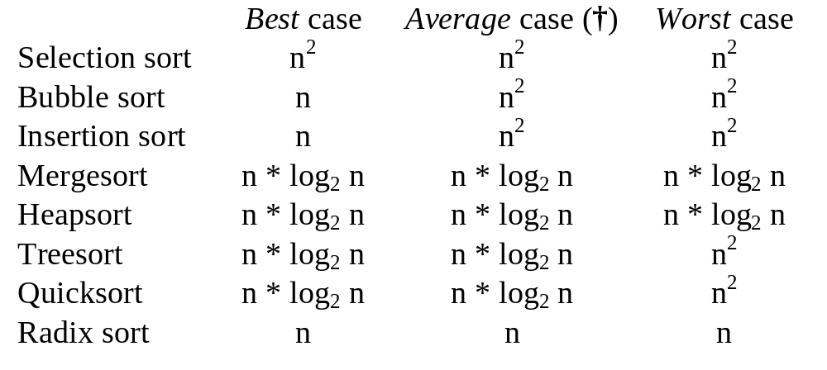
Growth Rates for Selected Sorting Algorithms
† According to Knuth, the average growth rate of Insertion sort is about 0.9 times that of Selection sort and about 0.4 times that of Bubble Sort. Also, the average growth rate of Quicksort is about 0.74 times that of Mergesort and about 0.5 times that of Heapsort.

