Slide 1
Final Project
Predicting Home Sale Price Using ML in Montgomery County, MD

Slide 2
Problem Statement
Why This Problem
Predict the sale price of a house in Montgomery County, MD based on a variety of attributes
Has practical applications - a web application could be created for potential buyers to predict fair market price of houses on sale
Interesting problem to collect and analyze data - supervised learning can be used easily since prior home sales data is available
Interesting to explore factors affecting home prices
Scale of data is just right. Each year, approximately ~15K houses are sold in Montgomery County, MD
Montgomery County, MD is a diverse geographical location covering all types of communities such as rural, suburban and urban with a total population of around 1M. This would eliminate any potential biases from analysis

Slide 3
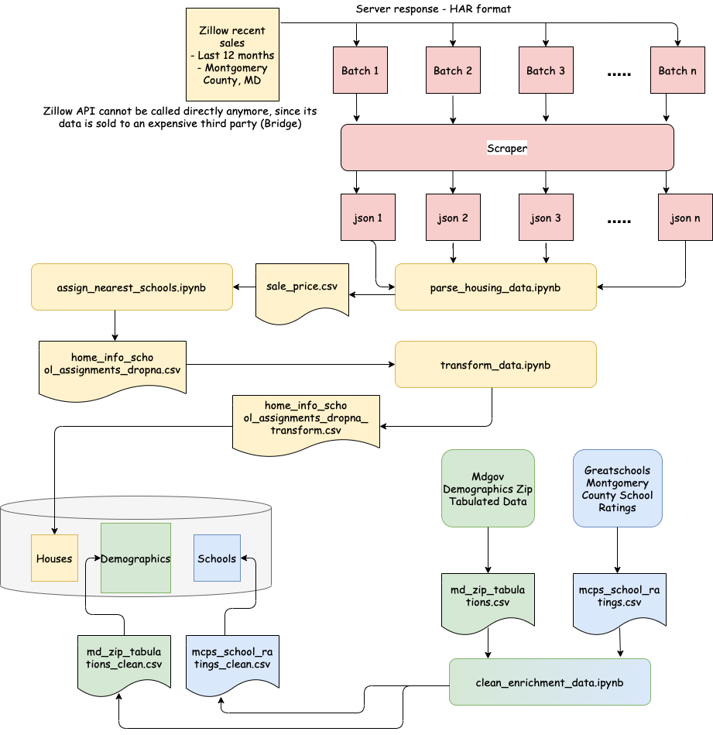
Data Collection

Slide 4
Questions To Be Answered
01
02
03
TYPICAL SALE PRICE
DOMINANT FACTORS
MODEL ACCURACY
04
05
06
OUTLIERS
FURTHER IMPROVEMENTS
PATTERNS
What is the typical sale price in Montgomery County, MD
What are the most dominant factors affecting the sale price
Have we collected enough attributes to be able to make accurate predictions?
If there are outliers, what causes them?
Can we collect further enrichment data to increase the model accuracy?
Can we uncover some other patterns outside of our stated problem?

Slide 5
Data Exploration
Location (lat, lng) → for visualization
School Location → for visualization
Zipcode → for matching
Sale price → target
Name → for matching
% ethnic breakdown
# bedrooms, bathrooms → feature
Type → Elementary, middle, high
Area, lot size in sq feet → feature
~75 zipcodes with ethnic breakdown
Rating → matched column
House type, year built → feature
~200 total schools with their ratings data
Elementary, middle, high school rating → feature
% ethnicities in zipcode → feature
~15K data points spanning the time interval from Q3 2020 to Q3 2021 (ongoing)

Slide 6
Preliminary Data Analysis
 | Without School Ratings Enrichment | With School Ratings Enrichment
Multiple Linear Regression | R² = 0.38 | R² = 0.76
Random Forrest (3 Features) | R² = 0.58 | R² = 0.85
Random Forrest (30 Features) | R² = 0.62 | R² = 0.88
And still going strong!

Slide 7
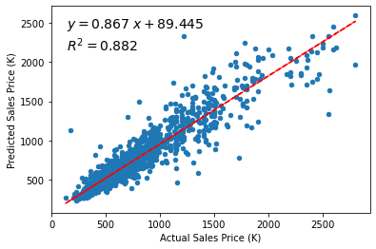
The best predictive model is nearly 88% accurate!

Slide 8
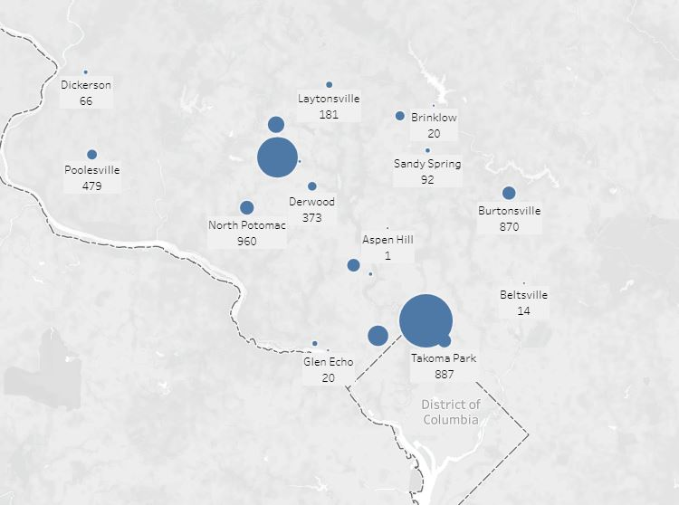
In this project we have utilized Tableau as a visualization tool
Data Analysis

Slide 9
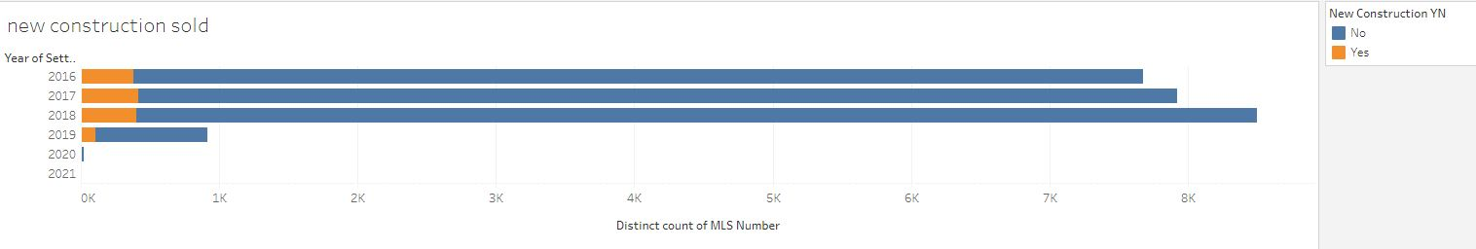
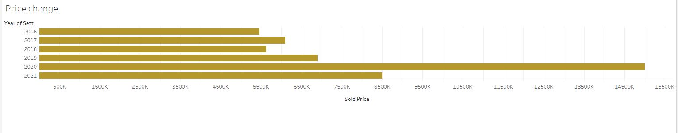

Slide 10
