Slide 1
Dashboard
File created on: 9/19/2021 8:46:54 PM

Slide 2
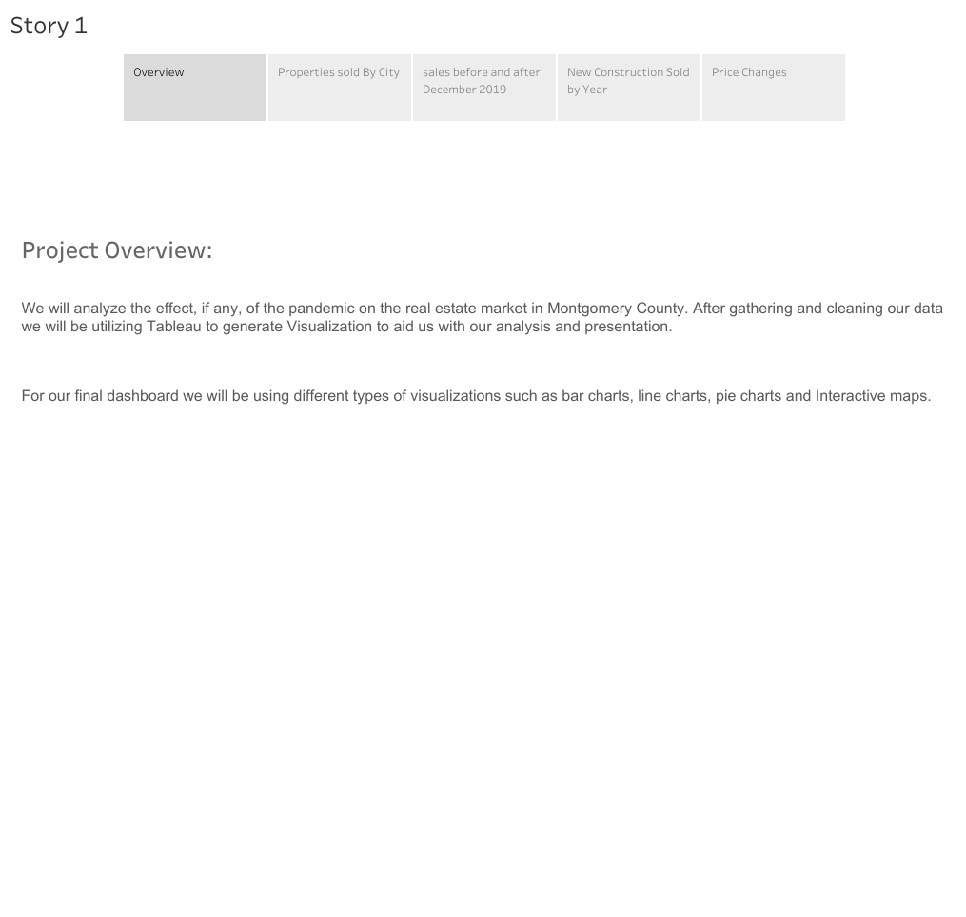

Slide 3
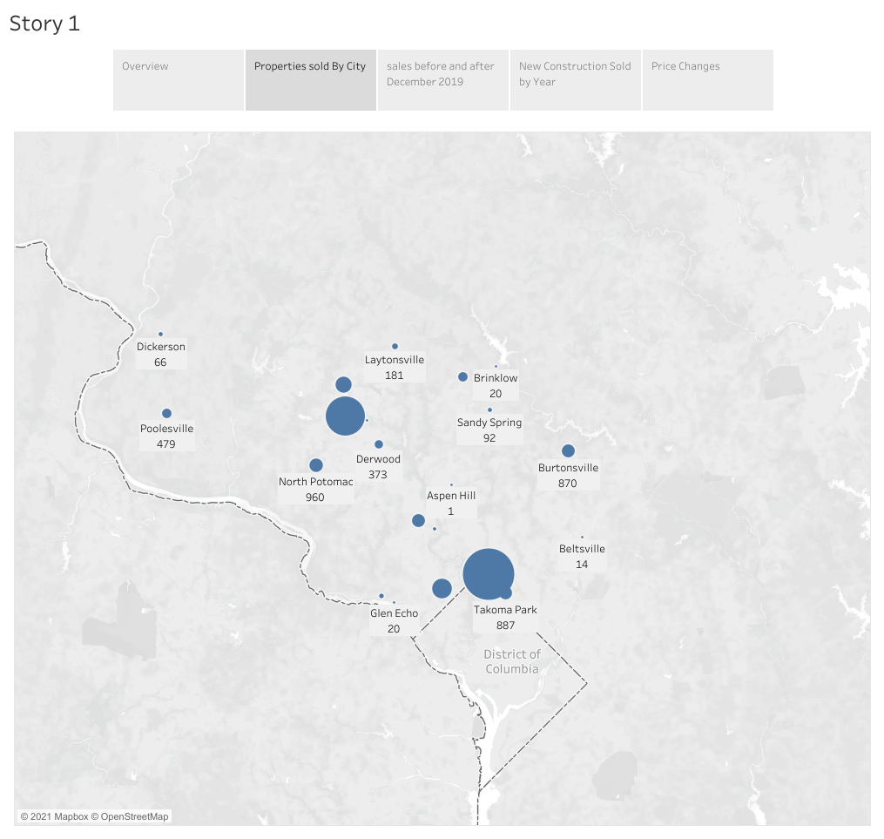

Slide 4
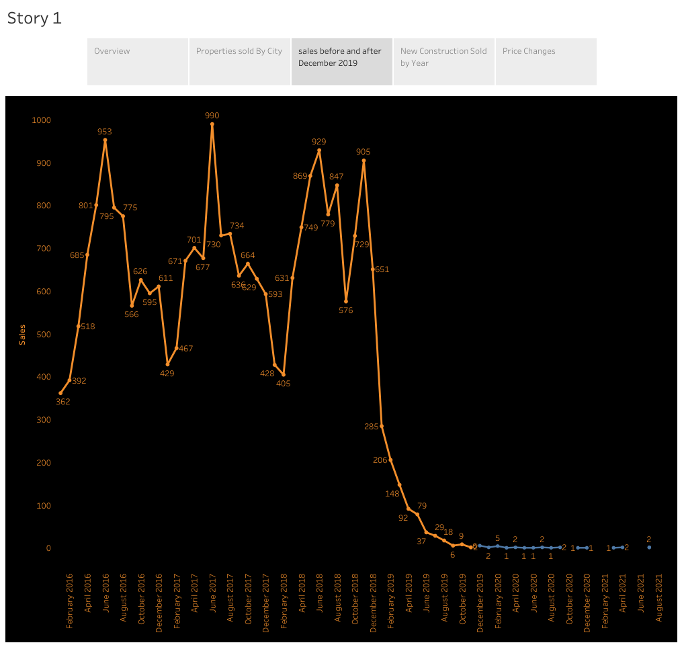

Slide 5
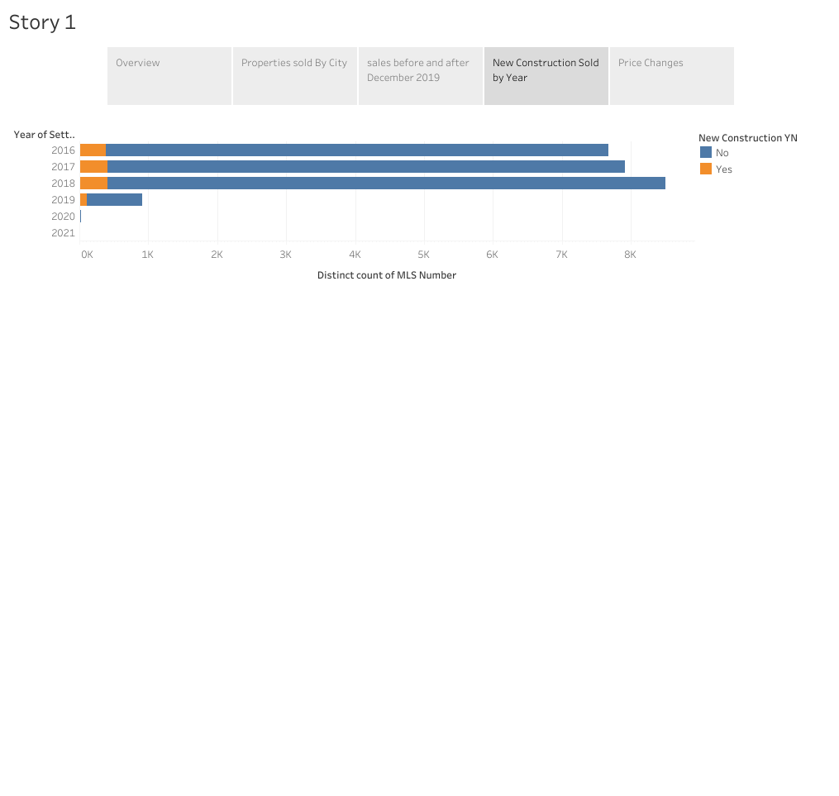

Slide 6
