Slide 1
Virtual Reality 3D Scanning
Senior Thesis
Nikhilesh Sigatapu, 2015
Advised by Thomas Funkhouser
Notes:
Hey everyone, I’m Nikhilesh. My advisor is Thomas Funkhouser, and today I will be giving a proposal for my senior thesis project.

Slide 2
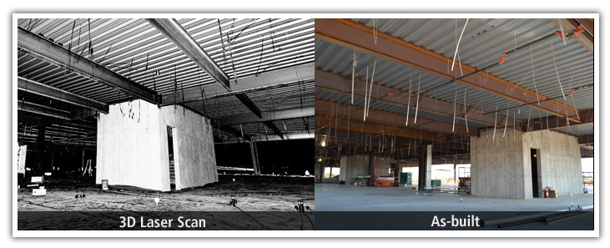
3d scanning
Collect data on real-world 3d shape, material
Could be object, person, environment, ...

Slide 3
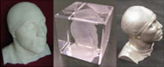
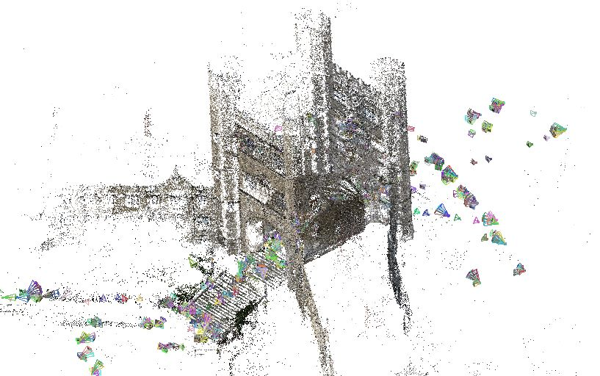
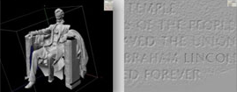
Motivation
3d scanning is useful:
Visualization: online catalog, tourism, tour monuments for education
Entertainment: characters, environments for games, movies
Inspection: compare parts to ideal models
Replication: scaling, restoration
Blair Arch
Lincoln Memorial

Slide 4
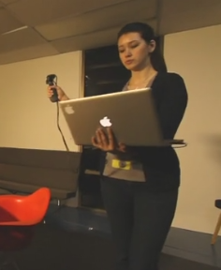
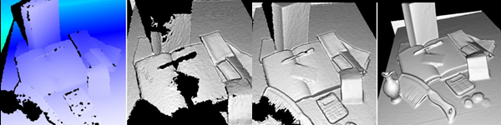
Problem
3d scanning is tricky:
Holes: crevices, under objects etc.
Devices clumsy to use
Need real-time feedback
Matterport scanner:
Carry a laptop around
Holes in Kinect scans

Slide 5
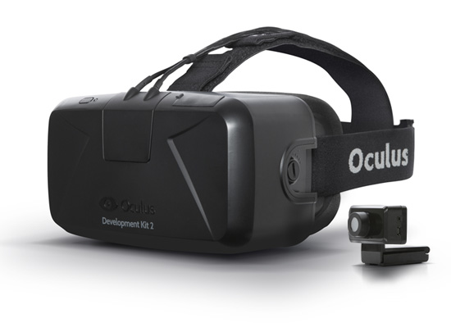
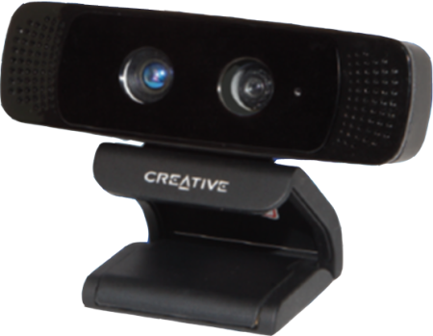
Idea
Head mounted scanner, VR + depth camera
Show real-time preview while scanning
Look around to direct scanner
+

Slide 6
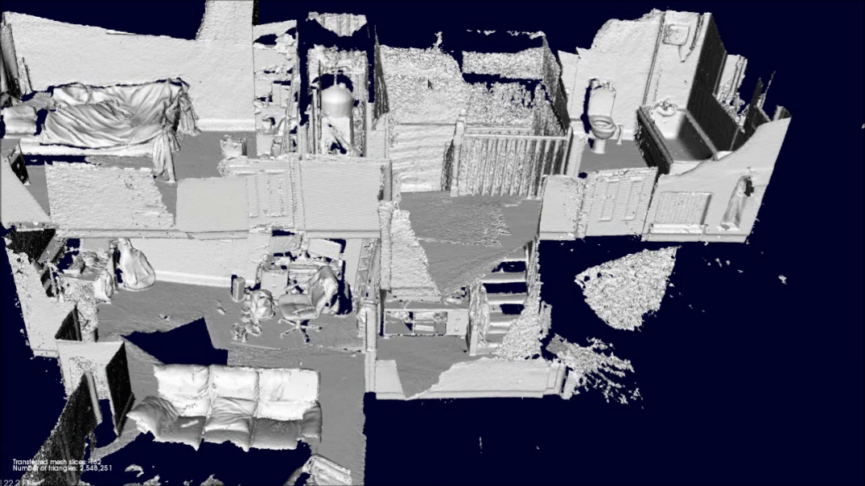
Background
Lots of research separately in VR, 3d scanning
Scanning: "Kintinuous: Spatially Extended KinectFusion" by T. Whelan, M. Kaess, M.F. Fallon, H. Johannsson, J.J. Leonard and J.B. McDonald: can scan large environments

Slide 7
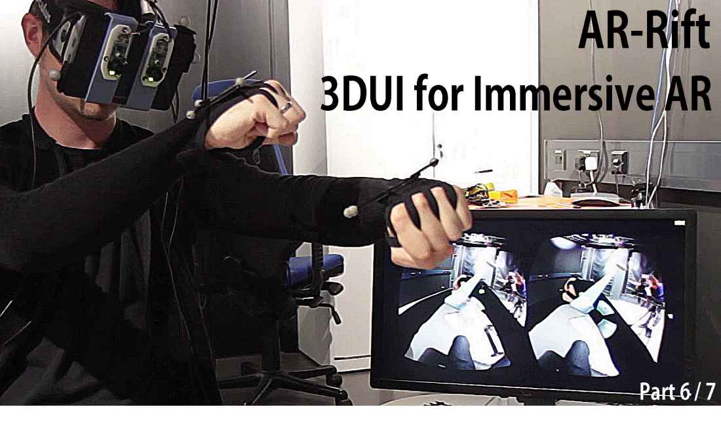
Background
Lots of research separately in VR, 3d scanning
Oculus + video: "AR-Rift" by William Steptoe: capture video, display in Oculus for ‘see-through,’ tracks hand markers

Slide 8
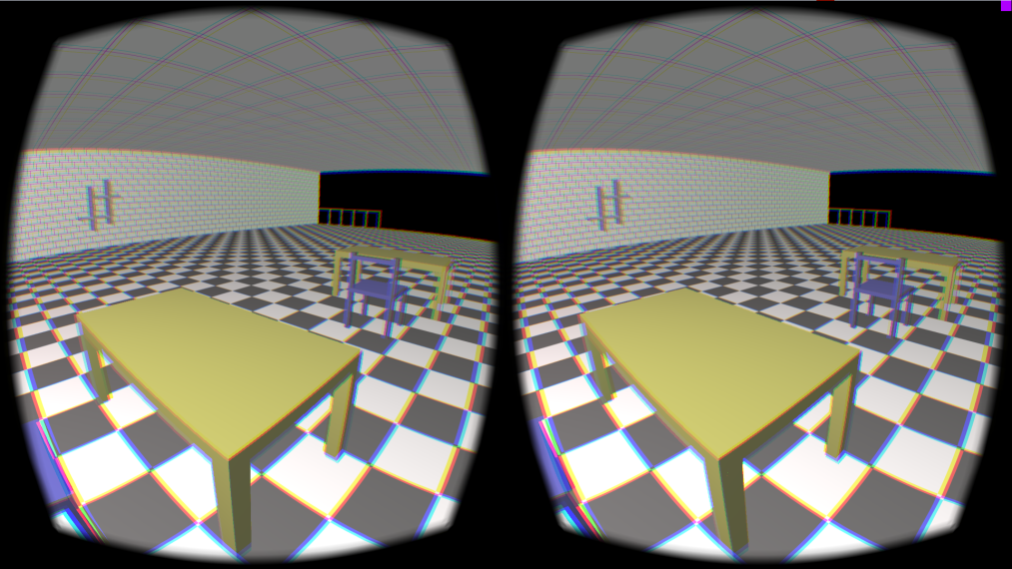
Progress
Acquired Oculus Rift hardware
Compiled, tested basic scene with head tracking using Oculus C API
Acquired prototype Intel depth camera (haven’t tested API yet)

Slide 9
Plan/Goals
Short term (~1 month):
Get depth camera API working
Develop VR point cloud viewer
This semester:
Integrate depth camera, Oculus APIs
Mount depth camera on Oculus
Integrate Oculus motion tracking with depth data
Next semester:
Deal with latency issues
Try real-time video overlay?
Extended motion tracking (beyond desk)?

Slide 10
Picture sources
http://mep.trimble.com/services/3d-laser-scanning-service
http://www.dirdim.com/lm_everything.htm
Bair Arch scan by David Dohan, 2015
http://msdn.microsoft.com/en-us/library/dn188670.aspx
http://www.gizmag.com/matterport-3d-scanner/22118/
https://www.oculus.com/order/
http://www.fabbaloo.com/blog/2013/9/7/expect-superior-3d-depth-cameras-in-2014.html

