Slide 1

Empowerment That
Values All (EVA)
Final Presentation
27 April, 2026
Nikki Dong | Muhammad Shahpur Sheraz | Derek Fuls | Ishan Patel
1 / 10

Slide 2
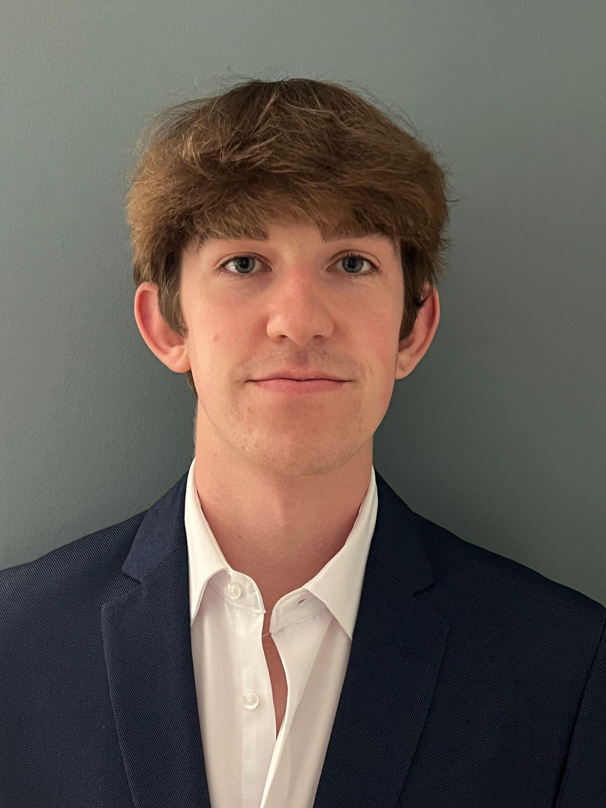
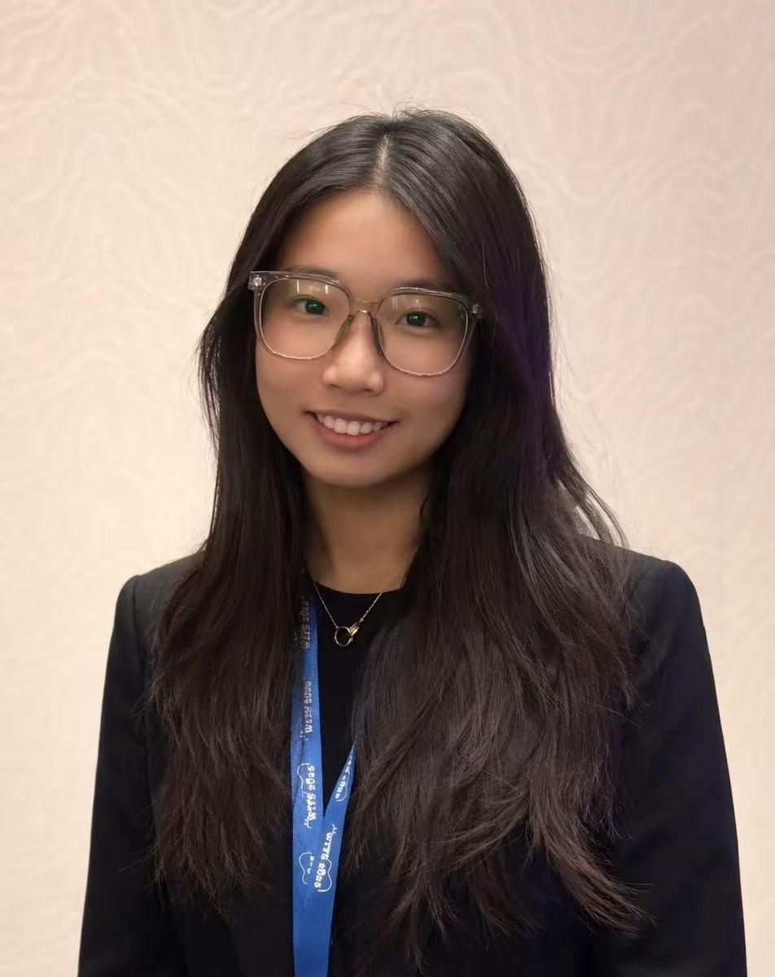
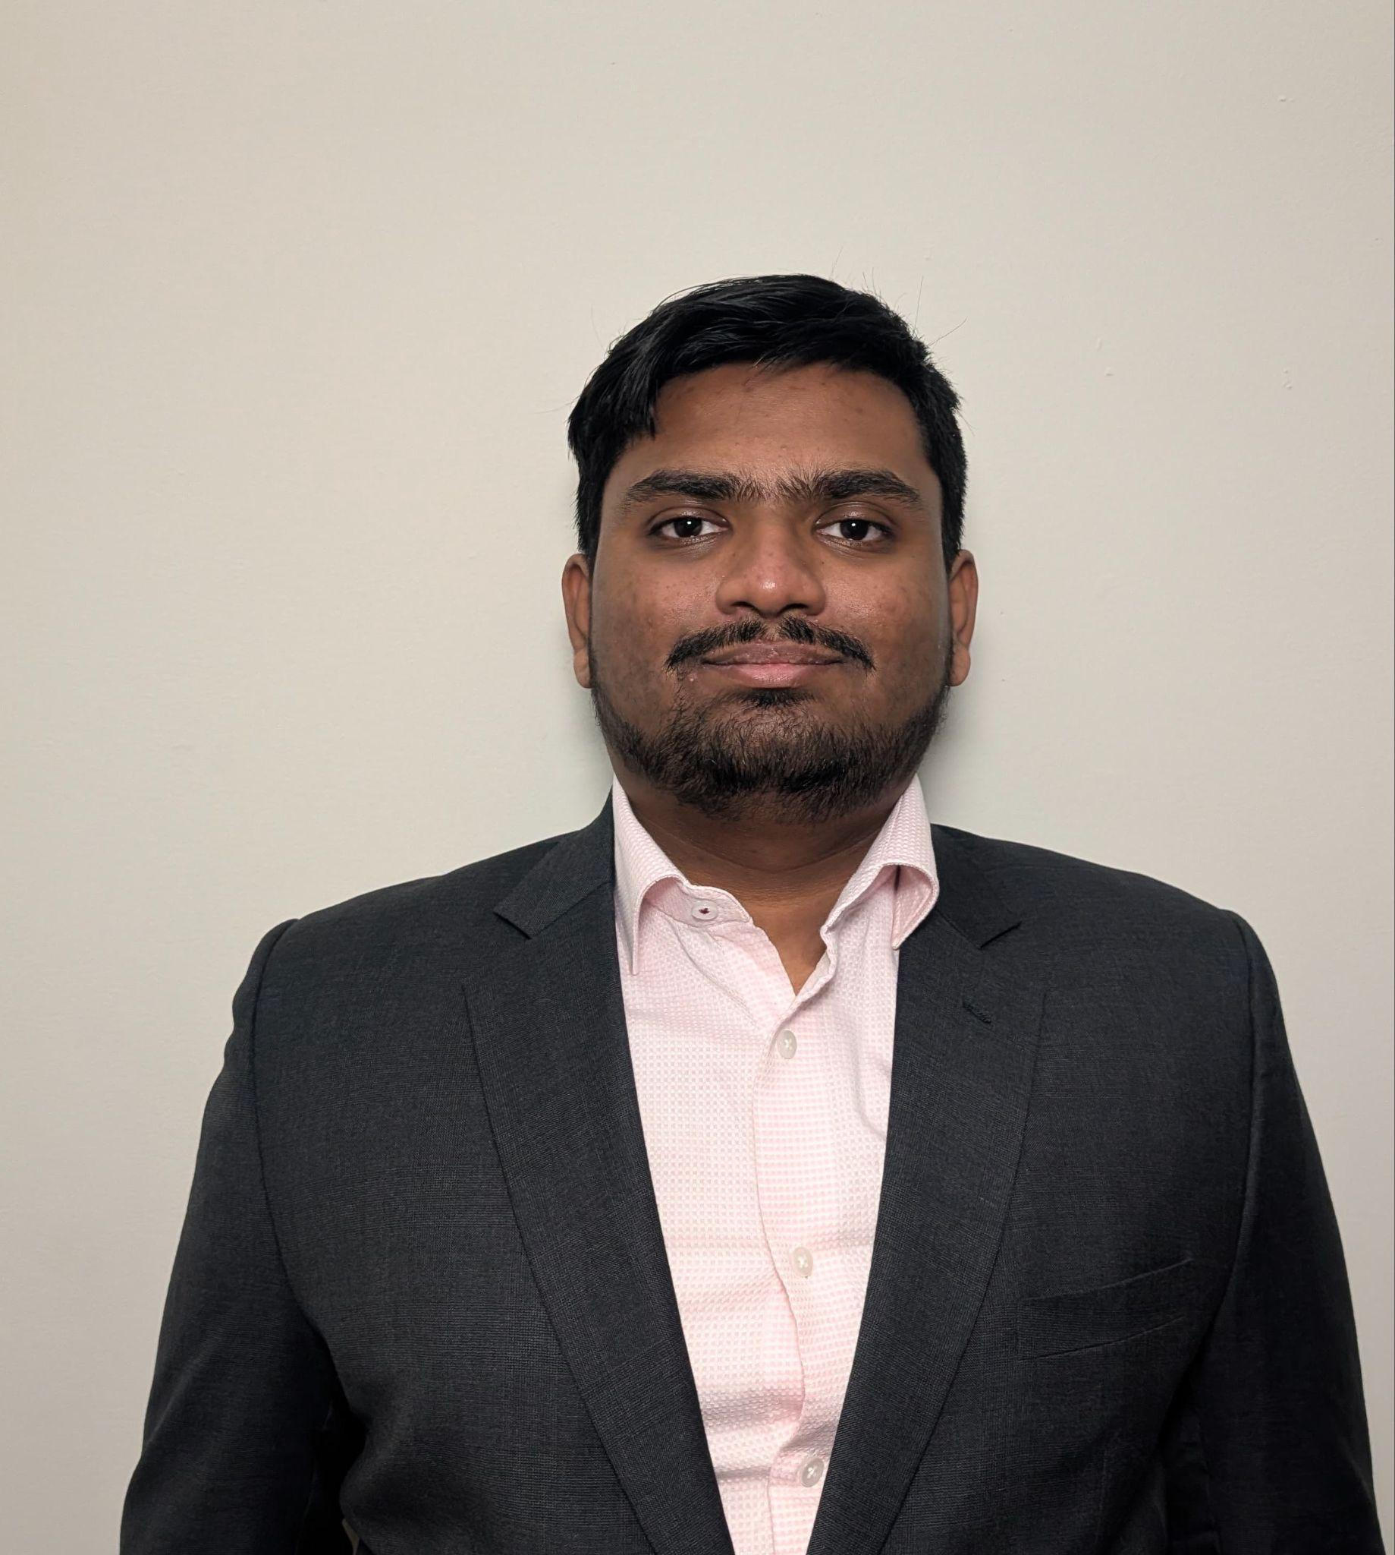
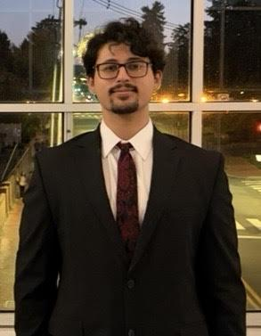
Team Introduction
Derek Fuls
Nikki Dong
Ishan Patel
Muhammad Shahpur Sheraz
Major: Accounting & MIS
Major: MIS
Major: Management Information Systems
Major: Management Information Systems
Minor: Business Analytics
2 / 10

Slide 3
Agenda Overview
01
PROJECT CONTEXT & SUCCESS CRITERIA (Derek)
02
SOLUTION DELIVERY & IMPLEMENTATION (Ishan)
03
LIVE DEMONSTRATION (Nikki)
04
RESULTS & IMPACT (Shah)
05
FUTURE ROADMAP & HANDOFF (Shah)
06
Q&A (Derek)
3 / 10

Slide 4
Project Context
Overview of Problem
Goal
Our Approach
Expected Impact
EVA’s previous site did not reflect the quality of its coaching work, weakening credibility with prospective clients and limiting lead capture.
Design and deliver a responsive, professional prototype website that clearly presents EVA’s services and positions the brand for long-term growth.
A React/Vite prototype refined iteratively with Troy and version-controlled on GitHub, built to hand off and evolve.
A credible digital front door that builds trust, guides visitors to Contact, and supports future SEO and lead-capture growth.
4 / 10
Notes:
Derek

Slide 5
Project Context - Success Criteria
Increased Traffic
Increased User Engagement
Enhanced User Experience
Stronger Brand Credibility
SEO-ready structure in place (semantic HTML, page titles, meta descriptions) to support measurable traffic growth after launch.
Every key page leads visitors to a clear call-to-action; Contact reachable in two clicks or fewer from any page.
Fully responsive on desktop and mobile, with consistent navigation and page loads under 3 seconds.
Visual design, copy, and service presentation reviewed by EVA leadership and signed off as premium-brand ready.
5 / 10
Notes:
Derek

Slide 6
SOLUTION DELIVERY & IMPLEMENTATION
Implemented Solution
Technical Structure
Key Features
Challenges & Execution
Responsive, multi-section prototype website built with React, TypeScript, and Vite — designed to improve visibility, strengthen credibility, and deliver a professional digital experience.
React + TypeScript + Vite on GitHub Pages. Component-based pages: Home, About, Services, Testimonials, Blog, Contact — shared styles keep updates low-effort.
https://github.com/nikkiDong/EVA.git
Responsive layout for desktop and mobile
Clear service presentation and structured content flow
Testimonials and blog sections for trust and engagement
Contact pathway for client inquiries and communication
Platform strategy — shipped React/Vite prototype; recommending Squarespace for long-term client maintenance.
Content clarity — iterated service messaging with Troy to match EVA’s premium brand voice.
Visual consistency — shared style tokens prevent drift.
6 / 10

Slide 7
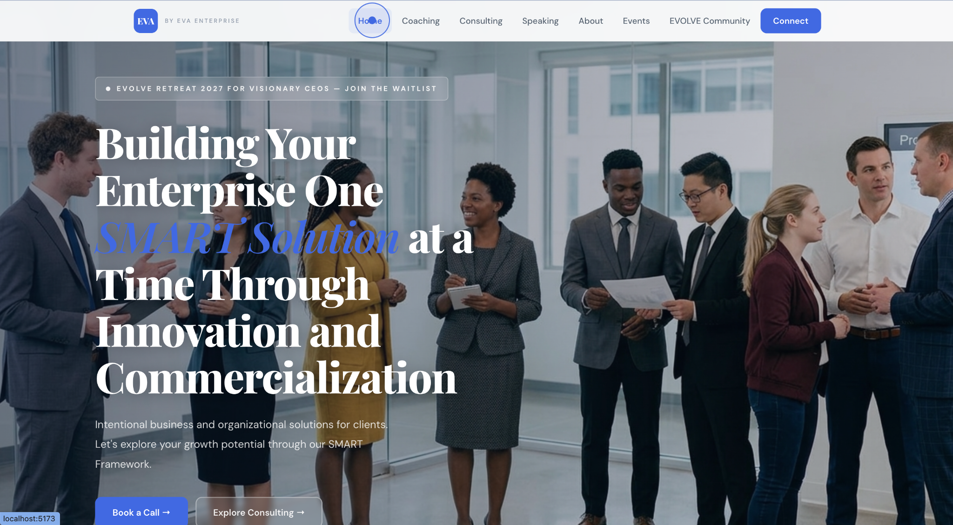
Live Demo (Nikki)
https://nikkidong.github.io/
7 / 10
Notes:
Demo script (target: 3 minutes):
1. Land on the Home page. Call out the hero message and premium visual tone vs. the old site (which was a flat single page with no CTA).
2. Scroll to Services: narrate how the structured layout makes EVA’s coaching offerings easy to scan.
3. Open Testimonials: highlight trust-building. Then jump to Blog to show the content surface for SEO.
4. Click through to Contact in two clicks from any page. Emphasize the clear pathway to inquiry, something the old site lacked.
5. Resize the browser (or show on phone) to demonstrate responsive design on mobile.
Before vs. After talking points:
Navigation: flat single page → six-section structured site. Mobile: unoptimized layout → fully responsive. CTA: none → clear Contact pathway on every page. Brand: inconsistent → premium and credible.

Slide 8
Results and Impact (Shah)
Success Criteria: Target vs. Delivered
All four criteria met at handoff: SEO-ready structure, clear CTAs with Contact in two clicks, responsive sub-3s loads, premium-brand design signed off by EVA.
Client Feedback & Business Impact
Client feedback from Troy on the prototype: “Great work.”
Stronger first impression that builds trust and supports future client acquisition
Clearer path to Contact; SEO foundation for future lead capture
.
1
Deliverables
GitHub repo + live React/TS/Vite prototype at nikkidong.github.io
EVA User Manual, Execution Plan, and Content Questionnaire
Component-based architecture for easy evolution or Squarespace migration
2
3
8 / 10
Notes:
“In closing, our team’s goal was not just to redesign a website visually, but to create a stronger digital experience that supports EVA’s business goals. The prototype improves how EVA presents its services, builds trust with prospective clients, and creates a more scalable platform for future growth. Overall, this project positions EVA with a more professional and strategic online presence.”
“EVA now has a stronger digital foundation to support credibility, client engagement, and future scale.”

Slide 9
FUTURE ROADMAP & HANDOFF (Shah)
Next Steps
Mid-Term Enhancements
Long Term Opportunities
Handoff Deliverables
Migrate prototype to Squarespace for client-maintainable production hosting
Finalize real content, testimonials, and client imagery; replace placeholders
Connect Mailchimp for Connect form and CEO Visionary Waitlist signups
Add confidentiality disclaimer, configure custom domain, and enable analytics
Expand blog and case study library for stronger SEO and credibility
Add deeper service comparison and clearer client self-qualification flows
Strengthen lead capture with CRM or email automation integration
Refine calls to action based on user behavior and engagement data
Launch membership or client portal functionality
Add e commerce/payment workflows for events, products, or digital offerings
Integrate resource hub, session recordings, and client progress tracking
Scale the platform into a more complete coaching ecosystem
GitHub repository with full source code and deploy pipeline
Live React/TypeScript/Vite prototype hosted on GitHub Pages
Component-based structure for low-effort content updates
User Manual, Execution Plan, and Content Questionnaire for the EVA team
User manual
https://docs.google.com/document/d/1pRTx7SAHvkRElRwNqvwGYUS7p8oUE9sD/edit
9 / 10
Notes:
Going forward, EVA can treat this project as a scalable foundation rather than a finished endpoint. In the short term, the focus is launching with finalized content, integrations, and analytics. In the mid term, EVA can expand content strategy and lead capture to improve conversion. In the long term, the site can evolve into a broader coaching platform with portal and e-commerce capabilities. Our handoff includes the repository, deployable prototype, and a structure that makes future updates more manageable

Slide 10
EVA
THANK YOU
Questions?
27 April, 2026
Nikki Dong | Muhammad Shahpur Sheraz | Derek Fuls | Ishan Patel
10 / 10

