Slide 1

HACK KRMU 5.0
Problem Statement ID :
Open Innovation (Women Safety)
Team Name :
CodeBloodedX
TEAM ID : TEAM MEMBERS :
HK-130
Nikki Chauhan
Piyush
Mohini Chauhan
1
01

Slide 2
HACK KRMU 5.0
Problem & SOLUTION
Problem
CURRENT SAFETY SOLUTIONS MAINLY FOCUS ON SENDING SOS ALERTS AFTER AN EMERGENCY OCCURS BUT FAIL TO PROTECT REAL-TIME EVIDENCE.
IN REAL-WORLD INCIDENTS, CRITICAL VIDEO, AUDIO, AND LOCATION DATA CAN BE LOST IF DEVICES ARE DAMAGED, TAKEN, OR TAMPERED WITH.
ADDITIONALLY, MOST SAFETY SYSTEMS DO NOT HELP USERS DURING RISKY SITUATIONS BEFORE AN EMERGENCY ACTUALLY HAPPENS.
Solution
  Pre-travel safety analysis of selected destination
  Suggests Safest Route (not just shortest route)
  Real-time risk alerts for unsafe areas
  Secret SOS-triggered video & audio recording
  Encrypted cloud evidence storage
  Instant live location sharing with trusted contacts
  Automatic call & SMS to nearest women helpline & police
  Enables real-time monitoring through a dashboard with emergency status and evidence timeline
2
02

Slide 3
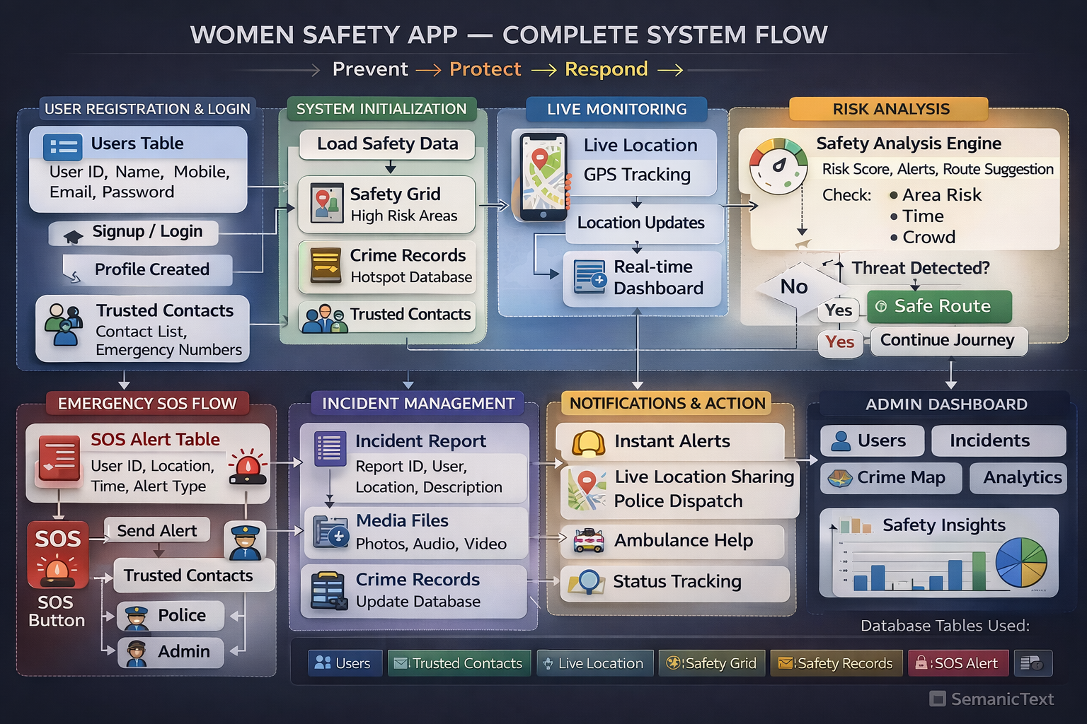
HACK KRMU 5.0
Flow of Solution
3
03

Slide 4
HACK KRMU 5.0
TECH STACK & APPROACH
Tech Stack
  Frontend: Android Mobile App (Kotlin)
  Backend: Supabase
  Database: PostgreSQL (Supabase)
  Cloud Storage: Supabase Storage (Encrypted files)
  Authentication: Supabase Auth
  Location & Maps: Google Maps API
  Encryption: Secure file encryption before upload
Approach
  Risk-based route analysis instead of distance-based routing
  Real-time monitoring system
  Automated emergency response mechanism
  End-to-end encrypted evidence storage
  Scalable architecture for smart cities integration
4
04

Slide 5
HACK KRMU 5.0
UNIQUENESS & INNOVATION FACTOR
What Makes AdiShakti Different?
  Shifts safety from reactive SOS response to proactive danger prevention
  Integrates pre-risk monitoring and emergency evidence protection in one platform
  Real-time cloud upload of video, audio, and location during recording
  Tamper-resistant evidence storage with timestamp and GPS tagging
  Suggests safest route instead of shortest route
  Pre-travel risk alerts before entering unsafe areas
  Stealth emergency activation using secret triggers (volume hold / gesture)
  Fully automatic emergency response system
  Live location sharing with trusted contacts
  Auto-call and SMS to nearest women helpline and police
  Encrypted cloud-based evidence storage
  Works even if device is damaged, lost, or taken
  Covers complete safety lifecycle: Prevention → Protection → Proof
5
05

Slide 6
HACK KRMU 5.0
Feasibility & Challenges
Feasibility
  Built using Kotlin (Android-native) → Highly practical & implementable
  Supabase backend → Scalable cloud infrastructure
  No experimental or untested hardware required — works on standard Android smartphones
  Can be developed and deployed quickly as a working MVP
  Cloud-based architecture allows easy scaling as users increase
Challenges
• Ensuring real-time cloud upload with unstable or low internet connectivity
• Managing high storage and bandwidth costs for continuous video recording
• Maintaining strong data encryption while keeping system performance fast
• Preventing false triggers in automatic emergency detection
• Ensuring user privacy and compliance with data protection regulations
• Battery optimization during background recording and GPS tracking
• Handling device-level restrictions on background services (Android limitations)
• Securing cloud storage against cyberattacks or unauthorized access
• Integrating with police and emergency helpline systems across different regions
• Achieving user trust and adoption for continuous monitoring features
• Scaling infrastructure as user base increases
• Supporting multi-language and region-specific safety data integration
Challenges
• Ensuring real-time cloud upload during low or unstable internet connectivity
• Managing high storage and bandwidth costs for continuous recording
• Maintaining strong data encryption while ensuring fast system performance
• Preventing false triggers in automatic emergency detection
• Battery optimization for continuous background recording and GPS tracking
• Integrating effectively with police and emergency helpline systems
• Securing cloud infrastructure against cyberattacks and unauthorized access
6
06

Slide 7
HACK KRMU 5.0
Research & Reference
Research Base
  National Crime Records Bureau (NCRB) crime reports
  Women safety research studies on predictive analytics
  Smart city surveillance systems research
  Emergency response automation systems
Technical References
  Google Maps API Documentation
  Supabase Official Documentation
  Android (Kotlin) Developer Documentation
  Data encryption & cybersecurity research papers
7
07

