Slide 1
DBMS SQL-Join

Slide 2
A SQL Join statement is used to combine data or rows from two or more tables based on a common field between them.

Slide 3
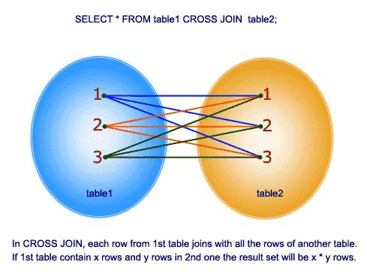
CROSS JOIN
The SQL CROSS JOIN produces a result set which is the number of rows in the first table multiplied by the number of rows in the second table if no WHERE clause is used along with CROSS JOIN. This kind of result is called as Cartesian Product.
If WHERE clause is used with CROSS JOIN, it functions like an INNER JOIN.
SELECT * FROM table1 CROSS JOIN table2;
OR
SELECT foods.item_name,foods.item_unit, company.company_name,company.company_city FROM foods,company;

Slide 4
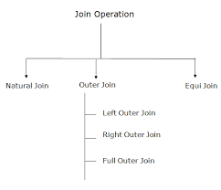

Slide 5
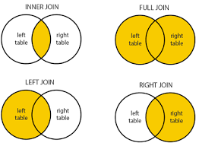

Slide 6
INNER JOIN
The INNER JOIN keyword selects all rows from both the tables as long as the condition satisfies.
This keyword will create the result-set by combining all rows from both the tables where the condition satisfies i.e value of the common field will be same.

Slide 7
Syntax
SELECT table1.column1, table1.column2, table2.column1,....
FROM table1 INNER JOIN table2
ON
table1.matching_column = table2.matching_column;
table1: First table.
table2: Second table
matching_column: Column common to both the tables.

Slide 8
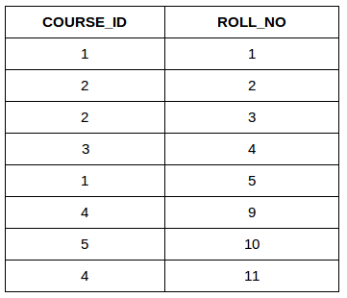
StudentCourse

Slide 9
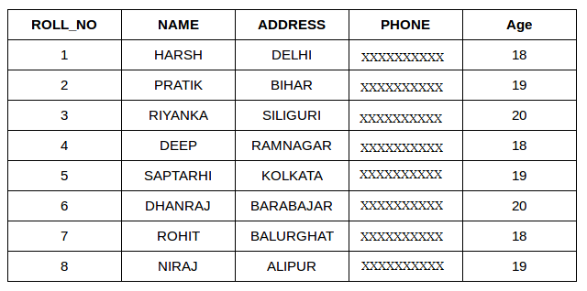
Student

Slide 10
SELECT StudentCourse.COURSE_ID, Student.NAME, Student.AGE FROM Student INNER JOIN StudentCourse
ON
Student.ROLL_NO = StudentCourse.ROLL_NO;

Slide 11
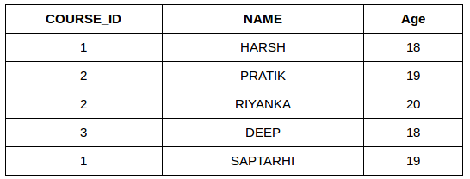
OUTPUT:

Slide 12
Natural Join
The SQL NATURAL JOIN is a type of EQUI JOIN and is structured in such a way that, columns with the same name of associated tables will appear once only.
Natural Join: Guidelines
- The associated tables have one or more pairs of identically named columns. - The columns must be the same data type. - Don’t use ON clause in a natural join.
SELECT * FROM table1 NATURAL JOIN table2;
SELECT * FROM foods NATURAL JOIN company;
COMPANY_ID ITEM_ID ITEM_NAME ITEM_UNIT COMPANY_NAME COMPANY_CITY ---------- ---------- ------------------------- ---------- ------------------------- -------------- 16 1 Chex Mix Pcs Akas Foods Delhi 15 6 Cheez-It Pcs Jack Hill Ltd London 15 2 BN Biscuit Pcs Jack Hill Ltd London 17 3 Mighty Munch Pcs Foodies. London 15 4 Pot Rice Pcs Jack Hill Ltd London 18 5 Jaffa Cakes Pcs Order All Boston

Slide 13
LEFT JOIN
This join returns all the rows of the table on the left side of the join and matching rows for the table on the right side of join.
The rows for which there is no matching row on right side, the result-set will contain null.
LEFT JOIN is also known as LEFT OUTER JOIN.

Slide 14
EG:
SELECT Student.NAME, StudentCourse.COURSE_ID
FROM Student LEFT JOIN StudentCourse
ON
StudentCourse.ROLL_NO = Student.ROLL_NO;

Slide 15
Syntax:
SELECT table1.column1, table1.column2, table2.column1,....
FROM table1 LEFT JOIN table2
ON
table1.matching_column = table2.matching_column;
table1: First table.
table2: Second table
matching_column: Column common to both the tables.

Slide 16
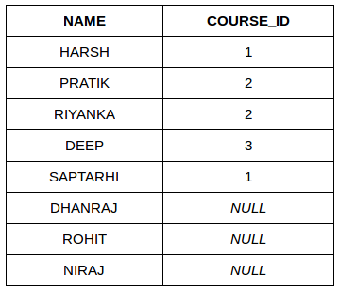

Slide 17
RIGHT JOIN:
RIGHT JOIN is similar to LEFT JOIN. This join returns all the rows of the table on the right side of the join and matching rows for the table on the left side of join.
The rows for which there is no matching row on left side, the result-set will contain null. RIGHT JOIN is also known as RIGHT OUTER JOIN.

Slide 18
SELECT table1.column1,table1.column2,table2.column1,....
FROM table1 RIGHT JOIN table2
ON
table1.matching_column = table2.matching_column;
table1: First table.
table2: Second table
matching_column: Column common to both the tables.

Slide 19
SELECT Student.NAME,StudentCourse.COURSE_ID
FROM Student RIGHT JOIN StudentCourse
ON
StudentCourse.ROLL_NO = Student.ROLL_NO;

Slide 20
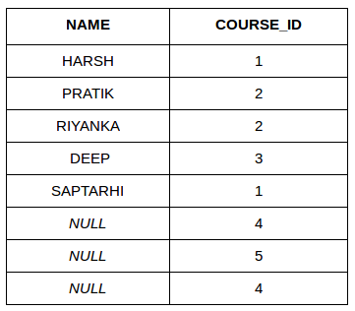

Slide 21
FULL JOIN
FULL JOIN creates the result-set by combining result of both LEFT JOIN and RIGHT JOIN.
The result-set will contain all the rows from both the tables.
The rows for which there is no matching, the result-set will contain NULL values

Slide 22
SELECT able1.column1,table1.column2,table2.column1,....
FROM table1 FULL JOIN table2
ON
table1.matching_column = table2.matching_column;
table1: First table.
table2: Second table
matching_column: Column common to both the tables.

Slide 23
SELECT Student.NAME,StudentCourse.COURSE_ID
FROM Student FULL JOIN StudentCourse
ON
StudentCourse.ROLL_NO = Student.ROLL_NO;

Slide 24
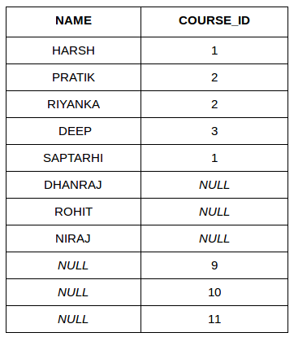

Slide 25
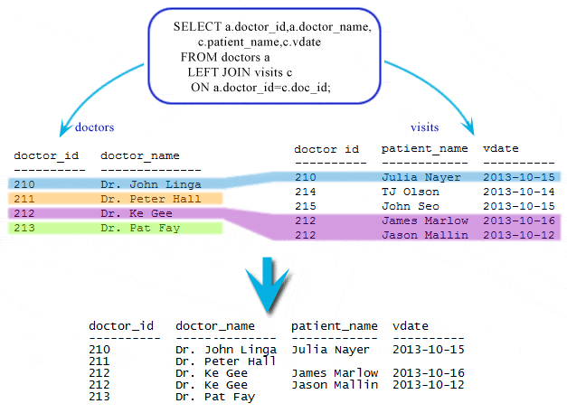

Slide 26
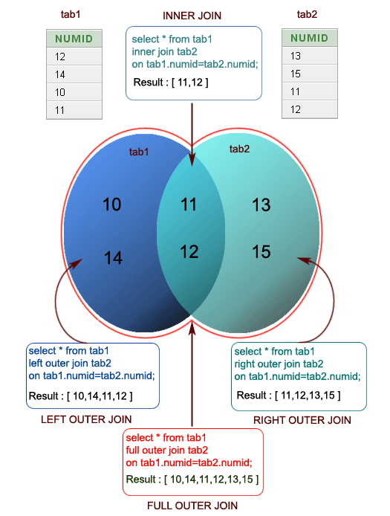

Slide 27
Self join
Join a table to itself
A SELF JOIN is another type of join in SQL which is used to join a table to itself, especially when the table has a FOREIGN KEY which references its own PRIMARY KEY.
In this join, the participating table appears twice after the FROM clause and is followed by aliases for the tables that qualify column names in the join condition
In this join, those rows are returned from the table which are satisfying the conditions.
+------------+---------------+--------------+ | COMPANY_ID | COMPANY_NAME | COMPANY_CITY | +------------+---------------+--------------+ | 18 | Order All | Boston | | 15 | Jack Hill Ltd | London | | 16 | Akas Foods | Delhi | | 17 | Foodies. | London | | 19 | sip-n-Bite. | New York | +------------+---------------+--------------+

Slide 28
Self Join
To get 'company_name' and 'company_city' from 'company' table which is entitled as alias 'a' and 'company_name' form 'company' table which is entitled as alias 'b' after an SELF JOINING with a table itself, the following SQL statement can be used:
SELECT a.company_name,b.company_name,a.company_city FROM company a, company b WHERE a.company_city=b.company_city;
COMPANY_NAME COMPANY_NAME COMPANY_CITY ------------------------- ------------------------- ------------- Order All Order All Boston Foodies. Jack Hill Ltd London Jack Hill Ltd Jack Hill Ltd London Akas Foods Akas Foods Delhi Foodies. Foodies. London Jack Hill Ltd Foodies. London sip-n-Bite. sip-n-Bite. New York
a.company_city=b.company_city excludes all pairs containing companies of different cities.

Slide 29
Self Join
To get the list of employees and their supervisor the following SQL statement has used:
SELECT a.emp_id AS "Emp_ID",a.emp_name AS "Employee Name", b.emp_id AS "Supervisor ID",b.emp_name AS "Supervisor Name" FROM employee a, employee b WHERE a.emp_supv = b.emp_id;

Slide 30
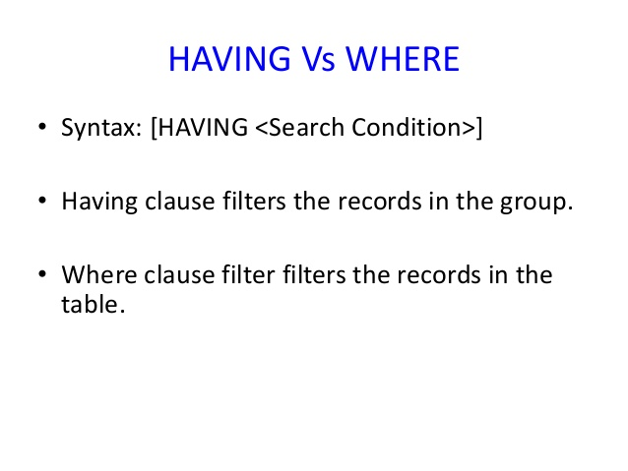

Slide 31
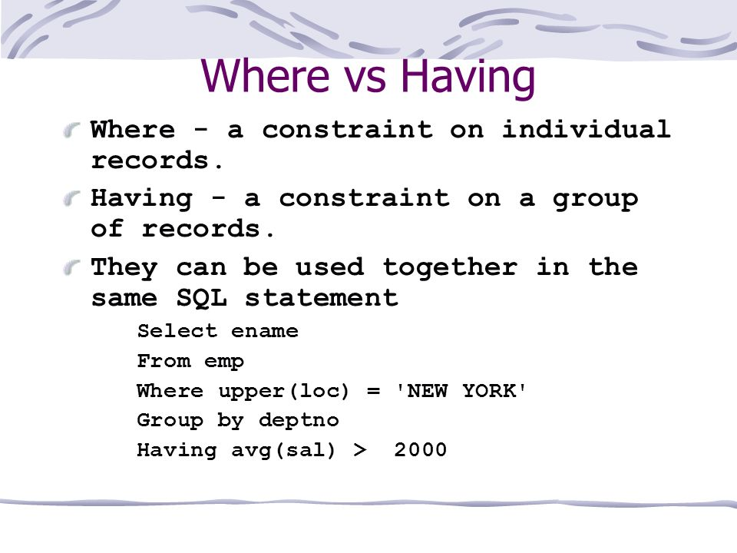

Slide 32
Thank you !

