Slide 1
Resume Sandbox
by David Havrilla, Nicole Lincoln, and Josh White

Slide 2
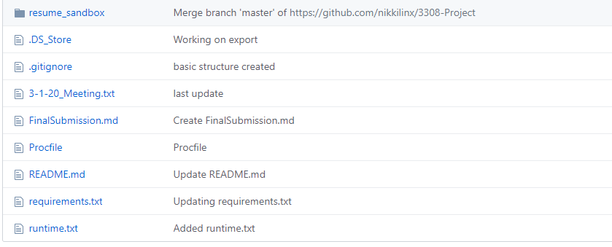
Tools Used:
Framework: Flask/Python
Languages: Python/HTML/CSS
Version Control: Git/GitHub
Project Tracker: Trello
Database: SQLite/PostgreSQL
Testing Environment:
Deployed on Heroku
Nicole Lincoln

Slide 3
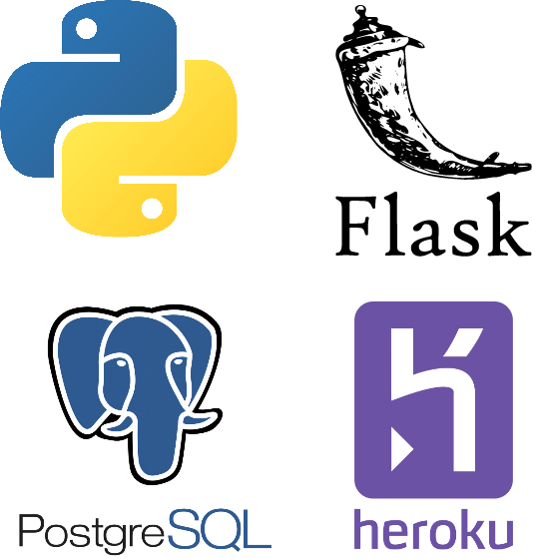
Challenges
Database Choice and Heroku
Psycopg2 and PostgreSQL
Testing Environment
Josh White

Slide 4
Project Demonstration
https://resume-sandbox.herokuapp.com/
Features:
Add Skills and Experience
Download Resume Content
Add Job Postings
David Havrilla

