Slide 1
Pmp study group
Week 1
Concept Review​
Presented by: Nikki Masani

Slide 2




Study Group Session Plan Wednesdays @ 6:30 PM- Hosted on discord
Week 1
Concept Review
Week 2
Open
Forum
Week 3
Mock
Exam
Week 4
Quiz
Challenge
Open time for anything the group would like to cover.
I will choose a Mock Exam to purchase, and we will take it in real time together.
Will create a timed quiz challenge based on concepts covered in week 1. Winner will receive a gift car.
Looking For:
Suggestions
Volunteers to host
Champions for in-person sessions
Will use Andrew’s Udemy course to structure out what concepts will be covered.

Slide 3
Study Group White Board
Click Here to Access

Slide 4
Concepts
Project Management Terms

Slide 5
Project Management Terms

Slide 6
Project
A temporary endeavor that produces a unique product, service, or result
MUST BE TEMPORARY
Temporary in nature and has a definite beginning and ending
MUST BE UNIQUE
This refers to the output. The project itself may not be unique, but it's unique for the customer.
MUST BE PROGGRESSIVELY ELABORATE** <<know this for exam>>
As time progresses, things become more elaborated.
Example: when you're building a house, you may not know exactly how big the rooms should be until further along in the project.
More information will come from stakeholders.
Roll and Wave Planning(a form of progressive elaboration)- A type of project schedule that focuses on iterative work and frequent updates to the project plan. It’s a project planning technique for projects that don’t offer all the data needed to create a plan or schedule up front.

Slide 7
What is a project producing?
Product: Fixing, upgrading, changing, and/or creating a new product for your company.
Service: Providing a new service or fixing, changing, upgrading an existing product. Configuring a new service that your company already offers.
Result: Projects done to test things. Example: Does this drug cure this disease?

Slide 8
Project Management
The application of knowledge, skills, tools, and techniques to satisfy project requirements.
Gather the requirements, know that the project is about. What is it that the stakeholders want? PMs will use their knowledge on different skills, whether it is communication skills, stakeholder management skills, people skills, different tools like expert judgement or different ways of estimating used to get these requirements done.
Examples of what PM’s do:
Preparing a business case to justify the investment.
Estimating resources and times.
Developing and implementing a management plan for the project.
Leading and motivating the project delivery team.
Managing the risks, issues, and changes on the project.
Monitoring progress against plan.
Closing the project in a controlled fashion when appropriate.

Slide 9
Value of projects
What value will this project bring to the company upon completion?
Why should we undertake this project?
What will result from this project?
Money, Brand Reputation, Customer Service, New or Change product or Service
No project should be done if it does not deliver value to that particular business, company, or stakeholders involved in that project.

Slide 10
Operations management
Different than a project since Operations is ongoing(no start date or end date) whereas a project is temporary
Deals with the ongoing production of goods and/or Services
Considers the acquisition, development, and utilization of resources that firms need to deliver the goods and services
Example: Sales Department is in charge of making sales, IT Engineer is in charge of network operations and companies cannot function without either.

Slide 11
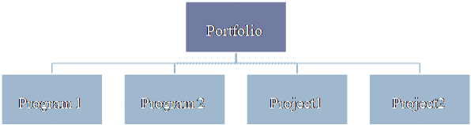
Portfolio management
A portfolio is a collection of projects, programs, subsidiary portfolios, and operations managed as a group to achieve strategic objectives.
A Portfolio Manager manages project managers and program managers.** <<know this for the exam>>
If you're working on a portfolio, it just means that the objectives of your project stays the same, but it's part of a larger portfolio to accomplish a big company goal.
Example: A company has a 3 to 5 year goal of increasing revenue by 50%.
To increase revenue by 50%, they may have to introduce a brand new project, ex: a new car. This would be considered a pretty big project.
Big projects such as these should be broken down to get the benefits that’s needed from managing them individual (aka a Program).
So in order to increase your revenue by 50%, you’re going to need one program to create a brand new product.
Collections of Projects, Programs, subsidiarity Portfolios
Achieve strategic (long term) objectives

Slide 12
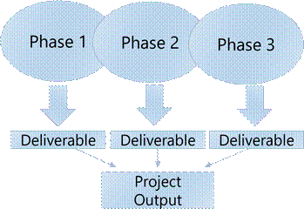
Phases & Deliverables
A phase is a collection of logically related project activities that culminates in the completion of one or more deliverables.
A phase is done to complete a deliverable. When you complete a phase, you have a deliverable.
Project activities that are getting done to complete the project deliverable.
Example: Developing a Software:
Phase 1: Gather the Requirements
Phase 2: Get the Approval to Start
Phase 3: Design the Software
Phase 4: Program the Software
Phase 5: Test the Software
Phase 6: Install the Software
A phase is only completed if you achieve a deliverable at the end of it.
The number of phases depends on the industry type and size and the complexity of the project.

Slide 13
Phases & Deliverables
A deliverable is any unique and verifiable product, service, or result.
A deliverable is what you get at the end of the a phase.
May be tangible or intangible.
Must be accepted by customer or sponsor for the phase.

Slide 14
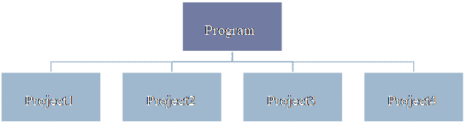
Program Management
A group of projects managed in a coordinated way to obtain benefits and control, not available from managing them individually.
Program = Group of Projects that are interrelated.
Program Management = If the project is very large, will you benefit from breaking up a large project into smaller sub projects and then managing them individually and their dependencies and their interdependencies amongst them?
A Program Manager generally manage very large projects.
Think of a bigger version of managing a project.
Must be some value add in managing them together as a program.
A project may or may not be part of a program, but a program will always have projects.
Focuses on the project interdependencies and helps to determine the optimal approach for managing them.

Slide 15
Project Life Cycle
A representation of the phases that a project typically goes through from start to finish.
Can be predictive or adaptive
Predictive- Waterfall or traditional
A project where you gather all your requirements from your customer and have a set scope, cost, schedule and build out the product in its entirety. Very little interaction with customers/stakeholders until end of project when acceptance is needed.
Adaptive- Changes are always coming in. Changing the product to adapt to the needs of stakeholders.
Changes are welcomed and you build a projects in increments.
Agile
Gather some requirements, go out and start to build the product. Customer comes back as you build in part of that product, they give you some more requirements. You build some more of that product. Basically building the product in increments, not its entirety.
More customer interaction.
Can also be hybrid.
When an organization usually uses both approaches.
Every project produces something unique, therefore the lifecycle that every project follows are generally going to be unique to that particular project.

Slide 16
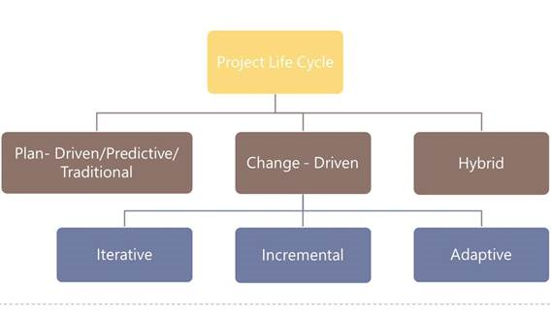
Project Life Cycle

Slide 17
Project Governance
Framework, functions, and processes that guide project management activities in order to create a unique product, service, or result to meet a company's goals. Should be tailored to the business.
Governance means to manage…so project management.
Project Governance are the processes that we follow, the different functions that we have within the business, and the framework that the business creates in order to accomplish the end product in order to accomplish the goals of the project.
Consistently improve the framework that the organization has to accomplish the project.
Find better ways of creating a budget
Find better ways of creating a schedule more efficiently, tracking the progress of the project.
Framework within which project decisions are made and having the right set of processes in place.
Three pillars:
Structure
People
Information

Slide 18
stakeholders
ANYONE who is affected by the project.
Individuals, group, or organization that may affect, be affected, or perceive to be affected by the project.
Key Stakeholders:
Project Manager - manages the project
Customer - uses the project deliverable(s). Will determine whether a project is ultimately a success or not.
Project team - the collection of individuals completing the project work.
Project Sponsor – Provides resources and support. Generally fund the project. May provide budgetary and scheduling approvals.
Regarding the PMP exam, this will generally be your boss.**
Functional Manager -Manage different functions within the organization. Departmental Manager, i.e Manager of Engineering, Vice President of Marketing, Director of IT. Generally controls resources
Worst Enemy to a Project Manager, because you both have the same needs when it comes to resources.

Slide 19
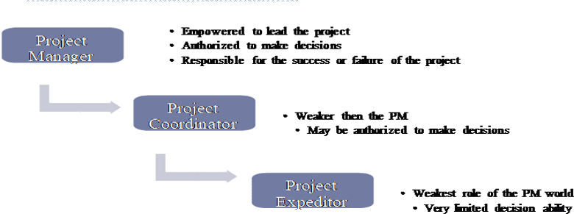
Project roles
ANYONE who is affected by the project.
Project Manager: You're empowered to lead the project. You make all the decisions and are held responsible for whether the project succeeds or fails. Generally, the boss of the resources of the project. The "go-to" person. The team reports to you and follow your directions. You are in charge of creating all the processes and getting the plan done and executing it correctly and monitoring and closing it.
Project Coordinator- like the boss but don't have much decision-making power. The team makes the decision most of the time or they may rely on the sponsor. If you're not the boss, you're probably a team member yourself. The team makes most of the decisions as a whole. They rely on the project sponsor for a lot of directions.

Slide 20
Project management office (pmo)
Organizational Structure that standardizes the processes and facilitates the sharing of resources, methodologies, tools, and techniques.
Types:
Supportive: Supports the project manager, such as providing templates, training, or lessons learned form other projects.
Controlling: Determines the framework or methodology and use of specific forms
Directive: Controls the project. PM will be assigned and report to the PMO.
PMO- In an organization, a PMO improves their services or improve their current product. They have a part in the organization that's dedicated to Project Management Process and helping out all the companies. They are there to help the Project Manager. They standardize the processes and facilities the sharing of resources, methodologies, tools, and techniques now (to prevent the conflict between different Project Managers). They are generally a set of individuals in a small business that might even just be one person that helps all the project managers in the organization.
**For the exam: When a Project Manager is having a problem with a process or don't know how to get a particular resource, they turn to the PMO.

Slide 21
Project Bosses
Sponsor:
Internal or External
Project Champion
Funding the project
Maybe used to resolve conflicts in the project
Program Manager.
Senior to Project Manager
Maybe responsible for several projects executing at the same time
Maybe used to resolve conflicts in the project

Slide 22
Organizational structures
Who has the control or power over the resources? Depending on the structure, that power shifts to the project manager or back to the functional manager.
Functional Organizations
Structure that groups staff members according to their area of expertise (sales, marketing, construction, etc.). Functional structures require the project team members to report directly to the functional manager. The project manager has very little power in this type of organization.
Matrix Organizations
There are three matrix structures: weak, balanced, and strong. The different structures are reflective of the project manager's authority in relation to the functional manager's authority.
Project Oriented Organizations, (Projectized)
Structure where the PM has the greatest amount of authority. The project team is assigned to the project on a full-time basis. When the project is complete, the project team members moves on to other assignments within the organization. The project team is assigned to the project its full time. Example: Consulting company where the company goes out and get a project to do and they hire a project manager. The Project Manager hires all the resources and reports to the project manager. Any project-oriented business, you (the PM) have all the power in this kind of a business, in this kind of a structure. There's really no contention between you and a functional manager since all resources report directly to you.
Hybrid
Blended type

Slide 23
Organizational structures
Organizational Structures Chart
For the exam, it is most likely a Strong Matrix Org, unless specified as a Functional or Projectized Org.
 | Functional | Weak Matrix | Balance Matrix | Strong Matrix | Projectized
PM | Little/No | Low | Low to Moderate | Moderate to High | High/Total
Resource Avail. | Little/No | Low | Low to Moderate | Moderate to High | High/Total
Budget controls | Functional Manger | Functional Manger | Mixed | PM | PM
Pm Role | PT | PT | PT/FT | FT | FT
PM Staff | PT | PT | PT/FT | FT | FT

Slide 24
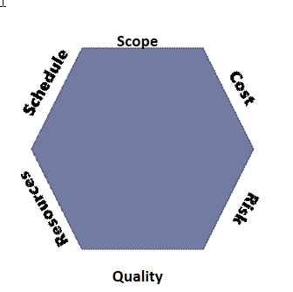
Project Constraints
Something that limits the project.
Scope- The work that needs to get done.
Schedule- No project has unlimited time. Finish the project within the given time.
Cost- No project has unlimited money, so every project is limited/constrained by cost. Do not spend more money than the allocated costs.
Risk- Negative or positive. Can affect the project.
Quality- Projects of poor quality is generally accepted.
Resources- Resources available in the organization to get the project done may be limited

Slide 25
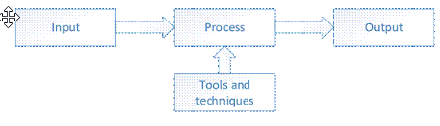
process
Inputs, Outputs and Tools/Techniques combined to execute a specific purpose on the project.
Why do we have a process? To obtain a certain Output.
Input
Starting point for the process, the raw materials to begin the execution
Could be the output of a previous process
Tools and Techniques
The actions or methods that are used to transform the raw materials into the output
Help you do the process.
Output
The end result of our efforts. The raw materials into a polished stone.
May be the input of another process.
Exam example: Process of developing the project charter: has inputs, tools, techniques, and output (ITTO)
Input or Tool/Technique: A template, expert judgement or help to build the project charger
Process: Develop Project Charter
Output: Project Charter

Slide 26
Process groups and knowledge areas
Be able to write and memorize in under 5 minutes-PMBOK PG 25**
49 Processes organized into 5 Process Groups and 10 Knowledge Areas
10 Knowledge Areas:
Integration Management (7)
Scope Management (6)
Schedule Management (6)
Cost Management (4)
Project Quality Management (3)
Resources Management (6)
Communications Management (3)
Risk Management (7)
Procurement Management (3)
Stakeholder Management
5 Process Groups:
Initiation (2)
Planning (24)
Execution (10)
Monitor & Control (12)
Closing (1)

Slide 27
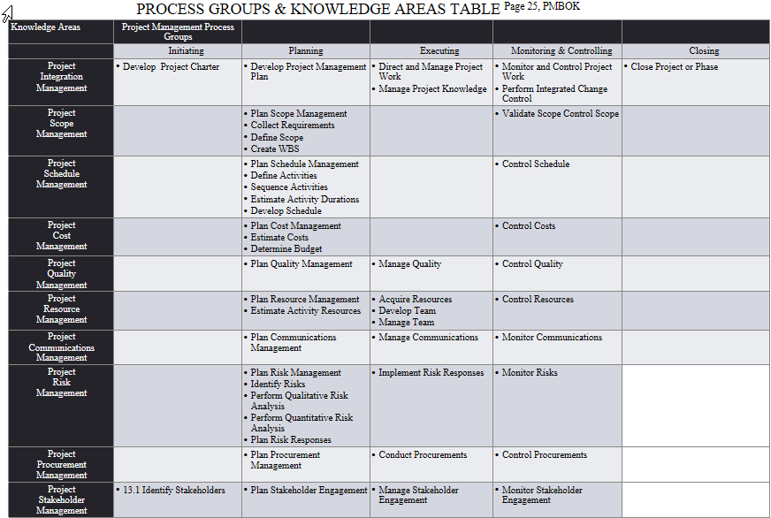
Process groups and knowledge areas
PROCESS GROUPS & KNOWLEDGE AREAS TABLE ^{Page 25, PMBOK}

Slide 28
Concepts covered next month
Project Management Principles
Project Management Performance Domains

Slide 29
THANK YOU
Please leave feedback on what worked well and what I can improve in in the Discord ☺

