Slide 1
Pmp study group
Week 2
Concept Review​
Presented by: Nikki Masani

Slide 2




Study Group Session Plan Wednesdays @ 6:30 PM- Hosted on discord
Week 1
Concept Review
Week 2
Concept Review
Week 3
Mock
Exam/Review
Week 4
Quiz
Challenge
Will use Andrew’s Udemy course to structure out what concepts will be covered.
Will create a timed quiz challenge based on concepts covered in week 1. Winner will receive a gift car.
Looking For:
Suggestions
Volunteers to host
Champions for in-person sessions
Will use Andrew’s Udemy course to structure out what concepts will be covered.
I will choose a Mock Exam to purchase, and we will take it in real time together. Or I will prepare a fun review game.

Slide 3
Study Group White Board
Click Here to Access

Slide 4
Concepts
Project Management Principles
Project Management Performance Domains

Slide 5
Project Management Principles

Slide 6
Principles
Principles serves as foundational guidelines for strategy, decision making, and problem solving.
Guideline- not necessary to follow, but they are best practices that you can follow.
Will be important throughout entire project (think scheduling, budgeting, creating a net scope statement, managing the quality of the project output, engaging the stakeholder, etc.)
Foundational methods of doing things.
Professional standards and methodologies are often based on principles.
Principles for project management provide guidance for the behavior of people involved in projects
Everyone in the project involved from the Project Manager to the Project Sponsor, to the Agile coach should be guided by these principles to ensure the project is successful. Principles such as to be caring, to have integrity, to focus on value, and always engage your stakeholders.
For your exam, there are 12 Principles that you must know (not memorize)**
If you’ve worked on a project before, you’re more than likely already following these principles.

Slide 7
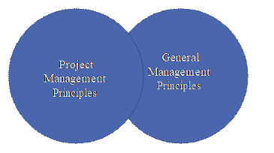
PMI Code of ethics and professional conduct
Different than Principles, but can have areas of overlap.
Principles can, but do not necessarily, reflect morals.
A code of ethics is related to morals.
A code of ethics for a profession can be adopted by an individual or profession to establish expectations for moral conduct. PMI is based on four values:
Responsibility- Responsible for taking on the weight of the project. People on the project depend on you to ensure that all the work is coordinated, and all the communication done is right.
Respect –As a PM, you will be talking to and managing a lot of people, so you should be respectful to those.
Fairness- Always do the right thing, but also the fair thing.
Honesty- Never lie to anyone on a project, as your team and others involved in your project are trusting you.
Notes:
We should just naturally have these morals (not necessarily a PMI requirement)
As project managers, you are generally expected to have these things.
Most operational managers will utilize these principles because they are so generic.

Slide 8
Principles of Project Management
Be a diligent, respectful, and caring steward
Be a good person with good integrity.
Create a collaborative project team environment
Build an environment that the team feels comfortable working in.
Effectively engage with stakeholders
Keep your stakeholders engaged, informed, and actively participating in the project.
Focus on value
Whatever value was recognized at the start is returned at the end of the project.
Recognize, evaluate, and respond to system interactions
Components must interact in order for the project to be successful (ex: Scope depends on Cost) and product the correct deliverables.
Demonstrate leadership behaviors
You will be looked to for guidance to complete project deliverables successfully.
Tailor based on context
As the project progresses, the approach may need to change.
Build quality into processes and deliverables
No one wants a low quality product. So build quality processes. Poor quality should not be acceptable.
Navigate complexity
So many moving components and different people involved in managing projects you must know how to navigate.
Optimize risk responses
Everything you do in life has a risk. You will need to know how to respond to the risks in an effective manner so it doesn't derail the project.
Embrace adaptability and resiliency
Be prepared for unforeseen circumstances so you know to adapt and keep projects moving forward. Not "if" but "when"
Enable change to achieve the envisioned future state
Every time you create a project, you're probably changing something. Manage these changes correctly.

Slide 9
1. Be a diligent, respectful, and caring steward
STEWARDSHIP: “The act of taking care of or managing something, for example property, an organization, money or valuable objects.”
Stewards act sensibly to carry out actions with integrity, care, and trustworthiness while keeping compliance with internal and external guidelines.
They demonstrate a broad commitment to financial, social, and environmental impacts of the projects they support.
Don't overspend! Be aware of social integrity. Don't harm the environment.
Stewardship has responsibilities both within and external to the company.
Stewardship includes:
Integrity
Stewards behave honestly and ethically at all times
Care
Stewards are fiduciaries of the organizational matters in their charge, and they diligently oversee them.
Trustworthiness
Stewards represent themselves, their roles, their project team, and their authority accurately, both inside and outside of the organization.
Compliance
Stewards comply with laws, rules, regulations, and requirements.
A holistic view of stewardship considers financial, social, technical, and sustainable environmental awareness.
Notes:
As a PM, the “something” you are taking care of is generally a project.

Slide 10
2. Create a collaborative project team environment
TEAM
Projects are done by project teams.
They create those deliverables that are defined by the those who accept it.
Project teams are made up of people who have diverse skills, knowledge, and experience.
Coders, painters, developers, etc.
Project teams that work collaboratively can finish a shared objective more effectively and efficiently than individuals working on their own.
Teams should work a unit- PREVENT SILOS!
This is how they can get the work done efficiently and effectively.
Project teams work within organizational and professional cultures and guidelines, often establishing their own “local” culture.
When members from different backgrounds come together, they will promote and build their own culture.
A collaborative project team environment facilitates:
Alignment with other organizational cultures and guidelines,
Individual and team learning and development, and
Optimal contributions to deliver desired outcomes.
Notes:
Who does the work on the project? Who creates the deliverable? The PROJECT TEAM DOES!
Need to build an environment where the team likes to work.’
Teams should work as a unit, not individually (siloed).
The deliverable is not a set of different work, it’s a set of collaborative work.
They need to work together to get the work done correctly and efficiently.
When your team is working sufficiently they still have to comply with organizational culture (whether that be adhoc or process oriented).

Slide 11
2. Create a collaborative project team environment
Project Teams will be affected by:
Team agreements - A set of guidelines your team should follow in order to have good behaviors.
Team agreements represent a set of behavioral parameters.
Organizational Structures
Project teams use, tailor, and implement structures that help.
Processes-Be a good servant leader. Nurture the team to support the team and give them the right environment.
Project teams define processes that enable completion of tasks and work assignments.
Transparency on roles and responsibilities can improve team cultures.
Authority- The order of having the right, within a given context, to make relevant decisions, establish or improve procedures, apply project resources, expend funds, or give approvals.
Let the team make relevant decisions and be authoritative in their work.
Accountability- The condition of being answerable for an outcome. Accountability is not shared.
Responsibility-The condition of being obligated to do or fulfill something. Responsibility can be shared.
Diversity- A diverse project team can develop the project atmosphere by bringing together different perspectives.
Teams should incorporate practice standards, ethical codes, and other guidelines as part of the professional work within the project team and the organization.
A collaborative project team environment promotes the free exchange of information and individual knowledge.
Notes:
The team should not feel like they are dependent on you the entire time (servant leadership)- they should feel like their opinion matters.

Slide 12
3. Effectively engage with stakeholders
STAKEHOLDERS
Stakeholders impact projects, performance, and outcomes.
Engage stakeholders proactively and to the point needed to contribute to project success and customer satisfaction.
Don’t' wait for them to come to you, go to them first and ask them about the requirement.
They may slow the project down or speed it up, depending on the feedback.
Rework may be required.
This is done proactively and will help with delivery value.
Project teams work for other stakeholders by engaging with them.
Stakeholder engagement proactively improves value delivery.
Will influence many aspects of a project.
Notes:
PMBOK-Stakeholder is usually referring to the customer.

Slide 13
3. Effectively engage with stakeholders
Stakeholders can affect many aspects of a project, including but not limited to:
Scope/requirements
Schedule
Cost
Project team
Plans
Outcomes
Culture
Benefits realization- at the end, does the result provide value?
Risk
Quality
Success
Identifying, analyzing, and proactively engaging with stakeholders from the start to the end of the project
Project teams are a group of stakeholders.
Consist of defining how, when, how often, and under what situations stakeholders want to be and should be engaged.
You will have to define how to engage someone and when to engage someone.
This relies on interpersonal skills, including taking initiative, integrity, honesty, collaboration, respect, empathy, and confidence.
Engagement helps project teams detect, collect, and evaluate information, data, and opinions.
Project teams actively engage other stakeholders throughout the project to minimize potential negative impacts and maximize positive impacts.
For the exam: Stakeholder is usually referring to the customer. **

Slide 14
4. Focus on value
VALUE
Continually evaluate and adjust project alignment to business objectives and intended benefits and value.
Is this project still delivering value in the way the customer intended?
Value is the ultimate indicator of project success.
Every project will deliver value of some sort that your customer wants. Did it increase revenue and decrease expenses the way they wanted? If yes, it's a success. If not, it's a failure.
Value can be realized throughout the project, at the end of the project, or after the project is complete.
In a waterfall method, the stakeholder may not see it until the project is done. In an agile method, they will see value throughout.
Value, and the benefits that contribute to value, can be defined in quantitative and/or qualitative terms.
Quantitative = monetary value gain
Qualitative = value gain that cannot be defined by a numerical value.
A focus on outcomes allows project teams to support the intended benefits that lead to value creation.
A lot of times, the team is just focused on making the deliverable. But if the team changes its focus from just creating deliverables to the value, then the team can see they're not just building the deliverable per requirement, they're building to meet the value.
Project teams evaluate progress and adapt to maximize the expected value.
Changes will be made throughout to enhance the value.
Includes outcomes from the perspective of the customer or end user, is the ultimate success indicator and driver of projects.
Is there is a business case that leads to value? Why do we need it? Can we justify why we need this?
A business case contains at least these supporting and interrelated elements:
Business need
Project justification
Business strategy
Value is the worth, importance, or usefulness of something. Value is subjective, in the sense that the same concept can have different values for different people and organizations.
To support value realization from projects, project teams shift focus from deliverables to the intended outcomes. Doing so allows project teams to deliver on the vision or purpose of the project, rather than simply creating a specific deliverable.
Notes:
Why do you buy the things you buy? Because you perceive some value behind it. The output of a project will deliver some kind of value that the stakeholder wants. People purchase ON value. We as PMs need to ensure that the products and services and results coming out of our project has value to our customers.

Slide 15
5. Recognize, evaluate, and respond to system interactions
SYSTEMS THINKING
A system is a set of interacting and interdependent components that function as a unified whole.
• A set of independent components that need to interact together to function in order to get the project done.
A project is a system of interdependent and interacting domains of activity.
• Must ensure we manage our scope right, or quality, or schedule or cost to make this project complete successfully.
Recognize, evaluate, and respond to the dynamic circumstances within and surrounding the project in a holistic way to positively affect project performance.
• A project manager doesn't see a project as a single component, they see it as a series of components or a set of components that act together.
Systems thinking entails taking a holistic view of how project parts interact with each other and with external systems.
• Projects will use external support (IT support)
Systems are constantly changing, requiring consistent attention to internal and external conditions.
• Organizational changes, budget changes, etc.
Being responsive to system interactions allows project teams to leverage positive outcomes.
• If you add more scope, you're going to increase time and scope- how to react?
Project teams should acknowledge this holistic view of a project, seeing the project as a system with its own working parts.
• A system doesn't just focus on one component.
A project works within other larger systems, and a project deliverable may become part of a larger system to realize benefits.
• Every company has a system of how it produces its deliverables.
As projects unfold, internal and external conditions are continuously changing. A single change can create several impacts
Systems thinking also applies to how the project team views itself and its interactions within the project system.
The project system often brings together a diverse project team engaged in working for a common objective.
Notes:
All projects have many individual components such as risk, quality, scope, schedule and costs. We need to " build the system that allows all the different components of a project to interact and be able to act in a unified way to produce those deliverables.

Slide 16
6. Demonstrate leadership behaviors
LEADERSHIP
Demonstrate and adapt leadership behaviors to support individual and team needs.
• Different leadership and techniques to keep the team motivated which you must adapt to.
Effective leadership promotes project success and contributes to positive project outcomes.
• Projects can fail due to poor leadership.
Any project team member can demonstrate leadership behaviors.
• Promote good leadership within the product team.
• Leadership = motivating people.
Leadership is different than authority.
Modify your leadership method based on the team.
Effective leaders adapt their style to the situation.
Effective leaders recognize differences in motivation among project team members.
Leaders demonstrate desired behavior in areas of honesty, integrity, and ethical conduct.
On a high-performing project multiple people may exhibit effective leadership skills including the project
You are not the only leader on the team.
It is important to remember that more conflict and misunderstanding can emerge when too many participants attempt to employ project influence in multiple, misaligned directions.
Leadership should not be confused with authority. Authority is the right to exercise power and control individuals.
It takes leadership to motivate a people toward a common goal, inspire them to align their individual interests in favor of collective effort, and achieve success as a project team rather than as individuals.
Notes:
All projects have many individual components such as risk, quality, scope, schedule and costs. We need to " build the system that allows all the different components of a project to interact and be able to act in a unified way to produce those deliverables.

Slide 17
6. Demonstrate leadership behaviors
Team members develops leadership wisdom by adding or practicing a combination of various skills or techniques, including but not limited to:
Focusing a project team around agreed goals
Articulating a motivating vision for the project
Generating consensus on the best way forward
Overcoming obstacles to project progress
Negotiating and resolving conflict
Adapting communication style and messaging to stakeholders
Coaching and mentoring fellow project team members
Having self-awareness of one’s own bias and behaviors
Projects work best when leaders understand what motivates people.
Project teams can flourish when project team members use suitable leadership traits, skills, and characteristics that match the specific needs and expectations of stakeholders.
Effective leadership promotes project success and contributes to positive project outcomes.
By mixing styles and leveraging motivators, any project team member or stakeholder can motivate or influence and in turn grow the project team, regardless of role or position.
Managing and adapting to change during the project
Notes:
All projects have many individual components such as risk, quality, scope, schedule and costs. We need to " build the system that allows all the different components of a project to interact and be able to act in a unified way to produce those deliverables.

Slide 18
7. Tailor based on context
There are a different approaches you can use to develop your deliverable (Waterfall, Agile with iterations, etc.). Tailor the approach to the actual project.
Each project is unique.
Design the project development methods based on the needs of the project and its objectives, stakeholders, governance, and the environment.
Using “just enough” process to accomplish the desired outcome while maximizing value, managing cost, and enhancing speed.
Project success is based on adapting to the unique context of the project
Tailoring the method is iterative, and therefore is a continuous process throughout the project.
Project teams tailor the proper framework that will enable the flexibility to consistently produce positive outcomes.
Project teams discuss and decide on the delivery approach and resources on a project-by-project basis.
Tailoring the project approach to suit the unique characteristics of the project and its environment
A tailored project approach can produce benefits, such as:
Deeper commitment from project team members
Reduction in waste in terms of actions or resources
Customer-oriented focus
More efficient use of project resources
Notes:
All projects have many individual components such as risk, quality, scope, schedule and costs. We need to " build the system that allows all the different components of a project to interact and be able to act in a unified way to produce those deliverables.

Slide 19
8.Build quality into processes and deliverables
QUALITY
Quality is about meeting the acceptance criteria for deliverables.
When gathering requirements for deliverables from the customer, ask them when we finish this project, what would it take for an acceptance? Does it perform in this method? Does it need to complete this function? Quality is going to be about knowing what those things are and meeting them.
Project quality is about satisfying stakeholders’ expectations and fulfilling project and product requirements.
Stakeholders will have to maintain a focus on quality that produces deliverables that meet project objectives and align to the needs set forth by stakeholders.
Project quality ensures processes are appropriate and as effective as possible.
Quality may have several different dimensions, including but not limited to the following:
Performance
Conformity
Reliability
Resilience
Satisfaction
Efficiency
Sustainability
Teams measure quality using metrics and acceptance criteria’s.
The objective is to help ensure that what is delivered meets the objectives of the customer and other relevant stakeholders.
Notes:
All projects have many individual components such as risk, quality, scope, schedule and costs. We need to " build the system that allows all the different components of a project to interact and be able to act in a unified way to produce those deliverables.

Slide 20
9.Navigate complexity
COMPLEXITY
Complexity is the outcome of human behavior, system interactions, uncertainty, and ambiguity.
Complexity can arise at any point during the project.
Constantly evaluate and navigate project complexity so that approaches and plans enable the project team to successfully navigate the entire project.
Complexity can be introduced by events or conditions
Project teams can stay vigilant in identifying elements of complexity and use a variety of methods to reduce the amount or impact of complexity.
Being vigilant for indications of complexity allows project teams to adapt their approaches and plans to navigate potential disruption to effective project delivery.
Project teams often cannot forecast complexity emerging because it is the result of many conditions and events.
Some of the more common sources of complexity are:
◦ Human behavior
◦ System behavior
◦ Uncertainty and ambiguity
◦ Technological innovation
Notes:
All projects have many individual components such as risk, quality, scope, schedule and costs. We need to " build the system that allows all the different components of a project to interact and be able to act in a unified way to produce those deliverables.

Slide 21
10. Optimize risk responses
RISK
A risk is an uncertain event or condition that, if it occurs, can have a positive or negative effect on one or more objectives.
Risks can be positive (opportunities) or negative (threats).
Project teams seek to maximize positive risks (opportunities) and decrease exposure to negative risks (threats).
Constantly evaluate exposure to risk, both opportunities and threats, to maximize positive impacts and minimize negative impacts to the project and its outcomes.
Risks are addressed continually throughout the project.
Risk responses should be:
Appropriate for the significance of the risk,
Cost effective,
Realistic within the project context,
Agreed to by relevant stakeholders,
Owned by a responsible person.
Project team members engage with relevant stakeholders to understand their risk appetite and risk thresholds.
An organization’s risk attitude, appetite, and threshold influence how risk is addressed
Notes:
All projects have many individual components such as risk, quality, scope, schedule and costs. We need to " build the system that allows all the different components of a project to interact and be able to act in a unified way to produce those deliverables.

Slide 22
11. Embrace adaptability and resiliency
ADAPTABILITY/RESCILIENCY
Adaptability is the ability to respond to changing conditions.
Resiliency is the ability to absorb impacts and to recover quickly from a setback or failure.
Build adaptability and resiliency into the organization’s and project team’s approaches
A focus on outcomes rather than outputs facilitates adaptability.
A project rarely performs exactly as initially planned.
Projects are influenced by internal and external factors—new requirements, issues, stakeholder influences, among other factors—which exist in a system of interactions.
In a project environment, capabilities that support adaptability and resilience include:
Short feedback loops to adapt quickly;
Continuous learning and improvement;
Regular inspection and adaptation
Open and transparent planning that engages stakeholders
Small-scale prototypes and experiments
Open organizational conversations
Diverse project teams with broad skill sets, cultures, and experience
Understanding from past learning
Building adaptability and resiliency in a project keeps project teams on track to the desired outcome when internal and external factors change, and it helps them recover from setbacks.
These features also help project teams learn and improve so that they can quickly recover from failures or setbacks and continue making progress toward delivering value.

Slide 23
12. Enable change to achieve the envisioned future state
CHANGE
Prepare those impacted for the acceptance to go from the current state to the intended future state created by the project output.
A structured approach will helps individuals, groups, and the organization transition from the current state to a future desired state.
Change can originate from internal influences or external sources.
Enabling change can be challenging as not all stakeholders embrace change.
Attempting too much change in a short time can lead to change fatigue and/or resistance.
Stakeholder engagement and motivational approaches assist in change adoption.
Remaining relevant in today’s business environment is a fundamental challenge for all organizations.
Change in an organization can originate from internal sources and external sources.
Enabling change in an organization can be challenging.
Effective change management uses a motivational strategy rather than a forceful one.
Knowing and addressing the needs of stakeholders to embrace change throughout the project life cycle helps to integrate the resulting change in the project work, making a successful outcome more likely.

Slide 24
Project Management Performance Domains

Slide 25
Principles and Performance Domains
Domains are a group of related activities that are critical for the effective delivery of project outcomes.
They are interactive, interrelated, and interdependent areas of focus that work in unison to achieve desired project outcomes.
They operate as an integrated system, with each domain being interdependent of the other domains to enable successful delivery of the project and its intended outcomes.
The specific activities undertaken within each of the performance domains are determined by the context of the organization, the project, deliverables, the project team, stakeholders, and other factors.
Notes:
Principles Vs Performance Domains-
Principles are followed while your project is started, while it's going, and when your project is ended.
Performance Domains are activities that you're going to do during the project to ensure the project is delivered effectively. AKA: what you do as the work is getting done. The principles will guide you. What you do during the project in unison with Principles to ensure deliverables are being met.

Slide 26
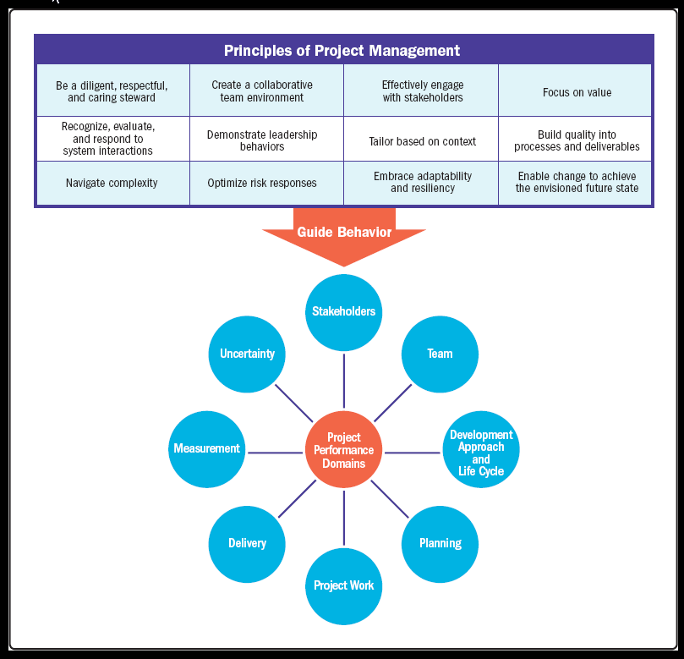
Notes:
The Principles will be the guided behavior itself when doing these eight domains.
When you’re doing the work on an Agile Project project and managing the project, you’re engaging stakeholders, managing your team, choosing the right development approach, planning the actual work on the project, doing the project work, delivering the work to the customer after the deliverables have been built, measuring that the work that has gotten done, and asking yourself- “are we on plan?” “Are we following the right budget?”

Slide 27
Stakeholder performance domain
Every single project has stakeholders. You have to identify and analyze them to know what they're doing. You have to meet their requirements as the project is progressing.
• Addresses activities and functions associated with stakeholders.
• A productive working relationship with stakeholders throughout the project.
• Stakeholder agreement with project objectives.
• Stakeholders who are project beneficiaries are supportive and satisfied while stakeholders who may oppose the project or its deliverables do not negatively impact project outcomes.
Defining and sharing a clear vision at the start of the project can enable good relationships and alignment throughout the project.
Notes:
You cannot have a project with out stakeholders. Stakeholders is anyone who is impacted by the project, people that are positively impacted, such as customers, or people that are negatively impacted, such as people losing their job because your project is optimized as the processes in the businesses.
This is what we’re going to be doing to deliver that product or service at the end.
You want to minimize the stakeholders with negative impact, and ensure that the people who are negatively impacted do not negatively impact the project outcome.

Slide 28
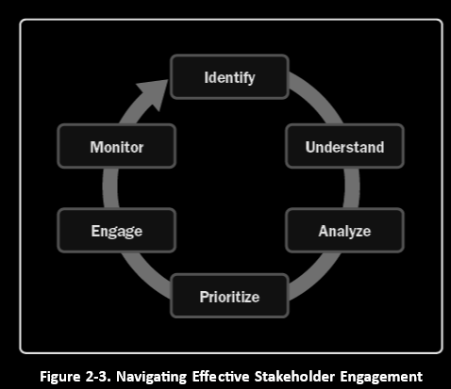
Stakeholder performance domain
Effective Stakeholder Engagement
Identify: Identification is done throughout the project to understand who your stakeholders are, both internal and external.
Understand and Analyze: the project manager and project team should seek to understand stakeholders’ feelings, emotions, beliefs, and values.
Prioritize: Focus on stakeholders with the most power and interest as one way to prioritize engagement.
Engage: Entails working collaboratively with stakeholders to introduce the project, elicit their requirements, manage expectations, resolve issues, negotiate, prioritize, problem solve, and make decisions.
Monitor: Throughout the project, stakeholders will change as new stakeholders are identified and others cease to be stakeholders.
Notes:
Identify- Stakeholders will be identified THROUGHOUT the project. Examples, a stakeholder that was identified at the beginning of the project can leave in the middle and replaced with a different stakeholder, who will have to be reanalyzed. Stakeholders come and go- not static.
Understand and Analyze- Are you stakeholders being negatively or positively impacted on the project? If negative, they will be very hesitant to talk to you and often push back.
Prioritize -There will be stakeholders that will give you a lot of requirements and will bear more weight on what requirements they tell you need to get done, than when others tell you what needs to get done. EX: When the CEO says this when and how a requirement should be done, it will more likely hold more weight and be prioritized first.
Engage- ALWAYS ENGAGE THE STAKEHOLDER! You get requirements and how they are expected to be managed by engaging with the stakeholder.
Monitor- Back to point number 1!

Slide 29
Effective Stakeholder Engagement
Deals with activities and functions associated with the people who are responsible for creating project deliverables that realize business outcomes.
Outcome | Check
A productive working relationship with stakeholders throughout the project | Productive working relationships with stakeholders can be observed.
Stakeholder agreement with project objectives | A significant number of changes or modifications to the project and product requirements in addition to the scope may indicate stakeholders are not engaged or aligned with the project objectives.
Stakeholders who are project recipients are supportive and satisfied; stakeholders who may oppose the project or its deliverables do not negatively impact project results | Stakeholder behavior can indicate whether project recipients are satisfied and supportive of the project or whether they oppose it. Surveys, interviews, and focus groups A review of the project issue register and risk register can identify challenges associated with individual stakeholders.
Notes:
This chart is a tool used to identify what we want to see out of the performance domain (Outcome) and how to check it (Check).

Slide 30
Team performance domain
Must manage the team appropriately to ensure you have a high performance team. If you don't manage this domain correctly, you have a poor performance team, the delivery of the work will be poor.
Deals with activities and functions associate with the people who are responsible for creating project deliverables that realize business outcomes.
This performance domain entails establishing the culture and environment that enables a collection of diverse individuals to evolve into a high-performing project team.
Terms used in this domain made of:
Project Manager: Assign by the business to lead the team and is responsible for accomplishing the project objectives
Project Management Team: People who are directly involved in project management activities
Project Team: A group of individuals performing the work of the project to achieve its purposes
Notes:
One of the indicators of whether a project is going to be successful is a high performance team. How do you get a high performance team with good leadership skills?

Slide 31
Team performance domain
Managers VS Leaders
Management activities includes:
Meeting project objectives,
Effective processes, planning, coordinating, measuring, and monitoring work, among others.
Leadership activities includes:
Influencing
Motivating
Listening
Enabling
Notes:
Is there a difference between Managers and Leaders? There are points in the project where you will have to be both.

Slide 32
Team performance domain
Leadership can be centralized and distributed.
Centralized: Accountability (being answerable for an outcome), is usually assigned to one individual,
Distributed: Shared among a project management team, and project team members
Servant leadership is a method of leadership that is based on the understanding and addressing the needs and development of project team members.
Servant leaders place emphasis on developing project team by focusing on addressing questions, such as:
Are project team members growing as individuals?
Are project team members becoming healthier, wiser, freer, and more autonomous?
Are project team members more likely to become servant leaders?
Servant leadership behaviors include:
Obstacle removal.
Diversion shield.
Encouragement and development opportunities.
Notes:
Distributed: An agile team
A team must grow individually to grow as a whole.

Slide 33
Team performance domain
Common Aspects of Team Development includes:
Vision and objectives: Everyone is aware of the project vision and objectives
Roles and responsibilities: members understand and fulfill their roles and responsibilities.
Project team operations: Facilitating project team communication, problem solving, and the process of coming to consensus
Guidance: ensure everyone is headed in the right direction
Growth: Identifying where the project team is carrying out well and pointing out areas where the project team can improve
Project team culture: each project team develops its own team culture.
The project manager is important in establishing and maintaining a safe, respectful, nonjudgmental environment that allows the project team to communicate openly.
This is accomplished by modeling behaviors such as:
Transparency
Integrity
Respect
Positive discourse
Support
Courage
Celebrating success
Notes:
Common Aspects of Team Development: How do we develop as a team?

Slide 34
Team performance domain
HIGH-PERFORMING PROJECT TEAMS
Factors that contribute to high-performing project teams:
Open communication.
Shared understanding
Shared ownership.
Trust.
Collaboration
Adaptability
Resilience.
Empowerment
Recognition
Leadership skills are valuable for all project team members whether the project team is operating. This includes:
Establishing and Maintaining Vision
Critical Thinking
Motivation
Interpersonal Skills
Emotional intelligence. Being able to be self aware, self-manage and have social awareness and social skills.
Decision making.
Conflict management
Leadership methods are also tailored to meet the needs of the project, the environment, and the stakeholders. D
Experience with the type of project
Maturity of the project team members
Organizational governance structures
Distributed project teams
Notes:
About 60% of the exam questions are based on resolving problems within a team (conflict management methods).

Slide 35
Team performance domain
Outcome | Check
Shared ownership | All team members know the vision and objectives.
A high-performing team | The team trusts each other and collaborates. The team adapts to changing situations and is resilient in the face of challenges. The project team feels empowered and empowers
Appropriate leadership and other interpersonal skills are demonstrated by all team members | Team members apply critical thinking and interpersonal skills. Team members leadership styles are appropriate to the project context and environment.

Slide 36
Development Approach and Life Cycle Performance Domain
Deals with activities and functions associated with the development approach, cadence, and life cycle phases of the project.
Outcomes include:
Correct development approaches.
A project lifecycle that connect the delivery of business and stakeholder value from the beginning to the end of a project.
A project lifecycle consisting of phases that facilitate the delivery cadence and development approach required to produce the project deliverables.
Delivery cadence refers to the timing and frequency of the project deliverables.
There are different development approaches. Three common approaches include:
Predictive Approach
Adaptive Approach, including both iterative and incremental
Hybrid Approach.
Notes:
Iterative- keep building the deliverable until it’s complete, but there’s only one delivery.

Slide 37
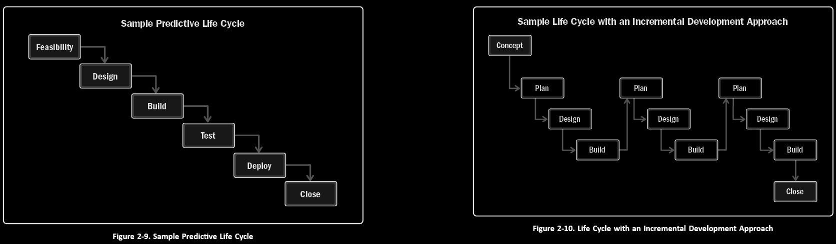
Development Approach and Life Cycle Performance Domain
There are several factors that influence the selection of a development approach:
Product, Service, or Result
Degree of innovation
Requirements certainty
Scope stability
Ease of change
Delivery options
Risk
Safety requirements
Regulations
The Project
Stakeholders
Schedule constraints
Funding availability
Organization
Organizational structure
Culture
Organizational capacity
Project team size and location
The type and number of project phases in a project lifecycle rest on upon many things.
Notes:
Figure 2-10 shows a life cycle with an incremental development approach. There are three iterations of plan, design, and build shown in this example. Each subsequent build would add functionality to the initial build.
Figure 2-11 shows a life cycle using an adaptive development approach. At the end of each iteration (sometimes known as a sprint ), the customer reviews a functional deliverable. At the review, the key stakeholders provide feedback, and the project team updates the project backlog of features and functions to prioritize for the next iteration.

Slide 38
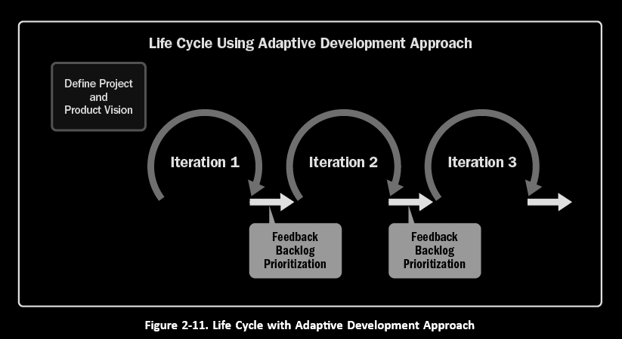
Development Approach and Life Cycle Performance Domain
Notes:
Figure 2-11 shows a life cycle using an adaptive development approach. At the end of each iteration (sometimes known as a sprint ), the customer reviews a functional deliverable. At the review, the key stakeholders provide feedback, and the project team updates the project backlog of features and functions to prioritize for the next iteration.

Slide 39
Development Approach and Life Cycle Performance Domain
Outcome | Check
Development approaches are reliable with project deliverables | The development approach for deliverables (predictive, hybrid, or adaptive) reflects the product variables and is suitable for the project and the organization.
A project life cycle entailing phases that connect the business and stakeholders to value from the beginning to the end of the project | Project work from start to end is represented in the project phases.
Project life cycle phases that facilitate the delivery cadence and development approach required to create the deliverable. | The cadence for development, testing, and deploying is represented in the life cycle phases.

Slide 40
Planning Performance Domain
Deals with activities and functions associated with the initial, ongoing, and evolving organization and coordination necessary for delivering project deliverables and outcomes.
The purpose of planning is to proactively develop an approach to create the project deliverables.
Notes:
You must ensure adequate planning has been done before starting the work.

Slide 41
Planning Performance Domain
Because each project is unique, the volume, timing, and frequency of planning varies.
Variables include, but are not limited to:
Development approach
Project deliverables
Organizational requirements
Market conditions
Legal or regulatory restrictions
When planning things to consider will be:
Delivery – What is the scope being delivered by the project
Estimating – Scope, schedule, budget of resources both people and physical
Schedules - Models used to determine when work has to be done
Budget- How much work will cost
Planning for how the team will be made begins with identifying the skill sets required to accomplish the project work.
Communication planning overlaps with stakeholder identification, analysis, prioritization, and engagement
Physical resources apply to any resource that is not a person.
Procurements can happen at any time during a project.
There will be changes throughout the project.
Some changes are a result of a risk event and others are due to customer requests or other reasons
Notes:
Every project has changes.

Slide 42
Planning Performance Domain
Outcome | Check
The project moves in an organized, coordinated, and deliberate manner. | A performance review of project results against the project baselines
There is a holistic approach to delivering the project outcomes. | The delivery schedule, funding, resource availability and procurements
Evolving information is elaborated to produce the deliverables and outcomes. | Initial information about deliverables and requirements compared to current information can demonstrate appropriate elaboration.
Time spent planning is appropriate for the project. | Project plans and documents demonstrate the correct level of planning
Planning information is sufficient to manage stakeholder expectations. | The communications management plan and stakeholder analysis indicate that the communications are sufficient to manage stakeholder expectations.
There is a process for the adaptation of plans throughout the project. | Projects using a backlog show the adaptation of plans throughout the project. Projects using a change control process have change
Notes:
IF YOU FAIL TO PLAN, YOU PLAN TO FAIL!!

Slide 43
PROJECT Work Performance Domain
Deals with activities and functions associated with establishing project processes, managing physical resources, and fostering a learning environment.
Project work is connected with establishing the processes and performing the work done by the project team to deliver the expected deliverables and outcomes.
Project work keeps the project team dedicated and project activities running correctly. This includes but is not limited to:
Managing the flow of existing, new and change work.
Keeping the project team focused
Establishing an efficient project systems and processes
Communicating with stakeholders
Managing physical resources
Working external vendors
Monitoring changes
Enabling project learning and knowledge transfer.
Notes:
When finished planning, you have to do the work… so how do you manage the work to drive the expected deliverables and the expected outcome?
WHO DOES THE WORK? The team!

Slide 44
PROJECT Work Performance Domain
The project manager and the project team establish and periodically review the processes the project team is using to conduct the work.
This can take the form of reviewing task boards such as using Kanban.
Process tailoring can be used to optimize the process for the needs of the project
Balancing constraints can take the form of fixed delivery dates, compliance to regulatory codes, a predetermined budget, and quality.
Project managers have a responsibility for assessing and balancing the project team focus and attention.
Much of the project work is associated with communication and engagement.
Some projects require materials and supplies from third parties.
Planning, ordering, transporting, storing, tracking, and controlling these physical resources can take a large amount of time and effort.
Working on procurements which can involve hiring and managing vendors throughout the project. This includes managing bids and contracts.
Monitoring new work and changes.
From time to time, the project team may meet to determine what they can do better in the future (lessons learned) and how they can improve and challenge the process in upcoming iterations (retrospectives).

Slide 45
Work Performance Domain
Outcome | Check
Efficient and effective project performance | Status reports show that project work.
Project processes that are appropriate for the project and the environment | Evidence shows that the project processes have been tailored to meet the needs of the project and the environment.
Appropriate communication and engagement with stakeholders | The project communications management plan and communication artifacts demonstrate that the planned communications are being delivered to stakeholders.
Efficient management of physical resources | The amount of material used, scrap discarded, and amount of rework indicate that resources are being used efficiently.
Effective management of procurements | A procurement audit demonstrates that appropriate processes utilized were sufficient for the procurement and that the contractor is performing to plan.
Effective handling of change | Projects using a predictive approach have a change log and Projects using an adaptive approach have a backlog that shows the rate of accomplishing
Improved capability due to continuous learning and process improvement | Team status reports show fewer errors and rework with an increase in velocity.

Slide 46
Project Delivery Performance Domain
Deals with activities and functions associated with delivering the scope and quality that the project was undertaken to achieve.
Project delivery is about meeting requirements, scope, and quality expectations to produce the expected deliverable
Some project deliver value throughout and others deliver the bulk at the end.
The project manager will need to understand how the deliverable is able to deliver value to the stakeholders. This includes:
Requirements gathering.
Evolving and discovering requirements
Managing requirements
Define and decompose the scope
Completion of deliverables
Quality requirements can be reflected in the completion criteria, definition of done, statement of work, or requirements documentation.
The project manager must consider the following of quality:
Cost of Quality
Prevention.
Appraisal.
Internal Failure
External Failure
Cost of Change

Slide 47
Project Delivery Performance Domain
Outcome | Check
Projects contribute to business objectives and advancement of strategy | The organization plans and the project demonstrate that the project deliverables and business objectives are aligned.
Projects realize the outcomes they were initiated to deliver | The business case and underlying data indicate the project is still on track to realize the intended outcomes.
Project benefits are realized in the time frame as planned | The project deliveries are being achieved as planned.
The project team has a clear understanding of requirements | In predictive development, small change in the initial requirements reflects understanding. In projects where requirements are developing, a clear understanding of requirements may not take place until well into the project.
Stakeholders accept and are satisfied with project deliverables | Interviews, observation, and end user feedback indicate stakeholder satisfaction.

Slide 48
Measurement Performance Domain
Deals with activities and functions associated with assessing project performance and taking appropriate actions to maintain acceptable performance.
Involves measuring project performance and implementing appropriate responses to keep the project on track.
This domain evaluates the amount to which the work done in the Delivery Performance Domain is meeting the metrics identified in the Planning Performance Domain.
Measures are used for multiple reasons, including:
Evaluating performance compared to plan
Tracking the utilization of resources
Demonstrating accountability
Providing information to stakeholders
Assessing whether project deliverables are on track
Ensuring the project deliverables will meet customer acceptance criteria.

Slide 49
Measurement Performance Domain
Creating effective measurements helps to ensure the right things are measured.
Ways to measure performance include:
Key Performance Indicators (KPI) - two types of KPIs: leading indicators and lagging indicators.
Leading indicators predict changes or trends in the project
Lagging indicators measure project deliverables or events. They provide information after the fact.
Effective Metrics
Use of SMART (Specific, Meaningful, Achievable, Relevant, Timely) criteria.
What to measure includes:
Deliverable Metrics
Information on errors or defects
Measures of performance
Delivery
Work in progress
Lead time
Cycle time
Process efficiency
Baseline Performance
Start and finish dates
Actual cost compared to planned cost
Resources
Planned resource utilization compared to actual resource utilization
Business Value
Cost-benefit ratio
Stakeholders
Mood chart
Forecasts

Slide 50
Measurement Performance Domain
Metrics can be presented using:
Dashboards
Information Radiators
Visual Controls
Pitfalls associated with measurement includes:
Hawthorne effect
Vanity metric
Demoralization
Misusing the metrics
Confirmation bias
A portion of measurement is having agreed to plans for measures that are outside the threshold ranges.
Thresholds can be established for an assortment of metrics such as schedule, budget, velocity, and other project-specific measures
Outcome | Check
A reliable understanding of the status of the project | Review measurements and reports demonstrate if data is reliable.
Actionable data to facilitate decision making | Measurements indicate whether the project is performing as expected.
Timely and appropriate actions to keep project on track | Measurements provide indicators and/or current status
Achieving targets and generating business value by making informed and timely decisions | Comparing the actual performance to the planned performance

Slide 51
Uncertainty Performance Domain
Deals with activities and functions associated with risk and uncertainty.
Projects happen in environments with varying degrees of uncertainty.
Uncertainty in the broadest sense is a state of not knowing or unpredictability.
Uncertainty presents threats and opportunities that project teams explore, assess, and decide how to handle.
There are many shades to uncertainty, such as:
Risk associated with not knowing future events
Ambiguity associated with not being aware of current or future conditions
Complexity associated with dynamic systems having unpredictable outcomes.
Options for responding to uncertainty:
Gather information
Prepare for multiple outcomes
Build in resilience

Slide 52
Uncertainty Performance Domain
Volatility exists in an environment that is subject to rapid and unpredictable change.
Volatility can occur when there are ongoing fluctuations in available skill sets or materials.
Risks are an aspect of uncertainty.
Outcome | Check
An awareness of the environment in which projects occur. | The team incorporates environmental considerations when evaluating uncertainty, risks, and responses.
Proactively exploring and responding to uncertainty | Risk responses are aligned with the project constraints.
An awareness of the multiple variables on the project | Actions to address complexity, ambiguity, and volatility.
The capacity to anticipate threats and opportunities | Systems for identifying, capturing, and responding to risk are appropriately.
Project delivery with little or no negative impact from unforeseen events | Scheduled delivery dates are met, and the budget performance is within the Variance.
Realized opportunities to improve project performance and outcomes | Teams use established mechanisms to identify and leverage opportunities.
Cost and schedule reserves used effectively to maintain alignment with project objectives | Teams take steps to proactively prevent threats.

Slide 53
Concepts covered next Session
Common Inputs, Tools, and Techniques, and Outputs- (Udemy Course Section 7)
Process Groups (Udemy Course Section 8)

Slide 54
THANK YOU
Please leave feedback on what worked well and what I can improve on in the Discord ☺

