Slide 1
Merge Sort
Nikki Pruitt and Sari Sabouh

Slide 2
Merge Sort
Recursive algorithm
Divides a list in half until each sublist only has one element
Recombines each sublist in order

Slide 3
Analysis
Worst and average case analysis: O(nlogn)

Slide 4
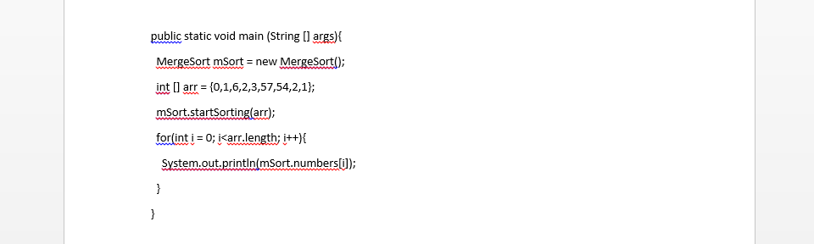
Implementation
Main Method:

Slide 5
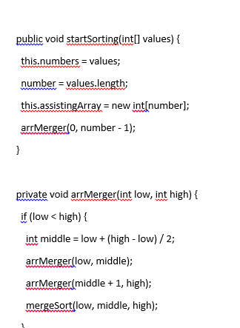
Implementation (2)
Starting Method
Arranging Method

